Slide 1
Proposal for snomed ct subset for nursing units (location)
Judith J. Warren, PhD, RN, FAAN, FACMI

Slide 2
Background
National Database for Nursing Quality Indicators (NDNQI) developed by American Nurses Association
Reports quality indicators and benchmarks according to nursing unit
  Created a standardized nursing unit typology and value set
  Used by over 2000 hospitals
  In 11 countries
Need to share value set with other quality indicator developers and with HL7
  NLM’ Value Set Authority Center
  Requires using a standardized terminology
    Either SNOMED CT or LOINC

Slide 3
Content Committee Charge
By October 2014, submit a request for subsets that pertain to Nursing’s needs
Nursing Unit subset could be one of these
Steps needed
  Assess Nursing SIG support
  NDNQI is willing to collaborate in the name of standard harmonization
  Determine IP of NDNQI
  Identify team
  Create Inception document

Slide 4
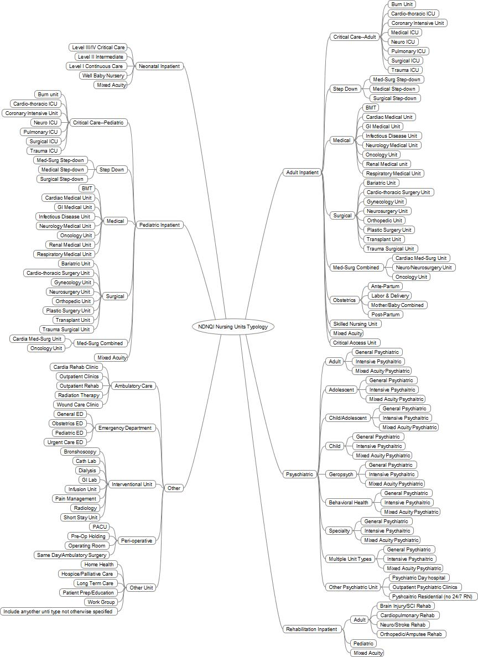
© NDNQI

