Slide 1
Introduction to the International Classification for Nursing Practice (ICNP®)
Nick Hardiker, RN PhD
Director
ICN eHealth Programme

Slide 2
‘Technological progress is like an axe in the hands of a pathological criminal’
  Albert Einstein

Slide 3


Slide 4
‘Gravitation is not responsible for people falling in love’
  Albert Einstein

Slide 5
‘Imagination is more important than knowledge’
  Albert Einstein

Slide 6

The International Council of Nurses
A federation of more than130 national nurses associations representing more than 16 million nurses worldwide
Operated by nurses and leading nursing internationally since 1899
Its purpose is to represent nursing worldwide, advancing the profession and influencing health policy

Slide 7


Slide 8


Slide 9
Hospital statistics
‘In attempting to arrive at the truth, I have applied everywhere for information, but in scarcely an instance have I been able to obtain hospital records fit for any purposes of comparison’ (p 176)
Nightingale F. Notes on Hospitals. 3rd Edition. London: Longman, Green, Longman, Roberts, and Green, 1863

Slide 10
ICN eHealth Programme
Transforming nursing through the visionary application of information and communication technology
25 years in the making
Announced at the ICN Conference 2011 in Malta
http://www.icn.ch/pillarsprograms/ehealth/

Slide 11
A personal vision
eHealth systems are in routine use to parallel other aspects of contemporary life
Data is available and routinely used/exploited for the benefit of patients and those caring for them
People are actively working on continually improving how things are i.e. advancing together the art/science of nursing informatics

Slide 12
e
Health

Slide 13
Emerging position statement
The right to connect via information and communications technology
  ICT can improve access to good healthcare, address inequalities in its provision and help citizens take a more active role

Slide 14
Why ICN eHealth?
Worldwide proliferation of ICT
ICN informs, supports and advocates for nursing and its members
eHealth threads through ICN processes and products
ICT in health care provides new opportunities, not least equity and improved access

Slide 15
ICN eHealth workstreams
Connecting Nurses
ICN Telenursing Network
International Classification for Nursing Practice (ICNP®)

Slide 16
Connecting nurses
A forum for expert healthcare professionals from around the world to share their ideas, advice and innovations

Slide 17
Information Shareapy
A patient education service for nurses and midwives to share, via a dedicated and moderated social network, links to high quality, reputable health resources with their patients, families, friends or colleagues

Slide 18
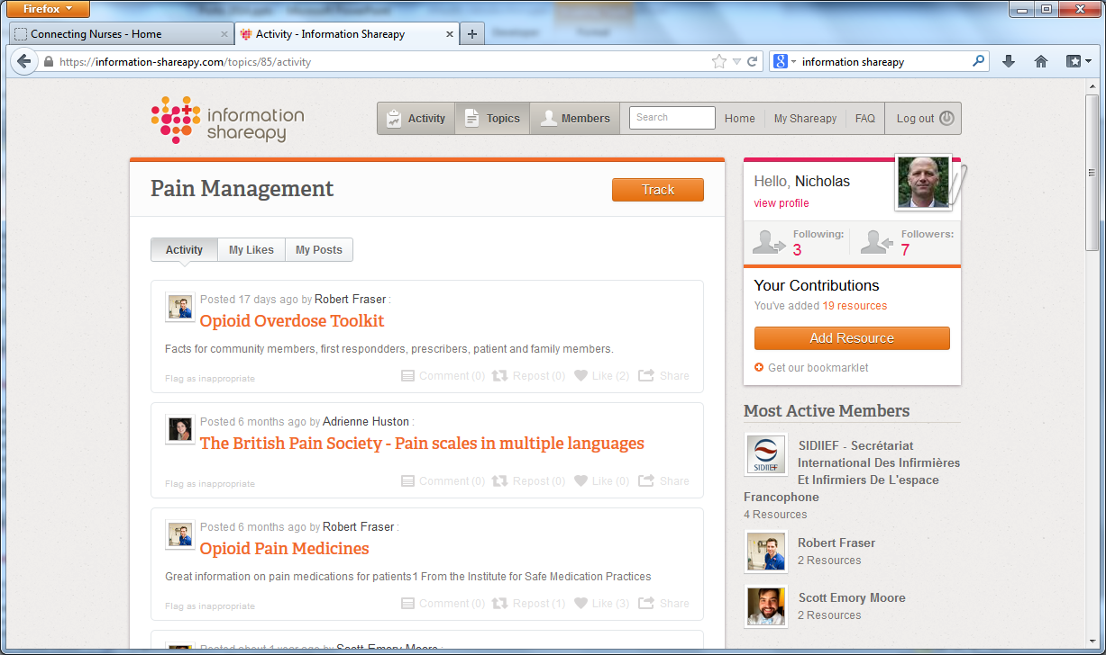

Slide 19
Care Challenge
A contest that highlights nursing innovations and helps to put them into practice
There have been two winning entries this year. The authors have chosen a professionally produced video displaying their project as means of support from Connecting Nurses

Slide 20
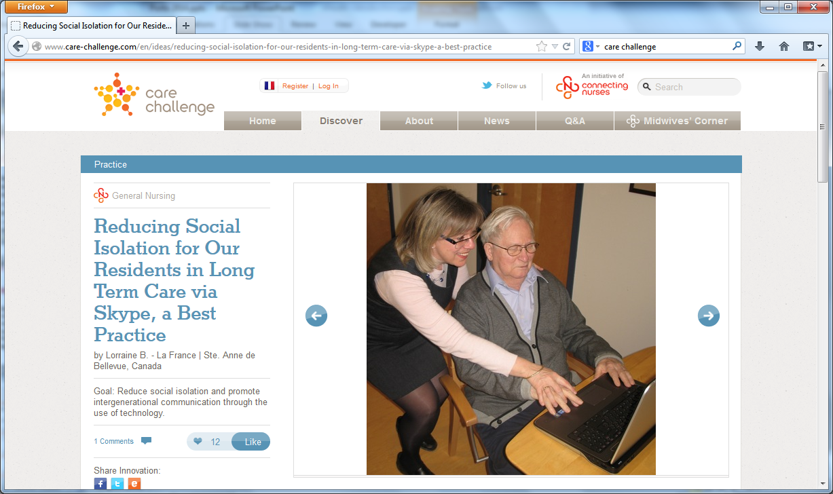

Slide 21
ICN Telenursing Network
Global resource for sharing knowledge and expertise around telehealth and telecare
Launched in 2009
296 members in 65 countries
Membership open to all

Slide 22
ICNP
ICN has supported ICNP since 1989
A standardised terminology used to represent nursing diagnoses, interventions and outcomes
http://www.icn.ch/pillarsprograms/international-classification-for-nursing-practice-icnpr/

Slide 23
ICNP Characteristics
Reliable
  Compliance with international standards
  Quality improvement process
  A formal infrastructure that facilitates cross-mapping and allows output in multiple formats

Slide 24
ICNP Characteristics
Easy to understand
    Ongoing focus on pre-formed (pre-coordinated) statements
  Increasing numbers of catalogues (subsets tailored for specific purposes)
  Available in 15 different languages

Slide 25
ICNP Characteristics
Internationally-recognised
  Recognised by a number of National Nurses Associations
  A Related Classification in WHO-FIC
  Harmonisation/collaboration agreements with other standards development organisations

Slide 26
Vital statistics
783 pre-coordinated diagnosis and outcome statements (15% increase from 2011)
809 pre-coordinated intervention statements (50% increase from 2011)
The 2015 release will comprise over 4000 elementary and pre-coordinated concepts

Slide 27
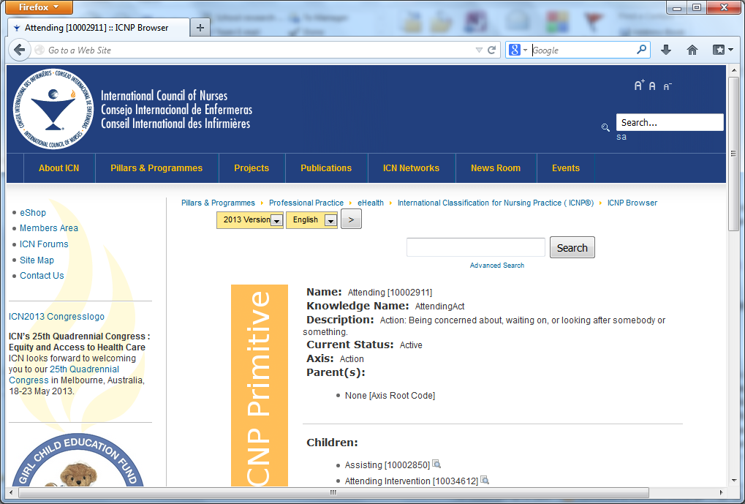

Slide 28
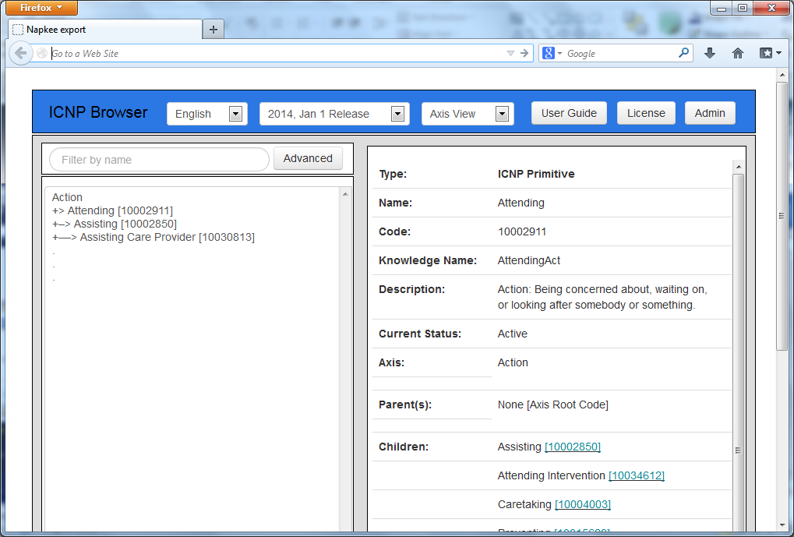

Slide 29
ICNP® Application & Development
Practical use at point of care
  A degree of national endorsement in Portugal, Norway, Canada, USA
  Commercial agreements with software suppliers in Norway, USA, Portugal
Catalogue development and translation activity
Individual and collaborative R&D projects
ICN Accredited Centres for ICNP® Research & Development

Slide 30
ICN Accredited Centres for ICNP® Research & Development
Australia – Canberra
  ICNP® and evidence-based practice
Australia – Flinders
  ICNP® and disaster nursing
Brazil
  Development and use of ICNP®
Canada
  ICNP® and RNAO Best practice guidelines
Chile
  ICNP® and family nursing
German-speaking countries
  3 NNAs and 3 national user groups – Translation - Development and use of ICNP®
Iran
  Translation - Development and use of ICNP®
Korea
  Translation - Development and use of ICNP®
Poland
  Translation - Development and use of ICNP®
Portugal
  Improve quality of care through Nursing Information Systems and ICNP®
USA
  ICNP® and minimum data sets

Slide 31
Natural language (speech and text)
Main currency for clinical information
Expressive
Familiar...
...but complex and difficult to analyse, manipulate and reuse

Slide 32
Finding the incidence of heart disease
angina pectoris
mitral stenosis
angina pectoris ruled out
family history of heart disease

Slide 33
Proliferation of terminologies
Many tasks, many users
Health care changes constantly
Health care is very ‘big’
For a particular purpose it is easy to build your own
Terminologies are getting bigger, more numerous, more complex

Slide 34
Terminologies within UMLS
AI/RHEUM, 1993
Alternative Billing Concepts
Alcohol and Other Drug Thesaurus, 2000
Beth Israel Vocabulary, 1.0
Canonical Clinical Problem Statement System, 1999
Clinical Classifications Software, 2003
Current Dental Terminology (CDT), 4

Slide 35
COSTAR, 1989-1995
Medical Entities Dictionary, 2003
Physicians' Current Procedural Terminology, 2004
Physicians' Current Procedural Terminology, Spanish Translation, 2001
CRISP Thesaurus, 2004
COSTART, 1995
Diseases Database, 2000
German translation of ICD10, 1995
German translation of UMDNS, 1996
DSM-III-R, 1987
DSM-IV, 1994
DXplain, 1994
Gene Ontology, 2004_03_02

Slide 36
HCPCS Version of Current Dental Terminology (CDT), 4
HCFA Common Procedure Coding System, 2004
HCPCS Version of Current Procedural Terminology (CPT), 2004
Health Devices Alerts, 1999
Home Health Care Classification, 2003
Health Level Seven Vocabulary, 1998-2002
ICPC2E-ICD10 relationships from Dr. Henk Lamberts, 1998
Health Product Comparison System, 1999
ICD10, 1998
ICD10, American English Equivalents, 1998
International Statistical Classification of Diseases and Related Health Problems, 10th Revision, Australian Modification, January 2000 Release
International Statistical Classification of Diseases and Related Health Problems, Australian Modification, Americanized English Equivalents, 2000
ICD10, Dutch Translation, 200403
ICD-9-CM, 2004
International Classification of Primary Care, 1993
International Classification of Primary Care 2nd Edition, Electronic, 2E, Dutch Translation, 200203
International Classification of Primary Care 2nd Edition, Electronic, 2E, 200203
International Classification of Primary Care, Version 2-Plus, 2000

Slide 37
ICPC, Basque Translation, 1993
ICPC, Danish Translation, 1993
ICPC, Dutch Translation, 1993
ICPC, Finnish Translation, 1993
ICPC, French Translation, 1993
ICPC, German Translation, 1993
ICPC, Hebrew Translation, 1993
ICPC, Hungarian Translation, 1993
ICPC, Italian Translation, 1993
ICPC, Norwegian Translation, 1993
International Classification of Primary Care, Version 2-Plus, Americanized English Equivalents, 2000
ICPC, Portuguese Translation, 1993
ICPC, Spanish Translation, 1993
ICPC, Swedish Translation, 1993
Online Congenital Multiple Anomaly/Mental Retardation Syndromes, 1999
Library of Congress Subject Headings, 1990
LOINC 2.12
MEDLINE (1994-1998)
McMaster University Epidemiology Terms, 1992
Master Drug Data Base, 2003_03
Medical Dictionary for Regulatory Activities Terminology (MedDRA), 7.0
Medical Dictionary for Regulatory Activities Terminology (MedDRA), American English Equivalents, 7.0
Medical Dictionary for Regulatory Activities Terminology (MedDRA), Dutch Edition, 7.0
Medical Dictionary for Regulatory Activities Terminology (MedDRA), American English Equivalents with expanded abbreviations, 7.0
Medical Dictionary for Regulatory Activities Terminology (MedDRA), with expanded abbreviations, 7.0
Medical Dictionary for Regulatory Activities Terminology (MedDRA), French Edition, 7.0
Medical Dictionary for Regulatory Activities Terminology (MedDRA), German Edition, 7.0
Medical Dictionary for Regulatory Activities Terminology (MedDRA), Portuguese Edition, 7.0
Medical Dictionary for Regulatory Activities Terminology (MedDRA), Spanish Edition, 7.0
MEDLINE (1999-2004)
Online Mendelian Inheritance in Man, 1993
Multum MediSource Lexicon, 2004_03
Micromedex DRUGDEX, 2001-08
Medical Subject Headings, MSH2004_2003_12_12
Czech translation of the Medical Subject Headings, 2004
Nederlandse vertaling van Mesh (Dutch translation of MeSH), 2004
Finnish translations of the Medical Subject Headings, 2004

Slide 38
Thesaurus Biomedical Francais/Anglais [French translation of MeSH, 2004
German translation of Medical Subject Headings, 2004
Italian translation of Medical Subject Headings, 2004, 2004
Japanese translations of the Medical Subject Headings, 2004
Descritores em Ciencias da Saude (Portuguese translation of the Medical Subject Headings), 2004
Russian Translation of MeSH, 2004
Descritores en Ciencias de la Salud (Spanish translation of the Medical Subject Headings), 2004
Swedish translations of the Medical Subject Headings, 2004
UMLS Metathesaurus
Metathesaurus CPT Hierarchical Terms, 2004
Metathesaurus FDA National Drug Code Directory, 2004_01
Metathesaurus HCPCS Hierarchical Terms, 2004
Metathesaurus additional entry terms for ICD-9-CM, 2004
International Classification of Primary Care 2nd Edition, Electronic, 2E, American English Equivalents, 200203
Metathesaurus Form of Medical Dictionary for Regulatory Activities Terminology (MedDRA), Spanish Edition, 7.0
Metathesaurus Version of Minimal Standard Terminology Digestive Endoscopy, 2001
Metathesaurus Version of Minimal Standard Terminology Digestive Endoscopy, French Translation, 2001
Metathesaurus Version of Minimal Standard Terminology Digestive Endoscopy, Italian Translation, 2001
Metathesaurus Forms of Physician Data Query Terms 2004
Metathesaurus forms of SNOMED Clinical Terms, 2004_01_31
Metathesaurus forms of Spanish SNOMED Clinical Terms, 2003_10_31
NANDA nursing diagnoses: definitions & classification, 2004
NCBI Taxonomy, 2003
NCI Thesaurus, 2004
NCI SEER ICD Neoplasm Code Mappings, 1999
National Drug Data File Plus Source Vocabulary, March 2004, 2004_03_11
National Drug File - Reference Terminology, 2004_01
Neuronames Brain Hierarchy, 1999
Nursing Interventions Classification, 1999
National Library of Medicine Medline Data
Nursing Outcomes Classification, 1997
OMIM, Online Mendelian Inheritance in Man, 1997
Omaha System, 1994
Patient Care Data Set, 1997
Physician Data Query, 2004
Pharmacy Practice Activity Classification, 1998
Thesaurus of Psychological Index Terms, 2001
Quick Medical Reference (QMR), 1996
QMR clinically related terms from Randolph A. Miller, 1999
Clinical Terms Version 3 (CTV3) (Read Codes), 1999
Read thesaurus, American English Equivalents, 1999
Read thesaurus Americanized Synthesized Terms, 1999
Read thesaurus, Synthesized Terms, 1999
RXNORM Project, META2004AB
SNOMED Clinical Terms, Spanish Language Edition, 2003_10_31
SNOMED-2, 2
SNOMED International, 1998
SNOMED Clinical Terms, 2004_01_31
Standard Product Nomenclature, 2003
Metathesaurus Source Terminology Names
UltraSTAR, 1993
UMDNS: product category thesaurus, 2004
University of Washington Digital Anatomist, 1.7.3
Veterans Health Administration National Drug File, 03
WHO Adverse Reaction Terminology, 1997
WHOART, French Translation, 1997
WHOART, German Translation, 1997
WHOART, Portuguese Translation, 1997
WHOART, Spanish Translation, 1997

Slide 39
Multiple nursing terminologies

Slide 40
Diverse overlapping systems
Endotracheal extubation
Positioning endotracheal tube
Removing endotracheal tube

Slide 41
A solution?
Classification
Of
Nursing

Slide 42
Another solution?
Endotracheal extubation
Positioning endotracheal tube
Removing endotracheal tube

Slide 46
Reference terminologies
Terminologies with reference properties
  SNOMED® Clinical Terms (SNOMED® CT)
  The International Classification for Nursing Practice (ICNP®)

Slide 47
Pain
Acute
pain
Pain that
comes on
suddenly
Acute pain

Slide 48
Pain
Neuralgia
Acute
pain
Acute pain

Slide 49
A unifying framework in practice
As a unifying framework ICNP® should be able to:
  handle a range of nursing terminologies
  determine any relationships/mappings between them
    the same entities
      ‘Acute pain’
        is equivalent to
      ‘Pain that came on suddenly’
    entities with more/less detail
      ‘Acute pain’
        is a child of
      ‘Pain’
Equivalence
Subsumption

Slide 50
How many times do we do bladder washouts?
Bladder washout
ICNP
IrrigatingBladder

Slide 51
How many times do we do bladder irrigations?
Bladder irrigation
ICNP
IrrigatingBladder

Slide 52
How many bladder procedures do they do?
Bladder procedure
ICNP
PerformingOnBladder

Slide 53
Bladder washout
Action
Performing
Irrigating
IrrigatingBladder
PerformingOnBladder
BodyPart
UrinaryBladder
Bladder irrigation
Bladder procedure

Slide 54
Action
Performing
Irrigating
IrrigatingBladder
PerformingOnBladder
BodyPart
UrinaryBladder
Before
Action
Performing
Irrigating
IrrigatingBladder
PerformingOnBladder
IrrigatingBladder
BodyPart
UrinaryBladder
After

Slide 55
How?
The primitive Irrigating is a child of Performing
Both ‘act on’ Urinary Bladder
We overlooked the fact that IrrigatingBladder SHOULD BE a child of PerformingOnBladder
Software can use the semantic information we provide to help manage the terminology

Slide 56
Action
Performing
Irrigating
IrrigatingBladder
PerformingOnBladder
IrrigatingBladder
BodyPart
UrinaryBladder
Bladder procedure
Bladder irrigation
Bladder irrigation = Bladder washout

Slide 57
Pain
Gall stone
Acute pain
Cholelithiasis
Dog
Cat
Mammal
Dog

Slide 58
Primary use of clinical data
Facilitating communication
Providing a record of care
Acting as an aide memoire

Slide 59
Focus for ICNP®
  Using ICNP® to provide raw data for primary use
  Catalogues
  Clinical Care Classification
  SNOMED® CT

Slide 60
Secondary use of clinical data
Country
Region
Hospital
Unit
Aggregation
Abstraction

Slide 61
Examples of secondary use
Mortality and morbidity reporting
Public health surveillance
Clinical audit
Research
Hospital financing

Slide 62
Focus for ICNP®
  Using the International Classification for Nursing Practice (ICNP®) to provide raw data for secondary use
  Hierarchisation
  Belgian Nursing Minimum Data Set (B-NMDS)
  International Classification of Health Interventions (ICHI)

Slide 63

International
Council of Nurses
ICNP® 25th Anniversary
1989-2014

Slide 64
Next steps for ICNP®
Reassert ICNP as a key component of the global informatics infrastructure
Routine biennial release (with early release for commercial partners and translators)
Implementation
  Facilitate translation
  Continue development and publication of catalogues
  Complete mapping to SNOMED® CT and other terminologies
  Foster further commercial partnerships
Dissemination
  Easier distribution
  Presentations and publications
  Positions, eHealth Bulletin, web pages

Slide 65
n.r.hardiker@salford.ac.uk

