Slide 1
LOINC – SNOMED CT
Cooperation on Content
Overview for IPaLM SIG
July 2014

Slide 2
Background
Cooperative agreement between Regenstrief Institute and IHTSDO
  July 2013
  Builds on strengths of each terminology
  Minimize and manage duplication
  SNOMED and LOINC work better together
Initial map between LOINC parts and SNOMED
  Most recent version from 201309
  5867 LOINC parts
  Exact match maps range from 6% (Adjustments) to 84% (Property)

Slide 3
Value
Greater consistency in coding of order entry and results reporting
Improved analytics and quality control
  Query LOINC via SNOMED hierarchy and relationships
  Better identification and maintenance of laboratory tests value sets for public health reporting
  Enhanced tracking and management of infectious disease outbreaks
Integrates disparate elements in EMRs
  Lab test in LOINC with elements in patient chart in SNOMED (e.g. allergies, chief complaint, vital signs, age)
  Enables clinical decision support, may aid in reimbursement
Multiple positive tweets!

Slide 4
Roles of Individuals and Groups
Internal project team – currently 6 individuals
  Head of Terminology (KSP), Head of Content Development (IGR), Head of Implementation and Education (DMA), Head of Delivery (RTU), Senior Terminologists (FAS, SSA)
Executive Policy Group (KSP, DSW, DMA, DVR, SHU, CMC)
Observable and Investigation Model Project
  Subproject on CollabNet (those interested in participating contact SSA or FAS)
Project groups (Substance Redesign; Organisms; Microbiology)
External collaborators:
  Kaiser Permanente (BGO, MSM)
  US Veterans Administration (KCA, SBR)
IHTSDO Content Committee:
  Guidance, coordination with other IHTSDO initiatives
Contractors:
  Developing implementation guidance: BITAC
  If needed for accelerated work. TBD

Slide 5
Project Scope and Phases
Scope
  Vital signs
  Laboratory LOINC
  Physiologic measurements
  Anthropomorphic measurements and evaluations
Phases:
  Initial:
    Top 2000 lab LOINC tests
    Microbiology
    Chemistry
    Vital signs
  Subsequent:
    Remainder of laboratory LOINC
    Measurements

Slide 6

Roadmap (as of March 2014)
Alpha release
Preview release
Candidate baseline
Map LOINC parts
to SNOMED
Map LOINC codes
to SNOMED
expressions
Develop
distribution
format
Create
SNOMED
value sets
for LOINC codes
March 2014
July 2014
November 2014
Jan 2014
May 2014
September 2014
January 2015

Slide 7
Goals for 2014
Complete map of ~6000 LOINC parts to SNOMED concepts
Add ~2000 SNOMED concepts by January 2015 release
Release alpha prototype of SNOMED expressions equivalent to ~117 LOINC terms in April 2014
Release technical preview of distribution format for expressions in August 2014 (subset of Top 2000 + microbiology + chemistry)
Develop documentation
Perform test plan for quality management
Define test plan for impact
Recommend modifications to Observables model if needed

Slide 8
Steps for Technology Preview
Map subset of LOINC parts to SNOMED concepts
  Evaluate existing map
  Add missing content
Map LOINC codes to SNOMED expressions
  Develop alpha prototype
  QA test with 117 lab tests in top 200 list from KP
  Analysis of feedback received
Develop distribution format
  To identify changes in SNOMED due to project
  For releasing expressions
Preview release of expressions
  ~8000 LOINC terms with equivalent SNOMED expressions based on Observable model redesign

Slide 9
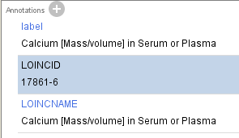
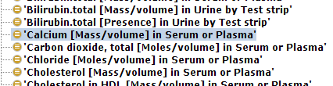
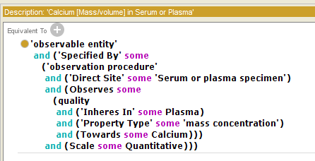
Example of mapping

Slide 10
LOINC – SNOMED CT
Cooperation on Implementation
Overview for IPaLM SIG
July 2014

Slide 11
Implementation Guidance on using SNOMED CT and LOINC together
Request for Proposals
  November to December 2013
  Contractor Bitac (Spain)
Phase 1: Scoping and Horizon Scan
  Scheduled 13 January-31 March 2014
    Delayed start – phase actually completed 10th April
Phase 2: Developing Guidance
  Scheduled completion 15 July 2014
  Seeking feedback by 15 August 2014

Slide 12
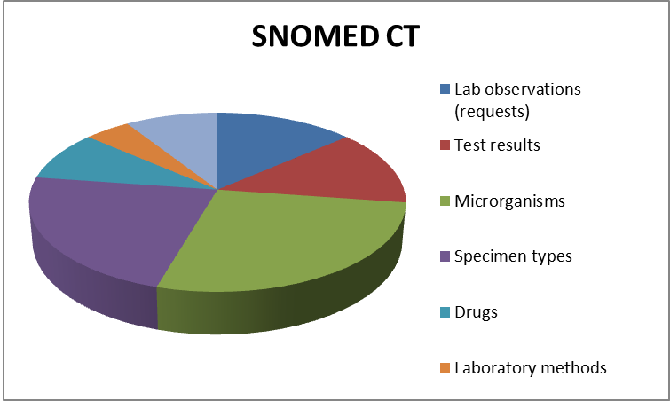
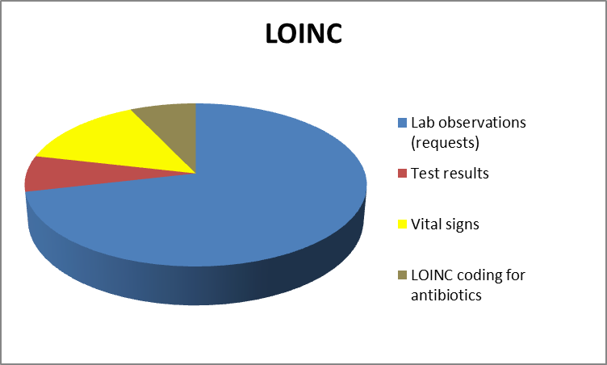
Implementation Guidance SNOMED and LOINC
Phase 1 deliverables: Horizon Scan
Use of SNOMED CT and LOINC together
  12 structured use case summaries based on phone interviews
  Revised based in feedback from interviewees
High-level summary of findings
  National spread: 7 different countries (6 Members + 1 Non-Member)
  Patterns of terminology use …

Slide 13
Implementation Guidance SNOMED and LOINC
Phase 1 deliverables: Scope for Phase 2
Relevant Clinical Scenarios
  Biosurveillance (animal/human health) networks
  Clinical laboratory reporting (mostly Microbiology area)
  Infectious diseases for lab order entries.
Guidance on models for combined use
  Advice on situations in which LOINC and SNOMED CT codes can be effectively used together.
    E.g. laboratory observations, test results, vital signs, microorganisms, antibiotic sensitivities, specimen types, etc.
  Take account of existing guidelines (e.g. HL7, CIMI)
    E.g. HL7, CIMI or other relevant initiatives
Added value from maps & expression associations
  Enhanced semantic processing for LOINC users
  Greater completeness of coverage from SNOMED CT + LOINC

Slide 14
IPaLM SIG input
Content
  Mapping advise
  Naming conventions
  Advice on laboratory reporting use cases
Implementation
  Review guidelines

Slide 15
Contact
IHTSDO Project Team
  Content:
      Farzaneh Ashrafi: fas@ihtsdo.org
      Suzanne Santamaria: ssa@ihtsdo.org
  Implementation:
      David Markwell: dma@ihtsdo.org

Slide 16
References
Alpha prototype files
  https://csfe.aceworkspace.net/sf/frs/do/viewRelease/projects.snomed_ct_international_releases/frs.3_other_releases.loinc_snomed_alpha_prototype
Observables redesign
  https://csfe.aceworkspace.net/sf/go/doc9931?nav=1
Project site on CollabNet
  https://csfe.aceworkspace.net/sf/docman/do/listDocuments/projects.observable_and_investigation_mod/docman.root.loinc_integration

Slide 17
QUESTIONS & DISCUSSION

