Slide 1
Classifications and terminologies in Italy
IHTSDO – IPaLM PG meeting
Toronto october 18 2010
A brief overview on the activities of Italian WHO-FIC Collaborating Centre in partnership with the Italian Society of Pathology and Diagnostic Cytology (SIAPEC)
Francesco Gongolo

Slide 2
WHO FIC - Italian CC
The Italian WHO Collaborating Centre for the Family of International Classifications:
Development and use of WHO-FIC (health information system)
Contribution in development of methodology for the use of WHO-FIC
Support WHO
Development of education and training
Mantainment of International Classification of Diseases – ICD 10
Support to the implementation of the WHO-FIC

Slide 3
WHO FIC - Italian CC
Coordination with WHO and in WHOFIC network, particularly with the Informatics and Terminology Committee.

Slide 4
WHO FIC - Italian CC
Agreement with the Italian Ministry of Health regarding the development and use of international classifications and standards at national level.
Development of a national portal of classification on behalf of the Italian Ministry of Health.

Slide 5
WHO FIC - Italian CC
Partnership with the Italian Society of Pathology and Diagnostic Cytology for the development maintenance and diffusion of classifications and terminologies for pathology.

Slide 6
About Francesco Gongolo
M.D. Specialist in Legal Medicine, Postgraduate Certificate in Bioethics, Master Degree in Clinical Risk Management
WHO Italian Collaborating Centre for the Family of International Classifications at Regional Health Agency of Friuli Venezia Giulia:
  coordination staff for the work lines on disability assessment;
  coordination and management of the activities of revision, updating and translating of WHO International Classifications.
World Health Organization:
  Medical reviewer for the WHO ICD11 revision process
  WHO-FIC Morbidity Reference Group
  Topic advisory group on Functioning for the ICD11 revision
  WHO-FIC Update and Revision Committee

Slide 7
International Classification of Diseases
international standard diagnostic classification:
  general epidemiological purposes
  health management
  clinical use.
Classification of diseases and other health problems:
  many types of health records including death certificates.
Adapted from www.who.int/classifications/icd/en

Slide 8
ICD 11 revision goals
Evolve a multi-purpose and coherent classification
  Mortality, morbidity, primary care, clinical care, research, public health…
  Consistency & interoperability across different uses
Serve as an international and multilingual reference standard for scientific comparability and communication purposes
Ensure that ICD-11 will function in an Electronic Health Records environment.
  Link ICD logically to underpinning terminologies and ontologies (e.g. SNOMED…)
  ICD Categories “defined” by "logical operational rules" on their associations and details
  Adapted from T.B. Ustun 2009

Slide 9
Content model and descriptive characteristics of ICD-11
The ICD 11 transition is made to move away from a list of codes into a formalized knowledge representation, capturing key parameters and related properties in a standardized and systematic way.
The ICD-11 content model has, as well as the name and definition of the disease, a list of thirteen ‘descriptive characteristics’ including signs, symptoms, etiology, functional properties, treatment...

Slide 10
THE CONTENT MODEL
Any Category in ICD is represented by:
TITLE of ENTITY: Name of disease, disorder, or syndrome…
  Textual definition
  Synonyms - Inclusion – Exclusion - Index terms
Descriptive characteristics
Type
Disease, disorder, syndrome, injury, sign/symptom, external cause, reason for encounter;
Body System(s) (physiology)
Body Part(s) (anatomical site)
Manifestation Attributes
  Signs & Symptoms
  Diagnostic Findings
Causal Properties (etiology)
  Causal Mechanisms /Agents
  Risk Factors
  Genomic characteristics
Temporal Properties
Severity and/or Extent
Functional Properties
Treatment Properties
Maintenance attributes
Unique identifier
Subset, adaptation, and special view flag
1. Primary Care
    2. Clinical Care
    3. Research
    4. Special indices (e.g. Public Health Indices or Resource Groupings)
Hierarchical relationships parents and children in ICD structure
Mapping relationships
  Linkages to other systems like SNOMED etc.
Other rules
Notes:
10
10

Slide 11
Terminologies as the key to link different classifications
Common reference point for comparison and aggregation of data about the entire health care process
K.A. Spackman et al. 1997
Non restrictive in the range of terms and language required by the numerous individuals, groups, and organizations who will be expected to use it.
R.J.C. Chalmers 2006

Slide 12
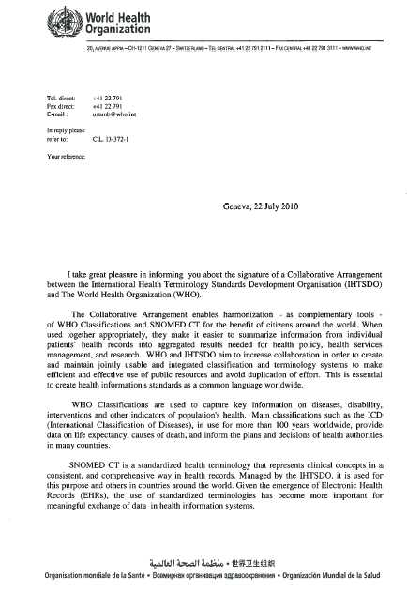
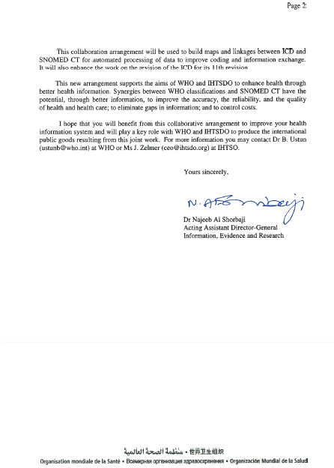
... to build maps and linkages between ICD and SNOMED-CT for automated processing of data to improve the coding and information exchange ...

Slide 13
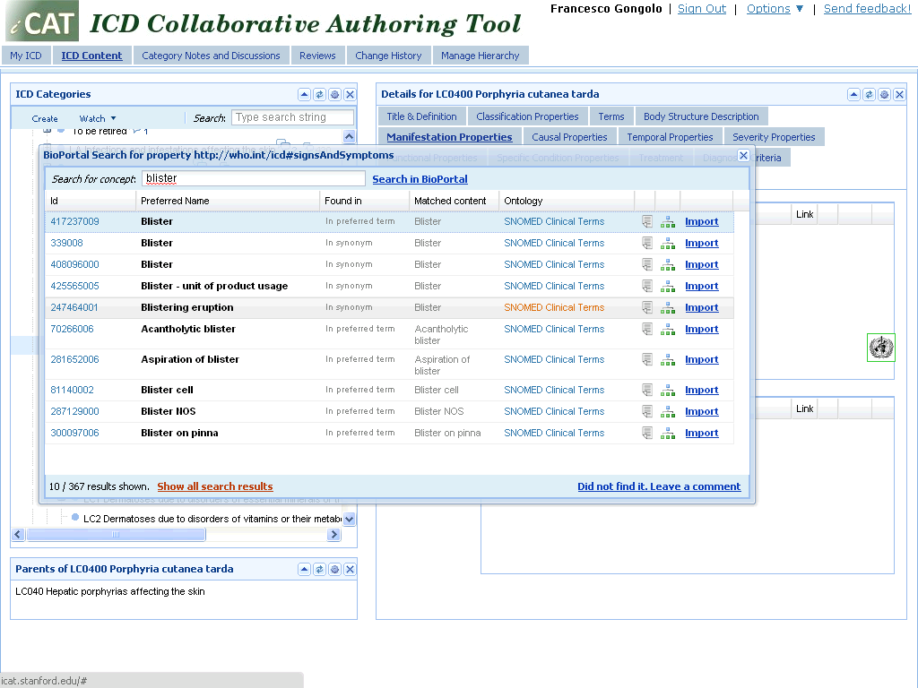

Slide 14
WHO-FIC: terminologies as link between classifications
REFERENCE Classifications
DERIVED Classifications
International Classification of Diseases for Oncology, Third Edition (ICD-O-3)
The ICD-10 Classification of Mental and Behavioural Disorders
Application of the International Classification of Diseases to Dentistry and Stomatology, Third Edition
(ICD-DA)
Application of the International Classification of Diseases to Neurology
(ICD-10-NA)
ICF, Children & Youth Version (ICF -CY)
RELATED Classifications
International Classification of Primary Care (ICPC)
International Classification of External Causes of Injury (ICECI)
The Anatomical, Therapeutic, Chemical (ATC) classification with Defined Daily Doses (DDD)
ISO 9999 Technical aids for persons with disabilities – Classification and Terminology
International Classification for Patient Safety (ICPS)
I nternational
C lassification of
D iseases
I nternational
C lassification of
F unctioning,
Disability & Health
I nternational
C lassification of
H ealth
I nterventions
(under development)

Slide 15
ICHI CONTENT MODEL Version 2.0
Any Intervention in ICHI is represented by:
TITLE of ENTITY: Name of intervention
  Textual definition
  Operational Hierarchy – Type – Use
  Synonyms - Inclusion – Exclusion - Index terms
Descriptive characteristics
Target
  Body Part(s) or Anatomical site(s)
  Body Function
  Traditional Target(s)
  Individual/Group/Population
Action
Means
  Approach
  Technique
  Method
Other characteristics
  Devices: GMDN, ISO9999
  Chemical substances(s): ATC
  Herbal substance
  Diagnostic tests: LOINC

Slide 16
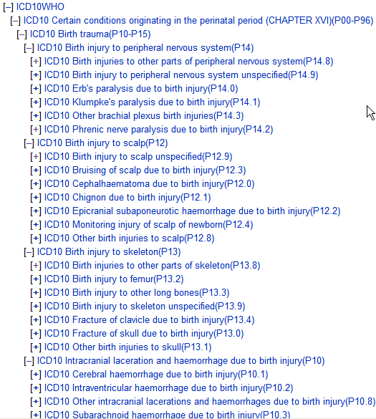
Different axes generate different hierarchies (adapted from C. Chute)

Slide 17
Role of terminologies in the ICD11 development process
The use of SNOMED-CT for the review process of ICD11 is the biggest test ever done linking a terminology to a classification.

Slide 18
The Italian Portal of Classifications
At the end of June 2009 the Italian Portal of Classifications (www.reteclassificazioni.it) has been officially released:
  developed by the Italian CC, the CC branches Regional Agency of Health (ARS) and University of Udine Dep. of Medical Informatics, Telemedicine and E-health (UNIUD),
  in agreement with the Ministry of Labour, Health and Social Policies.
This project is part of a wider plan of collaboration between the Ministry and the Italian CC for the development and implementation of classifications at national level.

Slide 19
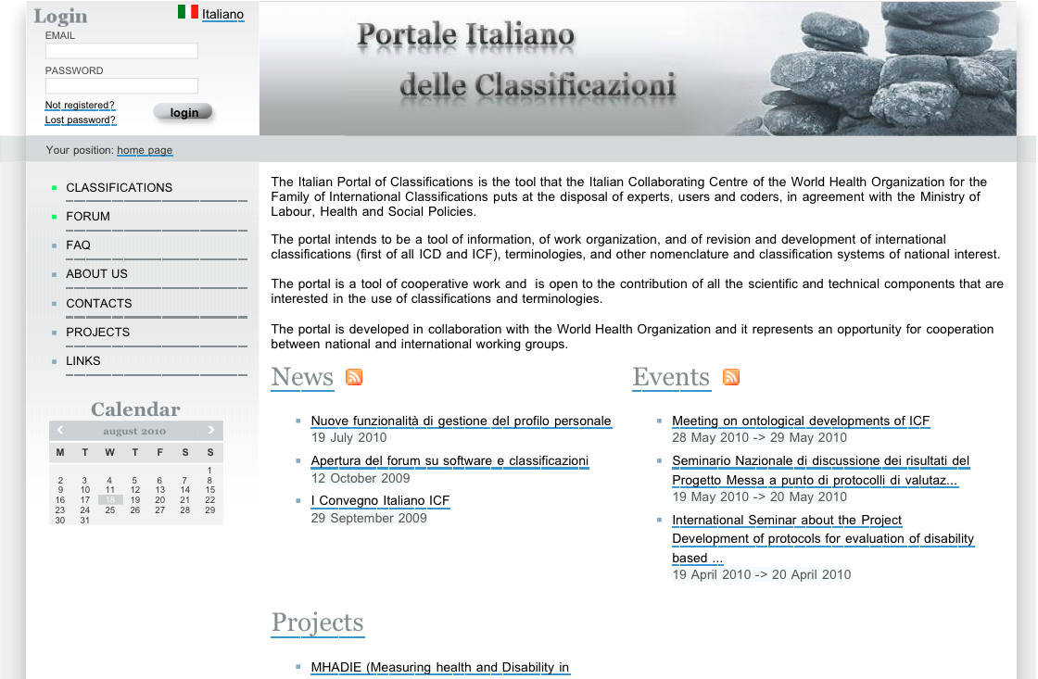
www.reteclassificazioni.it

Slide 20
www.reteclassificazioni.it
The main aims of the portal are:
  to create the Italian community of users and coders of WHO-FIC;
  to facilitate the dissemination of the electronic versions of WHO-FIC;
  to support the collaboration of Italian experts to the international development of WHO-FIC
  The portal implements the same wiki technology proposed by the WHO for the review process of ICD11.

Slide 21
www.reteclassificazioni.it
ICF, ICF-CY and ICD10 are currently available on the portal.
NAP (Nomenclatore di Anatomia Patologica) the classification developed by SIAPEC and Italian WHO-FIC CC for Pathology:
  loaded into the portal to facilitate revision by experts
  and will be also available to users of the portal.

Slide 22
NAP
In Italy autonomous development of “self-made” nomenclatures by the different Pathology Departments, raised the need for one national coding language.
A large project has been promoted to join the different coding systems of the many Pathology Departments in Italy and re-direct Italian Pathology to the international scenario.

Slide 23
NAP
SIAPEC and AIRTum (scientific core) and the Italian Collaborating Centre for the family of International Classifications (technical core) and are strongly committed in the NAP project which is autonomous for codes, structures and presentations.
The aim of the Italian Nomenclature of Pathology (NAP) is to be the national reference for the Italian pathology community.

Slide 24
Why an Italian NAP Project?
Join all different codes from local Pathology Departments
Serve as a reference and update according to requirements of various Pathology Departments
Achieve the final target of internationally converge to SNOMED CT and IHTSDO

Slide 25
Link to SNOMED-CT is unavoidable
The community of Pathologists is familiar with SNOMED-CT
SNOMED-CT is an international standard
Link to SNOMED-CT allows the link to other classifications
In the near future ICD11 will be logically linked to underpinning terminologies and ontologies such SNOMED-CT

Slide 26
Open issues
  The position vis-à-vis IHTSDO and SNOMED should be considered not only for pathology but also for Health Care terminology in general.
  SNOMED-CT is Anglophone and WHO and WHO FIC - Italian CC spearhead the rights and mechanisms for adopting the terminology standards as language independent concepts and enable multilingual knowledge representation.

Slide 27
Open issues
Italy does not have a policy on terminology for the development of interoperability between different coding systems.
In the absence of a national policy, it is essential, in the medium term, to have a strategy on terminologies.

Slide 28
Open issues
An "intermediate" or "preparatory“ phase have to be targeted to a link to SNOMED-CT:
increase knowledge on the terminology
demonstrating to decision-makers the "inevitability of the choice" in the medium term.

Slide 29
Thank You
www.reteclassificazioni.it
Francesco Gongolo

