Slide 1
“Nerve block of X (procedure)”
“A consistent concept model is needed for nerve blocks. Nerve block (procedure) is primitive and its modeling captures the means (administration of a drug for nerve block) rather than the outcome (the actual “nerve block”). The Anesthesia SIG will need to be consulted for input once this project has been prioritized.”

Slide 2
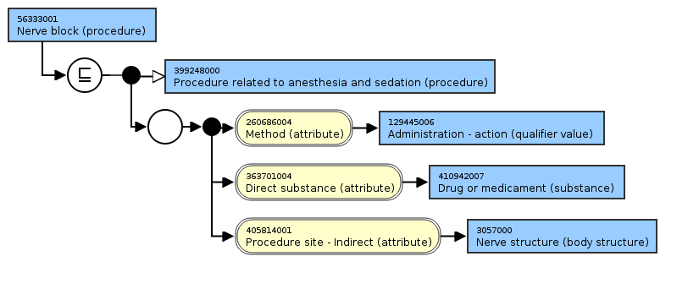
56333001 | nerve block (procedure) |
199 descendants

Slide 3
Nerve block’s children
Caudal cryotherapy (procedure)
Cryotherapy to dorsal root ganglion (procedure)
Cryotherapy to nerve root (procedure)
Cryotherapy to trigger point (procedure)
Intravenous regional block (procedure)
Nerve block anesthesia (procedure)
Nerve block with injection of lumbar spine using fluoroscopic guidance (procedure)
Neurolytic autonomic nerve block (procedure)
Neurolytic techniques (procedure)
Sympathetic ganglion block (procedure)
Sympathetic nerve block (procedure)
Sympathetic nerve or ganglion block (procedure)
Transsacral local anesthetic nerve block (procedure)

Slide 4
Nerve block outcome?
New morphologic abnormality: Nerve block
Cf. 75506009 | Construction of stoma (procedure) |

Slide 5
Nerve blocks
What classification criteria would you like to see?

