Slide 1
Rosetta Terminology Mapping
Management System
(RTMMS)
National Institute of Standards and Technology (NIST)
Information Technology Laboratory (ITL)
Systems and Software Division
Maria CHERKAOUI, John Garguilo, Sandra Martinez
April 2010

Slide 2
RTMMS Overview
A web application that allows vendors and reviewers access, retrieval, and reporting of Rosetta Tables over the internet in conformance to IHE RTM Profile.
The tool will provide the capability of saving the data in the xml format as defined by RTM Profile.
Aid in The harmonization process by:
  Identifying missing terms.
  Automatic generation of the “Harmonized Rosetta Table”
  View latest hRTM table.
Facilitate the proposal of New Terms to x73 Nomenclature

Slide 3
RTMMS Objectives
Enhance IEEE x73 Standardization Process
Aid in the harmonization process by:
  Identifying missing terms.
  Automatic generation of the “Harmonized Rosetta Table”
  View latest (“agreed upon”) hRTM table.
Facilitate the proposal of New Terms to x73 Nomenclature
Facilitate Conformance Tooling
  Message verification and conformance
  Leading to interoperability…

Slide 4
RTMMS vs. RTM Excel process
For Vendors
  Facilitate input of entries by vendors
    Tooltips providing supplementary information
    Available Interface to lookup values from the database
    Automatic completion of codes
    Validation of required content
  Reduce errors made by vendors while submitting entries
For Reviewers and SDO
  Facilitate the generation of the Harmonized Rosetta
  Help the review process of Rosetta entries
    Highlighting discussed entries
    Highlighting proposed REFIDs
    Adequate interface to view discussions and add comments
For all users
  Rosetta data available to everyone every time
  Provide XML version of tables
    All XSLT transformations can still be used

Slide 5
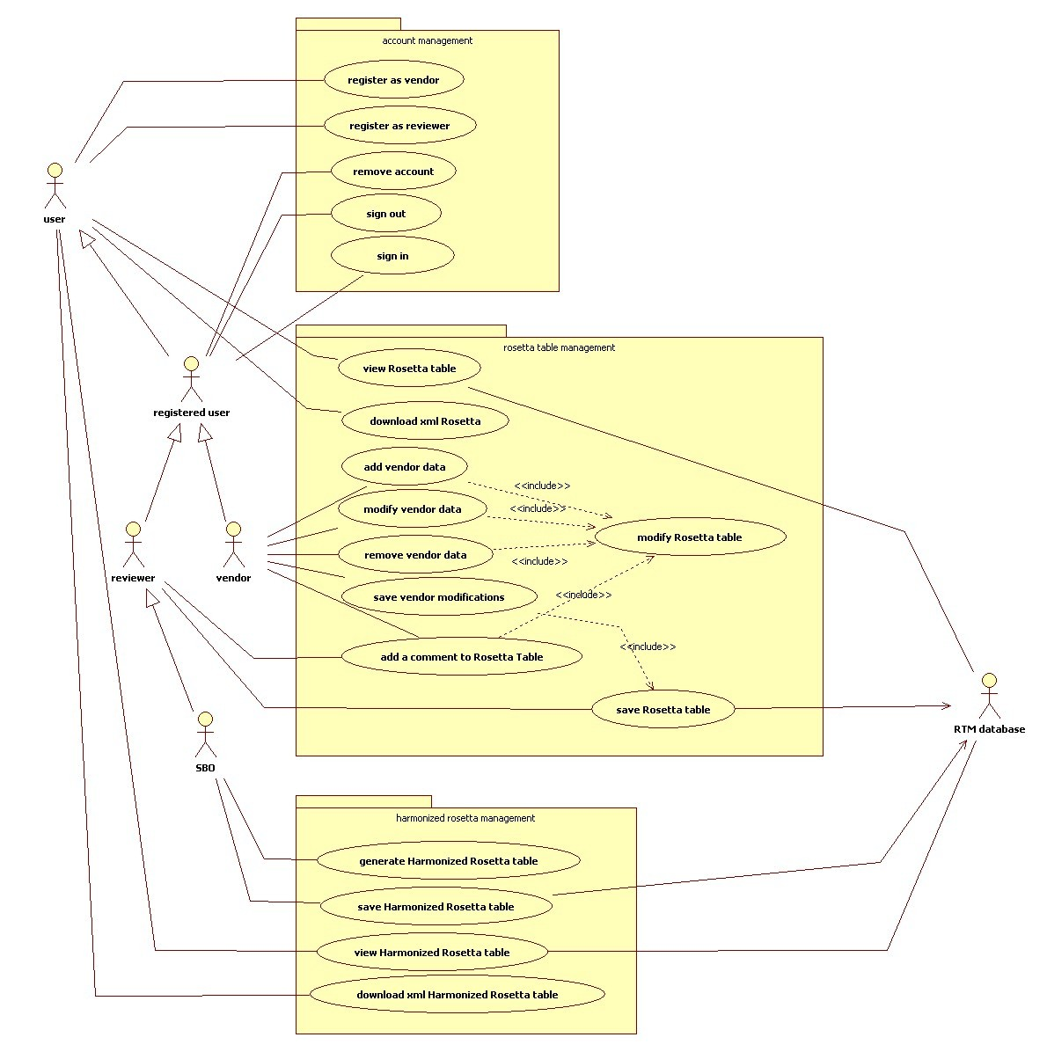
Use case

Slide 6
RTMMS Roles
“Non-registered User”
  Able to download RTM (latest approved version)
“Vendor” (Registered)
  Able to view, edit and propose vendor (only for vendor they are registered with) terms
“Reviewer” (Registered)
  Able to view all vendor terms and make annotations (discussion points)
“Expert Reviewer” (Registered and approved by SDO)
  Technical expert (e.g., Jan Wittenber (Phillips) and Paul Schluter (GE)) who can view and comment on all vendor terms
  Expert has the ability to generalize term to overall specification
“SDO” (Standards development organization approved official)
  Authority to approve/decline new or edited term proposed by vendor
  Approval based on SDO ballet rules
  Considers working group and especially ‘Expert Reviewer’ input
  Usually chair/co-chair of standards body and or working group
“Administrator” (Approved by ‘SDO’)
  Provides administrative support to database
  Generates and provides new user account information (user name and password)

Slide 7
Database
Models RTM data and relationships
Uses x73 Nomenclature database
  REFIDs
  Term codes
  Partition numbers
  (New terms added as approved/normative additions to standard)
Stores RTM data
  Rosetta table
  Units and Unit Groups
  Enumerations and Enumeration Groups
  hRTM table
  (New terms proposed – may be missing from x73 Nomenclature Database)

Slide 8
Database
Message Validation Tool
MDDB*
Message Generation Tool
x73 Nomenclature DB
RTM DB
Term Mapping Tool
*Medical Device Database
Notes:
MDDB: Medical Device Data Base – (to be developed over time: e.g., device profiles examples)
Explain the difference of x73 Nomenclature DB and RTM DB
Message Validation Tool: X73 + HL7 – uses Validation Context generated from hRTM
Term Mapping Tool: e.g., gateway for Vendor semantics mapped to Standards semantics

Slide 9
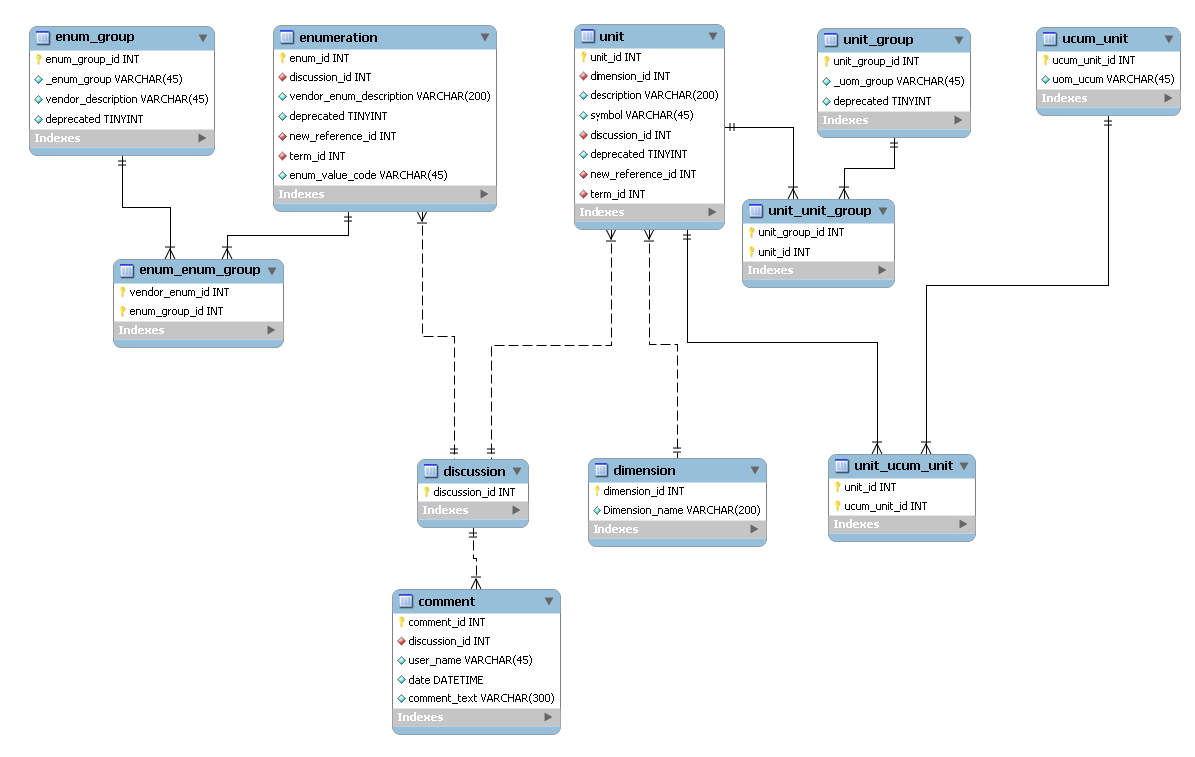
Database

Slide 10
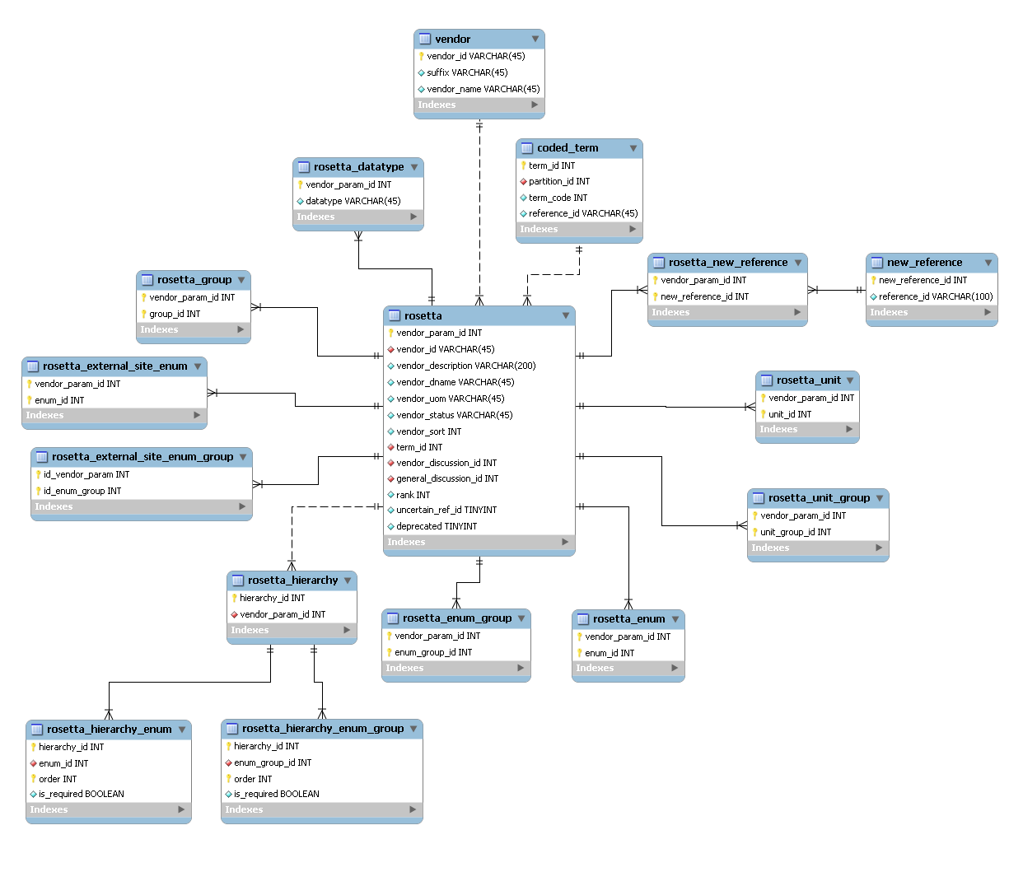
Database

Slide 11
RTMxml2DB
An “RTMxml2DB” tool was developed to:
  Populate RTM database from XML
  Identify inconsistencies against
    X73 Nomenclature (REFIDs, term codes)
    RTM Unit table (units, _UOM_GROUPS)
    RTM Enumeration table (enums, _ENUM_GROUPS)
Notes:
Process to populate our RTM DB that Paul Schluter provides(ed) (XML from Excel)
At the same time provides Validation on what Paul has produced.

Slide 12
RTMxml2DB
RTM XML Schema
RTM XML File
RTM DB
RTMxml2DB
RTM XML Library
Validation Report
POJO
O/R Mapping Files
x73 Nomenclature DB

Slide 13
Technologies employed
J2EE / JAVA 5
ExtJS 2.2.1 Cross-browser JavaScript library
Spring Framework
  Spring MVC: full-featured MVC (Model View Controller) implementation
  Spring Security: provides security solutions (authentication, identification)
Hibernate 3 Java persistence framework
MySQL 5.1
XMLBeans technology for accessing XML by binding it to Java types
Apache Tomcat 5.5
MySQL Workbench to design the database
Tested browsers
  Mozilla Firefox 3
  IE 7
  Google Chrome 1
Notes:
Spring framework http://www.springsource.org/
Hibernate https://www.hibernate.org/

Slide 14
Architecture
ExtJS Components (grid, panel…)
Presentation
JSP/JSTL, JSON
Spring MVC
Spring Security
Business Objects
Service
Business Services
Spring AOP
DAO interfaces and implementations
Persistence
Spring DAO / Hibernate Support
Hibernate 3

Slide 15
Benefits From Technologies
JavaScript library
  Sophisticated widgets library
  Cross browser compatibility
  Use of powerful techniques (AJAX, DHTML and DOM scripting)
MVC design
  Separation between business logic and GUI
  Modification of either the visual appearance of the application or the underlying business rules doesn’t affect the other
Persistence framework
  Mapping of Java classes to relational database tables
  Build a database independent application
Scalability, Performance and Stability

Slide 16
Available Features of RTMMS
Features based on the Rosetta Supplement
  Units table management
  Unit groups management
  Rosetta table management
  Handling uncertain REFIDs
  Automatic generation of the Harmonized Rosetta
    Need additional requirements
  XML Rosetta download
User oriented features
  User management module (Implemented user (roles) and privileges)
  Columns filtering
  REFIDs lookup in database
  Group lookup in database
  Units and Enumerations lookup in database
  Term codes completion from database
  Saving browsing history
  User registration

Slide 17
Features of RTMMS (continued)
RTMMS Architecture improvements
New Features (enhancements from May 2009 WG meetings)
  New x73 Nomenclature
    Terms in both annexes A and B.
    IDC Nomenclature
  Highlighted New Terms in Rosetta, Units and Enumerations Tables
  Added Interface for selecting REFID from x73 Nomenclature database
  Added Interface to propose New Terms
  Added New Term View for SDO users
  Enhanced registration process.
    Email confirmation, approval…
  Added Admin Type of users to manage users and enable new users
  XML Units Download
  Add ranking capabilities to assess probability of valid terms in the Rosetta table
    Scale from 1 to 10
  Include column filtering based on regular expressions
Notes:
RTMMS Architecture improvements
Fully implemented Hibernate
Data mapping
Reorganized the code in modules
Implemented JSON Mapping Capabilities

Slide 18
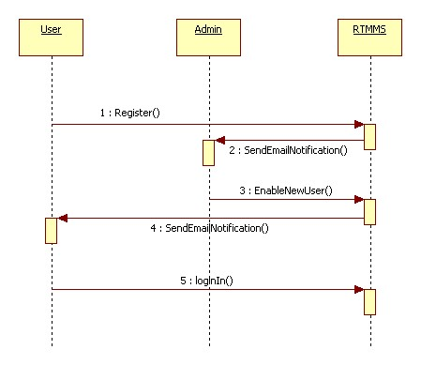
User Registration

Slide 19
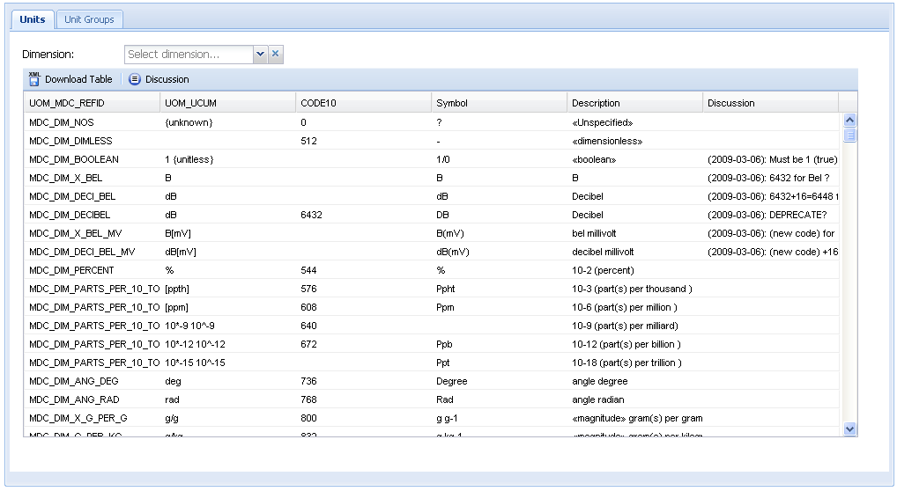
Units Table

Slide 20
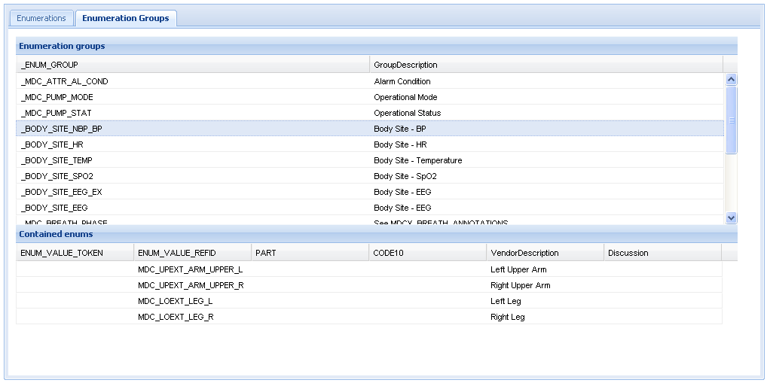
Enumeration Groups Table

Slide 21
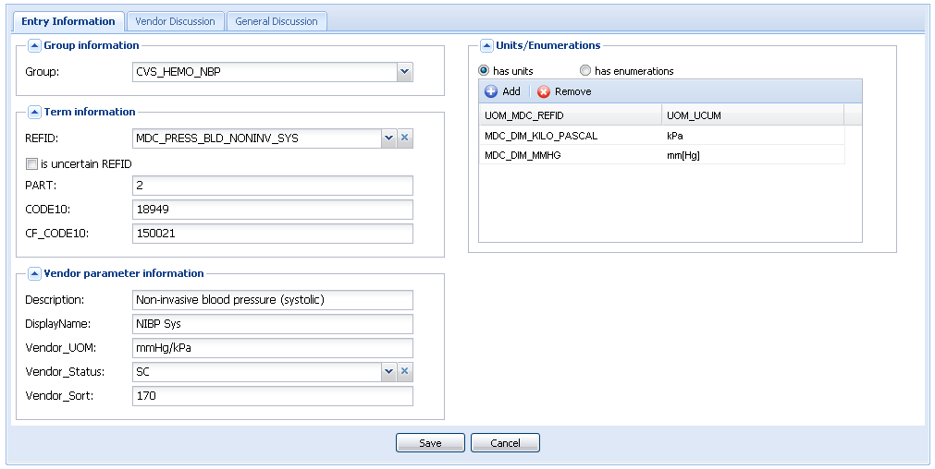
Edit Entry Form

Slide 22
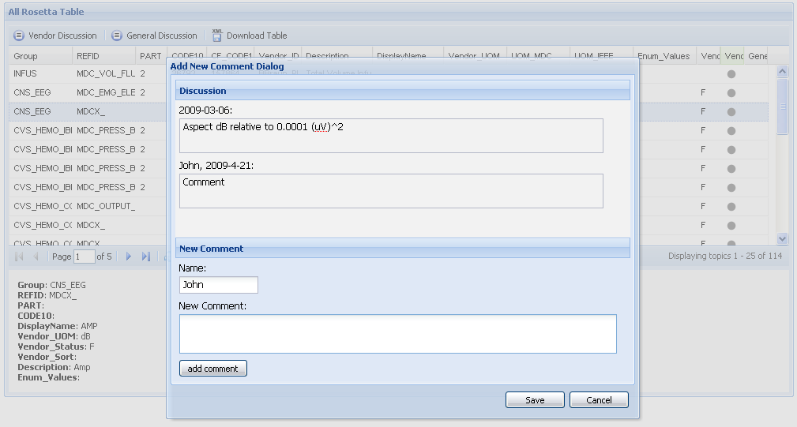
Add Comment Dialog

Slide 23
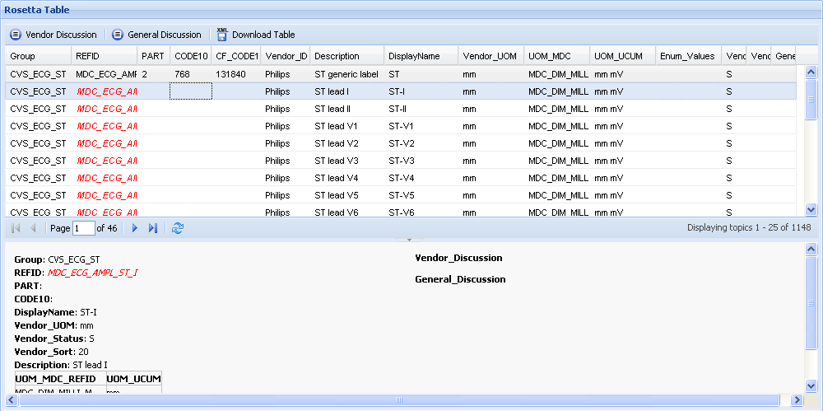
Rosetta Table

Slide 24
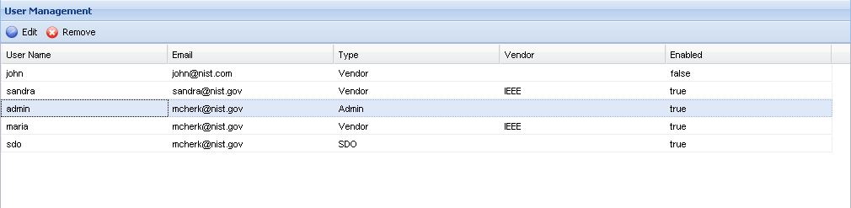
User Management Table

Slide 25
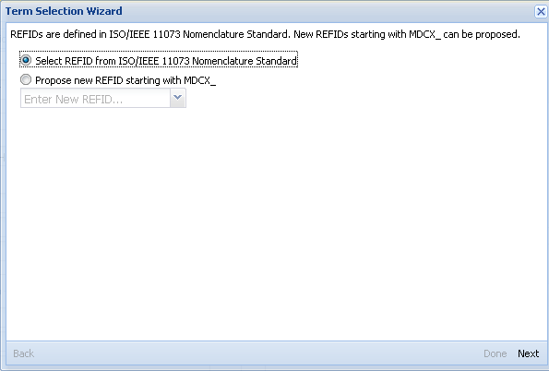
REFID Selection Dialog (1/3)

Slide 26
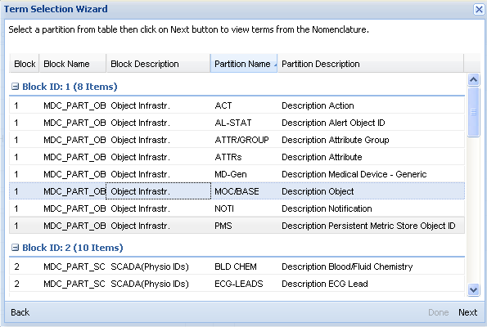
REFID Selection Dialog (2/3)

Slide 27
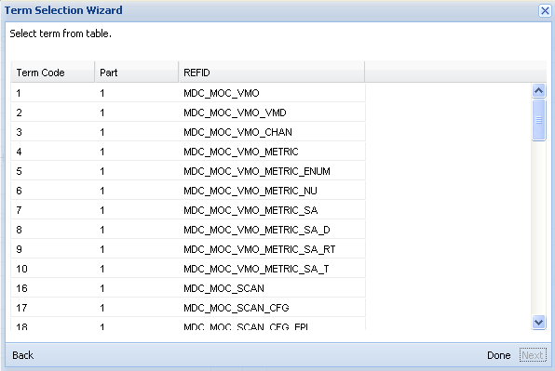
REFID Selection Dialog (3/3)

Slide 28
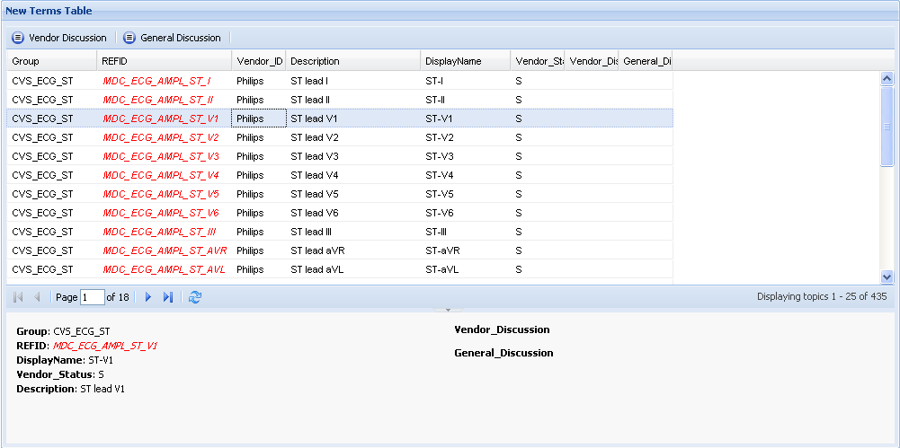
New Terms Table

Slide 29
RTMMS Modules
RTM DOMAIN
(Business Objects)
RTM DAO
(Data Access Objects and Services)
RTMMS
(Controllers and Presentation)

Slide 30
Next Steps
Features based on the Rosetta Supplement
  Incorporate “Enumerations” management capabilities
  Add “containedBy”, “contains” and “External_Sites” to the interface
  Implement Rosetta validation against H-Rosetta
    When activated user would be able to view invalid Rosetta entries
  Ability to edit Harmonized Rosetta table and save changes
User oriented features
  Implement “change trailing” capabilities
    To identify occurred changes, time they were made, users who made them…
  Incorporate enhanced X73 Nomenclature database
    Includes Systematic name, description…
  Automate generation of the “Harmonized Rosetta Table”
Continue discussion of approving and adding normalized terminology to IEEE x73
  Define and agree to user types/roles
  Build workflow defined by SDO into RTMMS software (e.g. role-based control to particular features or views)

