Slide 1
Lines and catheters and cannulas (oh my!)
or
How hard should I tug on this thread?

Slide 2


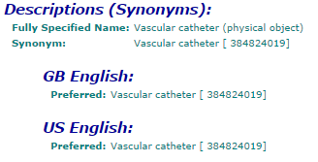
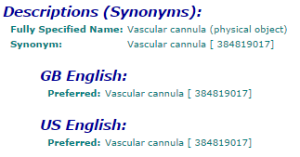

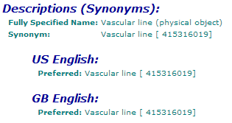

Slide 3
Vascular catheter (258623008)
Angioplasty catheter (310362005)
  Angioplasty balloon catheter, device (44959004)
    Cutting balloon angioplasty device (371794009)
    Percutaneous transluminal angioplasty balloon, device (102319006)
Arterial catheter (303727009)
  Hepatic artery catheter (404206007)
  Pulmonary artery catheter (397755005)
  Pulmonary artery flotation catheter (417747008)
    Swan-Ganz catheter, device (79952001)
Peripheral vascular catheter (446559007)
  Peripheral intravenous catheter, device (82449006)
Rapid infusion catheter (398084009)
Umbilical catheter (446476009)
Venous catheter (303728004)
  Central venous catheter, device (52124006)
    Cuffed central venous catheter (449861008)
    Hickman catheter, device (79834000)
    Nontunneled central venous catheter (449859004)
    Peripherally inserted central catheter (398176008)
    Tunneled central venous catheter (445085009)
  Implantable venous catheter, device (102318003)
Vascular cannula (258620006)
Arterial cannula, device (75192006
Hemodialysis catheter (450866001)
  Nontunneled hemodialysis catheter (450864003)
Venous cannula (258621005)
Vascular line (278422005)
Arterial line (261241001)
Venous line (262259000)

Slide 4
Global Medical Device Nomenclature (GMDN) ^{ǂ}
Catheter: “A flexible tube designed for insertion into a blood vessel, organ, or body cavity for purposes that include introducing/withdrawing fluids, occluding/dilating openings, or taking physical measurements. Some of these devices are implantable,”
Cannula: “A semi-rigid or rigid plastic or metal tube that is inserted into the lumen of a blood vessel, duct, or body cavity for the instillation or aspiration of fluid to/from a targeted area of the body”
Arterial catheter: “A flexible tube designed for passage into arteries, usually for arterial infusion/aspiration.
Arterial cannula: “A semi-rigid tube that is inserted into an artery to serve as a channel for the transport of fluid. Insertion is achieved with the use of a removable trocar. This device is single use.”
Not clear whether the “rigid” property has been omitted due to the fact that such a device would be inappropriate or whether an incidental omission
^{ǂ} Attachment to artf227760 (I do not have direct access to GMDN at this time)

Slide 5
Global Medical Device Nomenclature (GMDN)
Venous Cannula: “A semi-rigid or rigid tube that is inserted into a vein to serve as a channel for the transport of fluid. Insertion is achieved with the use of a trocar. This device is single use.”
Catheter, intravenous, peripheral: “A flexible tube designed for insertion into percutaneously accessible blood vessels of the extremities (i.e. the peripheral vasculature) and that is short in length to keep its distal tip near the insertion site.”
There is no term defined for central venous cannula.
Catheter, central venous: “A flexible tube usually introduced into a neck or thoracic vein and inserted into the superior vena cava for the purposes of infusion of substances and aspiration of blood. The proximal end of the tube is fixed to the patient for long-term use.”
Best I can determine, “line” is slang and (at least) ambiguous.

Slide 6
Insertion of vascular catheter
429446009
5 immediate subtypes
61 descendents
Subtype (2nd generation) of
Central venous cannula insertion
233527006
14 immediate subtypes
23 descendents
Direct device
Central venous catheter, device
(physical object)
52124006
5 immediate subtypes
5 descendants

Slide 7
Vascular cannula
258620006
Direct device
Insertion of cannula for hemodialysis
63421002
Subtype
Direct device
Subtype
Hemodialysis catheter
450866001
Subtype
Insertion of cannula for hemodialysis, vein to vein
61740001
Subtype
Non-tunneled hemodialysis catheter
450864003
Direct device
Insertion of non-tunneled hemodialysis catheter
450865002

Slide 8
Vascular catheter (physical object) (258623008)
Direct device (attribute) | 130
Indirect device | 5
Procedure device (attribute) | 1
Specimen source identity (attribute) | 9
Associated with (attribute) | 14
Using device (attribute) | 359
Using access device (attribute) | 19
Total | 537
11 concepts with vascular catheter in a defining component have cannula in FSN.
Of 537 concepts, 13 are disorders, 1 finding, 9 specimens, 5 regimes/therapy. The balance are procedures.
Vascular cannula (physical object) (258620006)
Direct device (attribute) | 52
Indirect device | 1
Procedure device (attribute) | 3
Specimen source identity (attribute) | 4
Total | 60
3 concepts with vascular cannula in a defining relationship have catheter in FSN.
Of 60 concepts, 56 are procedures, 4 are specimens.
Vascular line (physical object) (278422005)
Specimen source identity (attribute) | 1
Total | 1
1 specimen concept defined using the “arterial line” subtype. An additional 28 concepts are catheter specimens and 5 concepts are cannula specimens. Not all are related to “vascular devices”

Slide 9
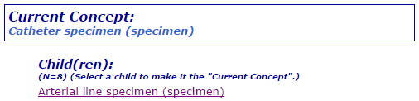
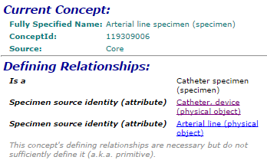
Hmm…

Slide 10
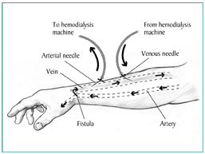
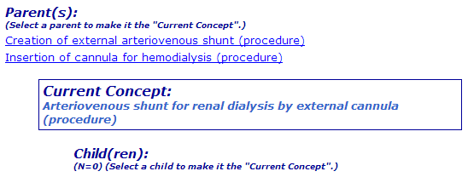
Odds and ends
This is an acquired body structure created to facilitate renal dialysis. It can be accessed via two external cannulas / catheters. I don’t think this refers to an “external” A-V shunt (aka Scribner shunt).

Slide 11
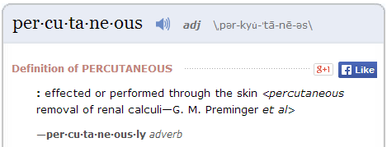
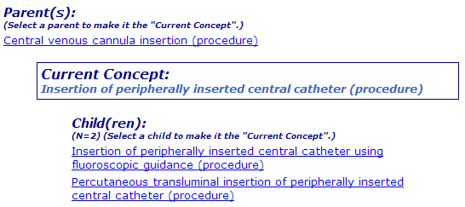
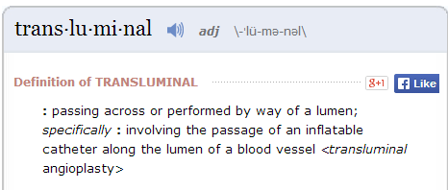
Stop thinking so hard?
How else does one insert a “peripherally inserted central catheter?”
Does a cut-down make it… …not percutaneous? …not transluminal?

Slide 12
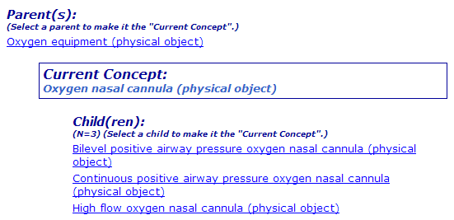
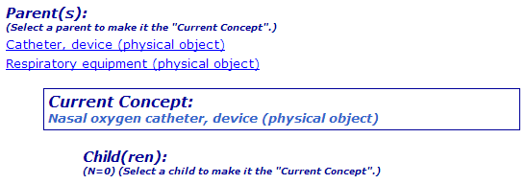


While I was under the hood…
BTW, both are biomedical devices.

Slide 13
Leave this alone?
Non-tunneled hemodialysis catheter (450864003)
Some kinds of catheters cannot be tunneled.
Some kinds of catheters can either be tunneled or not.
Some kinds of catheters are only tunneled.
So tunneling is a feature of catheter placement not (consistently) a catheter type.

