Slide 1


E-Learning Advisory Group
Monday 16th October 2017
Bratislava, Slovak Republic
Linda Bird
Head of Product Support

Slide 2

Agenda
Welcome and introductions
ELAG administration
Member reports
SNOMED International update
Feedback and discussion

Slide 3
Current ELAG Membership
Kirstine Gøeg* Denmark
Suptendra Sarbadhikari* India
Aileen dela Pena Australia
Katrien Scheerlinck Belgium
Linda Parisien Canada
Camilla Wiberg Danielsen Denmark
Krista Kärt Estonia
Avanti Joshi / Manisha Mantri India
  Theresa Barry Ireland
Kristina Dienine Lithuania
Pim Volkert Netherlands
Aleksandar Zivaljevic New Zealand
Marianne Bartvedt van Os Norway
Katarzyna Kowalczyk Poland
Leandro Luis Portugal
Nwe Ni Tun Singapore
Gonzalo Marco Cuenca Spain
Lotti Barlow Sweden
Johannes Gnaegi Switzerland
Ian Spiers UK
Fernando Portilla Uruguay
Suzy Roy USA

Slide 4
ELAG Workplan for 2017
Confluence space: http://snomed.org/elag
Objectives
  To review and provide advice on the pilot approach to open access
  To review and provide advice on pilot learning pathways for software developers and data analysts
  Advise on national and international priorities and activities to increase understanding of SNOMED CT
  Sharing of eLearning materials for translation and national use
Meetings
  April 2017 – London, UK
  August 2017 – Teleconference
  October 2017 – Bratislava, Slovak Republic
  December 2017 - Teleconference

Slide 5

ELAG Workplan for 2017
Activities
  Support delivery of E-Learning services
  Advise on development of E-Learning services
  Facilitate sharing of SNOMED CT E-Learning
  resources
  Advise E-Learning team about educational
  priorities and activities
Communication
  Two-way communication via Confluence space and meetings
Criteria for measuring success
  Availability of new E-Learning offerings that are welcomed
  and used by the community
  An outline recommendation on further practical steps for 2018+ to meet requirements for SNOMED CT education in ways that support and are supported by members, vendors, stakeholders

Slide 6
Key Goals for October Meeting
Meeting: Monday 16th October from 1:30pm to 5:00pm
For Members to share news on SNOMED education activities, plans and priorities in each country
For SNOMED International to provide an update on international education activities
To get feedback from Members on a range of topics including:
  Education courses
  New learning pathways
  Translation and sharing opportunities
  Future plans

Slide 7

Conflicts of Interest
Declaration of interests - https://confluence.ihtsdotools.org/display/ELAG/Declaration+of+Interests
  Please add any potential conflicts of interest
  If no changes to interests please update the ‘Last updated’ date

Slide 8

Reports from ELAG Members
SNOMED CT education activities in your country including
  New or planned SNOMED CT education activities,
  Plans or progress in localising SNOMED CT education material,
  Feedback on existing SNOMED CT eLearning experiences,
  Country-specific SNOMED CT priorities and requirements.
Member representatives
  Aileen dela Pena Australia (email)
  Katrien Scheerlinck Belgium
  Linda Parisien Canada
  Krista Kärt Estonia
  Avanti Joshi & Manisha Mantri India
  Theresa Barry Ireland
  Pim Volkert Netherlands
  Aleksandar Zivaljevic New Zealand
  Marianne Bartvedt van Os Norway
  Lotti Barlow Sweden
  Johannes Gnaegi Switzerland
  Ian Spiers UK (email)
  Fernando Portilla Uruguay

Slide 9

SNOMED International Update
E&PS team
Work plan 2017
Education
Documentation
Product support

Slide 10
Education and Product Support Team
Mission
  To increase awareness, knowledge and understanding of SNOMED CT and to improve the ease and effectiveness of SNOMED CT implementations
Scope
  Development, maintenance and delivery of:
    Guides
    Technical specifications and reference documents
    E-Learning materials
    Product support responses
    Presentations at specific events

Slide 11
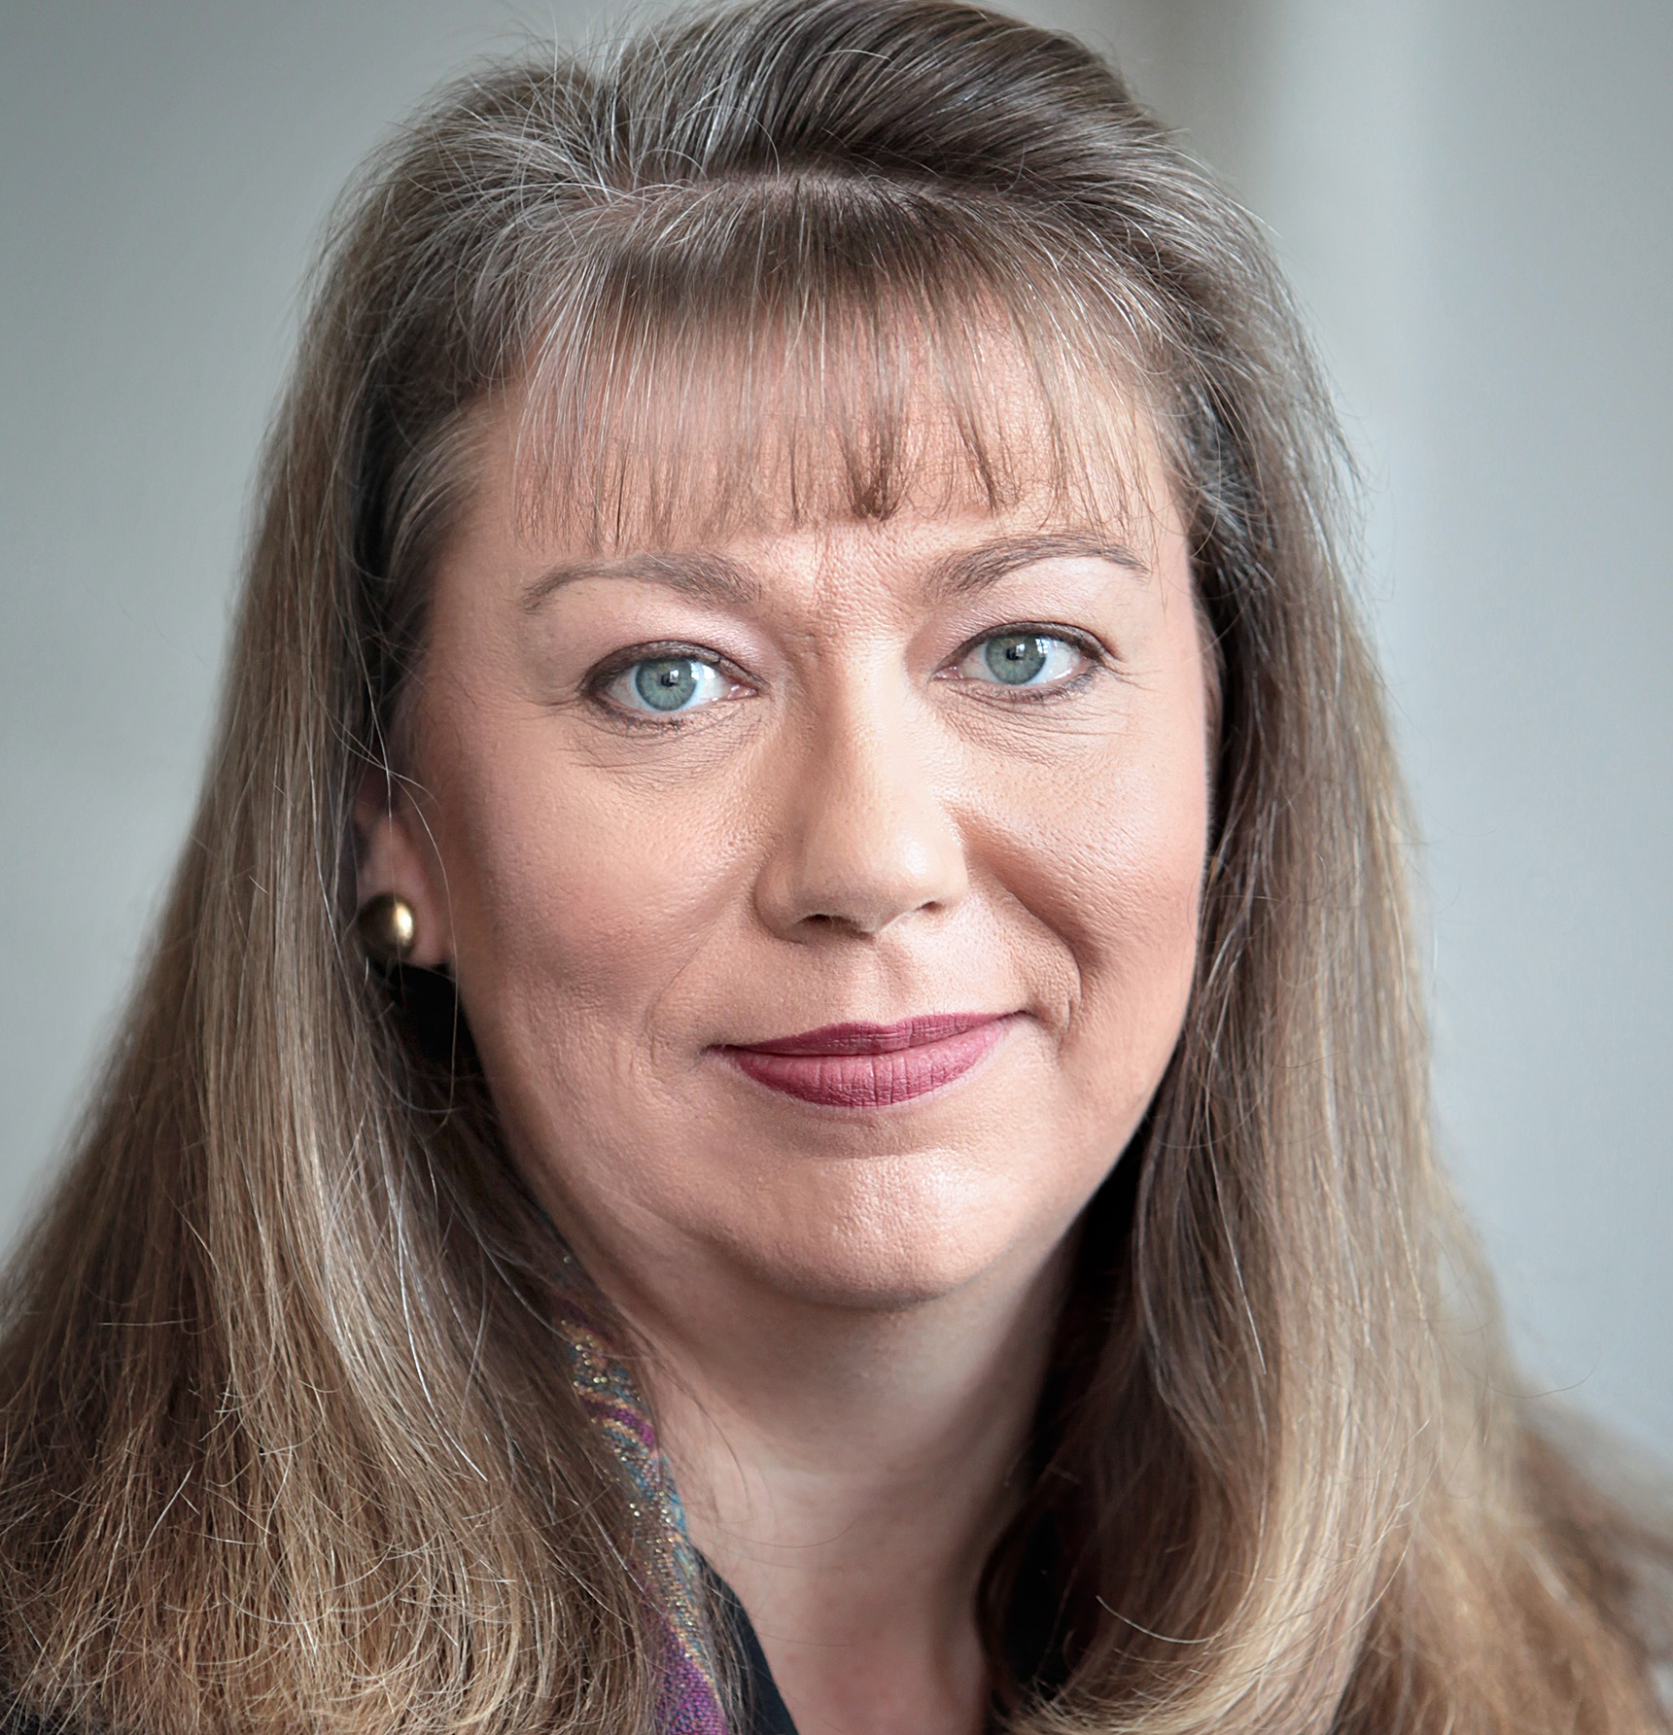
Education and Product Support Team
Linda Bird
Head of Product Support
David Markwell
Senior Product Support Specialist
Anne Højen
Implementation Specialist
Jon Zammit
Implementation Specialist
Cathy Richardson
Senior Terminologist
Louise Jones
E-Learning Administrator
Geraldine Wade
E-Learning
Content Expert

Slide 12
Work Plan 2017
Education
  Delivery
  Development
  Course maintenance and sharing
Documentation
  Development to meet emerging requirements
  Maintenance and updates
Product Support
  General activities
  Enhanced support activities

Slide 13

Documentation – Development
Clinical decision support guide - http://snomed.org/cds
Practical guide to reference sets - http://snomed.org/refsetpg
Using LOINC with SNOMED CT - http://snomed.org/loinc
Machine readable concept model - http://snomed.org/mrcm
SNOMED template syntax - http://snomed.org/sts
Expression template language - http://snomed.org/etl
Work in progress
  Extensions practical guide
  Human readable concept model
  SNOMED CT in SQL

Slide 14
Documentation – Maintenance
Documentation resources
  40 documents with over 2,000 pages
  Document maintenance review schedule
    6 to 24 month review cycles
Document updates
  Expression constraint language v1.3 – http://snomed.org/ecl
  SNOMED CT release file specification
  New CDS case studies
  SNOMED CT URI standard (work in progress)
General activities
  Migration of all guides and specifications to Confluence
  Short URL access to all documents – http://snomed.org/…
  Improved approach to PDF generation

Slide 15
Product Support
Freshdesk, Member, Vendor and internal product support
Presentation delivery (2017)
  Feb – David presented at HIMSS in Orlando
  Mar – Linda presented at AeHIN Digital Health
  Sep – Linda delivered workshops in China
  Oct – 11 education tutorial/workshops at expo
    SNOMED CT Quick Start
    Introduction to SNOMED CT
    SNOMED CT Implementation Roadmap
    Introduction to SNOMED CT Translation
    Introduction to Mapping
    SNOMED CT Managed Service for Beginners (x 2)
    A Practical Taste of SNOMED CT Authoring (x 2)
    SNOMED CT Analytics and Clinical Decision Support
    Practical Guide to SNOMED CT Reference Sets

Slide 16
Education – Delivery
E-Learning Server – http://snomed.org/elearning
  1,525 students have completed at least one SNOMED CT course
  Over 2,000 course completions
    Foundation course – self enrolling and self paced
    1,525 completions (from 66 countries)
    270 currently active
    Implementation course – 6 modules over 6 to 7 months
    350 completions (from 48 countries)
    203 currently active (May and Sep intakes)
    Content development theory course – 3 modules over 3 months
    228 completions (from 35 countries)
    142 currently active (Sep intake)
  58,270 individual presentation views

Slide 17
Education – Maintenance and Sharing
E-Learning Resources
  E-Learning presentations x 156
    120 in English, 18 in Spanish, 18 in Chinese (PDF only)
  E-Learning videos x 8
  E-Learning guides x 5
  E-Learning assignments x 9
  E-Learning assessment questions x 501

Slide 18
Education – Maintenance and Sharing
Other maintenance and sharing activities
  Automated support for cross-course presentation completion
  Improvements to presentation and course metadata
    Learning objectives on each presentation
    New approach to incorporate videos hosted by YouTube
  Foundation course
    Processed large backlog of feedback (over 1,000 items resolved)
    PDFs now include both slides and scripts
    Plans to take Spanish course live
    Chinese PDFs updated and published
  Implementation course
    4 new presentations added (Modules A, B and F)
    New assessment questions to test new content
  Content Development Theory courses
    Not offered in January 2018 to allow for
    important maintenance and improvements

Slide 19

Education – Maintenance and Sharing
Content Development Theory course
  Potential maintenance tasks
    Update presentations in line with concept model changes
    Redesign assignments for easier maintenance
    Combine content and implementation course presentations for reduced maintenance costs
  Potential course improvements
    Offer hands on exercises using new training instance of managed service
    Adapt course to teach about creating and maintaining
    an extension (rather than the international release)
  Next intake is planned for May 2018
Feedback and advice is sought from ELAG
  Feedback from Aileen dela Pena (Australia)

Slide 20

Content Development Theory Course
Student feedback
  Overall feedback is very positive
  Suggestions for improvement include
    Access to an authoring tool
    Extension content development
    More examples
    Subset development
    More personal assignment feedback
Notes:
Overall feedback- expect you may have already covered that in the presentation but can add to if needed.
More personal feedback – not doable.

Slide 21

Content Development Theory Course
Request for ELAG input to course revision
  Which groups within your country should be part of the target audience for this course?
  What areas of the course do you think would most benefit from the addition of hands-on exercises?
  Past students have suggested adding material on authoring in extensions. What subtopics of this should be covered?
  What additional topics should be included in the course?

Slide 22

Content Development Theory Course
ELAG feedback – Aileen dela Pena (Australia)
  Practical authoring – new and changed content
  Extensions
    What they are and why needed
    Links to NRC content, request processes and guidance
    Authoring considerations
    Content promotion to International Edition
    Permitted changes for International concepts
    Resources available for support

Slide 23
Content Development Theory Course
Discussion
  Which groups within your country should be part of the target audience for this course?
  What areas of the course do you think would most benefit from the addition of hands-on exercises?
  Past students have suggested adding material on authoring in extensions. What subtopics of this should be covered?
  What additional topics should be included in the course?

Slide 24

Content Development Theory Course
Request for ELAG Member information
  Access to and permission to draw from your country’s
    NRC editorial guidance
    NRC request submission process material
    Details of your modelling approach
    Extension maintenance processes
  Key issues you encounter with requests submitted to your NRC
  Please provide by 10th November 2017 if able to assist

Slide 25
Education – Development
New presentations
  ELP0088 – Qualifier Value Hierarchy
  ELP0089 – Introduction to SNOMED CT and ICD
  ELP0090 – Comparing Features of SNOMED CT and ICD
  ELP0091 – Data Analysis with SNOMED CT and ICD
  ELP0092 – Clinical Decision Support
  ELP0093 – How do I get SNOMED CT
  ELP0103 – Machine Readable Concept Model
  ELP0104 – Observable Entity Hierarchy Overview
  ELP0111 – SNOMED For Developers
  ELP0112 – Source Code Repositories Overview
  ELP0115 – Technology Considerations
  ELP0117 – Introduction to Reference Sets
  ELP0118 – Introduction to Terminology Services
  ELP0120 – SNOMED CT and Graph Databases

Slide 26
Education – Development
New videos
  ELV0001 – Executing ECL Using the SNOMED Query Service
  ELV0002 – SNOMED Repository Overview
  ELV0003 – Snapshot REST API
  ELV0004 – SNOMED in 5 Minutes
  ELV0005 – SNOMED Database Loader
  ELV0006 – Release Validation Framework
  ELV0007 – Snow Owl
  ELV0008 – SNOMED Query Service

Slide 27
Education – Development
Open Access SNOMED CT Learning Area
  Over 90 presentations available organized by topic
  Topic-based links to related documents and resources

Slide 28
Open Access SNOMED CT Learning Area

Slide 29
Education – Development
SNOMED CT for Developers
  Crash course for software developers
  Available as a pilot for feedback (self enrolment)
  Topics (presentations and resource links)
    Introduction
      Overview, Background, Getting Started
    SNOMED CT Essentials
      Design, Content
    Specifications
      Release Files, Reference Sets, Computable Languages
    Terminology Services
      Functionality, Relational Databases, REST APIs,
      Graph Databases
    Record Services
      User Interface, Storage, Clinical Decision Support,
      Data Analytics, Migration, Maintenance

Slide 30
Education – Development
SNOMED CT for Developers
  ELP0111 – SNOMED For Developers Introduction
  ELP0093 – How do I get SNOMED CT
  ELP0115 – Technology Considerations
  ELP0112 – Source Code Repositories Overview
  ELP0117 – Introduction to Reference Sets
  ELP0103 – Machine Readable Concept Model
  ELP0118 – Introduction to Terminology Services
  ELP0120 – SNOMED CT and Graph Databases
  ELP0092 – Clinical Decision Support
  ELV0002 – SNOMED Repository Overview
  ELV0003 – Snapshot REST API
  ELV0004 – SNOMED in 5 Minutes
  ELV0005 – SNOMED Database Loader
  ELV0006 – Release Validation Framework
  ELV0007 – Snow Owl
  ELV0008 – SNOMED Query Service
  ELV0001 – Executing ECL Using the SNOMED Query Service

Slide 31
SNOMED CT for Developers

Slide 32
SNOMED CT for Developers

Slide 33
Education – Development
SNOMED CT for Data Analysts
  Learning pathway for data analysts who may have
  had prior experience with analyzing data using ICD
  Pilot available before end of year
  Topics
    Introduction
      Overview, Background, SNOMED CT and ICD
    SNOMED CT Features
      Design, Reference Sets, Computable Languages
    SNOMED CT Content
      Overview, Hierarchies, Terminology binding
    Analytics
      Overview, Case Studies, Mapping, Description Logic

Slide 34
Education – Development
SNOMED CT for Data Analysts
  ELP0088 – Qualifier Value Hierarchy
  ELP0104 – Observable Entity Hierarchy Overview
  ELP0089 – Introduction to SNOMED CT and ICD
  ELP0090 – Comparing Features of SNOMED CT and ICD
  ELP0091 – Data Analysis with SNOMED CT and ICD
  ELP0117 – Introduction to Reference Sets
  Still to be developed
    SNOMED for Data Analysts Introduction
    Practical exercises

Slide 35
SNOMED CT for Data Analysts

Slide 36

Feedback Topics
Open access
SNOMED CT for developers
SNOMED CT for data analysts
Sharing or translation opportunities
Practical exercises
Potential approaches to CME/CPD accreditation

Slide 37
Open Access and Learning Pathways
Example feedback so far:
Australia
  Learning pathway approach is great
  Add practical exercises, discussion forums, links to FAQs, scheduled webinars on specific topics
Canada
  Issues with completion tracking (now fixed)
  Is there a way to be notified when new presentations become available? And date of last edit?
Netherlands
  Impressed by the content – very useful to developers
  How should developers participate in course?
  More use-case specific presentations (e.g. refsets)
  More on expressions and terminology services
UK
  Clinical courses, bite size, role based, and sharing
Other: Simplification of front page
  Boundary between Developers and Data Analyst pathways

Slide 38
Sharing or Translation Opportunities
What is the best way to facilitate greater sharing of:
  Localized SNOMED education resources?
    UK, Canada, Australia and others have offered to share localized material with other members
  Translated education materials and documents?
    Translated education materials on E-Learning Server
    Offers of translated guides and specifications

Slide 39
Practical Exercises
Considerations in developing practical exercises
for the Developers and Data Analyst pathways

Slide 40
E-Learning Practical Exercises
Old Chinese proverb:
“Tell me and I will forget.
Show me and I will remember.
Involve me and I will understand.
Step back and I will act.”
Exercises and Assessments
Approaches to practical exercises
Discussion about approaches and types of exercises

Slide 41
Practical Exercises and Assessments
Assessment
Assessments determine whether or not the goals of education are being met
Practical Exercises
Assignments increase the knowledge and practical skills of students
Students learn a lot more when they read or practice something by themselves
A practice assignment also prepares students for assessments

Slide 42
Practical Exercises and Assessments
Learning Goal
LO
LO
LO
LO
…
LO
LO
LO
LO
LO
LO
E-Learning Presentation
E-Learning Presentation
E-Learning Presentation
….
Assessment
Instructions
Activity
Result and evaluation
Grade
Exercises
Instructions
Activity
Result and evaluation
Feedback

Slide 43
Why Feedback?
Feedback is information a student receives after they have completed a piece of work
  It helps students understand the subject being studied and gives them clear guidance on how to improve their learning
  Feedback allows students to
    Reflect on their learning
    Clarifies areas where students can improve
    Provides students the opportunity to self-assess their skills and capabilities

Slide 44
Practical Exercise - Approaches
Document-based
  Document with instructions
  Document with results
  Easy to customize
  Limited options to provide feedback
Moodle quiz
  Similar to assessments
  Can provide immediate feedback
  Can be marked
Interactive powerpoint
  Powerpoint with instructions
  Answer questions interactively and get immediate feedback
    Flexible feedback – written and verbal
  Similar look and feel as presentations
  Unmarked
Different approaches for different pathways, tasks and audiences

Slide 45
Feedback
Ideas and specific examples would be appreciated
  Please email to lbi@snomed.org

Slide 46

Any Other Business?

