Slide 1
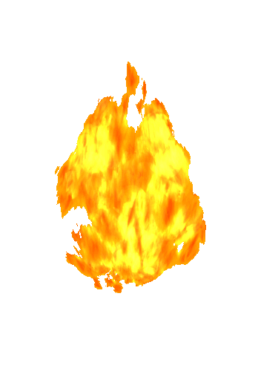
SNOMED on FHIR
Chaired by:
Linda Bird
Head of Product Support
SNOMED International
Dion McMurtrie
Director of Tooling
Digital Health Australia
Member Forum Workshop

Slide 2

Agenda
Welcome and introductions
Review existing and planned work
  Members
  HL7 International
  SNOMED International
Collaborative deliverables and plans
Implementation guidance principles
Progress existing work
Next steps

Slide 3

Welcome and Introductions

Slide 4

Review Existing and
Planned Work
Members
HL7 International
SNOMED International

Slide 5
IHTSDO HL7 Collaborations
SNOMED CT FHIR Terminology Binding Collaboration (2015-2016)
  Purpose
    For IHTSDO to provide SNOMED CT expert input to assist HL7 International with its efforts to ensure the quality and appropriateness of the use of SNOMED CT in value sets and bindings specified for use in international FHIR resources
  Phase 1 – Development of approach (Apr to Dec 2015)
    Model meaning binding approach for Condition resource
    Value set review process for SNOMED CT value sets
  Phase 2 – Testing of approach (Jan 2015 to Sep 2016)
    Model meaning binding for a selection of resources
    Value set view process tested on these resources
  Phase 3 – Adoption of approach (Oct 2016 onwards)
    HL7 to use approaches developed for remaining resources

Slide 6
HL7 FHIR Priority Use Cases¹
Quality checking FHIR models
  Checking for missing qualifiers or inappropriate qualifiers
Semantic checking of data instances
  E.g.: Code = |Fracture of femur|, Body site = |Humerus|
Composing/decomposing expressions
  Composing postcoordinated expressions from values
  Decomposing precoordinated expressions
1: As defined by Grahame Grieve (May 2016)

Slide 7
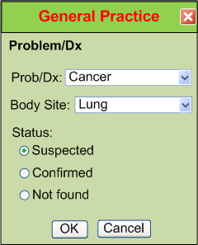
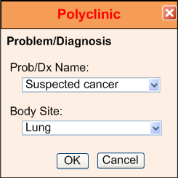
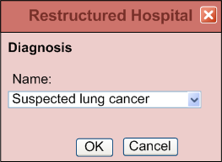
Example – “Suspected Lung Cancer”

Slide 8
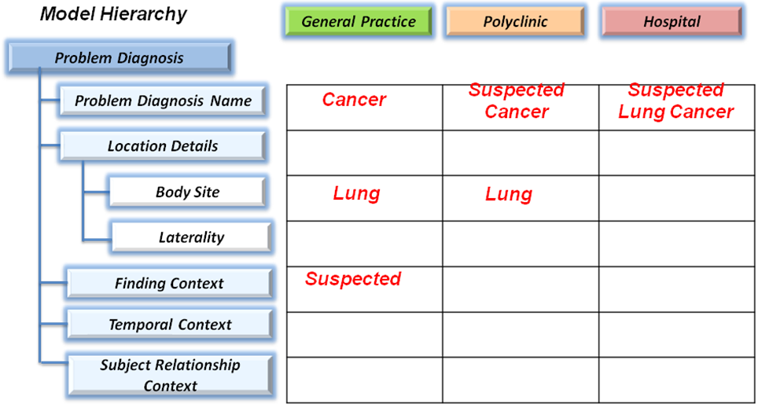
Example – “Suspected Lung Cancer”

Slide 9
Model Meaning Bindings – Proposed Approach
Attribute binding
  Linking coded data elements to a corresponding attribute in the SNOMED CT concept model.
Range binding
  Linking a resource or data element to a set of SNOMED CT concepts that represent the intended semantics of the instances (whether or not SNOMED CT is used to encode that element)
Template binding
  Linking a resource (or data group) to a SNOMED CT expression templates that enable the composition and decomposition of data instances using the SNOMED CT concept model.

Slide 10
Model Meaning Bindings – Examples / Objectives
Attribute binding
  Condition.bodySite bound to 363698007 |Finding site| attribute
  Objective 1: Quality checking models (Clarify and highlight)
  Objective 3: Enabling decomposition of data instances
Range binding
  Example: Condition.severity bound to “< 272141005 |Severities|”
  Objective 1: Quality checking models (Meaning and values)
  Objective 2: Semantic checking of data instances (inconsistencies)
Template binding
  413350009 |Finding with explicit context| : [[@group1 ]]
{ 246090004 |Associated finding| = [[ +id @condition ]],
408732007 |Subject relationship context| = [[+id @subjectContext ]],
408731000 |Temporal context| = 410512000 |Current or specified time|,
408729009 |Finding context| = 410518001 |Goal context| }
  Objective 3: Enabling composition and decomposition of instances

Slide 11
SNOMED CT Value Set Review – Proposed Process
Valid display text
  Display text is an acceptable synonym for the given ‘code’ (en-US)
Active concepts
  All concepts in international value sets are active in international edition of SNOMED CT (unless specifically required to be inactive)
Appropriate concepts
  All concepts in the value set are consistent and appropriate for the intended use
No content gaps
  No obvious gaps in the content of the value set (for intended use)
Clear context and meaning
  Context and qualifying information is represented consistently with no ambiguity, either in the terminology or separate elements
A value set version management strategy is also required

Slide 12

FHIR Resources
Condition
Allergy Intolerance
Procedure
Goal
Family Member History

Slide 13

Collaborative Deliverables and Plans

Slide 14
Collaborative Deliverables and Plans
Proposed scope of collaborative deliverables
  Format of deliverables
  General guidance or specific guidance for each resource
What existing or planned work can be leveraged
Who will be doing/coordinating collaborative work
Collaborative platforms for sharing work
Communication and meeting requirements

Slide 15

Implementation Guidance Principles

Slide 16
Implementation Guidance Principles
Is the goal (a) homogenous population of resources or (b) permissive guidance to cater for greater flexibility?
Do we restrict value sets to ensure that the same information cannot be represented in 2 different ways
  The same semantics can’t be included in 2 data elements
  The same semantics can’t be included in 2 resources
How widely do we require/recommend SNOMED CT is used across each resource (e.g. vital signs, statuses)
Which of these are potentially in scope?
  Restricting value sets to specific subhierarchies
  New value sets for elements not using SNOMED CT
  Restricting cardinalities to reduce ambiguity
  Splicing to align with SNOMED CT concept model
  Mapping FHIR value sets to SNOMED CT (e.g. status)
  Defining SNOMED CT templates to support transformations

Slide 17
Options for Handling Semantic Overlap
The following options could be considered to handle the semantic overlap between Condition code and bodySite
  Restrict bodySite to [0..0] and require finding site in code
  BodySite can only be populated if code has no finding site
  BodySite (if exists) must be a specialization of finding site
  BodySite must always be a specialization or self of finding site
  Only allow conditions with no finding sites and include bodySite
  Any condition and any bodySite

Slide 18
Option 1 – Pre/postcoordinated semantics
Restrict bodySite to [0..0] and require finding site in code
  code [0..1]: < 404684003 |Clinical finding|
  bodySite [0..0]:
Condition
  clinicalStatus = “active”
  verificationStatus = “provisional”
  severity = 246090004 |Severe|
  code = 71620000 |Fracture of femur|
  bodySite =
  subject = <Patient>

Slide 19
Option 2 – One or the Other (But Not Both)
BodySite can only be populated if code has no finding site
  code [0..1]: < 404684003 |Clinical finding|
  bodySite [0..*]:
  ONLY IF code IN (*: [0..0] 363698007|Finding site| = *)
Condition
  clinicalStatus = “active”
  verificationStatus = “provisional”
  severity = 246090004 |Severe|
  code = 71620000 |Fracture of femur|
  bodySite =
  subject = <Patient>

Slide 20
Option 2 – One or the Other (But Not Both)
BodySite can only be populated if code has no finding site
  code [0..1]: < 404684003 |Clinical finding|
  bodySite [0..*]:
  ONLY IF code IN (*: [0..0] 363698007|Finding site| = *)
Condition
  clinicalStatus = “active”
  verificationStatus = “provisional”
  severity =
  code = 363346000 |Cancer|
  bodySite = 28231008 |Gallbladder|
  subject = <Patient>

Slide 21
Option 3 – Consistency with no Redundancy
BodySite (if exists) must be a specialization of finding site
  code [0..1]: < 404684003 |Clinical finding|
  bodySite [0..*]:
  IF [[+@code ]].363698007|Finding site| AND bodySite
  THEN bodySite = < [[+@code ]].363698007|Finding site|
  ELSE < 91723000 |Anatomical structure|
  clinicalStatus = “active”
  verificationStatus = “provisional”
  severity =
  code = 125605004 |Fracture of bone|
  bodySite = 71341001 |Femur|
  subject = <Patient>

Slide 22
Option 3 – Consistency with no Redundancy
BodySite (if exists) must be a specialization of finding site
  code [0..1]: < 404684003 |Clinical finding|
  bodySite [0..*]:
  IF [[+@code ]].363698007|Finding site| AND bodySite
  THEN bodySite = < [[+@code ]].363698007|Finding site|
  ELSE < 91723000 |Anatomical structure|
  clinicalStatus = “active”
  verificationStatus = “provisional”
  severity =
  code = 363346000 |Cancer|
  bodySite = 28231008 |Gallbladder|
  subject = <Patient>

Slide 23
Option 4 – Forced Redundancy
BodySite must be a specialization or self of finding site
  code [0..1]: < 404684003 |Clinical finding|
  bodySite [0..*]: IF [[+@code ]].363698007|Finding site|
  THEN bodySite = << [[+@code ]].363698007|Finding site|
  ELSE < 91723000 |Anatomical structure|
Condition
  clinicalStatus = “active”
  verificationStatus = “provisional”
  severity =
  code = 125605004 |Fracture of bone|
  bodySite = 272673000|Bone structure|
  subject = <Patient>

Slide 24
Option 5 – Semantics only in One Place
Only allow conditions with no finding sites
  code [0..1]: < 404684003 |Clinical finding|:
  [0..0] 363698007 |Finding site| = *
  bodySite [0..*]: < 91723000 |Anatomical structure|
Condition
  clinicalStatus = “active”
  verificationStatus = “provisional”
  severity = 246090004 |Severe|
  code = 404684003|Clinical finding|
  bodySite = 71341001 |Femur|
  subject = <Patient>
Fracture morphology is lost!

Slide 25
Option 6 – Current Approach
Any condition and any bodySite
  code [0..1]: < 404684003 |Clinical finding|
  bodySite [0..*]: < 91723000 |Anatomical structure|
Condition
  clinicalStatus = “active”
  verificationStatus = “provisional”
  severity = 246090004 |Severe|
  code = 125605004 |Fracture of bone|
  bodySite = 71341001 |Femur|
  subject = <Patient>

Slide 26
Option 6 – Current Approach
Any condition and any bodySite
  code [0..1]: < 404684003 |Clinical finding|
  bodySite [0..*]: < 91723000 |Anatomical structure|
Condition
  clinicalStatus = “active”
  verificationStatus = “provisional”
  severity = 246090004 |Severe|
  code = 71620000|Fracture of femur|
  bodySite =
  subject = <Patient>

Slide 27
Option 6 – Current Approach
Any condition and any bodySite
  code [0..1]: < 404684003 |Clinical finding|
  bodySite [0..*]: < 91723000 |Anatomical structure|
Condition
  clinicalStatus = “active”
  verificationStatus = “provisional”
  severity =
  code = 363346000 |Cancer|
  bodySite = 28231008 |Gallbladder|
  subject = <Patient>

Slide 28
Option 6 – Current Approach
Any condition and any bodySite
  code [0..1]: < 404684003 |Clinical finding|
  bodySite [0..*]: < 91723000 |Anatomical structure|
Condition
  clinicalStatus = “active”
  verificationStatus = “provisional”
  severity =
  code = 363353009|Cancer of gallbladder|
  bodySite = 10200004|Liver structure|
  subject = <Patient>

Slide 29
Options for Handling Semantic Overlap
The following options could be considered to handle the semantic overlap between Condition code and bodySite
  Restrict bodySite to [0..0] and require finding site in code
  BodySite can only be populated if code has no finding site
  BodySite (if exists) must be a specialization of finding site
  BodySite must always be a specialization or self of finding site
  Only allow conditions with no finding sites and include bodySite
  Any condition and any bodySite

Slide 30
Progress Existing Work

Slide 31
Progress Existing Work
SNOMED Members
  As discussed
HL7 International
  TermInfo: Observation
  https://github.com/FHIR/snomed-ig
SNOMED International
  Condition
  Allergy Intolerance
  Procedure
  Goal
  Observation
  Family Member History

Slide 32

Next Steps

Slide 33
Next Steps
Collaboration mechanisms
  ‘SNOMED on FHIR’ Confluence space – http://snomed.org/fhir
  Snomed-fhir SnoChat channel – https://chat.snomedtools.org
  Snomedhl7 Zoom – https://snomed.zoom.us/my/snomedhl7
Meetings
  Tuesday 20:00 UTC - https://snomed.zoom.us/my/snomedhl7
Please email lbi@snomed.org with a link to national FHIR materials that may be shared with other Members

Slide 34

Questions and
Discussions

