Slide 1
Pseudoallergy

Slide 2

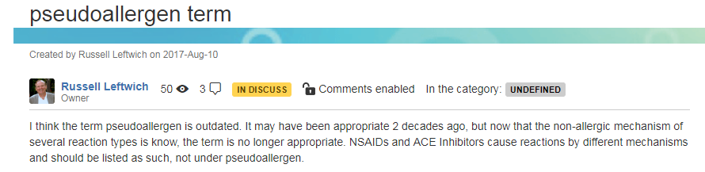

Pseudoallergy

Slide 3
Hypersensitivity causes objectively reproducible symptoms or signs, initiated by exposure to a defined stimulus at a dose tolerated by normal subjects.

Slide 4
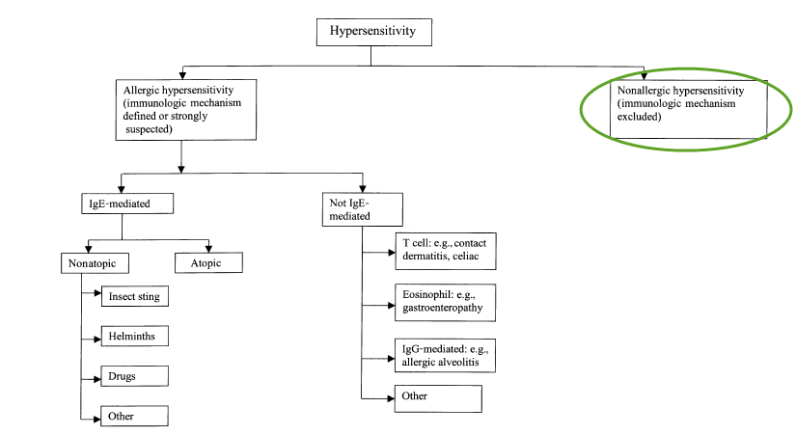
WAO view of hypersensitivity
X
We propose to use the term nonallergic hypersensitivity
when immunologic mechanisms cannot be proven, as
in hypersensitivity to aspirin (84). The term ‘‘pseudoallergy’’,
introduced many years ago (22) and still
occasionally used in some European countries, should
be abandoned.
*Hypersensitivity causes objectively reproducible symptoms or signs, initiated by exposure to a defined stimulus at a dose tolerated by normal subjects.

Slide 5

Proposed revision of hypersensitivity pathological process hierarchy

Slide 6
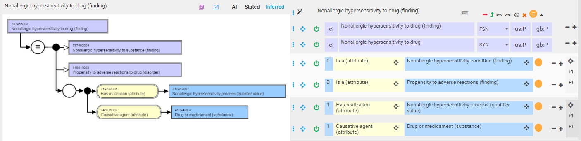
Revised model for nonallergic hypersensitivity

Slide 7
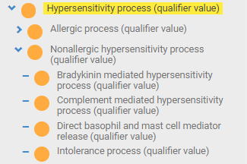
Possible revision of nonallergic hypersensitivity pathological processes to include specific subtypes

Slide 8
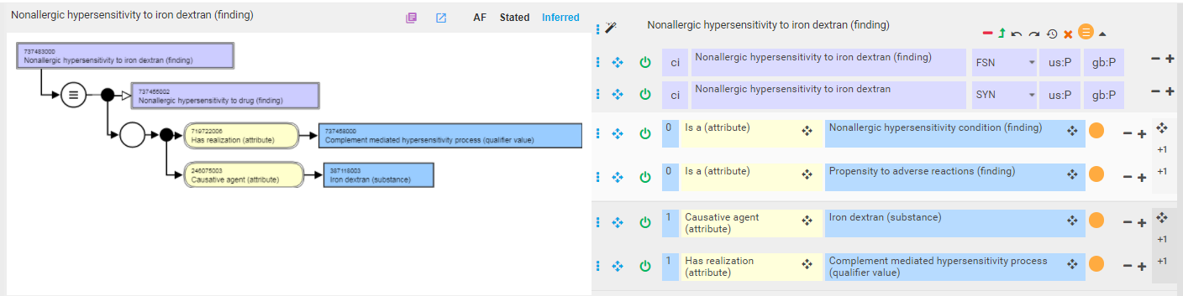
Example of nonallergic hypersensitivity with more specific nonallergic hypersensitivity pathological process 1

Slide 9
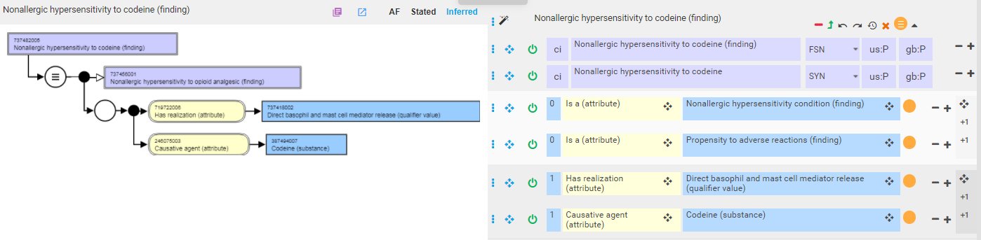
Example of nonallergic hypersensitivity with more specific nonallergic hypersensitivity pathological process 2

Slide 10
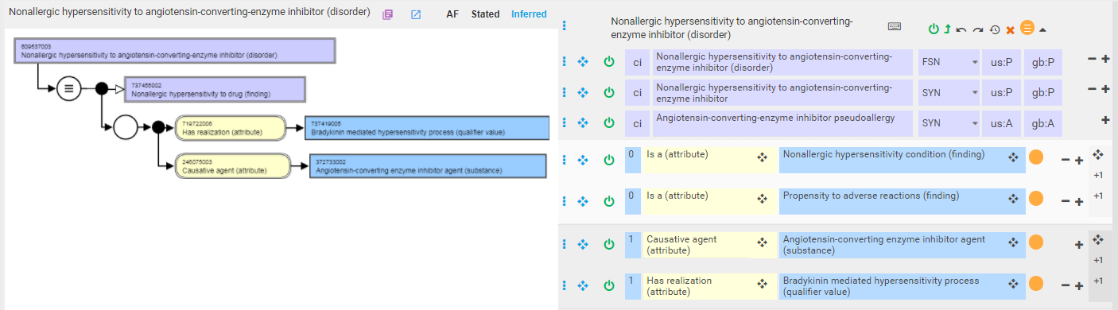
Example of nonallergic hypersensitivity with more specific nonallergic hypersensitivity pathological process 3

Slide 11
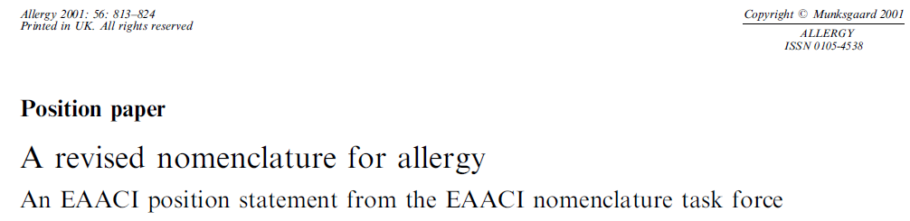
WAO position on nonallergic hypersensitivity
The term ‘‘nonallergic hypersensitivity’’ embraces many different disorders. However, it is not within the remit of this group to classify these entities.

