Slide 1
SNOMED CT and Genomic Medicine
Working together towards a common strategy

Slide 2
Overview
Implementing Genomic Medicine
Vision
Scope & Purpose
Background
SNOMED CT Strategy (what & how)
  Strategic objectives
Next steps (what next)

Slide 3
Scope and Purpose
Genomics promises to change the way that medical care is delivered across the globe. These changes will be delivered through the implementation of precision/personalised medicine. Discoveries within Genomics requires detailed health information to be made available to researchers, and in future the genomics community will supply actionable genomics based guidance to be made available within healthcare institutions, and specifically within EHR systems.
SCOPE
The scope of the following strategy is to focus future developments of SNOMED International to ensure that the requirements for the global Genomics community are supported by SNOMED CT.
PURPOSE
The purpose of the following SNOMED International strategy, is to ensure that moving forwards, SNOMED International and SNOMED CT can support the needs of the global Genomics community, and to ensure that SNOMED CT can fully support the future global implementation of Precision Medicine.

Slide 4
Vision
SNOMED CT: The global clinical terminology to support Genomic and Precision Medicine implementation.
(Supporting clinical information to the Genomics community and detailed genomics information to the clinical community)

Slide 5
Clarity of vision
SNOMED CT will not look to include content from all Genomic terminologies, but rather to align to those with a clear link to clinical practice through the EHR
SNOMED CT will look to leverage existing linkages between terminologies/classifications (both clinical and genomic) to enhance its usability
SNOMED CT will look to develop relationships with terminologies and classifications that will support the implementation of Genomics within SNOMED CT
SNOMED CT will look to adopt new clinical language and clinical definitions arising from Genomics, and reflect these changes within the descriptions included within the International release, when there are clear use case requirements to do so

Slide 6
SNOMED International Strategic directions
SD1. Product: Enable continuous development of the product to meet customer requirements
SD2. Adoption: Provide scalable products and services that remove barriers to drive adoption of SNOMED CT
SD3. Innovation: Leverage new trends and technologies that benefit SNOMED CT and its stakeholders

Slide 7
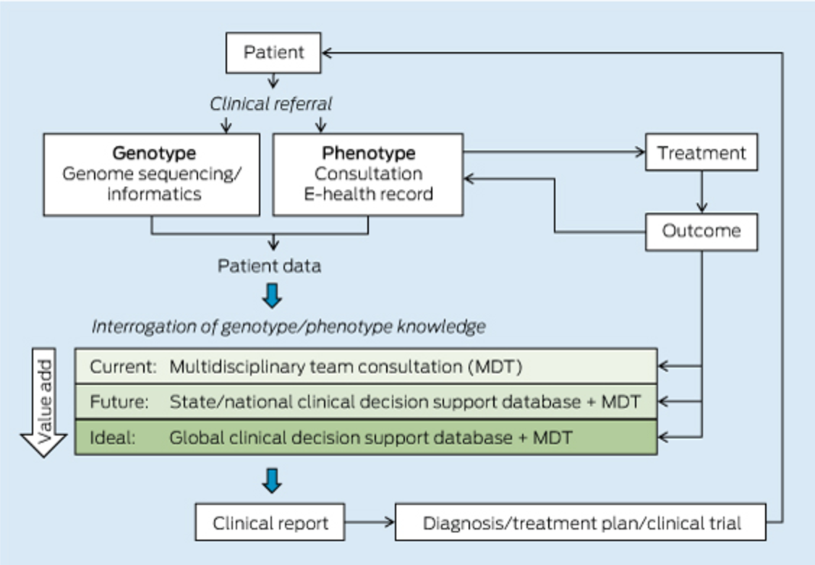
Patient journey in Genomic Medicine
Background
  Individual genomic data
  Accurate clinical data
  Alignment to the existing body of knowledge
Mattick JS, et al. The impact of genomics on the future of medicine and health.
Med J Aust. 2014 Jul 7;201(1):17-20.

Slide 8
Genomics Strategy objectives
Objective 1: Identify key stakeholders with appetite for trial/adoption of SNOMED CT for Genomic Medicine
Objective 2: Identify and gather use cases to support and validate SNOMED CT in the context of Genomic Medicine
Objective 3: Restructure domain knowledge around clinical genomics in SNOMED CT
Objective 4: Demonstrate added value provided by SNOMED CT in the context of Genomic Medicine
Objective 5: Raise awareness around SNOMED CT globally, and reinforce its suitability for supporting Precision Medicine

Slide 9
Identification of key stakeholders
Objective 1
Deliverable:
  Identified group of key genomics stakeholders/collaborators
Action plan:
  Select (or expand and then select) a group of key collaborators through direct contact
  Form a SNOMED CT subject matter expert group to provide continuous input into developments
  Develop and deliver engagement sessions focused on SNOMED CT
  Scope out and deliver a mid-to-long term engagement plan with the stakeholders forming the SNOMED CT stakeholders consultancy group
Measure of success:
  List of key genomics stakeholders/collaborators actively involved in SNOMED International developments
  Agreed mid-to-long term engagement plan
  (longer term) Proactive participation of stakeholders in showcasing events (see Objective 5)

Slide 10
Gathering of use cases
Objective 2
Deliverable:
  Set of use cases (in a standardised format) to drive both the development, as well as the showcasing of SNOMED CT in Genomic Medicine
Action plan:
  Deliver use case gathering workshops with the members of the SNOMED CT subject matter expert group, and document specified use cases
  Iteratively refine use cases based on findings emerging from O3
  Publish and disseminate use cases on the website
  Disseminate use cases at key academic / industry clinical genomics events
Measure of success:
  Number of documented use cases
  Coverage of the domain captured by the use cases

Slide 11
Restructure domain knowledge around clinical genomics in SNOMED CT
Objective 3
Deliverable
  Implemented and documented Genomics components in SNOMED CT
Action Plan
  Community building
    Genomics SME group
    Genomics Clinical Reference Group
    Communication plan
  Practical development
    Use case documentation
  Outreach
    Building connections with external knowledge sources
Measure of success:
  Number of use cases successfully validated based on the new model

Slide 12
Showcasing added value
Objective 4
Deliverable
  Tool / application that demonstrates the value added by SNOMED CT in Genomic Medicine
  Pilot site development - showcase SNOMED CT and Genomics functionality
Action plan:
  Select exemplary use case to be implemented in the application
  Develop application in collaboration with both the experts and stakeholders groups (e.g., using SMART on FHIR)
  Validate application with relevant stakeholders use case
  Use tool for presentations and conference globally
  Disseminate and make tool freely available to the public
  Pilot sites
Measure of success:
  Application is operational and accessible
  Chosen use case is validated by the application
  Number of accesses of the application

Slide 13
Showcasing added value – Pilot sites
Objective 4
Focus
  Use case driven
  Use of EHR information in Genomics
  Inter genomics information transfer
  Support for Rare Disease databases
Size
  Pilot size will be based on use case requirements - on a case to case basis
  Choice of pilot sites driven by use case requirements
Funding
  Explore access to global Genomics funding sources

Slide 14
Raising awareness
Objective 5
Deliverable:
  Web presence (e.g., documentation, forum for discussions, downloadable materials) around the Genomic component of SNOMED CT
  Calendar identifying key dissemination opportunities
Action plan:
  Showcase the capabilities of SNOMED CT via the use cases
  Develop and deliver showcasing events that feature members of the SNOMED CT stakeholders consultancy group, as well as experts from the SNOMED CT experts group
  Develop and disseminate materials describing and exemplifying the Genomic component of SNOMED CT
  Develop and deliver hands-on workshops / tutorials / sessions at key clinical genomics events - e.g., ASHG, ACMG, ESHG
  Leverage social media sites to highlight Genomics SNOMED CT focus
Measure of success:
  Number of attendees at the various events
  Number of users accessing materials

Slide 15
Next steps
Next steps
Community building
  Stakeholders
    Identify stakeholders/stakeholder groups
    Stakeholder engagement
  External resources
    Identify resources that can be leveraged to support the development
  Internal working groups
    Subject matter expert group (expert input)
    Genomics clinical reference group (community engagement)
Working group / task force creation
  Goals
  Action plan
  Taking ownership of the strategy
Implementation
  Development
  Validation
  Application
Outreach

Slide 16
Next steps - 2017 deliverables
Next steps
Agreed strategy in place
Agreed work plan in place
  Detailed work plan for 2017
  Work plan for 1-3 years
Engagement activities
  Genomics SME group
  Genomics Clinical Reference Group
Pilot site - identify and establish
Detailed requirements for the representation of phenotypic data within SNOMED CT
Detailed requirements for the linkage of SNOMED CT to external global phenotype terminologies
White paper on SNOMED CT and Precision Medicine

Slide 17
The future - Developing Genomic Medicine to support Precision Medicine
Next steps
White paper on SNOMED CT and Precision medicine
  Delivery Q3 2017
Review requirements for Genomics information to feed into EHR’s
  Completeness of concepts within SNOMED CT
  Review/updating of terming in line with Genomics led changes
  Analytics requirements
  Decision support requirements based on the implementation of precision medicine
Access to emerging knowledge
  Links to national Precision Medicine programmes, e.g. US, UK

