Slide 1
Template: Genetic Testing in Microbiology
James R. Campbell MD
W. Scott Campbell PhD
Departments of Internal Medicine and Pathology
University of Nebraska Medical Center
Observables Project Group and iPALM SIG; IHTSDO

Slide 2
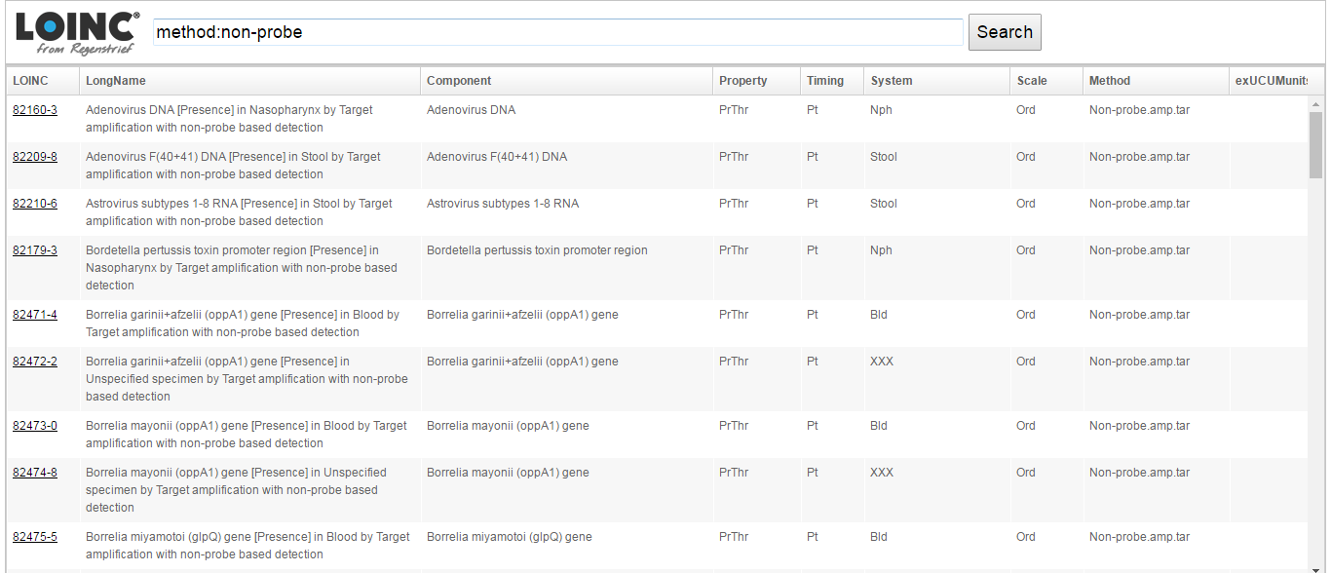
Biofire® Microbial Detection

Slide 3
82160-3 Adenovirus DNA detected in nasopharyngeal sample by PCR(Observable entity)
IS_A - Observable entity
INHERES_IN – 121246006 |Adenovirus Deoxyribonucleic acid (substance)|
INHERENT_LOCATION - 71836000 |Nasopharyngeal structure(body structure)|
TECHNIQUE – Non-probe with target amplification technique
DIRECT SITE – 433871000124101 |Nasal washings (specimen)|

Slide 4
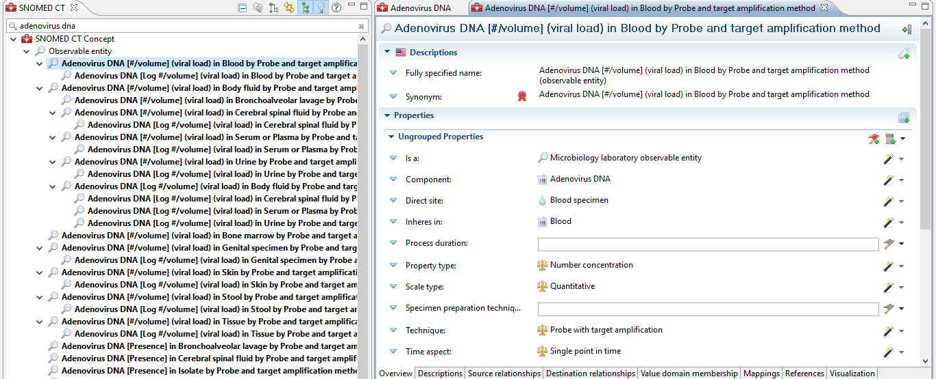
Tech Preview:
Adenovirus DNA in blood…

Slide 5
82475-5 Borrelia miyamotoi glpQ gene detected in blood sample by PCR(Observable entity)
IS_A - Observable entity
INHERES_IN – glpQ gene of Borrelia miyamotoi
INHERENT_LOCATION - 71836000 |Nasopharyngeal structure(body structure)|
TECHNIQUE – Non-probe with target amplification technique
DIRECT SITE – 119297000 |Blood specimen (specimen)|

Slide 6
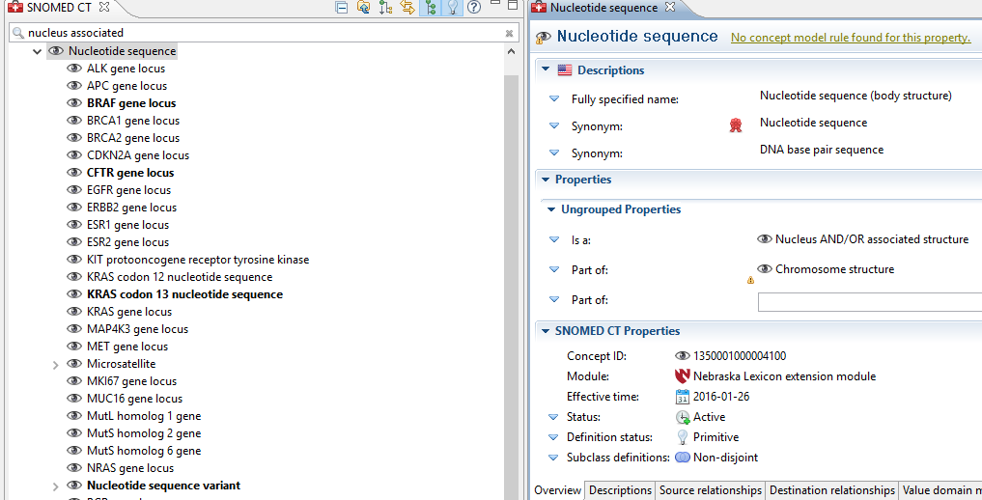
Genes (human nucleotide sequences): Nebraska Lexicon

Slide 7
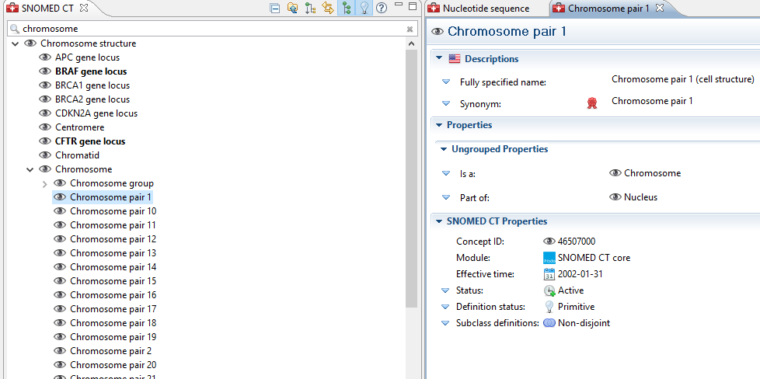
Chromosome (human!)

Slide 8
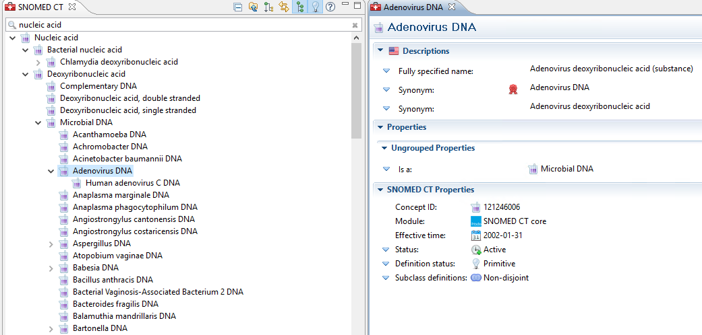
DNA (substance)
Adenovirus

Slide 9
Options
To interoperate results obtained from sequencing vs probe vs non-probe methods, Inheres_in - either substance or nucleotide structure – should be used uniformly in test definitions
To employ nucleotide structure, SNOMED human genetic structures need to be disambiguated from other species (and flagged for non-human refset)
The use case we reviewed and agreed for immunohistochemistry and sequencing concluded that we would use the gene loci (nucleotide sequence) as the independent continuant

