Slide 1
Update on ongoing issues with ECE
Bruce Goldberg, MD, PhD

Slide 2
Editorial guidance on complications/sequelae
Final agreement on the model for surgical complications/sequelae

Slide 3
Final agreement on the model for surgical complications/sequelae
Definitions
  A complication of surgery is an undesired effect due to surgery
  A postoperative complication is a complication that arises after surgery has been completed. It may or may not be due to the surgery
  A sequela of surgery is an undesired but expected effect that arises after surgery has been completed. It is not considered (by surgeons) to be a complication.
    E.g. inability to walk after leg amputation
  A preoperative complication is a complication that occurs before surgery. It obviously cannot be due to the surgery.
    E.g. preoperative hyponatremia
  A perioperative complication occurs before, during and/or after surgery
  An intraoperative complication occurs during surgery
Preoperative, intraoperative and postoperative complications are thus kinds of perioperative complications and denote time intervals (before, during, after) relating the complication to surgery but do not necessarily indicate a causal relationship between the complication and surgery

Slide 4
Models
116224001 |Complication of procedure (disorder)
  116223007 |Complication (disorder)|
    42752001 |Due to (attribute)|= 71388002 |Procedure (procedure)|
302049001 |Sequelae of disorders (disorder)|
  362977000 |Sequela (disorder)|
    42752001 |Due to (attribute)|= 64572001 |Disease (disorder)|
    255234002 |After (attribute)|= 64572001 |Disease (disorder)|
Perioperative complication (disorder)
  116223007 |Complication (disorder)|
    Temporally related to = 387713003 |Surgical procedure (procedure)|
Preoperative complication (disorder)
  116223007 |Complication (disorder)|
    288556008 |Before (attribute)|= 387713003 |Surgical procedure (procedure)|
Intraoperative complication (disorder)
  116223007 |Complication (disorder)|
    371881003 |During (attribute)|= 387713003 |Surgical procedure (procedure)|
385486001 |Postoperative complication (disorder)|
  116223007 |Complication (disorder)|
    255234002 |After (attribute)|= 387713003 |Surgical procedure (procedure)|

Slide 5
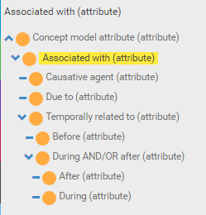
Revised associated with hierarchy

Slide 6
Modeling of peri-operative complications

Slide 7
Allergy to substance

Slide 8
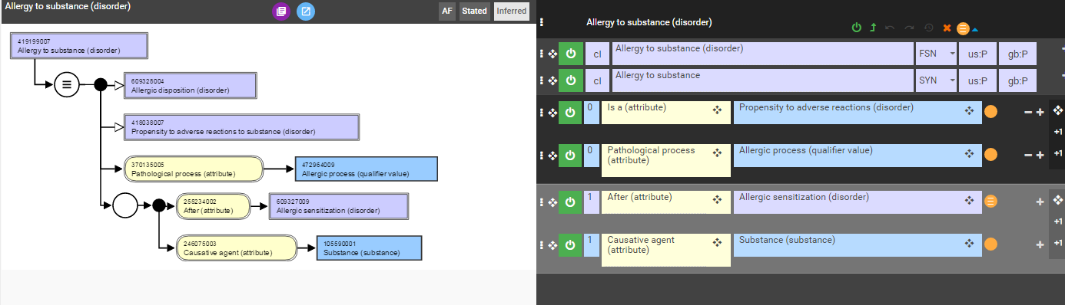
Original model (after replacing fully defined parent)

Slide 9
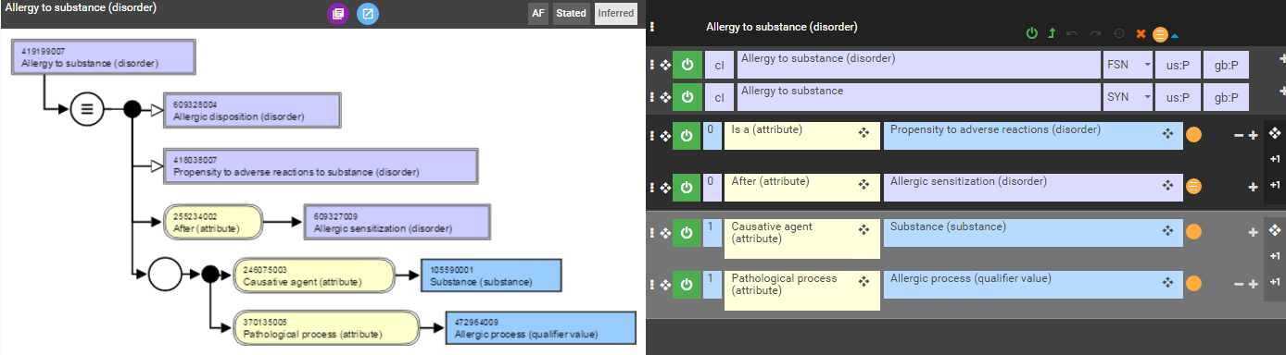
Proposed revision of model

Slide 10
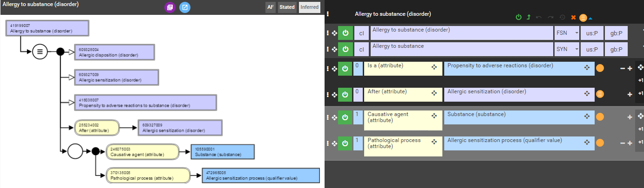
Effect of substitution of allergic process (qualifier value) with allergic sensitization (qualifier value)

Slide 11
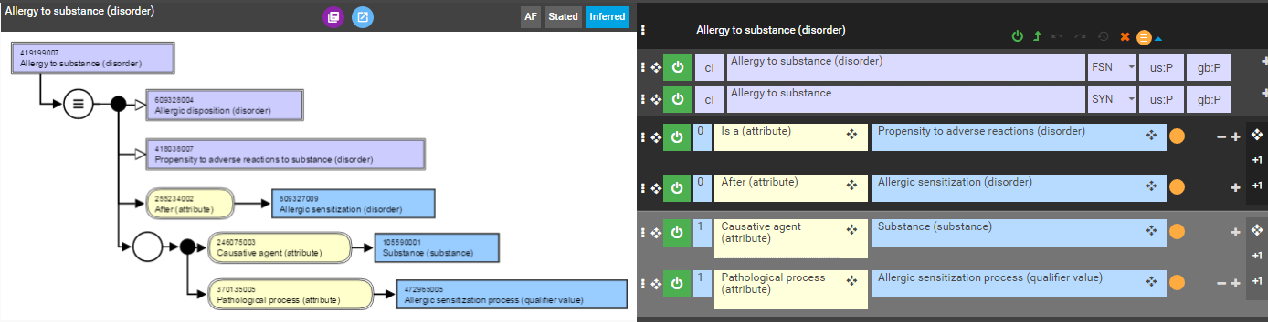
Effect of making Allergic sensitization (disorder) primitive

Slide 12
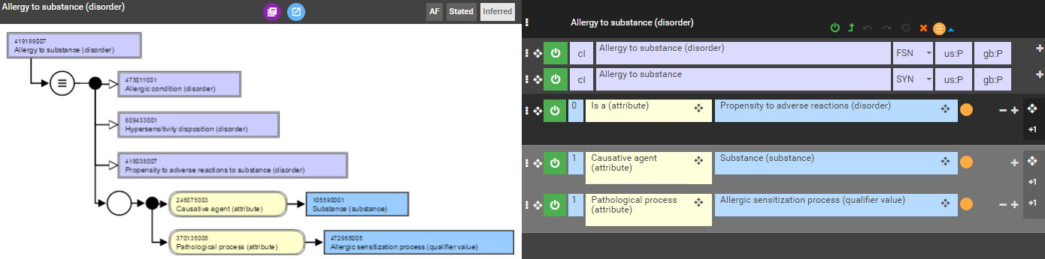
Effect of removing after Allergic sensitization (disorder) relationship

Slide 13
Recommendations
For now, go with this
Or this

Slide 14
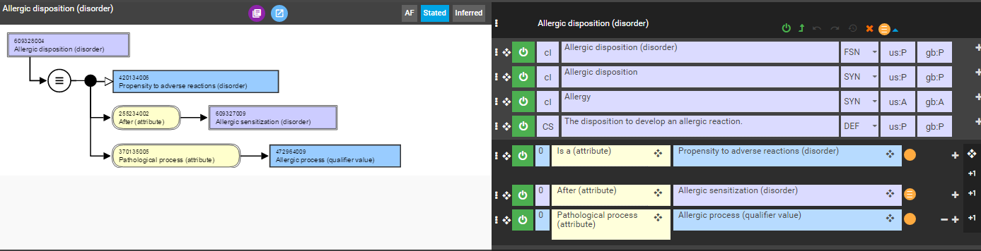
Issues with the allergy model
The top level nodes representing the conditions (disposition or reaction/process) are fully defined using pathological process allergic process (qualifier value) which results in the disposition inheriting the pathological process role from the condition.

Slide 15
Suggested long range revision of allergy model
The condition nodes which represent disjunction should not be fully defined.
Condition X would ideally subsume only 2-3 children; Disposition X, Pathological process X, Pathological structure Xª
Allergic diseases (e.g. allergic rhinitis) are ambiguous as to whether representing dispositions or processes and thus there may be a need to represent these separately as both i.e. allergic rhinitis and propensity to allergic rhinitis
ªFor the case of Allergic condition only Disposition and Process (reaction) are used

Slide 16

Proposed new models for allergy 1*
*This model will work equally as well for pseudoallergy in which the value of Has realization can be replaced by pseudoallergic reaction (disorder)

Slide 17
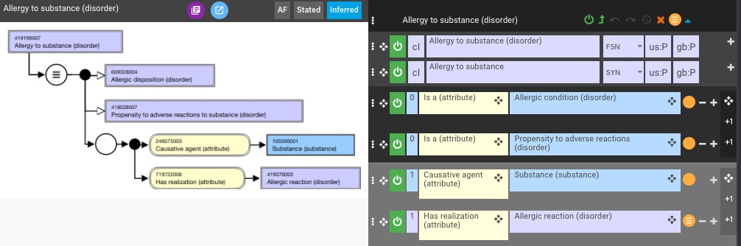
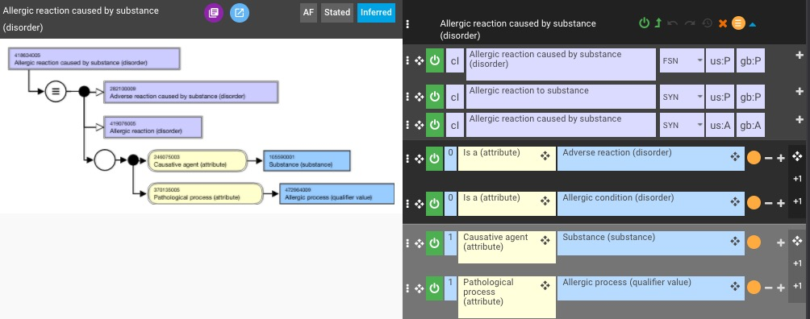
Proposed new models for allergy 2

Slide 18
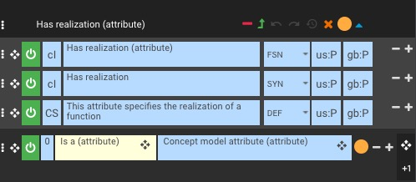

Has realization

Slide 19
Revised allergy model
Advantages
  Eliminates use of pathological process attribute in the definition of the disposition class
  Provides a direct link between an allergic disposition and it realization as an allergic reaction via a Has realization relationship
  Creates a uniform, consistent and accurate model for both allergy and pseudoallergy
  Eliminates requirement for allergic sensitization class
Disadvantages
  Top level classes are primitive
  Requires a new Has realization attribute
  May require duplication of some concepts as both dispositions and reactions
Additional considerations
  Should allergic reactions/processes be events?

Slide 20
Final approval on editorial guide updates for combined disorders

Slide 21
Additions - 1
Temporal sequencing (without necessary implication of causation)
As indicated in the truth table above, the current reason for selecting this option is to capture and emphasise the non-overlap of the phenomena (the preceding phenomenon is NOT included in the life phase being described). Explicit causation may be captured by either the use of a new due_to_and_after role, or perhaps by the use of both due_to AND after (not yet implemented).
Default modelling pattern | Default FSN construction
Assign the ‘second/following’ disorder as a supertype (or ensure that the caused disorder is present in the ancestor tree following classification) Assign the ‘first/followed’ disorder (or procedure) as the target of an After relationship Note – whilst there are no lexical cues to indicate this, the ‘following’ modelling pattern also applies to allergy dispositions (which occur ‘following sensitisation’). | Where X occurs after Y (and it is not specified that X is due to Y although causality is frequently implied), construct an FSN of the form: “X following Y”
Conformant examples:
Anetoderma following varicella (disorder)
Sweet's disease following infection (disorder)
Calcinosis following localized fat necrosis (disorder)
Adverse event following complementary therapy (disorder)
Aseptic peritonitis following a procedure (disorder)
Hemopericardium as current complication following acute myocardial infarction (disorder)

Slide 22
Additions - 2
For infectious complications, use causative agent role if the complication is the direct result of the presence of the infectious agent. Other wise use (co-occurrent and) due to or after infection
Examples:
103611000119102 |Cirrhosis of liver due to hepatitis B (disorder)| | Due to = Viral hepatitis type B (disorder)
195888009 |Proteus pneumonia (disorder)| | Caused by = Genus Proteus (organism)
123949001 |Post-streptococcal reactive arthritis (disorder)| | After = Streptococcus pyogenes infection (disorder)

Slide 23
Results of combine disorder naming exercise
Summary
# concepts revewed | 19
# reviewers | 5
Total agreement | 7 (37%)

Slide 24
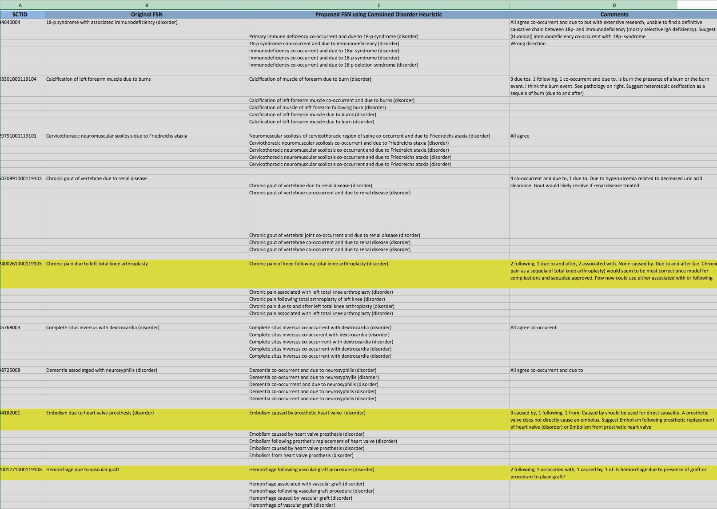
Combined disorder exercise # 2 (part 1)

Slide 25
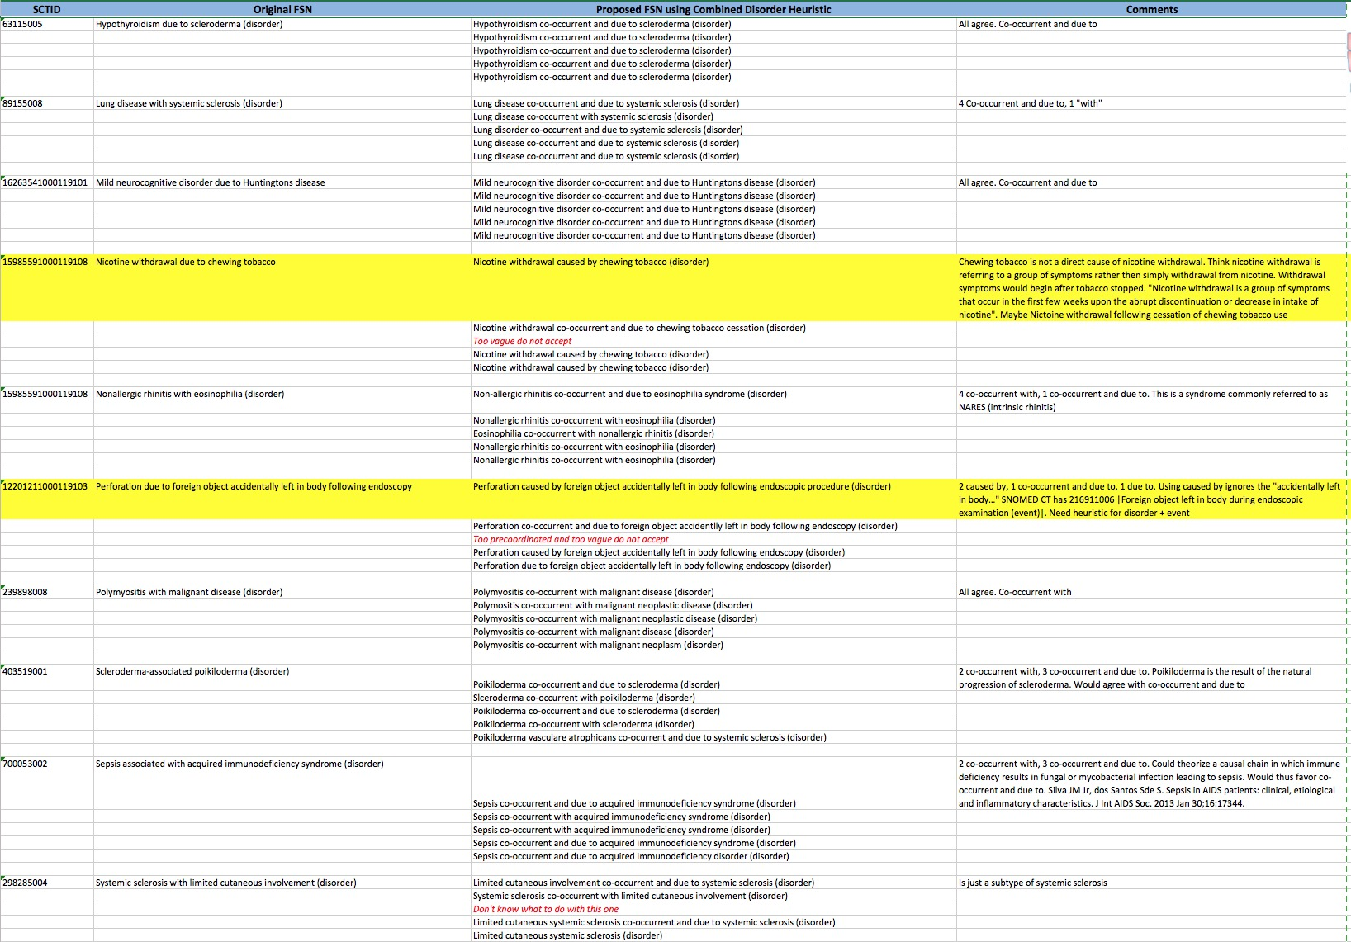
Combined disorder exercise # 2 (part 2)

