Slide 1




Care plan representation
Zac Whitewood-Moores, Chair Nursing Special Interest Group

Slide 2
What is a care plan? (ISO 13940)
dynamic, personalized plan including identified needed healthcare activities, health objectives and healthcare goals, relating to one or more specified health issues in a healthcare process
  A care plan may be recorded in one or more health records.
  A care plan could be subdivided from different perspectives by different constraints. One example is uniprofessional care plan, for example, a nursing care plan with the constraint of only one specific health professional involved. Other examples of specific constraints for a care plan are: care plan to address one health issue, one health condition, one contact, one clinical process, activities to be performed by one healthcare provider, etc.
  care plans are reviewed repeatedly during a healthcare process, each review based on a new healthcare needs assessment.
  The healthcare activities in a care plan follow a life cycle. Examples of statuses of such a life cycle are: 'planned', 'performed', 'cancelled', etc.; all of these statuses are included in the care plan
  In EN 13940-1:2007 programme of care was the preferred term for this concept.

Slide 3
Professional care planning
Evidence based plan for care
Outcome focussed
Activities needed
Structured care plans SHOULD be personalised, not fixed templates
A structured approach gives potential for interoperability and reporting

Slide 4
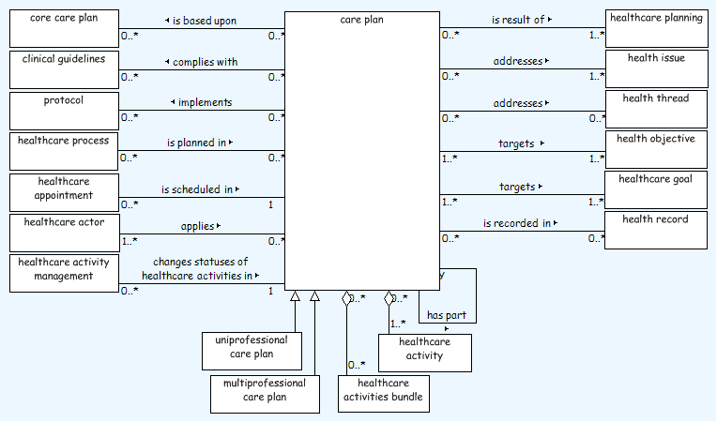
Care plan class diagram (ISO 13940)

Slide 5
Care plan representation in SNOMED CT
A reflection on five years of active use of SNOMED CT in nationally distributed content

Slide 6
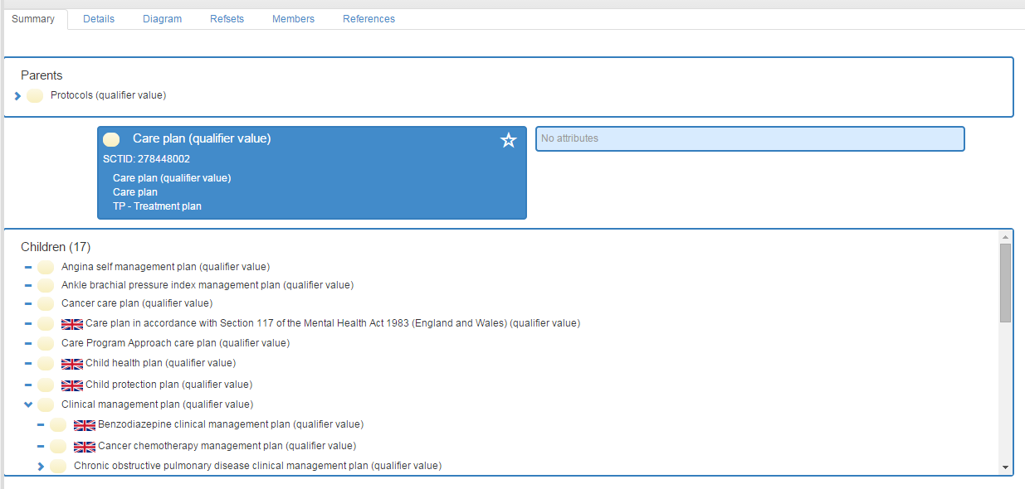
Qualifier value (n19 Int, n16 UK)
SUGGEST
DEPRECATE

Slide 7
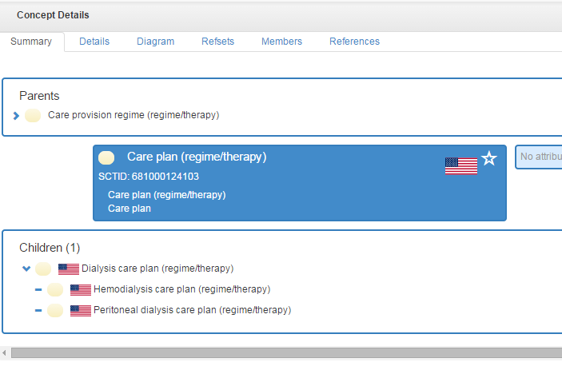
Regime/therapy (n4 US)
SUGGEST
DEPRECATE

Slide 8
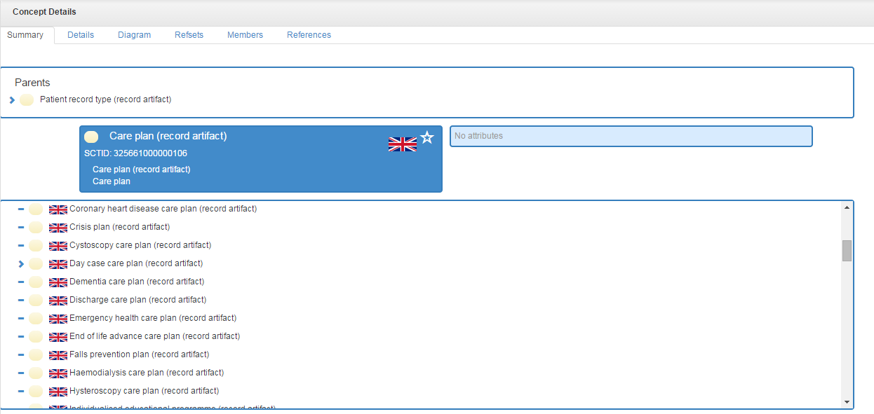
Record artifact (n112 UK)
SUGGEST
MOVE TO CORE

Slide 9
Care plan
Care setting
Gynaecology
Need
bladder training
Care location
Document type
inpatient
care plan
Gynaecology
inpatient
care plan
major surgery
806681000000101 | Gynaecology bladder training inpatient care plan:
  810321000000107 |Care setting of clinical document |=310061009 |Gynaecology service|,
  363702006|Has focus|=37799002|Urinary bladder training|,
  TBA|Care location|=22232009 |Hospital|,
  810311000000101 |Type of clinical document|=325661000000106 |Care plan|
774071000000109 |Gynaecology major surgery inpatient care plan|:
  810321000000107 |Care setting of clinical document |=310061009 |Gynaecology service|,
  363702006|Has focus|=781831000000109 |Major surgery care management|,
  TBA|Care location|=22232009 |Hospital|,
  810311000000101 |Type of clinical document|=325661000000106 |Care plan|

Slide 10
Outline of high level relationships
Record Artifact
Core Care Plan
Activity Bundle
Need
Activity Bundle
Goal
Activity
Activity Bundle
Activity Bundle
Goal
Activity
Need
Need
Goal
Activity
Goal
Activity
Need
Regime / Therapy
Management procedure
Finding / Situation / Observable
Procedure

Slide 11
Outline of activity bundle relationships
NEED
GOAL
ACTIVITY
1 - *
1 - *
At least one need, goal and activity is present in an activity bundle, this may be in a referenced sub-bundle.
The relationship between the Need and the Goal may be indirect but should be present in predefined content

Slide 12
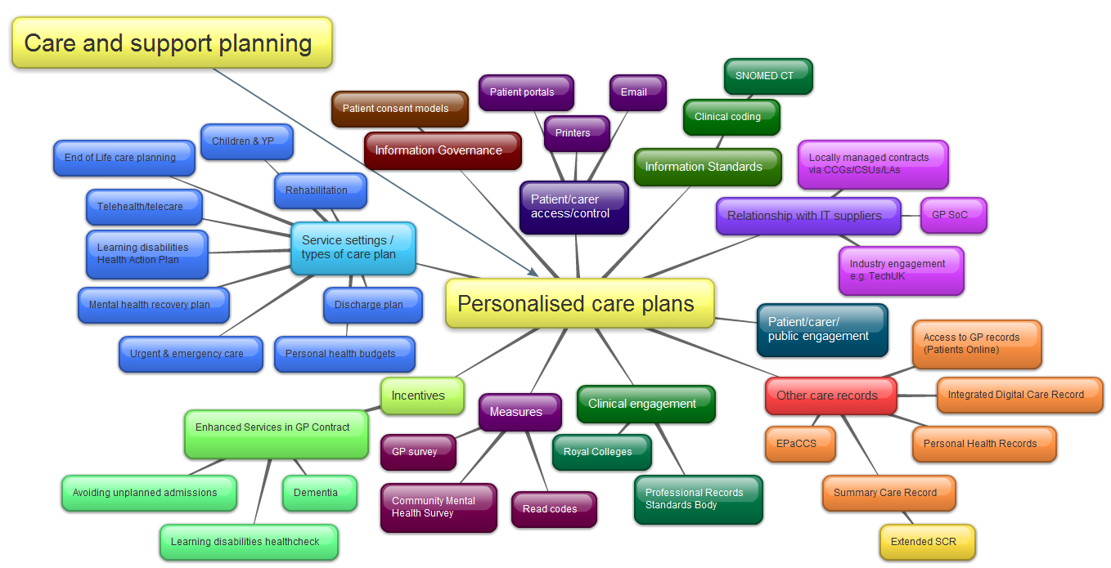
Care planning content and wider context
Read codes cannot be adequately context modified to support care planning
Mind map: Rachel Porter NHS England

Slide 13
Record Artifact vs Regime/therapy
US x4 currently (minimal impact to modify at this stage)
UK x112 currently (Nursing SIG supports this approach)
  Implemented in live records
The care plan container is a record artifact
An international consensus is desirable
This has been referred to the HCP coordination group for input from other professions.
  Recommendations based on ISO 13940, UKTC and Nursing SIG input so far

Slide 14
Care plan needs
Activity bundle ‘titles’ - Needs
  Contain multiple activities to address a given health issue
  Needs perhaps SHOULD be synonymous with the Regime/therapy hierarchy but Management procedures may also have a place
  May appear as a stand alone item in a care plan summary for patients with uncomplicated needs; e.g. ‘wound care’ for a day case surgery patient
  Typically have either ‘Management’ or ‘Care’ in the concept description

Slide 15
Management or Care
Reflections on the way concepts have been used in the UK
Management tends to refer to an overarching Need with multiple sub-needs
Rarely should a uni-professional approach be used to define activities for a given need
The application needs to allow planning for who is responsible for given actions and frequency/scheduling

Slide 16
The complexity of management vs care
Acute stroke care management
Acute pain control
Acute stroke care
Blood glucose monitoring
Care of neurological patient
Care planning session
Clinical management plan review
Management of thrombolytic therapy
Mobility deficit management
Multidisciplinary case management
Neurological observation regime
Patient transfer management
Physical rehabilitation therapy management
Positioning therapy management
Speech and language therapy case management

Slide 17
UK Care planning content
A national electronic care plan library
Utilises internationally approved language (SNOMED CT)
74 professionally assured and evidence-based core care plans
358 core activity bundles
Allow the user to build personalised care plans.

Slide 18
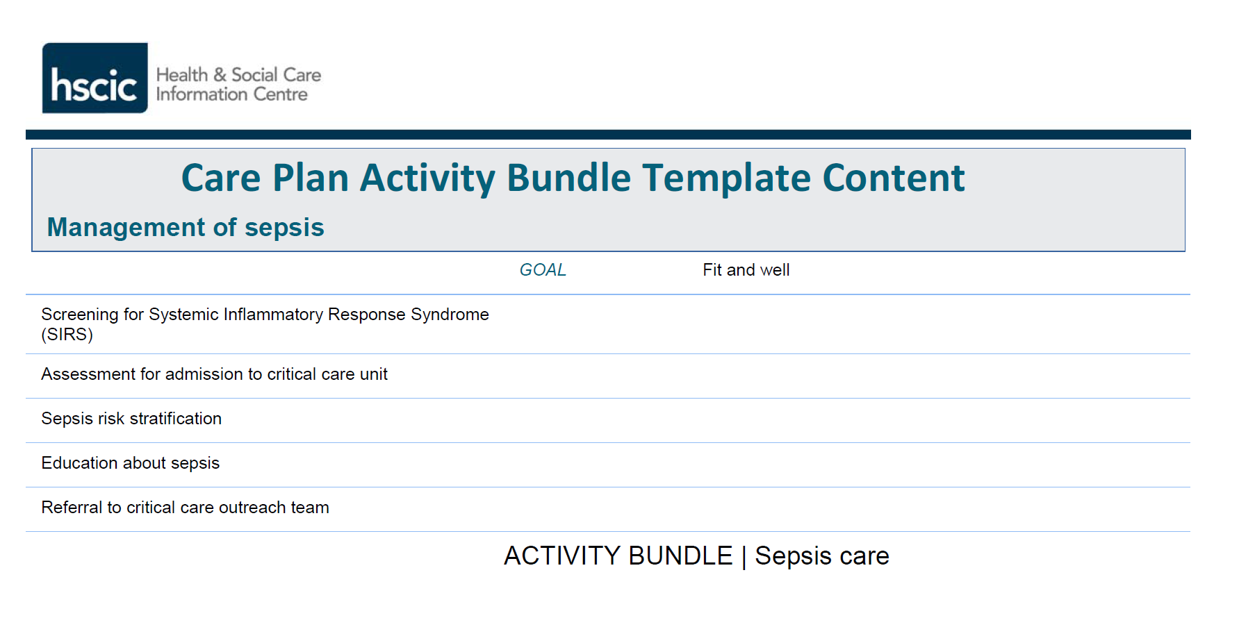
Management

Slide 19
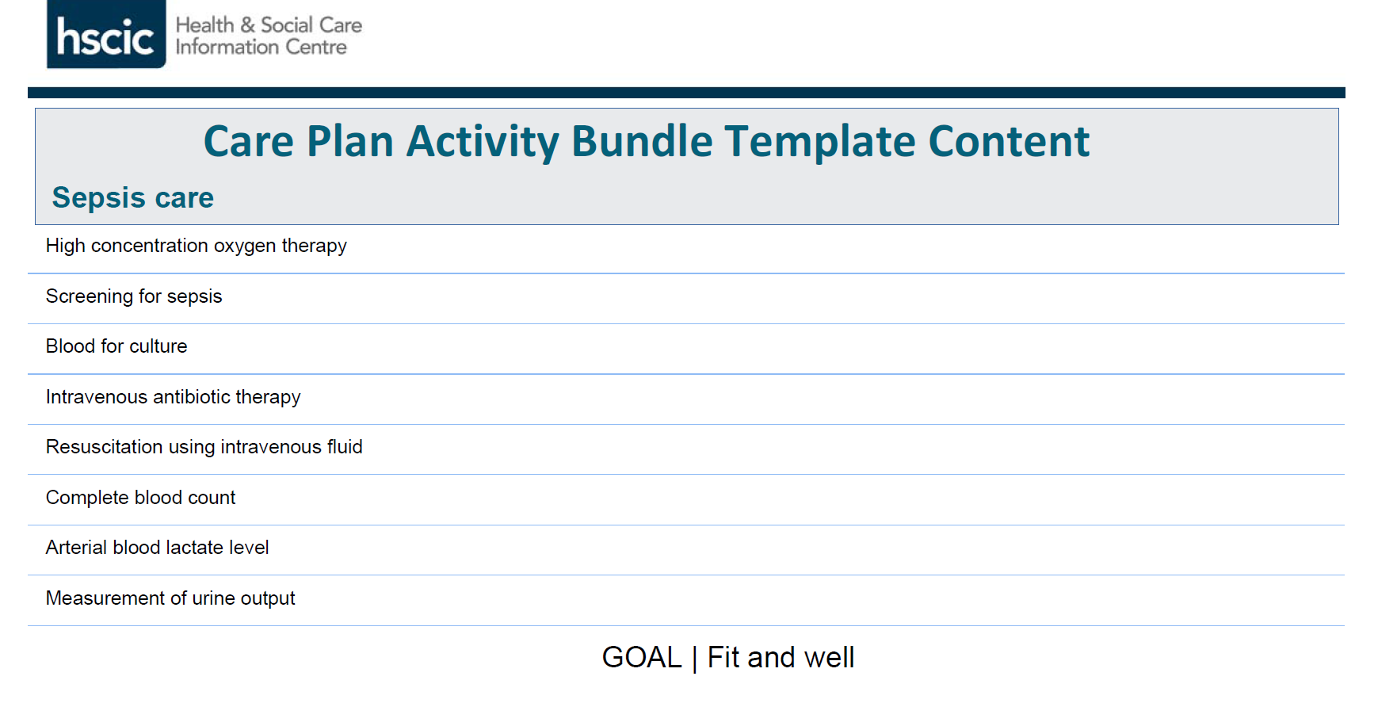
Care

