Slide 1
LOINC – SNOMED CT Cooperation Project
Issue Review
Use of “+” in LOINC Components

Slide 2
Issue description
LOINC components may contain “+” sign
  >1000 “+”s in LOINC parts related to laboratory LOINC terms in scope of agreement containing Substances, Organism, Cells
  Confirmed with RII that “+” and means “inclusive or” i.e. disjunction
    From LOINC manual: “If two or more constituents are measured as one quantity, each constituent should be named and the component separated by a plus sign, e.g., Cyclosporine+metabolites or Human papilloma virus 16+18+31+33+35+45+51+52+56 DNA.”
    QA with RII terminologist: “The meaning of + is the same across all component and divisor types, and means that all of the constituents are being measured but cannot be differentiated from one another, so they are essentially measured as one quantity.”

Slide 3
LOINC parts containing X + Y
"Examples “+”:
  LP38309-8 Helminth+Arthropod identified
  LP14312-0 Monocytes+Macrophages
  LP70080-4 Alanine+Beta Alanine+Sarcosine
  LP40440-7 West Nile virus Ab.IgG+IgM
  LP57131-2 Streptococcus pneumoniae 6+26 Ab
  LP147478-4 (Gadus morhua+Mytilus edulis+Pandalus borealis+Salmo salar+Thunnus albacares) Ab.IgE
  LP97602-4 Campylobacter jejuni+Campylobacter coli Ag
  LP100196-7 Neisseria meningitidis A+B+C+w135+Y Ag
  LP39164-6 Neisseria meningitidis A+B+C+w135+Y+Escherichia coli K1 Ag
  LP145539-5 Ureaplasma urealyticum+Ureaplasma parvum DNA
  LP38526-7 HTLV 1+2 DNA
  LP65524-8 Respiratory virus DNA+RNA

Slide 4
Problem Summary
How do we represent LOINC components containing “+”?
  Disjunction (“or”) is not within the SNOMED CT DL profile (EL+)
  EAG has reviewed this topic in a couple of meetings (See EAG Discussion forum for details) including face-to-face meeting in Wellington with the following recommendation:
    Concepts containing “+” sign (i.e. disjunctive components) will not be added to the core
    Existing substance concepts containing “+” (> 100) should be retired
    For now, make the observables post coordinated expressions primitive, no component is mapped
    Forward the issue to Modelling advisory group for resolution (possible solution: GCI, RefSet, ..)

Slide 5
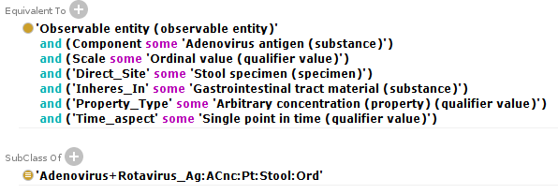
Solution 1: GCIs
Assign GCI axioms to each “single” components
  E.g. ‘Adenovirus Ag:ACnc:Pt:Stool:Ord’ SubClassOf ‘Adenovirus+Rotavirus Ag:ACnc:Pt:Stool:Ord’
Assign GCI axioms to “multi” components which have subset of components, if there are any
Multi-component observables cannot have components specified → false equivalences
Adenovirus Ag:ACnc:Pt:Stool:Ord
GCI

Slide 6
Solution 1: GCIs
Assign GCI axioms to each “single” components
  E.g. ‘Adenovirus Ag:ACnc:Pt:Stool:Ord’ SubClassOf ‘Adenovirus+Rotavirus Ag:ACnc:Pt:Stool:Ord’
Assign GCI axioms to “multi” components which have subset of components, if there are any
Multi-component observables cannot have components specified → false equivalences
Assigning GCIs manually a potential quality issue
Adenovirus Ag:ACnc:Pt:Stool:Ord
GCI

Slide 7
Solution 1: GCIs
Assign GCI axioms to each “single” components
  E.g. ‘Adenovirus Ag:ACnc:Pt:Stool:Ord’ SubClassOf ‘Adenovirus+Rotavirus Ag:ACnc:Pt:Stool:Ord’
Assign GCI axioms to “multi” components which have subset of components, if there are any
Multi-component observables cannot have components specified → false equivalences
Assigning GCIs manually a potential quality issue
Adenovirus Ag:ACnc:Pt:Stool:Ord
GCI

Slide 8
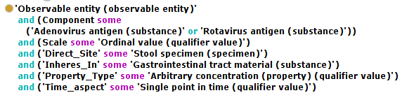

Solution 2: disjunction outside SNOMED CT
Using “or”
Use more expressive logic to identify subclasses
Extract inferred IsA relationships and add to observables definitions
  Can be combined with Solution 1

Slide 9
Syntactic structure
LOINC uses different syntactic structures for disjunctive components
  Simple: Alanine+Beta Alanine+Sarcosine
  Front +: Barley smut+Wheat smut IgE Ab
    Barley smut IgE Ab + Wheat smut IgE Ab
  Mid +: Human papilloma virus 16+18 Ag
    Human papilloma virus 16 Ag + Human papilloma virus 18 Ag
  Back +: West Nile virus Ab.IgG+IgM
    West Nile virus IgG Ab + West Nile virus IgM Ab
  Mixed: Neisseria meningitidis A+B+C+w135+Y+Escherichia coli K1 Ag
    Neisseria meningitidis A Ag + Neisseria meningitidis B Ag + … + Escherichia coli K1 Ag

