Slide 1
Vital signs observables

Slide 2
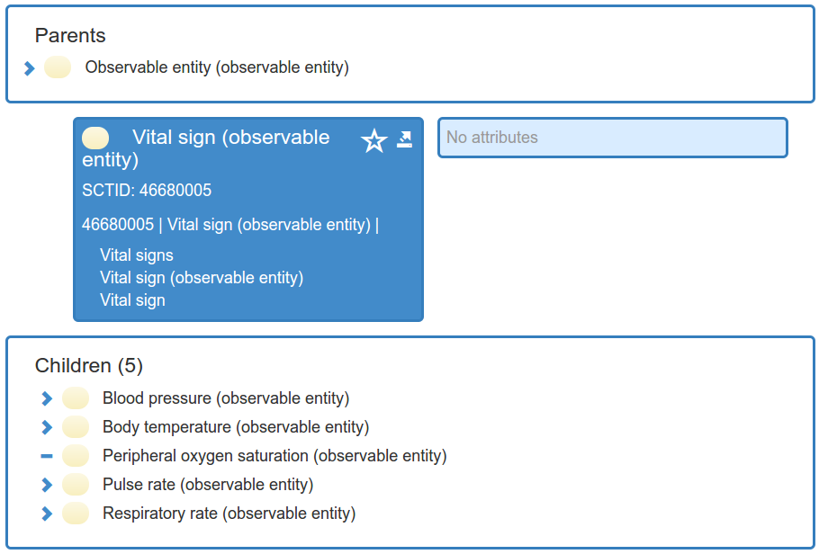
Vital signs
46680005 | Vital sign (observable entity) | hierarchy contains 139 concepts (+ 29)
I/E document

Slide 3
Vital signs issues (1)
Which observables are “true” vital signs
  433776001 | Temperature of toe (observable entity) |, 428420003 | Target heart rate (observable entity) |
  Confluence page on this issue
Time aspect and scale of vital signs observables
  Are all non-aggregate observables single-point-in-time?
Peripheral temperature observables
Process observables (rates) process output
  The output of some cardiac process is a set of heart beats
What does the blood pressure inhere in?
  Vessel, inner wall of vessel, lumen, fluid, or all of the above?
  What is a reproducible (and economical) representation? “Fluid contained in lumen of vessel X (or cardiac space) and that structure’s inner-wall surface” or just Vessel X?

Slide 4
Vital signs issues (2)
Property type for SpO₂
  Quantity fraction, Substance fraction, Mass fraction?
Ankle-brachial pressure index

