Slide 1
Stakeholder Engagement for Consultant Terminologist Project IHTSDO-836, entitled “Concept Model: Presence”
David Sperzel, MD, MS
August-September 2016

Slide 2
PROJECT GOAL
Analyze and integrate exiting materials on the Observables Model, Clinical Life Phases, and Situations with explicit context in an effort to improve the representation of “presence” in the SNOMED CT Concept Model

Slide 3
Overview
Background on the Observables Model
The problem of “presence”
Observation results and formal ontological principles
Observation results and Clinical Life Phases (CLPs)
Observation results and Situations with explicit context
Additional analysis and proposed recommendations

Slide 4
Background on the observables model
An observation “is about” something
Different kinds of observables that have been identified
Problem: The Observables Model typically uses property types to say what an observation is about, but this approach is not appropriate for representing “presence”

Slide 5
Observables Model:
What is observed?
How is the observation made?
Every observation is about something, i.e., every observation has a “target.”
The Observables Model contains two sets of attributes:
  Those that describe what is being observed, i.e., the target of the observation
  Those that describe how the observation is made, i.e., the process or procedure that observes the observation target
The PROPERTY TYPE attribute is used to model an observable as a feature of an entity (where an entity is anything that exists).

Slide 6
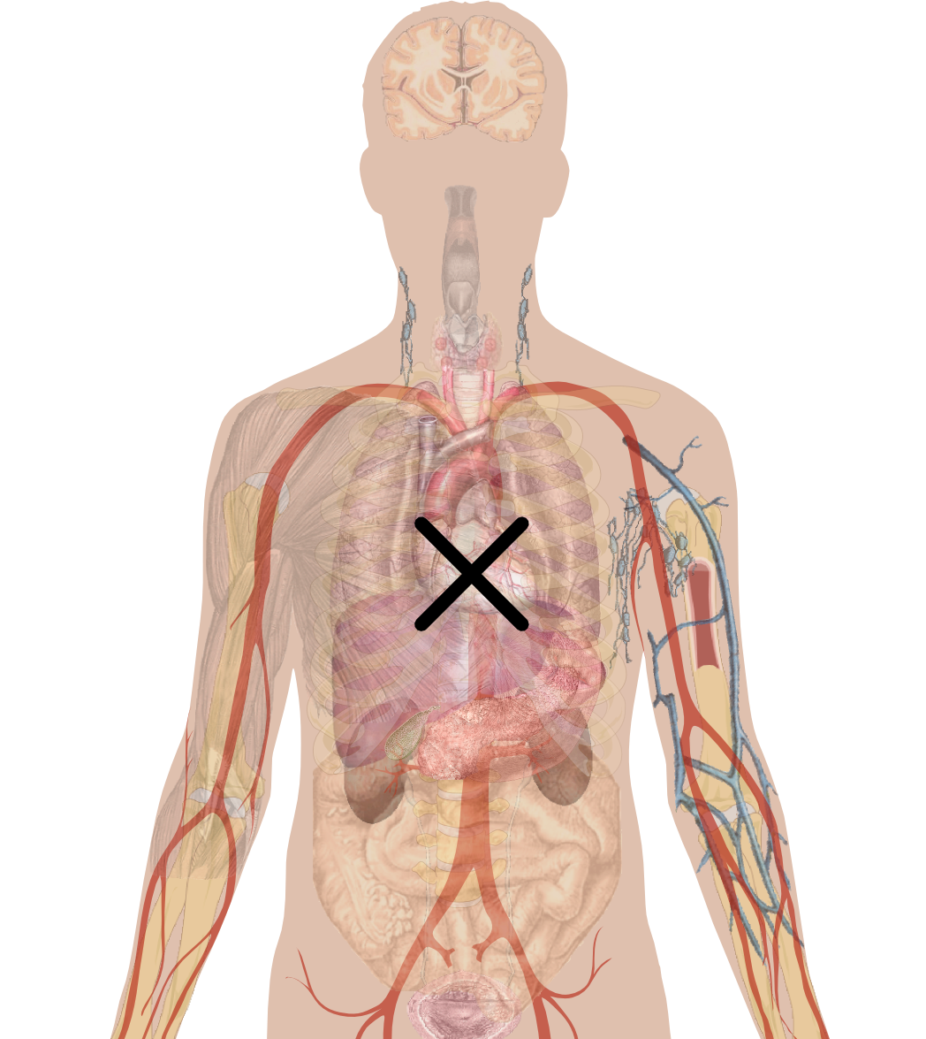
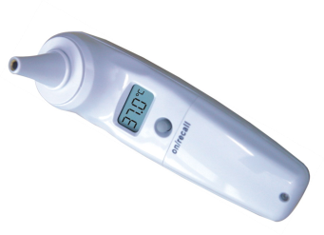
Observable Entities in 30 Seconds
Copied from presentation by Daniel Karlsson to Consultant
Terminologist Group on December 15, 2015
WHAT
TECHNIQUE
PROPERTY TYPE
INHERES IN
INHERENT LOCATION
COMPONENT
TOWARDS
PRECONDITION
...
SCALE
UNITS
DIRECT SITE
Observable
entity
DIRECT SITE
USING DEVICE
TECHNIQUE
SCALE
UNITS
PROPERTY TYPE
INHERES IN
...
HOW
PRECONDITION

Slide 7
Consider explicitly assigning different sets of Observable Model attributes to different types of observables
PROPERTY TYPE
SCALE
UNITS
TECHNIQUE
DIRECT SITE
INFORMER
Quality observable
Disposition observable
Function observable
Feature of entity observable
Process observable
Inherent Feature Observable
INHERES IN
INHERENT LOCATION
IHNHERENT INGREDIENT
TOWARDS
HAS REALIZATION
RELATIVE TO
RELATIVE TO PART OF
PRECONDITION
CHARACTERIZES
PROCESS AGENT
PROCESS DURATION
PROCESS OUTPUT

Slide 8
Four Kinds of Observable (at least?)
These observables have clear, understandable property types. They concern features of entities.
Quality observables
Disposition observables
Function observables
Process observables
(Presence/absence observables)
These kinds of observables are different, because they do NOT have obvious property types and are do not concern features of entities. They are the focus of this project.
Adapted from presentation by Daniel Karlsson to Consultant
Terminologist Group on December 15, 2015

Slide 9
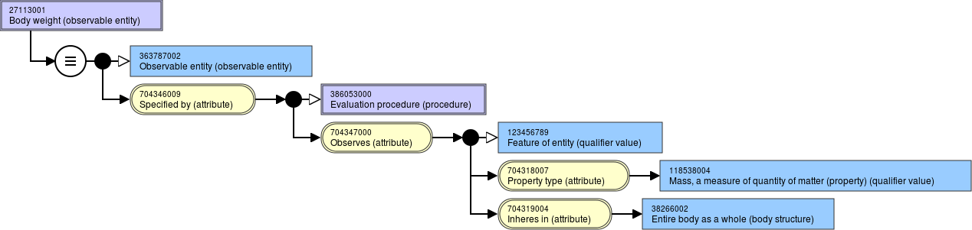
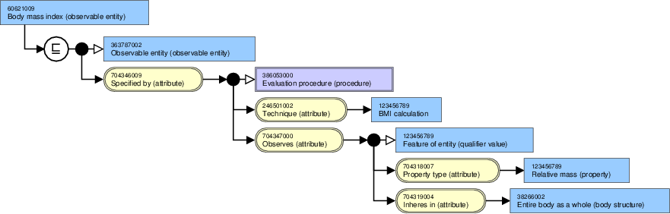
Examples: Quality observables
Copied from presentation by Daniel Karlsson to Consultant Terminologist Group on December 15, 2015

Slide 10
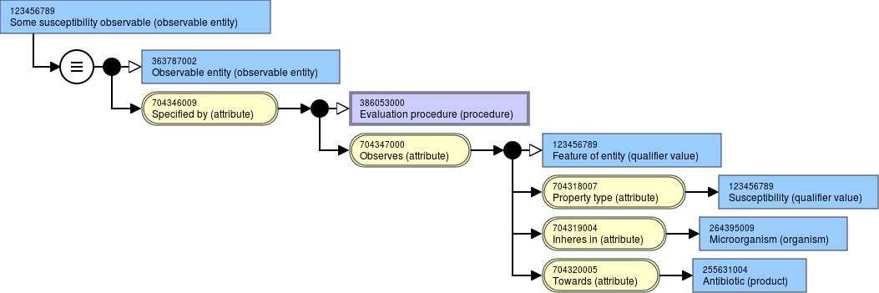
Example: Disposition observable
Copied from presentation by Daniel Karlsson to Consultant
Terminologist Group on December 15, 2015

Slide 11
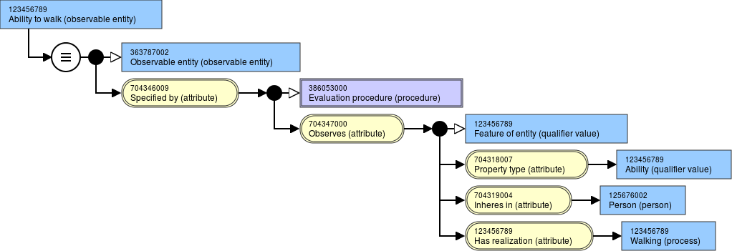
Example: Function observable
Copied from presentation by Daniel Karlsson to Consultant
Terminologist Group on December 15, 2015

Slide 12
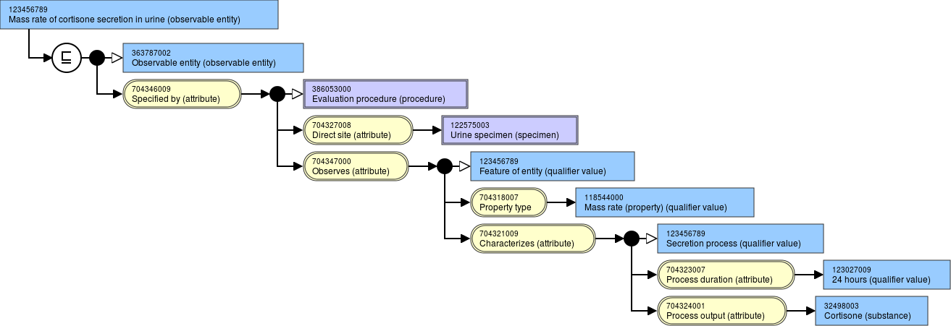
Example: Process observable
Copied from presentation by Daniel Karlsson to Consultant
Terminologist Group on December 15, 2015

Slide 13
The problem of presence
Examples of how “present” is currently represented in SNOMED CT
What is different about observations concerning “presence?”
  Can “presence” be represented using property types?
  No, ”presence” (and “absence”) should be represented as observation results.

Slide 14
Examples of how “presence” is currently represented SNOMED CT
Semantic Tag | Number of Concepts | Examples
(finding) | 435 | 302112009| Colostomy present (finding) | 301319006| Hand present (finding) | 438508001| Virus present (finding) | 300563005| Spleen present (finding) | 278551006| Dental inlay present (finding) | 301155005| Radial pulse present (finding) | 450657002| Insulin pump present (finding) | 289438002| Fetal heart rate present (finding) | 299933002| Vibration sensation present (finding) |
(situation) | 74 | 162057007| Nausea present (situation) | 162260006| Dizziness present (situation) | 274721007 | Carotid bruit present (situation)
(disorder) | 30 | 162166009| Nipple discharge present (disorder) | 247068008| Aphakia - lens capsule present (disorder) |

Slide 15
The problem of “Presence” observables
Some observables do not represent features of entities and do not have property types. What do we do about these?
Observable
Some other kind of observable
Feature of entity observable
Quality observable
Disposition observable
Function observable
Process observable

Slide 16
“Presence” as an observation result in the Observables Model
Copied from final Observables Model presentation prepared by Kent Spackman and dated December 26, 2014

Slide 17
Observation results and formal Ontological principles
What is an observation result?
How do observation results relate to formal ontological principles?
Basic Formal Ontology (BFO) and the Observables Model
Observation results as information artifacts

Slide 18
SNOMED CT and formal ontological principles
Making SNOMED CT consistent with formal ontological principles can
  Make it easier to inter-operate with other biomedical ontologies based on these principles.
  Help remove inconsistencies from SNOMED CT and improve the overall quality of the terminology.
Formal ontologies rely on precise philosophical thinking, which may initially seem difficult to understand.
The Observables Model may seem “difficult” because it is one of the first efforts to introduce formal ontology into SNOMED CT.
It may not be practical for SNOMED CT to incorporate all aspects of any formal ontology, but it should not be “wrong” from a formal ontological standpoint.

Slide 19
Basic Formal Ontology (BFO)
For background on the current release of BFO, see
http://ncorwiki.buffalo.edu/index.php/Basic_Formal_Ontology_2.0
Other formal ontologies, such as BioTopLite (see http://www2.imbi.uni-freiburg.de/ontology/biotop/ ) are based on similar principles.
BFO is the most commonly used and well documented formal ontology in the biomedical realm.
BFO serves as an upper-level ontology that provides to organizing framework for over 100 more specific domain ontologies.
Domain ontologies based on BFO can avoid “re-inventing the wheel.”
Domain ontologies based on BFO are easier to compare and integrate with each other.

Slide 20
The IS ABOUT attribute of the Observables Model in relation to formal ontology
Features of entities
Features of entities
Features of entities
Something else
Something else
Copied from final Observables Model presentation prepared by Kent Spackman and dated December 26, 2014

Slide 21

The continuant vs. occurrent distinction in BFO
Copied from
http://ncorwiki.buffalo.edu/index.php/Basic_Formal_Ontology_2.0

Slide 22
Dependency relationship between continuants
Note that “occurrent,” “process,” and “event” are used more or less interchangeably here.
Copied from
http://ncorwiki.buffalo.edu/index.php/Basic_Formal_Ontology_2.0

Slide 23
Dependency relationship between occurrents and independent continuants
Copied from
http://ncorwiki.buffalo.edu/index.php/Basic_Formal_Ontology_2.0

Slide 24
The advisability of introducing formal ontological language into SNOMED CT
The meanings of terms such as independent continuant, dependent continuant, and occurrent are very unfamiliar to typical clinicians and may discourage them from using SNOMED CT.
On the other hand, the meanings of terms like process and material entity probably seem intuitively obvious to clinicians.
Consider introducing unfamiliar formal ontological terms into a module for internal use only (by content editors) a modeling aid, but do not include such terms in the International Release.
Operating assumption: Release formal ontological terms only if their meanings seem “intuitively obvious.”

Slide 25
Relating the Observables Model to BFO (1)
What types of observables are handled well by the use of property types in the Observables Model?
Observables about ANY dependent continuants, including qualities, dispositions, and functions. Adding more property type values should make it possible to handle other types of dependent continuants if necessary.
Observables about properties, characteristics, or attributes of processes.
  Referred to as “process observables” in the Observables Model
  Referred to as “process profiles” in BFO

Slide 26
Relating BFO to “property type” or “feature of entity” observables
Protégé screen shot from
http://ontology.buffalo.edu/bfo/BFO2.png
Quality observables
Disposition observables
Function observables
Process observables

Slide 27
Relating the Observables Model to the BFO continuant hierarchy
BFO: Continuant
Independent Continuant
Generically dependent continuant
Specifically dependent continuant
Quality
Realizable entity
Relational Quality
Role
Disposition
Function
Material entity
Immaterial entity
Arp R, Smith B, Spear AD. Building Ontologies with Basic Formal Ontology. Cambridge, MA: MIT Press; 2015.

Slide 28
Relating the Observables Model to BFO (2)
What types of observables are NOT handled well by the use of property types in the Observables Model?
Observables that are “directly” about independent continuants, i.e., independent continuants that cannot be modeled in terms of their dependent continuants. These include:
  Body structures
  Organisms
  Substances
Observables that are “directly” about processes and that cannot be characterized by attributes of processes. These include:
  Clinical life phases
  Procedures

Slide 29
Relating BFO to observables and observation results without property types
Protégé screen shot from
http://ontology.buffalo.edu/bfo/BFO2.png
Observation targets:
Body structures
Organisms
Substances
Observation targets:
Clinical life phases
Procedures

Slide 30
Main types of observables and corresponding observations results
Observables that use property types, i.e., observables about features of entities
  Currently classified as quality, disposition, function, and process observables
  Values of observation results are often numbers associated with units of measure, which would typically be represented in an information model
  Depending on the property type, allowed (non-numeric) values may be specified in the Qualifier hierarchy
Observables that do not use property types
  Observables about material entities (which are independent continuants)
  Observables about occurrents that cannot be represented as process observables using property types.

Slide 31
Example of modeling “presence” as an observation result about a material entity (body structure)
colostomy present (observation result)
Copied from final Observables Model presentation prepared by Kent Spackman and dated December 26, 2014

Slide 32
Example of modeling “presence” as an observation result about a material entity (organism)
Copied from final Observables Model presentation prepared by Kent Spackman and dated December 26, 2014

Slide 33
Relationships among observable entities, observation procedures, and observation results
specified-by ○ observes ⊑ is-about
But for “presence,” the observation target is NOT a property or quality
Adapted from final Observables Model presentation prepared by Kent Spackman and dated December 26, 2014

Slide 34
Observation procedures and observation results differ from observables mainly by the addition of a single attribute
Copied from final Observables Model presentation prepared by Kent Spackman and dated December 26, 2014

Slide 35
Desirability of parallel sub-hierarchies for observable entities, observation results, and allowed observation result values
Observable entity
Observation result
X observable
Y observable
Z observable
X observation result
Y observation result
Z observation result
A detailed analysis of observation procedures is outside the scope of this project, but a similar parallel structure is probably desirable.
Observation result value
X observation result value
Y observation result value
Z observation result value

Slide 36
Suggested modeling patterns for observable entities and corresponding observation results
Since observable entities and observation results have so many attributes in common
  Put the common attributes in the observable entity and link the corresponding observation result to it with an IS ABOUT attribute (if an observable and a corresponding observation result or both modeled).
  Alternatively, put all of the attributes in the observation result and do not model a corresponding observable entity (in order to reduce the total number of concepts).
Always put the HAS VALUE attribute on the observation result.

Slide 37
What is an observation result?
An information artifact
  Is-about some observable
  Has-value some {value}
What is an information artifact?
Copied from final Observables Model presentation prepared by Kent Spackman and dated December 26, 2014

Slide 38
Relating the Observables Model to BFO (3)
Information artifacts are Generically dependent continuants in BFO.
Distinction between specifically dependent and generically dependent continuants:
  A specifically dependent continuant depends on a single, specific instance of a bearer. John’s headache specifically depends on John’s head. The headache cannot be migrated or copied to Mary’s head.
  A generically dependent continuant can have more than one bearer and can be migrated or copied from one independent continuant to another. The information content of a document can be borne by a PDF file on a laptop or by patterns of ink on pieces of paper.
Arp R, Smith B, Spear AD. Building Ontologies with Basic Formal Ontology. Cambridge, MA: MIT Press; 2015.

Slide 39
Information Entities or Artifacts
Concepts in the Situation with explicit context hierarchy should be regarded as information artifacts (which are dependent continuants) rather than situations or life phases (which are occurrents).
Copied from final Observables Model presentation prepared by Kent Spackman and dated December 26, 2014

Slide 40
OBSERVATION RESULTS AND Clinical LIFE PHASES
What are clinical life phases (CLPs)?
What should be done when the target of an observation is a CLP?
What is the difference between a clinical life phase and an observation (result) about a clinical life phase?

Slide 41
History: Disambiguating findings, disorders, observables, and observation results (1)
Copied from final Observables Model presentation prepared by Kent Spackman and dated December 26, 2014

Slide 42
History: Disambiguating findings, disorders, observables, and observation results (2)
Copied from final Observables Model presentation prepared by Kent Spackman and dated December 26, 2014

Slide 43
Ontological commitment
“Agreement about the ontological nature of the entities being referred to by the representational units in an ontology”
  Two competing interpretations of disease
    Conditions
      pathological structure e.g. 432504007 | cerebral infarction (disorder) |
      pathological disposition e.g. 420134006 | propensity to adverse reactions (disorder) |
      Pathological process e.g. 31642005 | acute gingivitis (disorder) |
    CLPs-Clinical life phases (situations)
      A phase of a patient’s life during which a condition is fully present.
  Thus a disease can be interpreted as a condition, a CLP or both
  The position taken by the IHTSDO-WHO JAG is that diseases will be interpreted as CLPs for both SNOMED CT and ICD-11
  There are no named condition concepts
Copied from a presentation by Bruce Goldberg to the Consultant Terminologist Group on February 16, 2016

Slide 44
….then where are the conditions ?
In formal ontologies such as BIOTOP2 lite, conditions are associated with a clinical life phase by the has condition property. This is reimagined in SNOMED CT as a role group.
  Note: Model incomplete as only obvious when a condition can be defined with a role group. This mostly applies to pathological structures which are represented as a role group containing a morphology and a finding site.
  For CLPs that do not contain/are not definable with such role groups, the existence of a condition (disposition or process) is implied.
BT2L | SNOMED CT
CLP and ‘has condition’ some ‘clinical condition’ | CLPx = CLP and RoleGroup some (ClinicalStructure and (FindingSite some Ax) and (AssociatedMorphology some Bx)
Copied from a presentation by Bruce Goldberg to the Consultant Terminologist Group on February 16, 2016

Slide 45
Subtype relationships
In formal ontologies, subtype relationships are analogous to the subset relationship of set theory
Thus, subsumption statements are either true or false and based on the following:
  B is subsumed by A is true if all members of B are equally members of A
Copied from a presentation by Bruce Goldberg to the Consultant Terminologist Group on February 16, 2016

Slide 46
Subtype relationships
In formal ontologies, subtype relationships are analogous to the subset relationship of set theory
Thus, subsumption statements are either true or false and based on the following:
  B is subsumed by A is true if all members of B are equally members of A
Copied from a presentation by Bruce Goldberg to the Consultant Terminologist Group on February 16, 2016

Slide 47
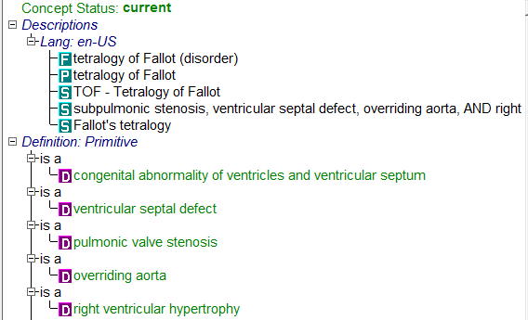
Conditions vs CLPs 2
Tetralogy of Fallot
  Is a child of VSD, pulmonic valve stenosis, overriding aorta, LVH
  But is Tetralogy of Fallot a kind of e.g. pulmonic stenosis?
Tetralogy of Fallot can be re-phrased as a Patient with Tetraology of Fallot and pulmonic stenosis can be re-phrased as a patient with pulmonic valve stenosis
Thus all patients with Tetralogy of Fallot are also patients with pulmonic valve stenosis because every instance of Tetralogy of Fallot has one instance of pulmonic valve stenosis as part
The ontologic interpretation of clinical findings/disorders as CLPs corrects many incorrect subsumptions while exposing additional taxonomic relations that may be valuable for data retrieval.
Copied from a presentation by Bruce Goldberg to the Consultant Terminologist Group on February 16, 2016

Slide 48
Clinical Life Phases and “Presence”
Remember the definition of Clinical life phase:
Emphasis added!
CLPs-Clinical life phases (situations)
  A phase of a patient’s life during which a condition is fully present.
Thus a disease can be interpreted as a condition, a CLP or both
“Presence” is implied in the definition of a CLP as a phase of a patient’s life (i.e., an occurrent) in which a condition is fully present.
An observation result about a CLP is an information artifact.
What should be the allowed values for a HAS VALUE attribute in an observation result that is “about” a CLP? “Present” seems redundant and confusing.

Slide 49
Suggested allowed values for the HAS VALUE attribute in observation results about CLPs
Qualifier value
Suggested values based on
Observation result value
Schulz, S., Martínez-Costa, C., Karlsson, D., Cornet, R., Brochhausen, M., & Rector, A. L. (2014, September). An Ontological Analysis of Reference in Health Record Statements. In FOIS (pp. 289-302).
Clinical life phase observation result value
Confirmed
Likely
Not excluded
Unlikely
Excluded

Slide 50
Suggested meanings of proposed CLP observation result values
Remember that observation results can be erroneous or uncertain.
A CLP observation result of “confirmed” means that the presence of a condition has definitely been observed.
A CLP observation result of “excluded” means that the presence of a condition of has definitely not been observed. This can serve as an indicator of negation, with the caveat that an observation result can be erroneous.
CLP observation results with values of “likely,” “not excluded,” and “unlikely” reflect different degrees of uncertainty about the accuracy of an observation.

Slide 51
Comments on connecting CLPs to observable entities with the INTERPRETS attribute
Certain CLPs, such as bradycardia, tachycardia, and fever arguably depend on “Feature of entity” observables:
  Bradycardia or tachycardia INTERPRETS Heart rate (observable entity)
  Fever INTERPRETS Body temperature (observable entity)
Thus, the range of the INTERPRETS attribute should arguably be restricted to “Feature of entity” observables (i.e., those observables that use property types).
There was a previous suggestion that all Clinical finding concepts having INTERPRETS attributes be moved from that hierarchy to the observation result hierarchy, but it seems important to preserve a link to “Feature of entity” observables if a description such as “a period of a patient’s life in which bradycardia is fully present” is reasonable.

Slide 52
Clinical life phases vs. Clinical findings
Although most existing concepts in the Clinical finding hierarchy should arguably be interpreted as clinical life phases, some may actually be better treated as observation results.
“Clinical life phase” will be used in this project for the sake of clarity, regardless of whether the Clinical finding hierarchy is eventually renamed to Clinical life phase.
The attributes available for defining CLPs can connect them to body structures, organisms, substances, procedures, events, observable entities, and other clinical life phases.

Slide 53
An interesting question about CLP observation results
Because CLP concepts can connect to so many other kinds of concepts, can any observation result that does not involve the use of property types be treated as a CLP observation result?
Answering this question would likely require additional extensive analysis by the Event-Condition-Episode Project Group and the Observables Project Group.
In particular, how do CLP observation results relate to the Situation with explicit context model?
Observation result
Clinical life phase observation result
Feature of entity observation result

Slide 54
observation results and
Situations with explicit context
What is the difference between a CLP and a situation?
Re-interpreting FINDING CONTEXT and PROCEDURE CONTEXT
Continued need for SUBJECT RELATIONSHIP CONTEXT and TEMPORAL CONTEXT

Slide 55
Clinical life phases vs. situations
Question: What is the difference between a CLP and a situation? Answer: Not much.
The notion of Clinical life phase arose out of work comparing different interpretations of disorder codes in SNOMED CT and ICD as “conditions” vs. “situations.”
The phrase Clinical life phase was chosen instead of Clinical situation to avoid confusion because the word situation was already used in the Situation with explicit context hierarchy.
Schulz S, Rector A, Rodrigues JM, Spackman K. Competing interpretations of disorder codes in SNOMED CT and ICD. AMIA Annu Symp Proc. 2012;2012:819-27.

Slide 56
Re-interpreting Situations with explicit context
Hypothesis #1: If Situations with explicit context are information artifacts, they can be treated as observation results.
Hypothesis #2: ASSOCIATED FINDING and ASSOCIATED PROCEDURE can be replaced by IS ABOUT CLINICAL LIFE PHASE and IS ABOUT PROCEDURE, respectively.
Hypothesis #3: The ranges of the FINDING CONTEXT and PROCEDURE CONTEXT attributes be treated as observation result values, meaning that each of these attributes can be replace by the HAS VALUE attribute.
Hypothesis #4: SUBJECT RELATIONSHIP CONTEXT and TEMPORAL CONTEXT are the only context attributes that are still needed.

Slide 57
Situations with explicit context could be split into observables about CLPs and Procedures
Observable entity
Clinical life phase observable
Procedure-related observable
IS ABOUT CLINICAL LIFE PHASE instead of
ASSOCIATED FINDING
IS ABOUT PROCEDURE
instead of
ASSOCIATED PROCEDURE
HAS VALUE
instead of
FINDING CONTEXT
HAS VALUE
instead of
PROCEDURE CONTEXT

Slide 58
Importance of allowed values for CLP observation results and procedure-related observation results
Qualifier value
Observation result value
Clinical life phase observation result value
Procedure related observation result value
Replacement for the current Finding context value
sub-hierarchy
Replacement for the current
Context values for actions
sub-hierarchy

Slide 59
Concepts in the Finding context value sub-hierarchy (current range for FINDING CONTEXT)
SCTID | Concept Name | Possible Replacement | Reference Count
410519009 | At risk context (qualifier value) | ? | 4
410605003 | Confirmed present (qualifier value) | Confirmed
410594000 | Definitely NOT present (qualifier value) | Excluded
410591008 | Definitely present (qualifier value) | Confirmed
410517006 | Expectation context (qualifier value) | ? | 1
410518001 | Goal context (qualifier value) | ? | 0
703039001 | Health objective (qualifier value) | ? | 0
71033007 | Impending (qualifier value) | ? | 0
36692007 | Known (qualifier value) | Confirmed
410516002 | Known absent (qualifier value) | Excluded
410590009 | Known possible (qualifier value) | Not excluded
410515003 | Known present (qualifier value) | Confirmed
410596003 | Likely outcome (qualifier value) | Likely
428263003 | NOT suspected (qualifier value) | Not excluded
410593006 | Probably NOT present (qualifier value) | Unlikely
410592001 | Probably present (qualifier value) | Likely
410595004 | Prognosis context (qualifier value) | ? | 0
415684004 | Suspected (qualifier value) | Not excluded
609412005 | Suspected or known present (qualifier value) | ? | 2
261665006 | Unknown (qualifier value) | Not excluded

Slide 60
Comments on concepts in the Finding context value sub-hierarchy
Most of these concepts can probably be replaced by the suggested set of allowed values for clinical life phase observation results: confirmed, likely, not excluded, unlikely, and excluded.
Those that remain are currently referenced by only a small number of existing concepts.
The referenced concepts could be evaluated to determine whether they can be modeled in a way that would make using the remaining concepts in the Finding context value sub-hierarchy unnecessary.

Slide 61
Concepts in the Context values for actions sub-hierarchy (current range for PROCEDURE CONTEXT)
SCTID | Concept Name
385657008 | Abandoned (qualifier value)
385645004 | Accepted (qualifier value)
410537005 | Action status unknown (qualifier value)
44996008 | Approved and scheduled (qualifier value)
410542002 | Attended (qualifier value)
385649005 | Being organized (qualifier value)
89925002 | Canceled (qualifier value)
703465008 | Change made (qualifier value)
703466009 | Change recommended (qualifier value)
441898007 | Consented (qualifier value)
385661002 | Considered and not done (qualifier value)
410536001 | Contraindicated (qualifier value)
441889009 | Denied (qualifier value)
410543007 | Did not attend (qualifier value)
410546004 | Discontinued (qualifier value)
385658003 | Done (qualifier value)
385656004 | Ended (qualifier value)
385651009 | In progress (qualifier value)
410535002 | Indicated (qualifier value)
442633000 | Legal agent consented (qualifier value)
410525008 | Needed (qualifier value)
385660001 | Not done (qualifier value)
410534003 | Not indicated (qualifier value)
410529002 | Not needed (qualifier value)
410530007 | Not offered (qualifier value)
410521004 | Not to be done (qualifier value)
SCTID | Concept Name
385653007 | Not to be stopped (qualifier value)
410528005 | Not wanted (qualifier value)
410527000 | Offered (qualifier value)
385650005 | Organized (qualifier value)
398166005 | Performed (qualifier value)
397943006 | Planned (qualifier value)
410523001 | Post-starting action status (qualifier value)
410522006 | Pre-starting action status (qualifier value)
442681007 | Recipient consented (qualifier value)
443390004 | Refused (qualifier value)
609589008 | Refused by parents of subject (qualifier value)
385647007 | Rejected by performer (qualifier value)
385648002 | Rejected by recipient (qualifier value)
385644000 | Requested (qualifier value)
443942000 | Requested by recipient (qualifier value)
385646003 | Schedule rejected (qualifier value)
416151008 | Scheduled - procedure status (qualifier value)
385652002 | Started (qualifier value)
410545000 | Stopped before completion (qualifier value)
385655000 | Suspended (qualifier value)
385643006 | To be done (qualifier value)
385654001 | To be stopped (qualifier value)
385642001 | Under consideration (qualifier value)
410531006 | Under consideration, not wanted yet (qualifier value)
410532004 | Under consideration, not yet offered (qualifier value)
410526009 | Wanted (qualifier value)
410524007 | Was not started (qualifier value)

Slide 62
Comments on concepts in the Context values for actions sub-hierarchy
Most of these concepts should probably be retained as allowed “Procedure-related observation result values,” since many of them relate to specific issues about scheduling procedures and obtaining informed consent.
Nevertheless, the allowed values could probably be reduced to a set of mutually exclusive choices. For example, “Done” and “Performed” would appear to have the same meaning.

Slide 63
Remaining explicit context attributes
Information
Entity
Explicit context now consists only of
SUBJECT RELATIONSHIP CONTEXT and TEMPORAL CONTEXT
The SUBJECT RELATIONSHIP CONTEXT and TEMPORAL CONTEXT will continue to be necessary, although particular users may choose to avoid them and represent these contexts in an information model instead.
Observation result
Observation result with explicit context
Procedure-related observation result
Clinical life phase observation result

Slide 64
What about default contexts?
Concepts in the Procedure and Clinical finding hierarchies have a default context of the following:
  The procedure has actually occurred (versus being planned or canceled ) or the finding is actually present (versus being ruled out, or considered);
  The procedure or finding being recorded refers to the patient of record (versus, for example, a family member);
  The procedure or finding is occurring now or at a specified time (versus some time in the past).
A possible re-interpretation is that the default value for a Clinical life phase observation result is “Confirmed” and the default value for a Procedure-related observation result is “Done.”
From the SNOMED CT® Editorial Guide July 2016 International Release:
https://confluence.ihtsdotools.org/display/EditorialGuide/6.4.1+Situation+with+explicit+context
Notes:
The rationale behind SNOMED CT default contexts is presumably based on the desire to avoid this proliferation of concepts where there is one concept for a clinical entity that “exists in reality” and another concept for an information artifact (i.e., observation result) that is about (or refers to) the corresponding clinical entity. When an SCTID for a Clinical finding or Procedure is recorded in an electronic health record, the information model used by that electronic health record (or the software that manages the information model) presumably needs to “know” that the recorded SCTID “really means” that a Clinical finding (or clinical life phase) has been confirmed by observation or that a Procedure has been performed.

Slide 65
Modeling examples
High-level observation result concepts
Specific observation result concepts

Slide 66
11111111
Clinical life phase observation result (observation result)
≡
44444444
Observation result
(observation result)
704647008
Is about (attribute)
404684003
Clinical finding (finding)
22222222
Has value (attribute)
44444444
Clinical life phase observation result value (qualifier value)

Slide 67
11111111
Procedure-related observation result (observation result)
≡
44444444
Observation result
(observation result)
704647008
Is about (attribute)
71388002
Procedure (procedure)
22222222
Has value (attribute)
44444444
Procedure-related observation result value (qualifier value)

Slide 68
11111111
Observation result with explicit context
(observation result)
≡
44444444
Observation result
(observation result)
408731000
Temporal context (attribute)
410510008
Temporal context value (qualifier value)
408732007
Subject relationship context (attribute)
125676002
Person (person)

Slide 69
473143003
Chronic disease absent
(observation result)
≡
11111111
Clinical life phase observation result (observation result)
704647008
Is about (attribute)
27624003
Chronic disease (disorder)
22222222
Has value (attribute)
44444444
Excluded (qualifier value)

Slide 70
433442009
Family history of bariatric operative procedure (observation result)
11111111
Procedure-related observation result (observation result)
≡
11111111
Observation result with explicit context
(observation result)
408731000
Temporal context (attribute)
410511007
Current or past (actual) (qualifier value)
408732007
Subject relationship context (attribute)
444148008
Person in family of subject (person)
704647008
Is about (attribute)
430715008
Bariatric operative procedure (procedure)
22222222
Has value (attribute)
385658003
Done
(observation result value)

Slide 71
301319006
Hand present
(observation result)
≡
44444444
Material entity observation result (observation result)
704647008
Is about (attribute)
302539009
Entire hand (body structure)
22222222
Has value (attribute)
52101004
Present
(observation result value)

Slide 72
Additional analysis and proposed recommendations
Property types in the Observables Model
Observables without property types
Proposed hierarchy of observation results
Allowed values for observation results
Closing comments

Slide 73
Property types in the Observables Model (1)
Property types are essential to the Observables Model.
The approach to modeling quality observables, disposition observables, function observables, and process observables is relatively well-established and understood.
With respect to the IS ABOUT attribute, the PROPERTY TYPE attribute can be interpreted as meaning IS ABOUT PROPERTY TYPE in a “flat” modeling style that does not support nesting.
If necessary, the use of property types could be expanded to model ANY type of “specifically dependent continuant” in BFO.

Slide 74
Property types in the Observables Model (2)
Recommendation: Since the Observables Model arguably works best when property types can be used, the sub-hierarchy of allowed property type values in the Qualifier value hierarchy should be enhanced in an effort to maximize the number of observables that can be modeled successfully using property types.
The sub-hierarchy of allowed property type values
  Is currently rooted at 118598001| Property of measurement (qualifier value) |.
  Should be expanded to include property types that do not have corresponding numeric values and units of measure.
  Examples include “Level of dependence” (for assessments of functioning) and “briskness of response” (for reflexes).

Slide 75
Observables without property types
Observables about material entities (which are independent continuants)
Observables about occurrents that cannot be represented by process observables with a property type that characterizes a process
  Observables about Clinical life phases
  Observables about Procedures
  Comment: Clinical life phases and Procedures are the main types of occurrents represented in SNOMED CT. Observables about other types of occurrents, such as those in the Event hierarchy, may be added if necessary.

Slide 76
Recommendation: proposed hierarchy of observation results
Quality observation result
Disposition observation result
Function observation result
Information Entity
Observation
Result
Feature of entity observation result
Process (profile) observation result
Clinical life phase observation result
Procedure-related observation result
Material entity observation result

Slide 77
Creating a hierarchy of allowed values of observation results within the Qualifier value hierarchy (1)
Recommendation: Allowed values for Clinical life phase observation results must take into account that “presence” is implied in the definition of a clinical life phase.
Recommendation: Allowed values for Procedure-related observation results can be based on the current “Context values for actions” sub-hierarchies.
Recommendation: Allowed values for Material entity observation results can be based on the existing 260411009|Presence findings (qualifier value)| and 272519000| Absence findings (qualifier value)| sub-hierarchies.

Slide 78
Creating a hierarchy of allowed values of observation results within the Qualifier value hierarchy (2)
Recommendation: Allowed values for observation results should be mutually exclusive whenever possible.
Recommendation: Allowed values for Material entity observation results should not be conflated with the material entity that the observation is about.
Recommendation: Allowed non-numeric values for Feature of entity observation results should correspond to specific property types.

Slide 79
Closing comments on the problem of “presence”
Since presence (and absence) should be represented as observation results, the problem can only be addressed in the context of a larger effort to represent observation results in general.
The Observables Model (including representing observation results) is an big challenge for IHTSDO because of the number of concepts affected and the need to “retrofit” existing terminology to be consistent with formal ontological principles.
Consequently, implementation of the Observables Model must proceed in relatively small steps within an overall long-term plan.

