Slide 1
Achieving Logical Equivalence between SNOMED CT and ICD-10-PCS Surgical Procedures
  S14: Evaluating SNOMED-CT and Its Use to
  Achieve Semantic Interoperability
Kin Wah Fung, MD, MS, MA
  National Library of Medicine, NIH

Slide 2
Disclosure
I and my co-authors have no relevant relationships with commercial interests to disclose.

Slide 3
Background
ICD-10-PCS is a brand-new procedure classification system created by U.S. Centers for Medicare and Medicaid Services (CMS)
In the US, ICD-10-PCS replaced ICD-9-CM procedure codes since Oct 2015 to encode hospital-based medical procedures for administrative and reimbursement purposes
ICD-10-PCS is also used in other countries e.g. Belgium, Spain, Portugal

Slide 4
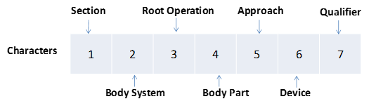
ICD-10-PCS
Much more granular compared to ICD-9-CM procedure codes
  ICD-9-CM 3,800 codes
  ICD-10-PCS > 75,000 codes
Multi-axial structure - the seven characters in the code correspond to the seven axes, each describing a particular aspect of the procedure

Slide 5
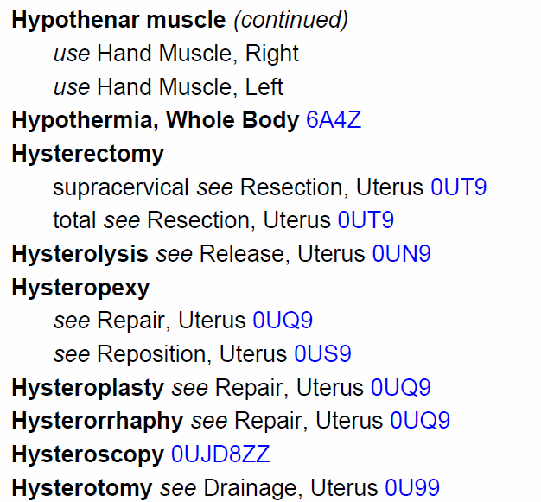
ICD-10-PCS index

Slide 6
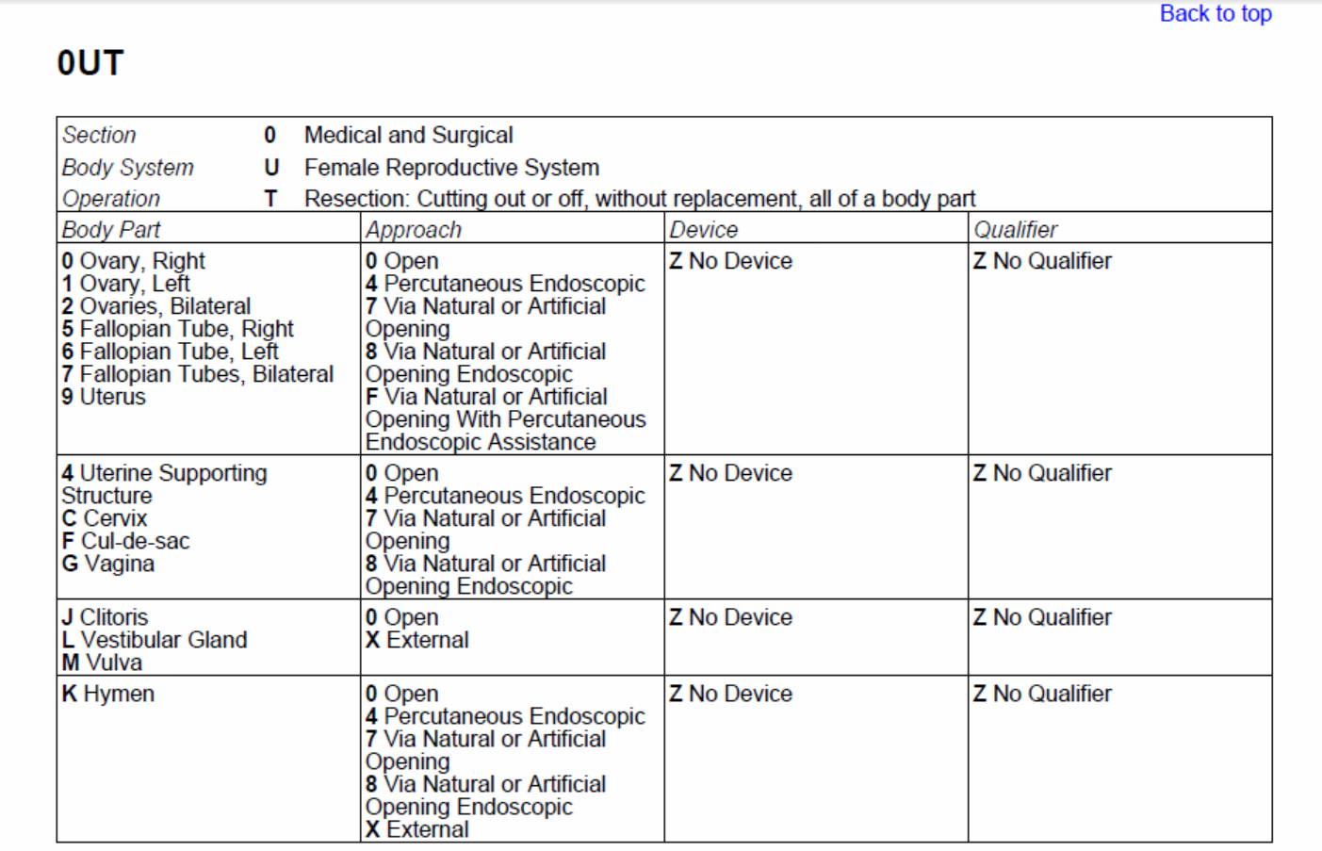

ICD-10-PCS tables
Endoscopic hysterectomy = 0UT94ZZ

Slide 7
ICD-10-PCS map project group
Formed in 2015 under SNOMED International (formerly International Health Terminology Standards Development Organisation, IHTSDO)
Representatives from Belgium, Spain, Portugal and U.S.
To explore ways to map between SNOMED CT and ICD-10-PCS.
Expected benefits of the map:
  Improve SNOMED CT and ICD-10-PCS coding efficiency and accuracy
  Promote re-use of clinical data for administrative, epidemiologic and statistical purposes
  Facilitate integration of clinical and administrative data to support data analytics

Slide 8
Mapping approaches explored
Lexical mapping
  ICD-10-PCS index
  ICD-9-CM procedure codes index
UMLS synonymy
General Equivalence Maps (ICD-9-CM to ICD-10-PCS)
Concept model alignment

Slide 9
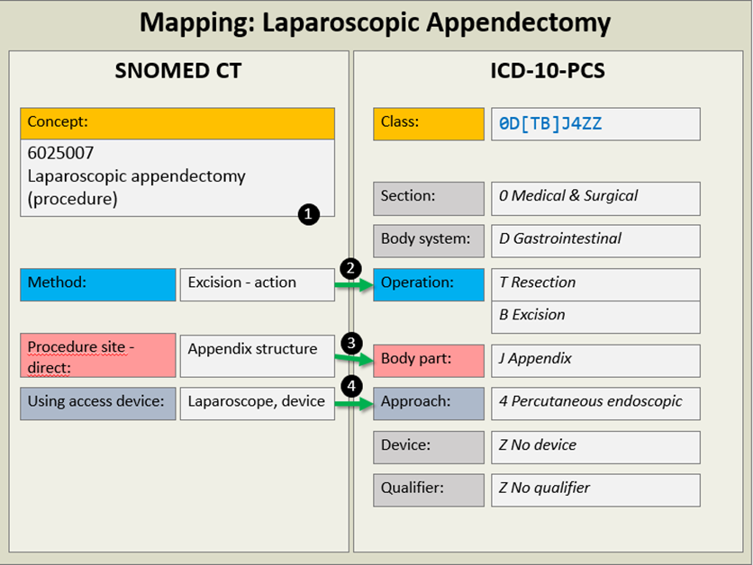

Slide 10
Concept model mapping prerequisites
SNOMED CT concept model is expressive enough to represent the meaning of ICD-10-PCS codes
Logical definitions of SNOMED CT concepts are available for equivalence checking
  Existing pre-coordinated SNOMED CT content
  Post-coordination
This study aims to explore the feasibility of concept model mapping

Slide 11
Modeling of procedures in SNOMED CT
24 attributes allowed (excluding Is-A relationships)
10 most commonly used attributes:
Attribute | % concepts with attribute
Method | 100.00%
Procedure site - direct | 85.23%
Direct morphology | 28.60%
Procedure site - indirect | 13.27%
Using device | 13.14%
Procedure site | 8.80%
Revision status | 4.89%
Using access device | 4.48%
Access | 4.30%
Direct device | 4.19%

Slide 12
ICD-10-PCS axis | % of ICD-10-PCS codes | Corresponding SNOMED CT attributes | % of SNOMED CT concepts with attributes
1. Section | 100% | NA | NA
2. Body system | 100% | Procedure site Procedure site – direct Procedure site – indirect | 97.1%
3. Root operation | 100% | Method | 100%
4. Body part | 100% | Procedure site Procedure site – direct Procedure site – indirect | 97.1%
5. Approach | 100% | Access Using access device | 8.7%
6. Device | 54.5% | Using device Direct device Procedure device Direct substance Using substance | 23.5%
7. Qualifier | 17.2% | Procedure site – direct* Has intent Direct substance Using substance | 8.9%

Slide 13
Methods
List of ICD-10-PCS codes with usage frequencies obtained from the data warehouse of Nebraska Medicine Medical Center – a 600 bed acute care facility with over 1,000 physicians covering all major sub-specialties
Focus on top 100 medical and surgical procedures (first digit of ICD-10-PCS code = 0)
Two authors (both MDs) independently match the ICD-10-PCS codes to SNOMED CT concepts by
  Meaning match - based on the SNOMED CT fully-specified names
  Logical match – based on the logical definition
Results collated and differences discussed until consensus is reached, or a third author casts a deciding vote

Slide 14
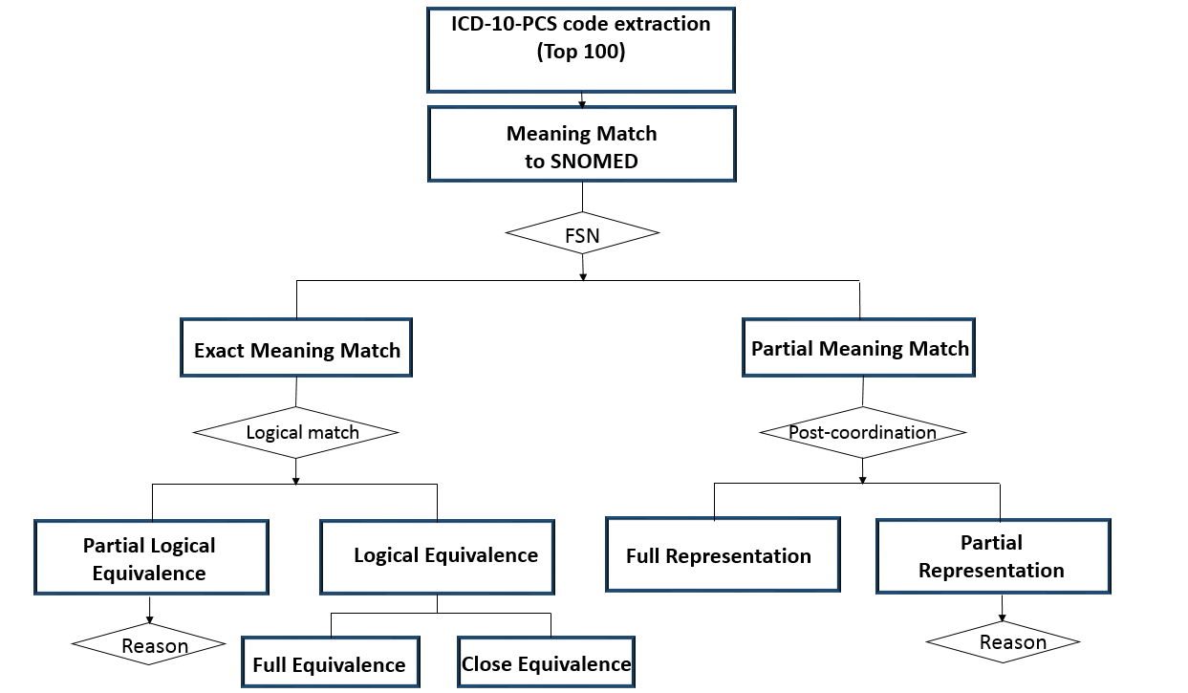

Slide 15
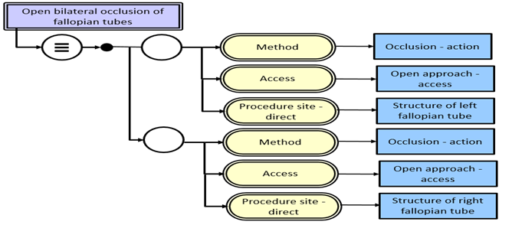
Results:
Exact meaning match, full logical equivalence (1 case)
  ICD-10-PCS: Occlusion of Bilateral Fallopian Tubes, Open Approach (0UL70ZZ)
  SNOMED CT: Open bilateral occlusion of fallopian tubes (176936004)

Slide 16
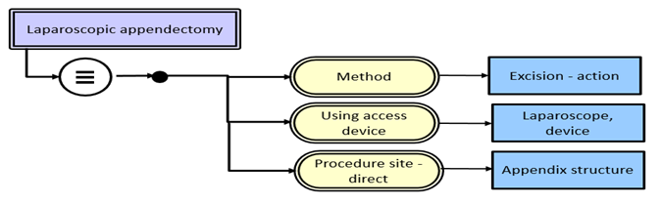
Exact meaning match, close logical equivalence (24 cases)
  ICD-10-PCS: Resection of Appendix, Percutaneous Endoscopic Approach (0DTJ4ZZ)
  SNOMED CT: Laparoscopic appendectomy (6025007)
  Strictly speaking, not exact logical equivalence because
    Missing Approach = Percutaneous approach
    Body site should be Entire appendix, since Resection in ICD-10-PCS means removal of whole body part or organ
  However, no ambiguity caused by missing attributes - could be added back algorithmically e.g.
    All laparoscopic procedures → add Approach = Percutaneous approach
    All biopsies → add Has intent = Diagnostic intent

Slide 17
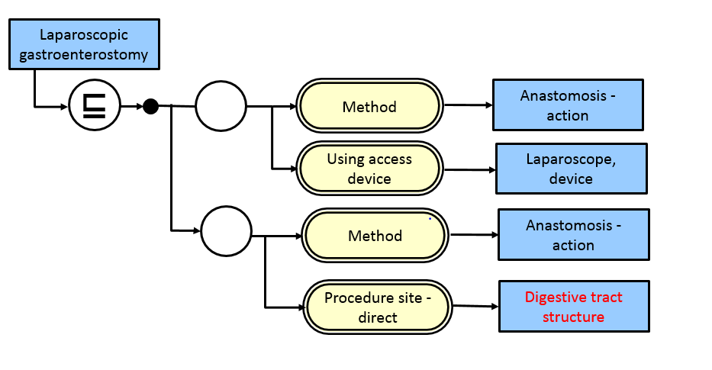
Exact meaning match, partial logical equivalence (7 cases)
  ICD-10-PCS: Bypass Stomach to Jejunum, Percutaneous Endoscopic Approach (0D164ZA)
  SNOMED CT: 307195003 Laparoscopic gastroenterostomy (307195003)

Slide 18
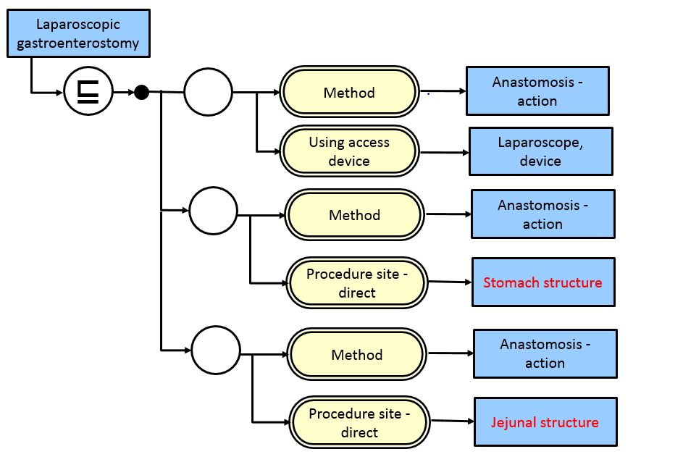
Exact meaning match, partial logical equivalence (7 cases)
  ICD-10-PCS: Bypass Stomach to Jejunum, Percutaneous Endoscopic Approach (0D164ZA)
  SNOMED CT: 307195003 Laparoscopic gastroenterostomy (307195003)

Slide 19
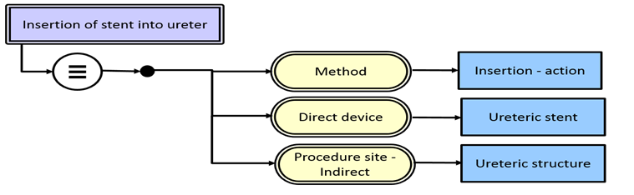
Partial meaning match, full representation possible by post-coordination (57 cases)
  ICD-10-PCS: Dilation of Left Ureter with Intraluminal Device, Via Natural or Artificial Opening Endoscopic (0T778DZ)
  SNOMED CT: Insertion of stent into ureter (428817001)

Slide 20
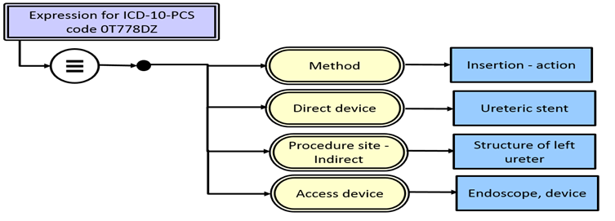
Partial meaning match, full representation possible by post-coordination (57 cases)
  ICD-10-PCS: Dilation of Left Ureter with Intraluminal Device, Via Natural or Artificial Opening Endoscopic (0T778DZ)
  SNOMED CT: post-coordinated expression

Slide 21
Partial meaning match, full representation not possible by post-coordination with current SNOMED CT concept model and content (11 cases)
  Beyond SNOMED CT logical model – cardinality
    Bypass Coronary Artery, Two Arteries from Aorta with Autologous Venous Tissue, Open Approach (021109W)
  Missing body part concept
    Insertion of Monitoring Device into Upper Artery, Percutaneous Approach (03HY32Z)
    ‘Upper artery’ in ICD-10-PCS refers to any artery above diaphragm – no corresponding body part concept in SNOMED CT
  Missing surgical method concept
    Extraction of Abdomen Skin, External Approach (0HD7XZZ)
    ‘Extraction’ in ICD-10-PCS refers to removal by any means other than surgical excision – no corresponding ‘non-surgical removal’ concept in SNOMED CT

Slide 22
SNOMED CT concept model
Existing SNOMED CT concepts
Complete logical definitions
ICD-10-PCS codes
25%
6%
57%
12%
Logical mapping to existing concepts
Logical mapping possible by post-coordination
Logical mapping not possible with existing concept model
Logical mapping possible if existing definitions become complete

Slide 23
Conclusion
SNOMED CT concept model is expressive enough to support logical mapping to ICD-10-PCS – 88% of ICD-10-PCS procedures can be represented fully
Exact meaning match can be found for about one-third of commonly used ICD-10-PCS codes. Among these, 78% of these SNOMED CT concepts are defined adequately to support logical mapping, the rest will require additional editing to make their definitions more complete. This will not only benefit mapping but useful for other description logic-based computations e.g., equivalence checking, subsumption calculation
Even non-exact logical matches (one-to-many matches) can be useful
  SNOMED CT: Total splenectomy (174776001) can be mapped to 2 ICD-10-PCS codes
    Resection of Spleen, Percutaneous Endoscopic Approach (07TP4ZZ)
    Resection of Spleen, Open Approach (07TP0ZZ)
  This can be used to narrow down the search for mappers, or to prompt additional input from clinicians during data entry

Slide 24
Thank you!
  Email me at: kfung@mail.nih.gov

