Slide 1
CCI to ICHI map
Partial matches 2 types
  Partial postcoordination with missing information
  No postcoordination (“no additional codes available”)
  Will combine to align with the other two maps
“without contrast” – should be ignored e.g.,
  3VQ10VA Xray, tibia and fibula without contrast (e.g. plain film) (with or without fluoroscopy) MNB.BA.BA X-ray of tibia or fibula N/A N/A Partial Precoordination match N/A N/A Not applicable without contrast Partial Match Not applicable- no additional detail available

Slide 2
CCI to ICHI map
“homologous platelets” same as platelets
  1LZ19HHU4J Transfusion, circulatory system NEC using homologous transfusion of platelets DIA.DG.AF Transfusion of blood or blood products Transfusion platelets ⇒ http://id.who.int/icd/entity/1401811875 Partial Precoordination match N/A N/A Not applicable Homologous Partial Match Not applicable- no additional detail available
“during labour” – ignore timing
  5LD07JAFX Fetal heart monitoring during active labour, using fetal scalp electrode NMR.AI.AC Internal fetal monitoring Inclusion term: Fetal scalp electrode ⇒ http://id.who.int/icd/entity/1722009250 Partial Precoordination match N/A N/A Not applicable during active labour Partial Match Not applicable- no additional detail available

Slide 3
CCI to ICHI map
“vacuum traction” – same as vacuum delivery
  5MD54NF Vacuum traction with episiotomy NOS "NME.JF.ACPAW.FA.AA" "Vaginal deliveryEpisiotomy" "Inclusion and Index terms: Vacuum delivery ⇒" http://id.who.int/icd/entity/1257189887 Partial Precoordination match N/A N/A Not applicable vaccum traction Partial Match Not applicable- no additional detail available
Meaning of “device NEC” e.g. “Release, abdominal cavity endoscopic [laparoscopic] approach using device NEC”

Slide 4
Summary of results from mapping 3 terminologies

Slide 5
 | SNOMED CT |  | ICD-10-PCS |  | CCI
Unmappable | 7 | 2.33% | 8 | 2.67% | 0 | 0.00%
Full match stem code | 102 | 34.00% | 71 | 23.67% | 112 | 37.33%
Full match foundation | 110 | 36.67% | 43 | 14.33% | 68 | 22.67%
Full match postcoordination | 32 | 10.67% | 79 | 26.33% | 26 | 8.67%
Partial match | 49 | 16.33% | 99 | 33.00% | 94 | 31.33%
Total | 300 | 100.00% | 300 | 100.00% | 300 | 100.00%

Slide 6
SNOMED CT unmappables
Excision of benign lesion of trunk (procedure)
Acne surgery (procedure)
Extracorporeal shockwave lithotripsy (procedure)
Operation on Bartholin's gland (procedure)
Excision of malignant lesion of trunk (procedure)
Chemodenervation (procedure)
Excision of malignant lesion of scalp and neck (procedure)

Slide 7
ICD-10-PCS unmappables
Inspection of Gallbladder, Percutaneous Endoscopic Approach (closest match is PAK.AE.AB Laparoscopy)
Insertion of Pacemaker, Dual Chamber into Chest Subcutaneous Tissue and Fascia, Open Approach (ICHI has separate codes for temporary vs. permanent pacemaker)
Insertion of Pacemaker Lead into Right Ventricle, Percutaneous Approach
Insertion of Pacemaker Lead into Right Atrium, Percutaneous Approach
Insertion of Defibrillator Lead into Right Ventricle, Percutaneous Approach
Insertion of Defibrillator Lead into Right Atrium, Percutaneous Approach
Insertion of Defibrillator Generator into Chest Subcutaneous Tissue and Fascia, Open Approach
Dilation of Cervix, Via Natural or Artificial Opening (closest match is NME.JE.AC Dilatation and curettage of uterus)

Slide 8
Partial match
Missing information | SNOMED CT (50 codes) |  | ICD-10-PCS (99 codes) |  | CCI (94 codes)
Target | 23 | 46.94% | 76 | 76.77% | 20 | 21.28%
Action | 1 | 2.04% | 1 | 1.01% | 3 | 3.19%
Method | 6 | 12.24% | 0 | 0.00% | 14 | 14.89%
Approach | 3 | 6.12% | 12 | 12.12% | 18 | 19.15%
Device | 5 | 10.20% | 26 | 26.26% | 34 | 36.17%
Other | 6 | 12.24% | 5 | 5.05% | 19 | 20.21%
Broad to narrow | 5 | 10.20% | 0 | 0% | 0 | 0%

Slide 9
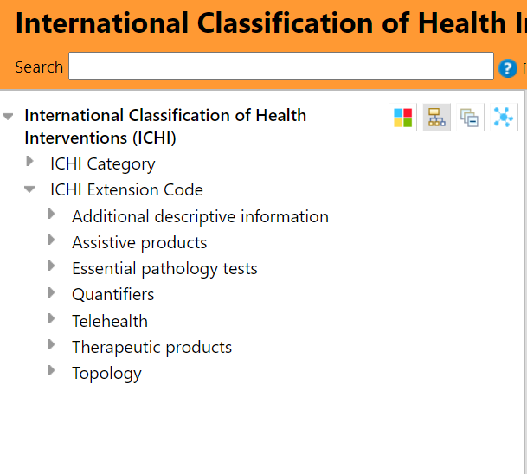
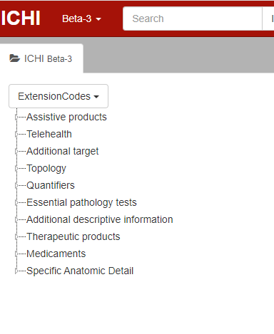
Changes in ICHI extension codes – anatomic entities gone!

Slide 10
SNOMED CT broad to narrow maps
SCTName | StemCode | StemCodeName
Endoscopic myomectomy (procedure) | NME.JI.AB|NME.JI.AC | Laparoscopic excision of lesion of uterus|Transvaginal local excision of lesion of uterus
Complete excision of nail AND nail matrix (procedure) | LBD.JK.AA | LBF.JK.AA | Total excision of nail of finger | Total excision of nail of toe
Wedge excision of skin of nail fold (procedure) | LBD.JJ.AA|LBF.JJ.AA | Partial excision of nail of finger|Partial excision of nail of toe
Partial excision of nail and nail matrix (procedure) | LBD.JJ.AA | LBF.JJ.AA | Partial excision of nail of finger | Partial excision of nail of toe
Interruption of vena cava (procedure) | HIB.LA.AA | HIC.LA.AA | Interruption of the superior vena cava | Interruption of the inferior vena cava

