Slide 1
AXIS 3 and 4
SCT to PCS MAPPING
F. Ameye
Snomed-CT to ICD-10-PCS mapping
17-11-2016

Slide 2
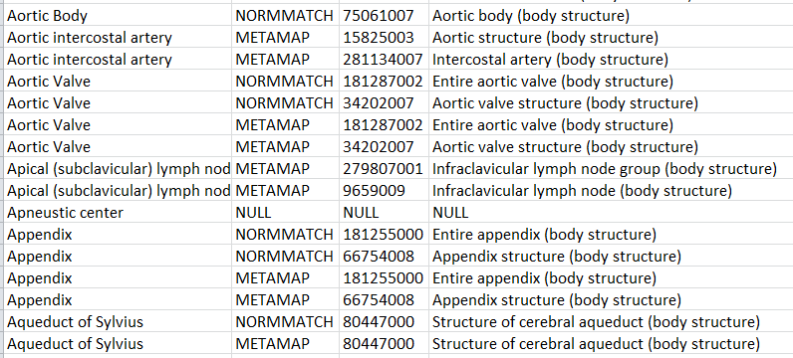
1. Axis 4 Lexical Map

Slide 3
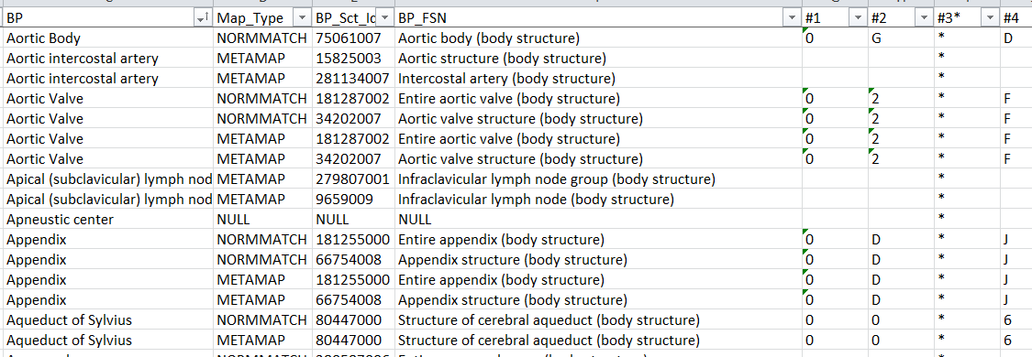
1. Axis 4 Lexical Map #1->#4

Slide 4
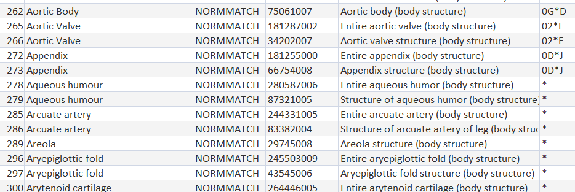
1. Qry Axis 4 Normmatch lexical map to Pcs-Id’s

Slide 5
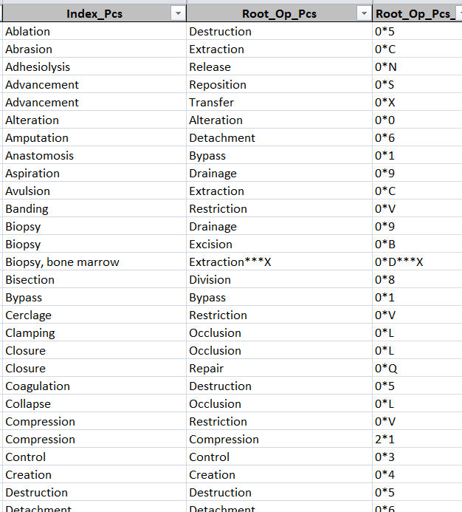
2. Axis 3 Index to Root_Op and Root_Op_Pcs_Id

Slide 6
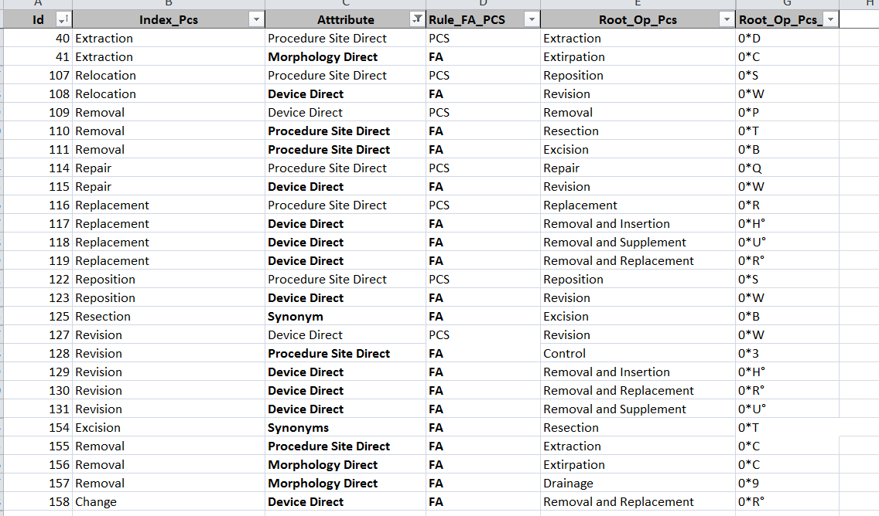
2. Axis 3 enriched attribute based Index to Root_Op
# Index entries = 160

Slide 7
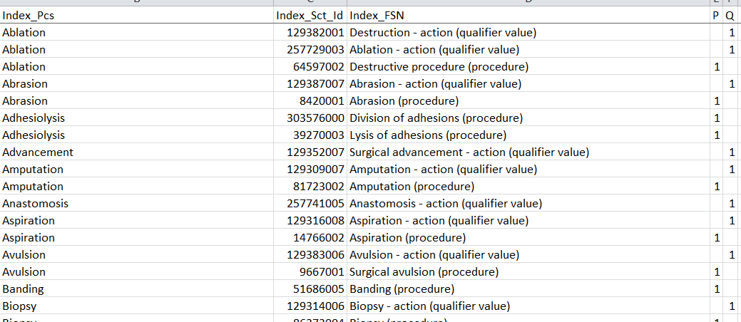
2. Axis 3 Index to Sct Lexical Map
# qualifiers = 61

Slide 8
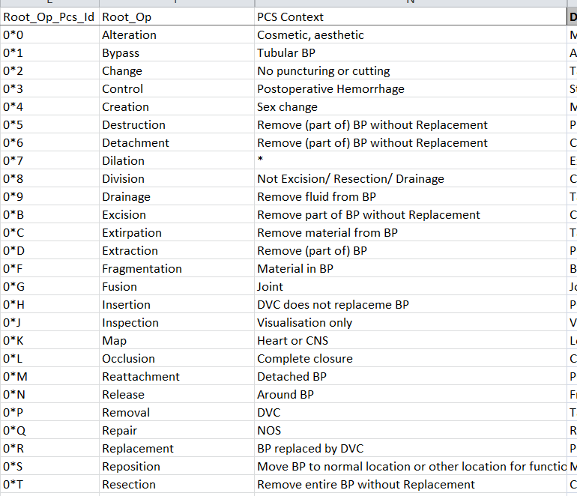
2. Axis 3 Root_Op Entry Masks

Slide 9
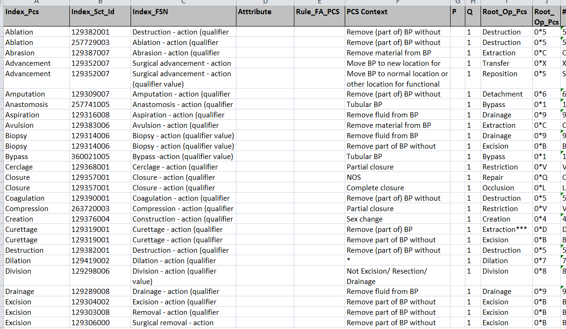
2. Qry Axis 3 Map

Slide 10
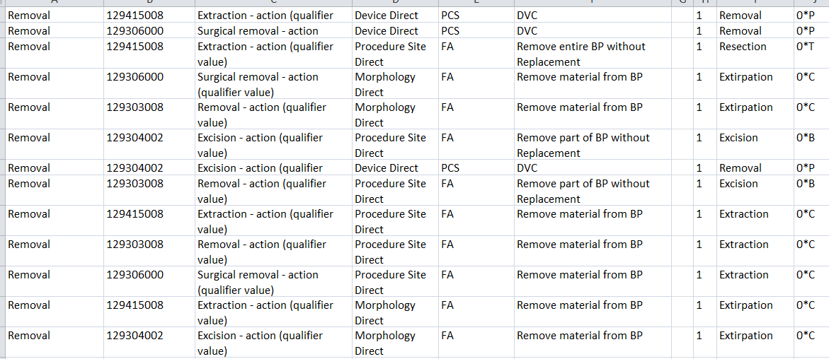
2. Qry Axis 3 Map with attributes and PCS context

Slide 11
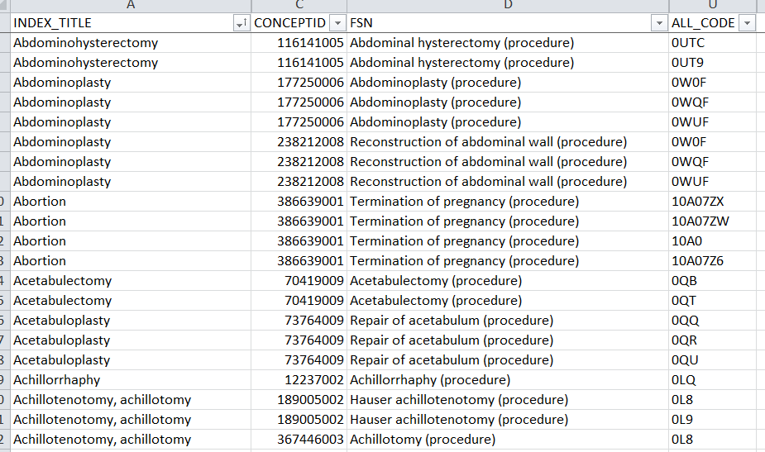
3. Implementation 1: Index to Sct lexical Map

Slide 12
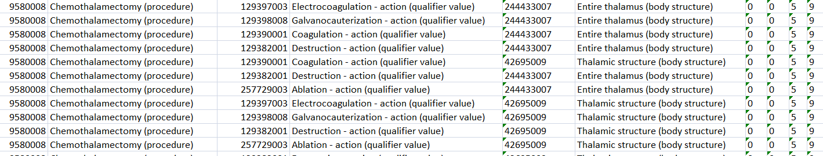
3. Implementation 1 - Example 1:
Qry Index_Sct_to_Sct_Root_Op_&_BP

Slide 13
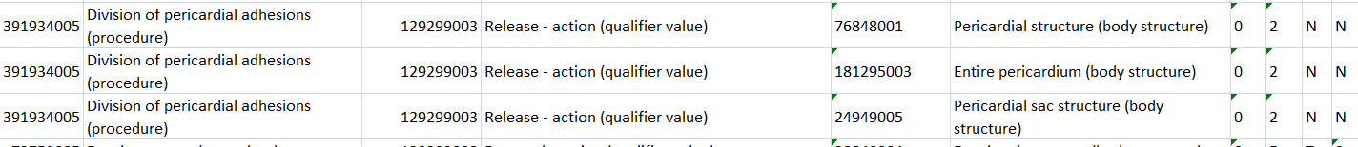
3. Implementation 1 - Example 2:
Qry Index_Sct_to_Sct_Root_Op_&_BP

Slide 14
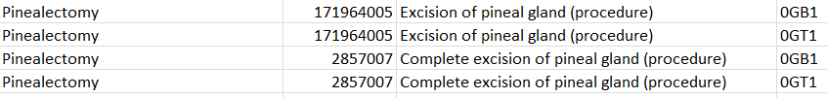
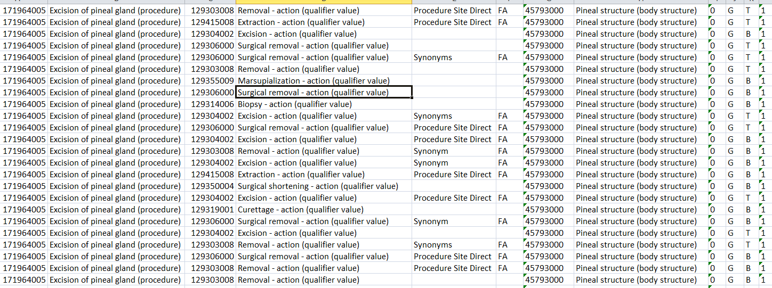
3. Implementation 1 - Example 3:
Qry Index_Sct_to_Sct_Root_Op_&_BP

Slide 15
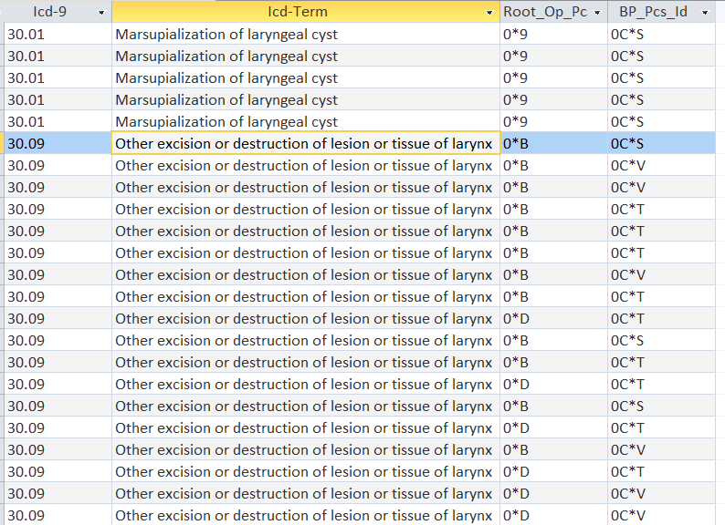
4. Implementation 2:
Qry Gem_Resp_to_Root_Op_and_BP_Id’s

Slide 16
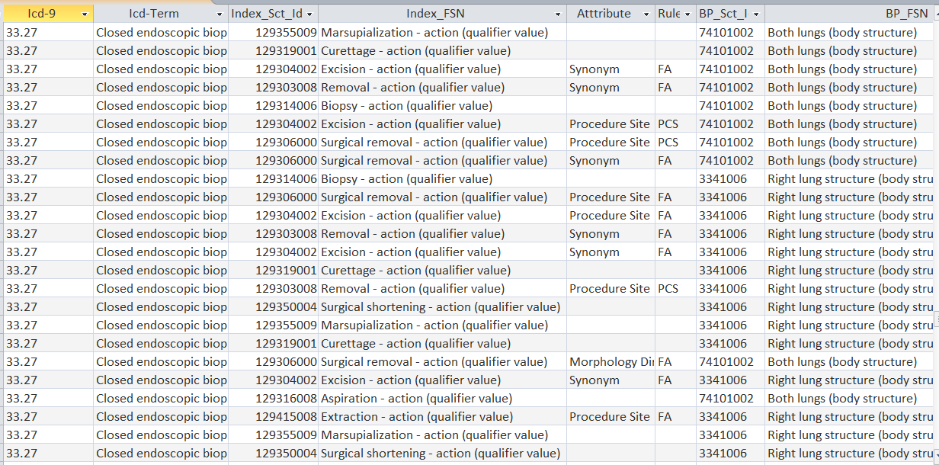
4. Implementation 2 – Example 1:
Qry Gem_Resp_to_Sct_Root_Op_and_BP

Slide 17
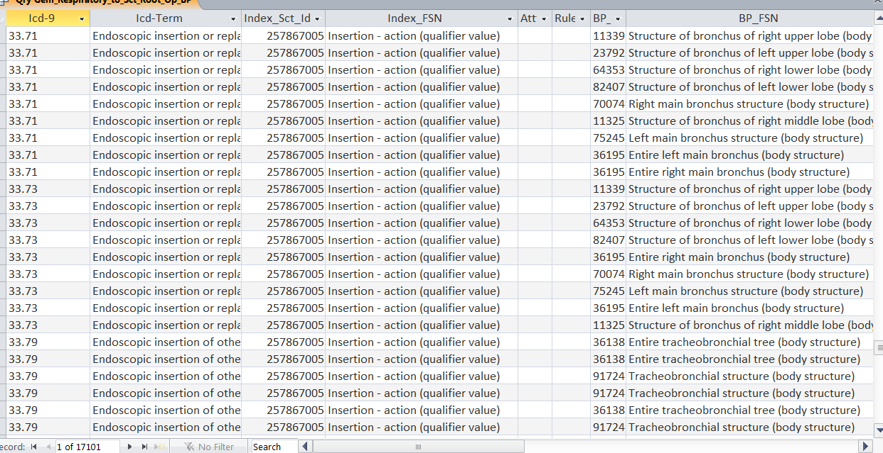
4. Implementation 2 – Example 2:
Qry Gem_Resp_to_Sct_Root_Op_and_BP

Slide 18
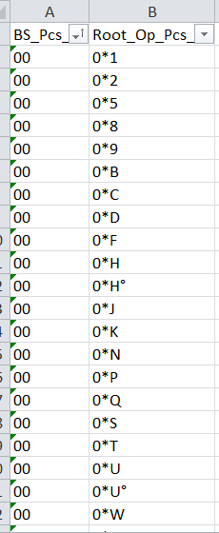
5. Implementation 3 – Associative table
Qry Sct_Root_Op_&_Sct_BP
Associative table

