Slide 1
MAGPIE – an Interactive Tool to Find SNOMED CT and ICD-10-PCS Codes for Medical Procedures
Kin Wah Fung¹, Julia Xu¹ , Filip Ameye² ,
Arturo Romero-Gutiérrez³ , Ariel Busquets⁴
1 U.S. National Library of Medicine
2 National Institute for Health and Disability Insurance, Belgium
3 Ministry of Health, Social Services and Equality, Spain
4 Hospital Privado Universitario de Córdoba, Argentina
SNOMED CT Expo
October 2018, Vancouver, Canada

Slide 2
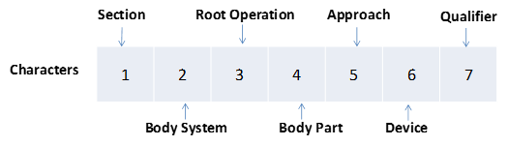
ICD-10-PCS
Brand-new classification system created by U.S. Centers for Medicare and Medicaid Services (CMS)
Multi-axial structure. The seven characters in the code correspond to the seven axes, each describing a particular aspect of the procedure.

Slide 3
ICD-10-PCS map project group
Formed in 2015, bi-weekly conference calls
Members from Belgium, Spain, Argentina and U.S.
To explore ways to map between SNOMED CT and ICD-10-PCS
Expected benefits of the map:
  Improve SNOMED CT and ICD-10-PCS coding efficiency and accuracy
  Promote re-use of clinical data for administrative, epidemiologic and statistical purposes
  Facilitate integration of clinical and administrative data to support data analytics

Slide 4
ICD-10-PCS coding is difficult
Many more codes compared to ICD-9-CM procedure codes:
  ICD-9-CM Volume 3 (2013) – 3,882
  ICD-10-PCS (2018) – 78,705
ICD-10-PCS names are not clinically-intuitive
  Root operation definitions:
    Extraction - Pulling or stripping out or off all or a portion of a body part by the use of force
    Removal - Taking out or off a device from a body part
    Extirpation – Taking or cutting out solid matter from a body part
  Cataract removal is extraction, not removal
  Wound excision (debridement) is also extraction, not removal or excision
  Extraction of embolus is extirpation

Slide 5
  Root operation definitions:
    Excision - Cutting out or off, without replacement, a portion of a body part
    Resection - Cutting out or off, without replacement, all of a body part
  Appendectomy is resection
  Partial nephrectomy is excision
ICD-10-PCS index is relatively sparse and not as rich as ICD-9-CM procedure index

Slide 6
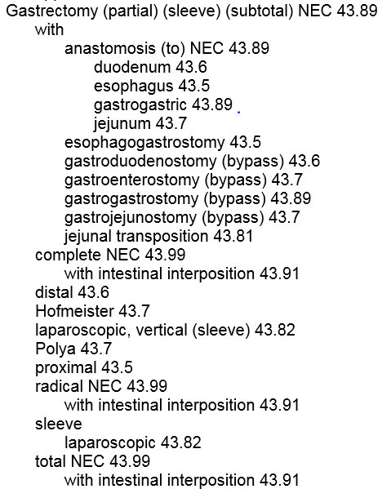
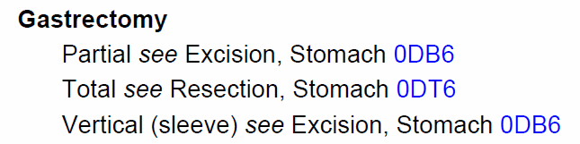
ICD-9-CM procedure codes index
ICD-9-CM
ICD-10-PCS
Compared to the ICD-10-PCS index, ICD-9-CM index is much richer – has more refinement options and includes eponyms e.g. Polya gastrectomy

Slide 7
ICD-9-CM procedure codes index
ICD-9-CM
ICD-10-PCS
General Equivalence Map (GEM)
Compared to the ICD-10-PCS index, ICD-9-CM index is much richer – has more refinement options and includes eponyms e.g. Polya gastrectomy

Slide 8
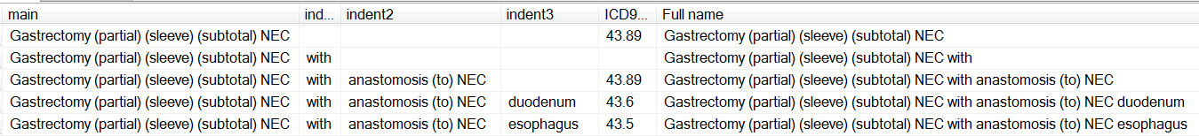
Re-purposing the ICD-9-CM index
The original file is in .rtf file format
Index parsed to extract main entry, indented entries, see references and codes
Generate full name by concatenating main and indented entries

Slide 9
Indirect map through the GEM
Map ICD-9-CM index to SNOMED CT
  Map ICD-9-CM codes to SNOMED CT through UMLS
  Map concatenated index terms to UMLS terms after normalization
Use the forward GEM (General Equivalence Map) to map ICD-9-CM to ICD-10-PCS
SNOMED CT
ICD-9-CM Index
ICD-10-PCS
UMLS, lexical map
GEM
‘Gastrectomy Polya’ – 43.7 Partial gastrectomy with anastomosis to jejunum
0DB60ZZ Excision of Stomach, Open Approach
0D160ZA Bypass Stomach to Jejunum, Open Approach
0DB64ZZ Excision of Stomach, Percutaneous Endoscopic Approach
0D164ZA Bypass Stomach to Jejunum, Percutaneous Endoscopic Approach
26565004
Polya operation, gastrectomy (procedure)

Slide 10
MAGPIE
Map-Assisted Generation of Procedure and Intervention Encoding
A browser to find codes in SNOMED CT and ICD-10-PCS for medical procedures and interventions
Special features:
  Cascading search
  Hybrid lexical and map-assisted matching
  Semantic filters

Slide 11
Cascading search
Sequential navigation through SNOMED CT and ICD-9-CM to hone in on ICD-10-PCS tables and codes
MAGPIE has suggestions at each step, but users can change selections
SNOMED CT concept
ICD-9-CM term
ICD-10-PCS tables
Search
term
ICD-10-PCS codes

Slide 12
Hybrid lexical and map-assisted matching
At each step, optimizing search by a combination of
  Lexical matching
    Build index tables for SNOMED CT, ICD-9-CM and ICD-10-PCS
    At each step, match search terms to index terms using Apache Lucene information retrieval library functions
    Search terms are enriched by synonyms of the identified SNOMED CT and ICD-9-CM codes
  Map-assisted matching
    Maps created between the 3 terminologies
    Codes identified in each step will be used to find codes in the next terminology

Slide 13
Index tables generation
Terminology | Resources used to build index tables
SNOMED CT | Repurposed I9 index UMLS
ICD-9-CM | Repurposed I9 index UMLS
ICD-10-PCS | ICD-10-PCS index UMLS

Slide 14
Mapping tables generation
Source terminology | Target terminology | Resources used to build mapping tables
SNOMED CT | ICD-9-CM | Repurposed I9 index UMLS
SNOMED CT | ICD-10-PCS | Repurposed I9 index UMLS GEM
ICD-9-CM | ICD-10-PCS | GEM

Slide 15
Semantic filters
make use of words in search string to hone in on the ICD-10-PCS tables and codes
Body system and body part filters
  “total replacement of left hip”
    Axis2 (body system): Lower joints
    Axis4 (body part, body region): Hip Joint, Left
Approach filter
  “laparoscopic excision of right ovary”
    Axis2 (body system): Female reproductive system
    Axis4 (body part, body region): Ovary, right
    Axis5 (approach): Percutaneous endoscopic

Slide 16
Search methods
lexical + map + filter
lexical
lexical + map
SNOMED CT concept
ICD-9-CM term
ICD-10-PCS tables
Search
term
lexical + map + filter
ICD-10-PCS codes
map

Slide 17
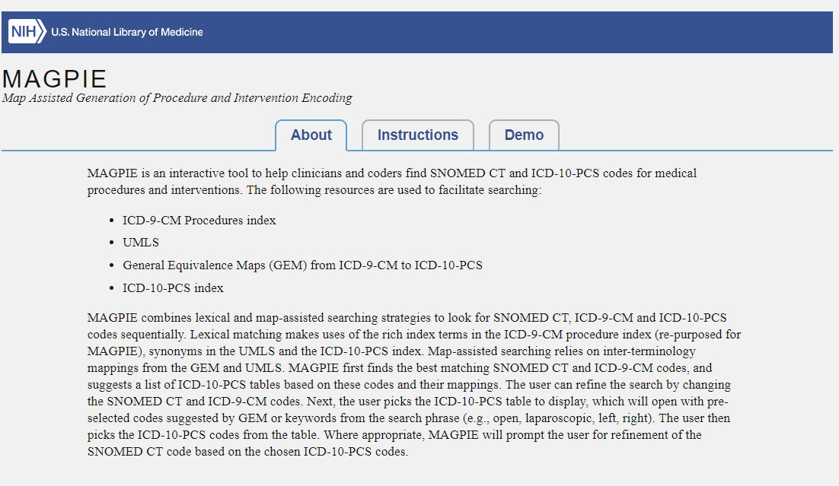
MAGPIE website
magpie.nlm.nih.gov – work in progress
We welcome your feedback!

Slide 18
Questions?
kwfung@nlm.nih.gov

