Slide 1
Four Attributes Created for Defining Observables in the January 2017 International Release of SNOMED CT
Discussion for the Observables Project Group
July 25, 2016

Slide 2
Background
Most attributes of the new Observables model were created by FAS and SSA in 2014-15 for the LOINC – SNOMED CT Cooperation Project Technology Preview
  Attributes used in the post-coordinated SNOMED CT expressions to define LOINC Terms in 3 alpha releases
Observables I/E document revised in 2015, 2016
FAS and SSA created 4 new attribute concepts for the January 2017 International Release of SNOMED CT
  Two slightly different definitions of each attribute in I/E doc, combined for definition of new concepts in SCA Tool
FAS and SSA to start modeling existing SNOMED CT Observables content for the January 2017 release
Desire input from Observables PG on the new attributes created
Notes:
https://confluence.ihtsdotools.org/display/OBSERVABLE/Observables+Inception-Elaboration+document

Slide 3
Attribute names and hierarchy
Direct children of 410662002 | Concept model attribute (attribute)
New attributes:
  719715003 | Relative to part of (attribute)
  719716002 | Procedure informer (attribute)
  719722006 | Has realization (attribute)
  719723001 | Constituent (attribute)

Slide 4
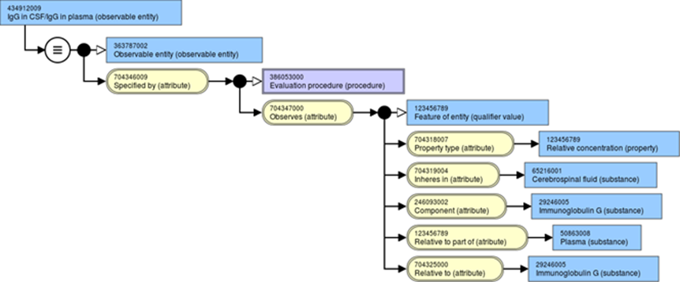
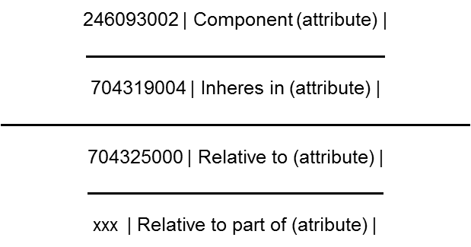
Relative to part of (attribute)
Example of usage in I/E doc:

Slide 5
  Relative to part of (attribute)
Text definition in SCA Tool: This attribute is used to specify the denominator of a relative relational property type, such as a ratio of ratios
Range in I/E doc: 123037004 | Body structure | OR 410607006 | Organism | OR 105590001 | Substance |123038009 | Specimen | OR 260787004 | Physical object | OR 373873005 | Pharmaceutical / biologic product | OR 419891008 | Record artifact |
Previous discussions on changing name – any update?
Any comments on definition?

Slide 6
Relative quantities in LOINC – a search
All Rel* properties – 265
  RelRto – 62
  RelSCnc – 2
  RelMCnc – 27
Fractions
  Possibly not all need the additional attributes?
  CFr – 97
  NFr – 1949
  MFr – 432
  SFr – 140
  Possibly other fractions (LenFr, SatFr, …)
Differences
  TimeDiff, CncDiff, SCncDiff, MCncDiff, …

Slide 7
Relative vs. Relational
Relational qualities, e.g. concentration, use Inheres in and Constituent
What about relative qualities?
  E.g. time (duration) difference
  Inheres in = Process 1, Relative to = Process 2, or
  Inheres in = Process 1, Constituent = Process 2

Slide 8
Relative to… attributes alternatives
Keep attributes with existing names
  Has been described as hard to understand
Rename as “Relative to Inheres in” and “Relative to Constituent” to reflect the relationship to the attributes “Inheres in” and “Constituent” (prev. “Component”)
  The preferred alternative?
Make all relative observables primitive, i.e. remove (or do not add) Relative to… attributes
  Could make hundreds to thousands of observables primitive which could potentially be fully defined using the proposed attributes

Slide 9
  Procedure informer (attribute)
In Observables I/E document: “Informer (attribute)”
SSA and FAS suggested name change to “Procedure informer” to avoid confusion with and be more consistent with existing concept 419066007 | Finding informer (attribute)
Range in I/E doc: 420158005 | Performer of method (person) | OR 419358007 | Subject of record or other provider of history (person) |
Text definition in SCA Tool: This attribute is used to specify anyone who performs the observation procedure and is the provider of information
Comments on name change and definition?

Slide 10
  Has realization (attribute)
Text definition in SCA Tool: This attribute specifies the realization of a function
Comments on definition?
  Should the definition include processes as well?
Range in I/E doc: xxx | Process (qualifier value)
  Plan for implementing this?

Slide 11
  Constituent (attribute)
New “Component – like” attribute to be used instead of 246093002 | Component (attribute) |
Range in I/E doc: 123037004 | Body structure | OR 410607006 | Organism | OR 105590001 | Substance |123038009 | Specimen | OR 260787004 | Physical object | OR 373873005 | Pharmaceutical / biologic product | OR 419891008 | Record artifact |
Text definition in SCA Tool: This attribute is used to specify what is in the numerator of ratios for relational property types, e.g. ratios, concentrations
Comments on name and definition?

Slide 12
Timeline
Comments needed by August 15, 2016

