Slide 1
LOINC – SNOMED CT Cooperation Project
Issue Review
LOINC component parts that contain specimen
June 27, 2016

Slide 2
Background
LOINC component parts containing specimen:
  Type 1: Used as a nominator (or denominator, depending on the part type: Component/divisor) in LOINC terms with the "Relative Ratio" property:
    LP95499-7 COMPONENT Albumin.serum:
    LP129554-4 COMPONENT Albumin.periton fld
    LP95500-2 DIVISORS Albumin.periton fld
  Type 2: Used in LOINC terms with property types: "Difference in Mass Concentration" or "Difference in Substance Concentration".
    LP157160-5 COMPONENT Albumin.serum-albumin.periton fld

Slide 3
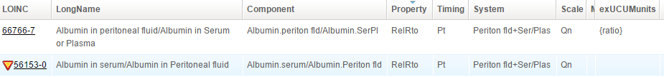
Associated LOINC terms
Type 1
Type 2

Slide 4
Clarification with RII
“The first and second type of terms are similar – the first is a ratio of results between two different specimens, and the second is the difference in results between two specimens. In both cases, the two measurements (on the two different samples) are done separately, and the final result is calculated from the two specimen-specific results.
In both cases, the specimen is in the Component as well as the System because the info in the System just says which specimens were used, but the Component specifies exactly how they were used in the calculation.”

Slide 5
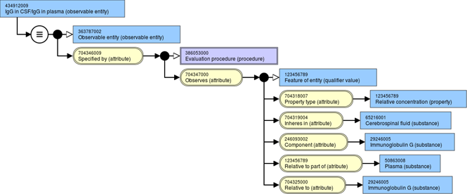
Observable Model
Type 1: From the Observable redesign IE document)
Type 2: Use the same model with new attributes?
  Difference in Mass Concentration
  Difference in Substance Concentration

