Slide 1
LOINC – SNOMED CT Cooperation Project
Issue Review
Use of “+” and “&” in LOINC Components
June 27, 2016

Slide 2

Background
Previously we reported a subsumption issue involving LOINC components that contain “+” sign:
  In many instances X + Y is subsumed by X and/or Y.
  But there are instances where the subsumption is the other way around
  RII feedback: “in the example it looks like X+Y and Y are subsumed by X. And wouldn’t it be more accurate to have X+Y as a parent of both X and Y?”
  Substance project and Observable Redesign Project (face-to-face meeting) requested clarification regarding use of “+”

Slide 3
Issue description
“+”, “&or”, and “&” have been used in LOINC components. According to LOINC User Guide:
  “If two or more constituents are measured as one quantity, each constituent should be named and the component separated by a plus sign, e.g., Cyclosporine+metabolites or Human papilloma virus 16+18+31+33+35+45+51+52+56 DNA.”
  “If multiple analytes are measured separately, the analytes are separated by an ampersand (&) surrounded by spaces. Two cases that use the ampersand convention are the names of panel terms and impression terms.”

Slide 4
Examples “+”
  LP38309-8 Helminth+Arthropod identified
  LP14312-0 Monocytes+Macrophages
  LP70080-4 Alanine+Beta Alanine+Sarcosine
  LP40440-7 West Nile virus Ab.IgG+IgM
  LP57131-2 Streptococcus pneumoniae 6+26 Ab
  LP147478-4 (Gadus morhua+Mytilus edulis+Pandalus borealis+Salmo salar+Thunnus albacares) Ab.IgE
  LP97602-4 Campylobacter jejuni+Campylobacter coli Ag
  LP100196-7 Neisseria meningitidis A+B+C+w135+Y Ag
  LP39164-6 Neisseria meningitidis A+B+C+w135+Y+Escherichia coli K1 Ag
  LP145539-5 Ureaplasma urealyticum+Ureaplasma parvum DNA
  LP38526-7 HTLV 1+2 DNA
  LP65524-8 Respiratory virus DNA+RNA

Slide 5
Examples “&or” and “&”
"&or"
  LP39687-6 Salmonella sp &or Shigella sp identified
"&"
  LP64677-5 COMPONENT Calcidiol & Calciferol
    LP64575-1 COMPONENT Calcidiol+Calciferol
  LP40307-8 COMPONENT Borrelia burgdorferi Ab.IgG & IgM
    LP40402-7 COMPONENT Borrelia burgdorferi Ab.IgG+IgM
  LP149789-2 COMPONENT Mycoplasma sp & Ureaplasma sp
    LP29087-1 COMPONENT Mycoplasma sp+Ureaplasma sp

Slide 6
Clarification with RII regarding “+”
Is the meaning the same across all components and divisor?
  RII: “The meaning of + is the same across all component and divisor types, and means that all of the constituents are being measured but cannot be differentiated from one another, so they are essentially measured as one quantity.”
Is it equivalent to “and/or”?
  RII: “I think we’re saying the same thing, but just to make sure, it means the lab is looking for ALL of the constituents specified, and if the result is positive, it means any or all of the antigens may be present.”
The measurement for all of the constituents separated by "+" is not necessarily done using the same substance, for example in the following, the antibody is not a single substance directed against all of the allergens, but one or more antibodies directed against one or more allergens
    LP147478-4 COMPONENT (Gadus morhua+Mytilus edulis+Pandalus borealis+Salmo salar+Thunnus albacares) Ab.IgE
  RII: “Yes, the test is looking for specific IgE antibodies against any of the allergens, not a single IgE that acts against everything.”

Slide 7
Clarification with RII regarding “&”
How is "&" different from "+“
  RII: “The “&” means that all of the constituents are being measured, but in contrast to “+”, each constituent can be differentiated/measured separately. The & is often used for panel terms, where each constituent will have its own child within the panel”.
Based on the agreement, the terms containing such components are out of scope.
  RII: “Yes”

Slide 8
Clarification with RII regarding “&or”
What does "&or" imply?
  RII: “We rarely use &or, and when we do it’s typically in the clinical domain or for survey questions. Our intention is that it means ‘either or both’”.
  “Regarding the Components with &or below, I don’t know why they were created the way they were, and I suspect that they were created this way in error. We will review them and most likely discourage or deprecate them”
    LP39687-6 Salmonella sp &or Shigella sp identified

Slide 9
Items for discussion
“&” and “&or” seem to be out of scope
How do we represent LOINC components containing “+” (~ 250 LPs in the top 2000)?
  We have created some concepts (~100), but the understanding is that they need to be retired:
    This concept means “and/or” and they are out of scope for SNOMED CT
    Classification issues
  Is there a way to represent this in the Observable model: multiple components (+primitive)?
  Out of scope?

Slide 10
New slides from here on

Slide 11
The problem in summary
“+” and “&or” means “inclusive or” i.e. disjunction/union
  “&or” is under consideration by RII
  ~ 2 300 “+”s in whole LOINC, ~ 250 in top 2000
“&” means “and”, is used in panels (and is thus out of scope so far) and poses no problem for SNOMED CT logic
“+” and synergistic effects, e.g. susceptibility
  Different because here “+” means (a variant of) “and”
  Still the synergistic effect relevant!

Slide 12
Disjunction in SNOMED CT
Representing disjunctive (“or”) concepts (e.g. LP40831-0 Adenovirus+Rotavirus) as conjunction (“and”) results in erroneous subsumption hierarchy
  The union is subsumed by the constituents
Disjunction (“or”) is not within the SNOMED CT DL profile (EL+)
  Some approximation is needed

Slide 13

Manually maintained substance hierarchies
Observables:
Substances:

Slide 14

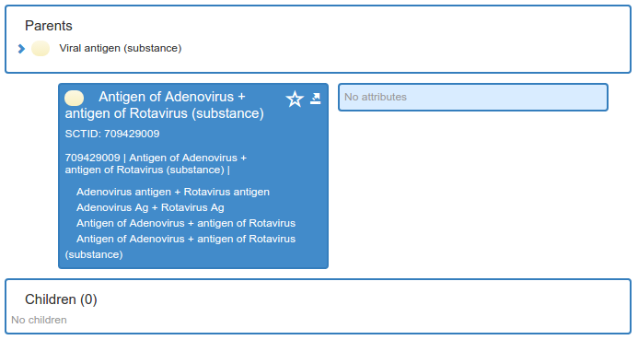
Manually maintained substance hierarchies

Slide 15
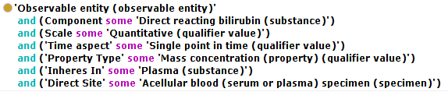
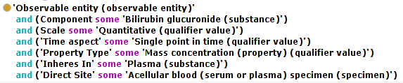
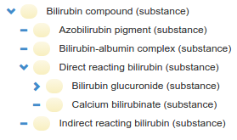
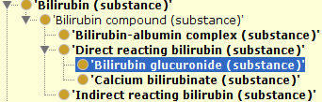
Manually maintained substance hierarchies

Slide 16
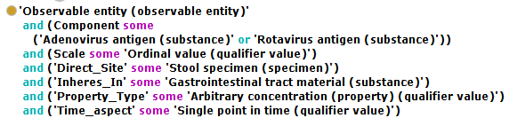

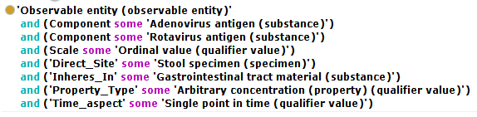


Disjunction in OWL
Using “or”
Using “and”

Slide 17
Alternative solutions
Use disjunction in OWL
  Not an alternative for full SNOMED CT
Use disjunction for a subset of “disjunctive component” concepts
  ~ 2 300 in LOINC
  Export the classified results as a primitive hierarchy
  Disjunction in Observables, not Substances
Manually maintain observables
  Has been shown to introduce some inconsistencies
Accept that there will be false subsumption

