Slide 1
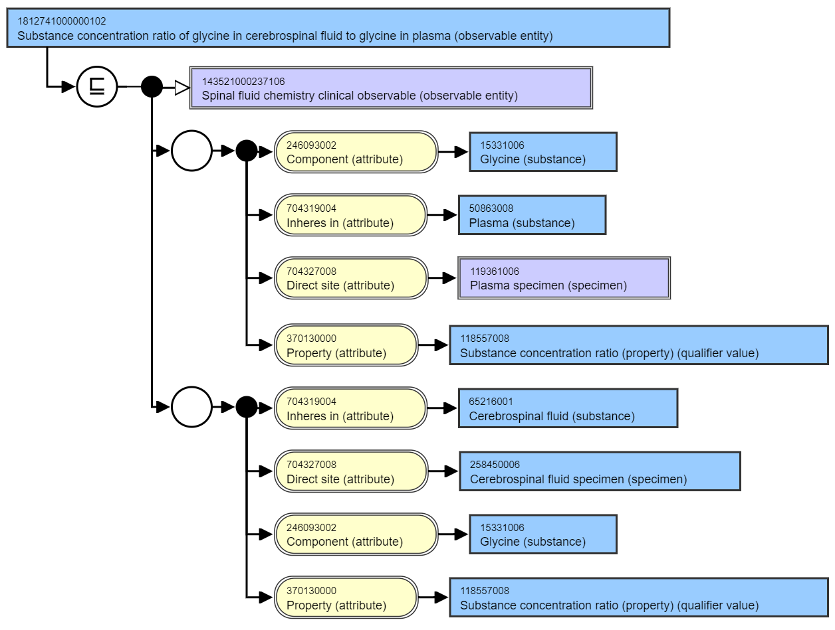




Option 1 – relative role grouping
Not possible in the SNOMED CT data model
False positive autoclassification – needs to be represented in the logic
LOINC 73913-6 - Glycine in CSF/Glycine in plasma
A
Property attribute outside RG A and B
Relative concentration of RG A to RG B
B

Slide 2
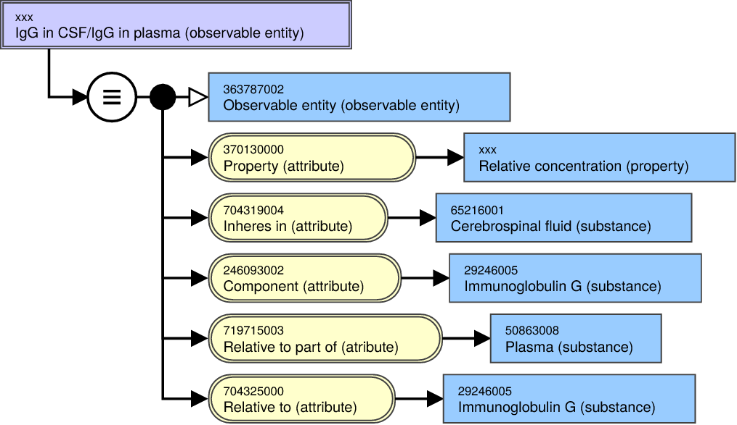
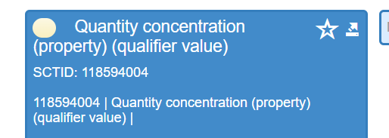





Option 2 – Create ‘relative’ attributes
New defining attributes
False positive autoclassification
Mitigated by intermediate primitive authoring
https://goldbook.iupac.org/terms/view/R05255
IUPAC - relative (R05255)
The IUPAC Compendium of Chemical Terminology
Or if direct site
Relative to inheres in
Relative to direct site
Relative to component

Slide 3
Mass/Mol relative concentrations
40486-3 Protein/Creatinine [Ratio] in 24 hour Urine
Unit - g/mmol
Option 2 continued – relative attributes and relative concentration property qualifiers
New defining attributes
New qualifier values
Relative mass to substance concentration (property)
Or if using direct site
Relative to inheres in
Relative to direct site
Relative to component

Slide 4








Mass/Mol relative concentrations
40486-3 Protein/Creatinine [Ratio] in 24 hour Urine
Unit - g/mmol
Option 3 – Create numerator and denominator attributes
New defining attributes
Minimises false positive autoclassification
Proximal primitive authoring
Different to current ratio model – inconsistent
<numerator attribute>
<denominator attribute>

