Slide 1
Translation of feeding
Louise Bie, Terminologist in NRC Denmark

Slide 2
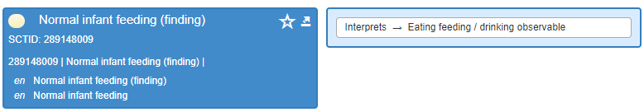
Example: 289148009 |Normal infant feeding (finding)|
Who is the subject of feeding in this concept?
  Is it the person feeding the infant?
  Or is it the infant itself?
There can be several interpretations of this concept.
  Via CRS we asked the Content Team if it means:
  the infant's food intake is normal?
  the feeding process of the infant is normal?
  or something else?

Slide 3
CRS and Jira
CRS-ticket:
960733 Translation of feeding in concepts in the hierarchy of 230126006 |Finding relating to infant feeding (finding)|
Jira-ticket:
[IHTSDO-1273.] 230126006 |Finding relating to infant feeding (finding)| needs review and rework
Answer in the Jira-ticket:
There has been a CRS request regarding content in this hierarchy—289148009 |Normal infant feeding (finding)| and 161838002 |Infant feeding problem (finding)| which are in the ICNP. Nursing have confirmed the intended meaning of these concepts is about the infant feeding pattern not intake. So, when work commences in this area, we need to liaise with Nursing and Cathy.

Slide 4

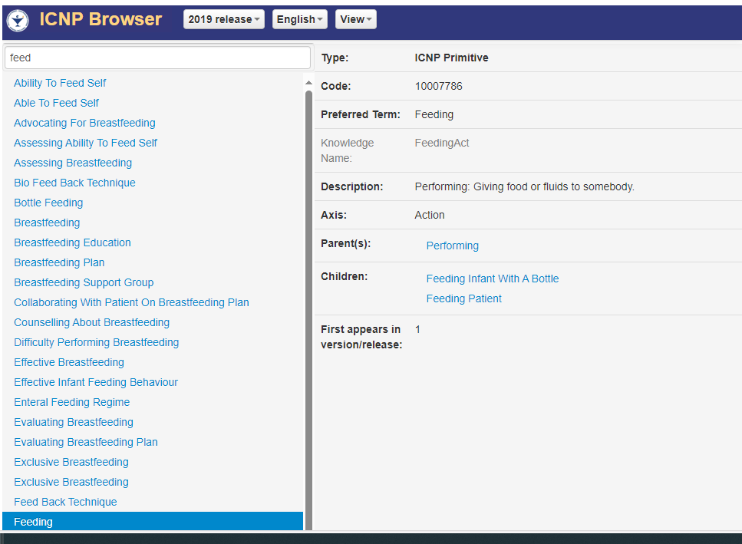

Slide 5
Different translations
Country | Translation | DeepL back translation to English
Germany | Normale Säuglingsernährung | normal infant feeding
Netherlands | normaal voeden van zuigeling | normal feeding of infant
Norwegian | normal spiseatferd hos spedbarn | normal eating behavior in infants
Argentina | alimentación del lactante, normal | infant feeding, normal
Denmark Plan before Jira | normal fødeindtagelse hos spædbarn | normal food intake of infant
Denmark Plan now | normal ernæring af spædbarn | normal feeding of infant
Notes:
Principle decision about translation of feeding to ernæring

