Slide 1

Closing Plenary
April 2019 Business Meeting
Kelly Kuru
April 10, 2019

Slide 2

April 2019 Business
Meeting Recap
180+ Delegates
26 Countries Represented
Opening Plenary:
          Peter Rhijnbeek
          New Update Session
          Sessions:
          7 project & working groups
          7 governance meetings
          6 clinical meetings
          6 advisory group meetings
          Evaluation & Materials to be shared Friday

Slide 3
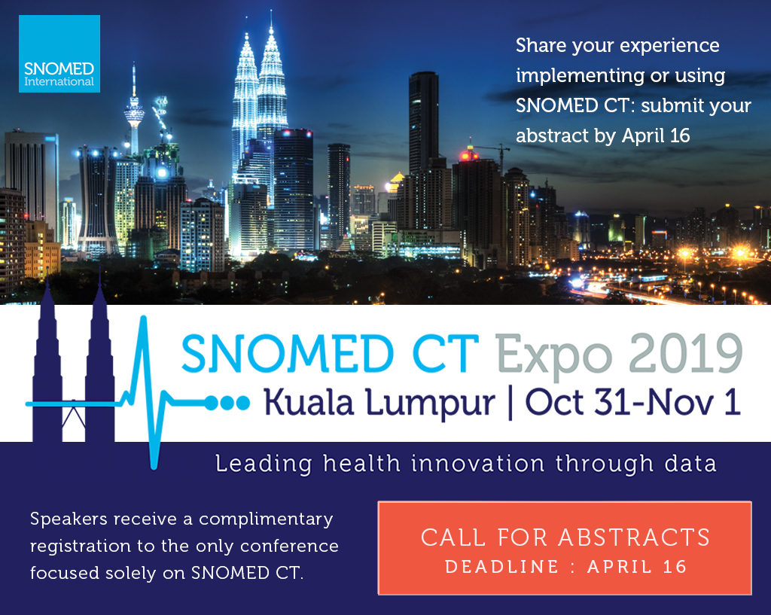

Slide 4
April 2019 Business Meeting Outcomes
Project & Working Groups
Clinical Reference Group
Advisory Groups

Slide 5
Project & Working Group Outcomes
Observables: Daniel Karlsson
  Almost concluded susceptibility observables
  Cognitive function observables, joint with MBH CRG, next steps identified
  Agreement of use of Observables model for international lab interoperability

Slide 6
Project & Working Group Outcomes
Cancer Synoptic Reporting: Scott Campbell
  At request of of Canada, Sweden and UK - Synoptic observables and Nebraska Pathology Module content for colon cancer, breast cancer and melanoma submitted to SI for consideration for international adoption.
  Reviewed and discussed inception and elaboration with colon examples.
  Language refsets under consideration for French (Canada provinces of Quebec and New Brunswick) and Swedish. To be determined if these can be developed and complete by international adoption.
  Next worksheets
      Lung Cancer
      Prostate (Total prostatectomy) – ICCR request
      Continue on with gastrointestinal tract cancers

Slide 7

Project & Working Group Outcomes
Terminology Management Workshop: Rory Davidson
A working group representing a cross-section of the community covered:
  free-flowing, open discussion on aspects of on-going 2020-2025 strategy options
  the technology details around validation as a service
  frequent releases
The meeting will take place in Kuala Lumpur, please get in touch if you would like to be involved.

Slide 8
Project & Working Group Outcomes
Events, Conditions & Episodes: Bruce Goldberg
  409774005 |Inflammatory morphology (morphologic abnormality)|
      Effect of retiring 23583003 |Inflammation (morphologic abnormality)|resulting in various abscesses inheriting an inflammation (“..itis”) parent discussed
      Impact of moving 44132006 |Abscess (morphologic abnormality)|from under 708039003 |Inflammatory lesion (morphologic abnormality)|to 4147007 |Mass (morphologic abnormality)|will require systematic review of subtypes of inflammation that need to be replaced or remodeled
      Need to review duplicates of inflammation and inflammatory morphology that may be referring to same thing.
  Editorial policy for simple co-occurrence
      Appropriate for syndromes and manifestations of systemic disorders
  Sepsis
      Create modeling template for 91302008 |Sepsis (disorder)|Remodel 371770009based on Sepsis – 3 definition
      Remodel|Endotoxemia (disorder)|as a finding
      Inactivate (19) concepts containing “septicemia” in the FSN and (19) concepts contining “Severe sepsis with acute organ dysfunction” in the FSN

Slide 9
Clinical Reference Group Outcomes
Allergy/Intolerance: Bruce Goldberg
  Need to interact with SNOMED on FHIR group with respect to allergy/intolerance with regards to
      Limited value sets containing content relevant to allergy/intolerance
      Differences in model between Hypersensitivity and Intolerance
      Relevant categories
    Project created to move Allergy to substance terms to other hierarchies if they do not represent true allergies

Slide 10
Clinical Reference Group Outcomes
Pathology & Laboratory Medicine: Deborah Drake (Scott to Present)
  The focus on the meeting was on collaboration - developing use cases for microbiology (organism surveillance), and combined solutions potentially for blood sciences
  The members at the meeting committed to creation of a database of current areas of work / interest or priority within the IPaLM CRG area on confluence
  Members of the CRG are also going to collate usage statistics for blood sciences based on test codes used where available and inform work prioritisation
  The group supports the promotion of the cancer synoptic content to international
  The next meeting will be within the next 2 months and organised via confluence

Slide 11
Clinical Reference Group Outcomes
Anesthesia: Andrew Marchant
  Discussed use of SNOMED for health issues and problem lists including anaesthesia at Salford Royal Hospitals
  Considered issues around clinical engagement and trying to encourage new members
  Presentation of SNOMED CT anaesthesia content and HL7 modelling work for anaesthesia records to Royal College and Association of Anaesthetists
  Discussions on definitions of coma and unconsciousness

Slide 12
Advisory Group Outcomes
Content Managers: Cathy Richardson
  Continued discussion on:
      context values for actions
      administrative content
  Discussion on content submissions

Slide 13
Advisory Group Outcomes
Modeling: Peter Williams
  DL Enhancements and OWL transformations
  Concrete Domains - solution roadmap
  Specific modelling considerations

Slide 14
Advisory Group Outcomes
Terminology Release: Andrew Atkinson
  Global Patient Set (GPS)
      Use Cases, Scope of Content, Format, licensing
  Migration to OWL
      Trial results, Users’ readiness, Validation
  Frequent Delivery
      Planned frequency, Perception, Impact on Derivatives
  Spanish Edition change process presentation
      Agreement, further interest

Slide 15
Advisory Group Outcomes
Editorial AG Major Topics: Jim Case
  Approved for testing: new modeling pattern for Traumatic injury
  Established a project group to discussion improvements to inactivation statuses and historical relationships
      Agreed to inactivate WAS A relationships from the International release
  Approved a way forward to address “product roles” in the medicinal product hierarchy
  Identified options to address the finding/disorder false dichotomy
  Developed a high level process to begin identification of the SNOMED CT “Clinical core”

Slide 16
Advisory Group Outcomes
Tooling User: Terance Shird
  Members Managed Service Sub-Group
      Commence development of MS specific reports in the Reporting Platform
      Continue to develop use of Templates in the MS Authoring Platform (Sweden)
      Proof of Concept for simple request management (Denmark & Ireland)
  Tooling User Advisory Group
      Demo & Tooling Updates including Refset Hands On Session
      Updates on future tooling

Slide 17
Advisory Group Outcomes
E-Learning Advisory Group: Linda Bird
  ELAG home – http://snomed.org/elag
  Member education regional update
      New or planned SNOMED CT education activities
      Feedback on existing SNOMED CT E-Learning experiences
      National or regional SNOMED CT priorities
      Education collaboration or partnership opportunities
    SNOMED International update
      Foundation and implementation courses
      Authoring courses and certifications
      Education for developers and clinicians
      Other education activities

Slide 19
Thank-you for your continued support and commitment to SNOMED International and SNOMED CT.
See you in Malaysia!
2020 April Business Meeting
April 5th-8th, 2020:
London, UK

