Slide 1
Challenges in Documenting Activities of Daily Living using SNOMED CT
SNOMED Nursing Clinical Reference Group (CRG)
Monthly Meeting
December 10, 2024
Presenter and Coauthors
Michael Stearns, MD (Presenter)
Sarita Keni, MD, MA, FAMIA
John Kilbourne, MD
Jennifer Peeples
Notes:
Dr. Sarita Keni and Dr. John Kilbourne are with the Veterans' Administration and coauthors of the abstract on this topic that was accepted at the SNOMED CT Expo 2024. Jennifer Peoples and I work for a company called J P Systems and we provide terminology services to the VA as a contractor. I was asked to present the findings from the abstract today. However, this talk will be very similar to the excellent presentation Dr. Susan Matney gave at the SNOMED CT Expo, which I encourage everyone to listen to, including the Q&A session. Dr. Matey is also the principal author of the abstract.

Slide 2
Acknowledgements
termMed
Guillermo Reynoso, MD
Maria Yunes, MD
Megan Berry
Alejandro Rodriguez
Patricio Goyal
Apelon
Shapoor Shayegani, MD, MS
David Sperzel, MD, MS
Veterans Health Administration (VHA) Digital Health Office
Jonathan Nebeker, MD, MS (Chief Medical Informatics Officer)
Steven Brown, MD, MS, FACMI, FAMIA, FIAHSI (Director of Knowledge Based Systems)
Catherine Hoang, MS, RN, FAMIA
Holly Miller, MS, RN, FAMIA
Loren Stevenson, MD
Melanie Loucks
Pamela Nobel
J P Systems
Carol Davis, PMP, CSM
Seth DeBartolo
Carrie Densmore, MHI, RHIA
H. Alpha Garrett, MD
Donna Redley, MSN, BSN, RN
Elizabeth Rivera
Susan A. Matney, PhD, RNC-OB, FAAN, FACMI, FAMIA, FHIMSS, FHL7, AL2 (former JP Systems contractor and principal author of abstract)
Notes:
Acknowledgements: The Veterans Health Administration provided support for this project under the leadership of Dr. Nebeker, Dr. Brown, Catherine Hoang and Holly Miller. Several additional individuals contributed to this work at J P Systems, termMed, and Apelon. J P Systems provides a broad range of terminology related services to the VA. termMed edits and maintains the VA SNOMED CT Extension under the direction of Drs. Keni and Kilbourne. Apelon creates and refines content requests for the VA Extension.

Slide 3
Disclosures
The authors of this presentation have no conflicts of interest to disclose.

Slide 4
AGENDA
Background
  How SNOMED CT is used in the VA
  Basic Activities of Daily Living
ADL Documentation Process
  Assessment
  Clinical Finding
ADL SNOMED CT Observable Entity and Finding Hierarchies
  Current
  Proposed Revisions
Notes:
This is the basic structure of the abstract.

Slide 5

How is SNOMED CT Used by the VA?

Slide 6
The VA use of SNOMED CT
SNOMED CT standard is adopted by the United States Department of Veterans Affairs (VA).
SNOMED CT is mandated by the United States Core Data for Interoperability (USCDI) standard for documenting observation result values and clinical findings within the medical record.
The VA manages its own SNOMED CT Extension.
Problem list entities in the VA medical record are stored as SNOMED CT codes.
The VA Terminology Team has an ongoing project to encode data elements within the electronic medical record to SNOMED CT.
Notes:
The Office of the Assistant Secretary for Technology Policy (ASTP - formerly ONC) has put out a recommendation that when observations are documented SNOMED CT should be used. LOINC is an alternative option.

Slide 7
Scope

Slide 8
Activities of Daily Living (ADLs)
Describe fundamental skills (activities) required to independently care for oneself.
Used as an indicator of functional status and identifies the areas of disability where assistance may be required.
Are an important predictor of the need for alternative living arrangements beyond living independently at home.
ADL assessments are performed by many different clinical roles such as nurses and occupational therapists.

Slide 9
ADL Care Documentation Process
8 basic ADLs are used in patient assessments:
  Bathing/showering
  Toileting and toilet hygiene
  Dressing
  Eating/swallowing
  Feeding (the setting up and bringing food to the mouth)
  Functional mobility
  Personal device care (utilizing personal care items such as hearing aids, contact lenses, glasses, orthotics, walker, etc.)
  Personal hygiene and grooming
These eight ADLs are assessed to determine if the patient:
  Can perform the activity
  Has difficulty performing the activity
  Unable to perform the activity
Following the assessment, a SNOMED CT finding concept may be placed in patient’s problem list such as “Difficulty bathing”

Slide 10
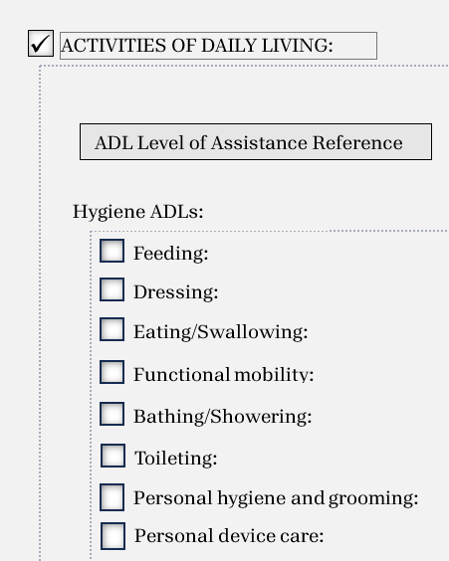
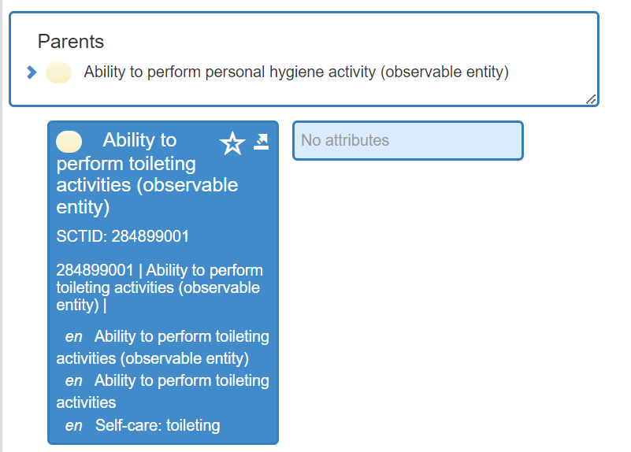
ADL Assessment Question
Notes:
Here is an example of how hygiene ADLs are documented in the EHR. We align the ADL of toileting to observable entities in SNOMED CT as the answers are the qualifier value concepts: Able, Able with Difficulty, and Unable – as we will discuss.

Slide 11
ADL Observable Entities
Element | SCT FSN | SCT ID
Bathing/Showering | Ability to perform bathing activity (observable entity) | 284797005
Toileting | Ability to perform toileting activities (observable entity) | 284899001
Dressing | Ability to dress (observable entity) | 165235000
Eating/Swallowing | Ability to eat (observable entity) | 288883002
Feeding | Ability to feed self (observable entity) | 288999009
Mobility | Ability to walk (observable entity) | 282097004
Personal device care | None
Personal Hygiene/grooming | Ability to perform personal hygiene activity (observable entity) | 284779002
Notes:
We found that SNOMED CT has observable entity ability concepts for 7 of the 8 basic ADLs.

Slide 12
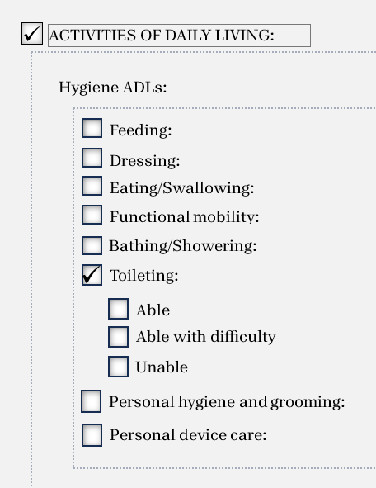
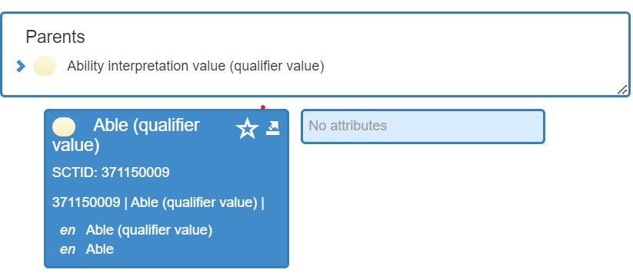
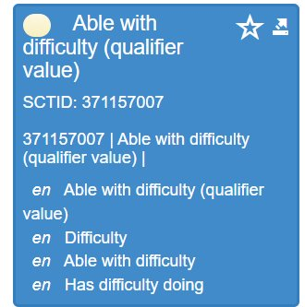
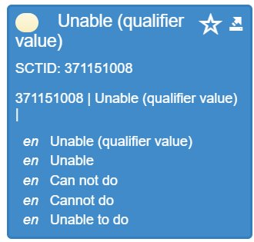
ADL Assessment Values
Notes:
This slide show the options that appear in the EHR when Toileting is selected. Assessments are resulted to qualifier values Able, Able with Difficulty, and Unable. All three values are available in SNOMED CT as children of the Ability interpretation value (qualifier value) concept in SNOMED CT.

Slide 13
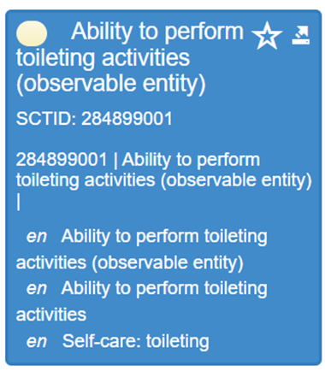
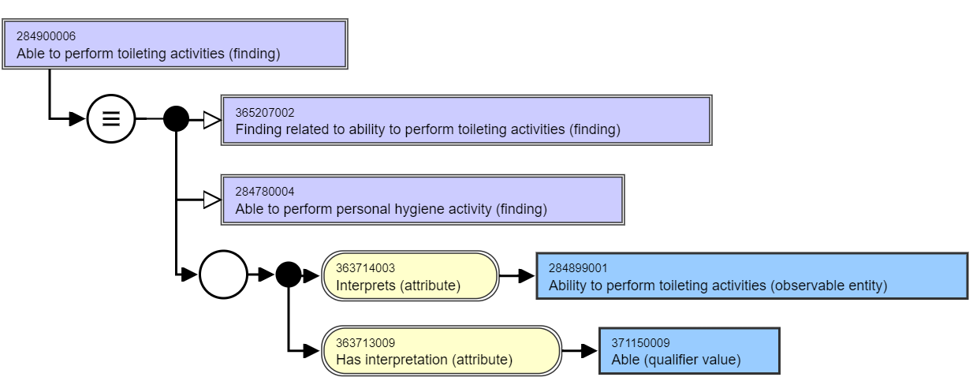
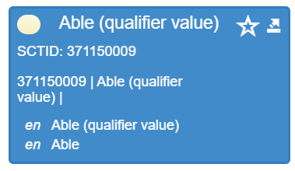
ADL Clinical Finding
Notes:
Fully defined clinical findings for ADLs are modeled using the clinical findings concept model attributes of “Interprets” and “Has Interpretation.” We developed an expression constraint language (ECL) query to retrieve the clinical findings for each of the 8 ADL observable entity concepts. The values for the “Interprets” attribute should be one of the eight observable entities (e.g., Ability to perform toileting activities (observable entity)) and the values for the “Has interpretation” values (e.g., Able (qualifier value)) are the children of “371148001 |Ability interpretation value (qualifier value)|.”
We are unable to query primitive (undefined) concepts, Hence, the goal is to increase fully defined concept modeling.

Slide 14
ECL for Toileting Findings
<< 404684003 |Clinical finding (finding)| : 363714003 |Interprets (attribute)| = 284906000 |Ability to use toilet (observable entity)|, 363713009 |Has interpretation (attribute)| = << 371148001 |Ability interpretation value (qualifier value)|
Concept (Fully Specified Name) | Preferred Term | Id
Difficulty using toilet (finding) | Difficulty using toilet | 284911003
Unable to use toilet (finding) | Unable to use toilet | 284908004
Able to use toilet (finding) | Able to use toilet | 284907009
Notes:
This shows the result of the ECL query for findings in SNOMED CT for ability to toilet. We constrained the query to concepts in the Finding hierarchy that had the following two attribute value pairs:
363714003 |Interprets (attribute)| = 284906000 |Ability to use toilet (observable entity)|,
363713009 |Has interpretation (attribute)| = << 371148001 |Ability interpretation value (qualifier value)| (and children)
We found all three of the toileting ability finding concepts.

Slide 15
Mapping Results

Slide 16
Summary of Mapping Results
Observable entity: 7/8 ADL (88%) questions mapped to observable entity concepts
  The one missing observation was "Personal device care.”
Qualifier value: All three (100%) of the qualifier values (able, difficulty, and unable) were present in SNOMED CT
Clinical finding: 21/24 (87.5%) of the data elements mapped to clinical findings.
Issues with the observable entities and clinical finding hierarchies were also identified.

Slide 17
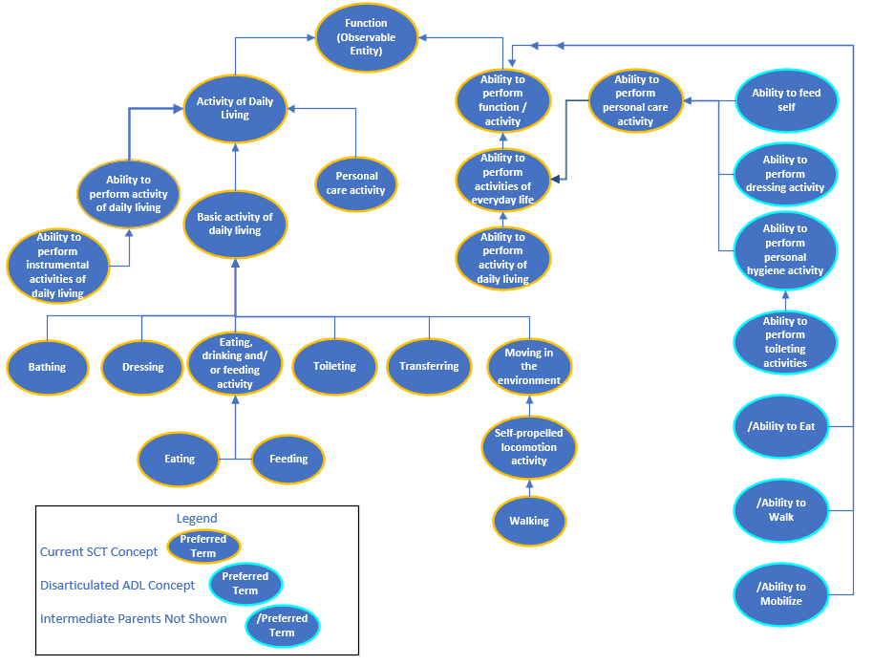
Current ADL Observable Entity Hierarchy
Notes:
The Observable entity hierarchy contains a concept 129025006 |Activity of daily living (observable entity)| which has child 413634008 |Basic activity of daily living (observable entity)|. “Basic activity of daily living” includes all eight ADLs as descendants. However, they not “ability to” concepts and are single observations such as bathing, dressing, and toileting. They are not an observation of the ability because they do not include the words "Ability to.” This may have been because the current observable entity ADL hierarchy is intended to represent ADLs that are "done" by the patient vs. "able/ability to" be done.
We did find “ability to perform” observation concepts (as shown on the right) but these concepts did not resolve to an “Ability to perform basic activities of daily living” concept.

Slide 18
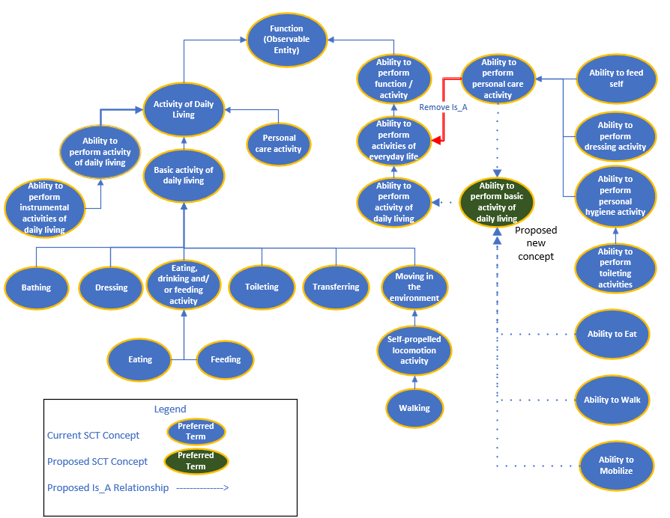
Proposed Observable Hierarchy Modification
Notes:
A possible solution could be to 1) create a new concept “Ability to perform basic activity of daily living (observable entity)” as a child of “1297080006 |Ability to perform activity of daily living (observable entity)|”, with “Ability to mobilize (observable entity)”, “282097004 |Ability to walk (observable entity)|”, “288883002 |Ability to eat (observable entity)|” and “284773001 |Ability to perform personal care activity (observable entity)|” as children; and 2) removing the direct IS-A relationship between “Ability to perform personal care activity (observable entity)” and “Ability to perform activities of everyday life (observable entity).” This would resolve all basic activities of daily living observable entity concepts, required by nursing, to a single high-level parent and facilitates retrieval using ECL.

Slide 19
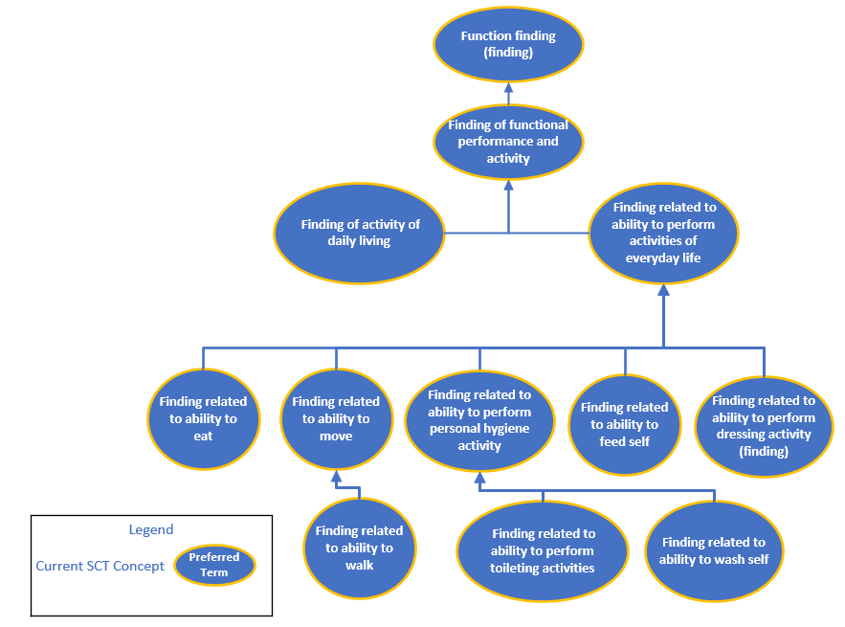
Current ADL Clinical Finding Hierarchy
Notes:
The clinical findings discovered using the ECL query were in multiple sub-hierarchies and only resolved up to 118228005 |Functional finding (finding)|, a very high-level parent with 304 immediate subtypes. There is no clinical finding concept that exactly aligns with the observable entity concept 413634008 |Basic activity of daily living (observable entity)|, including the ability to perform the ADL.

Slide 20
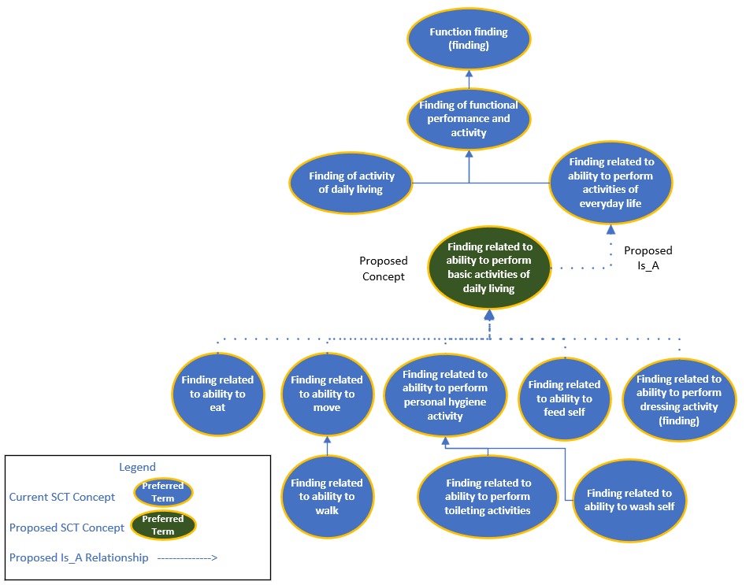
Proposed Clinical Finding
Hierarchy Modification
Notes:
Therefore, to facilitate querying basic ADLs, we suggest creating a new navigational concept “Finding related to ability to perform basic activity of daily living (finding)” as a child of “365031000 |Finding related to ability to perform activities of everyday life (finding)|.” This would allow all basic ADL clinical findings collected by nurses and other clinicians to be children of “Finding related to ability perform basic activity of daily living (finding)” and facilitate robust ECL queries.

Slide 21
Conclusion
VA data element mapping to ADL SNOMED CT clinical concepts was performed including:
  Assessment related observable entities and qualifier values are used for the observation
  Clinical findings for ability to ADLs are well represented in SNOMED CT
  Evaluation of the SNOMED CT Hierarchy
A large percentage of VA data elements mapped to SNOMED CT concepts
Hierarchical issues were identified and solutions proposed

Slide 22
Questions?

