Slide 1
HL7 EU Laboratory semantic WG
Brief introduction

Slide 2
History
Established during EU X-eHealth (https://www.x-ehealth.eu/) project in 2021 as WG responsible for Functional specification of EU laboratory ordering and reporting
Focus on all lab types except genetics and histopathology
Contribution from many EU countries
Key Deliverables:
  Logical information model
  D5.1 - Laboratory Requests and Reports guideline and functional specifications (https://www.x-ehealth.eu/wp-content/uploads/2022/09/D5.3-Laboratory-Requests-and-Reports-guideline-and-functional-specifications.pdf)
  Cover key aspect in all layers of the Re-EIF (European Interoperability Framework), i.e.: legal and regulation, process, information, semantic, technical
  FHIR Implementation guide (implementable specification)

Slide 3
Present focus
WG continue working on voluntary basis after the end of X-eHealth project and transitioned into HL7 Europe
Number of participants and participating countries grown as laboratory interoperability gained huge interest of M/S driven (not only) by EHDS regulation
M/S represented in the WG by individuals and/or national organizations or projects: CZ, SE, IT, NO, DE, NL, ES, PT, EE, IE, US, LU, FR, AT, EU (MyHealth@EU)
Composition/ expertise: Laboratory medicine, Health Information, Semantic, Terminology, FHIR

Slide 4
Impact
Direct impact on EHN Laboratory guidelines
Direct impact on MyHealth@EU project
Direct impact on EU and global lab standardization through HL7 EU and participation in EU projects (Xpandh, x-Share, …)
  HL7 EU Laboratory FHIR IG released in 2024
  Now handed over to HL7 International for balloting as global standard
  Objective:
    global HL7 standard
    ISO/CEN standardization process
Impact on EHDS Implementation act through Xt-EHR (EU Joint action)

Slide 5


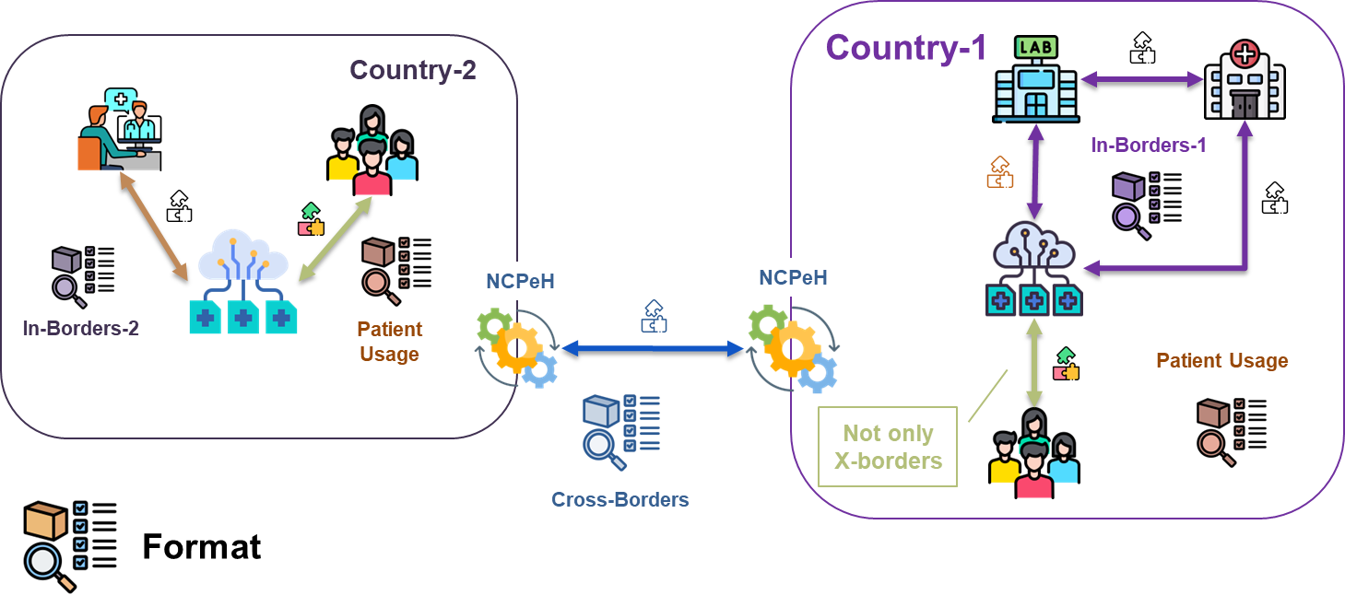
The strategy
Standards
Global
A consistent system (i.e. a federation) of cooperating, coherent and possibly standard-based specifications
If exists
European
European Auth.
If needed
X-Borders
Common
National Auth. / Stand.
image: Flaticon.com
Notes:
The strategy for supporting this goal is – as I said – not to but to have the format as ….

Slide 6
Plans
Continuation of work on EU value sets and data standards for cross border exchange and basis for national use
Improvements of the HL7 EU ang global FHIR laboratory guide esp. for microbiology reporting
EEHRxF data set specification for EHDS implementation act
EHR requirements for EHDS implementation act
Extend collaboration with international expert bodies (ESCMID, EFML, HL7 OO WG, SNOMED Pathology and laboratory CRG)

Slide 7
Core results of our work
Laboratory reporting data model can be found at HL7 EU A - Laboratory Report - HL7 Europe Laboratory Report v0.2.0-ci (fhir.org)
HL7 EU FHIR Implementation guide: Home - HL7 Europe Laboratory Report v0.2.0-ci (fhir.org)
Xt-EHR refined logical information models: Laboratory Report (model) - Xt-EHR v0.1.0 (fhir.org)
X-eHealth logical data model: https://x-ehealth.min-saude.pt/

Slide 8
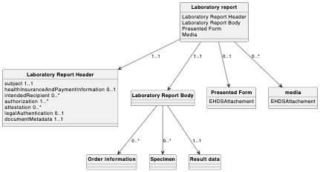
Basic lab report logical model (Xt-EHR)

Slide 9
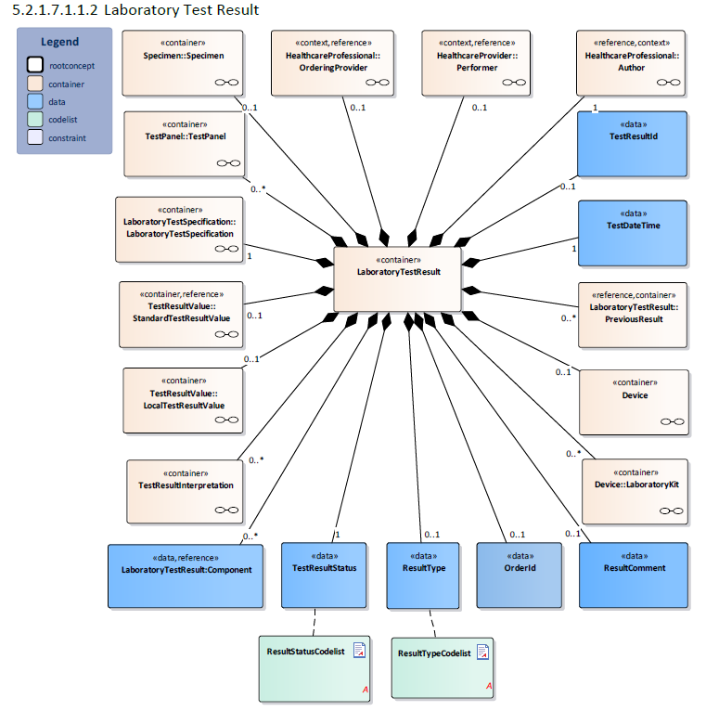
X-eHealth Component model

Slide 10
Ideas for possible collaboration
Evaluation and improvement of the HL7 EU Laboratory report FHIR IG
  Provide feedback
  Extend guidelines for users and implementers
Standard units for the lab tests
Evaluation, comments, improvements of current EU value sets
Maintenance of CRM value set
Support and marketing for interoperability in the lab domain
Standardization of lab orders ?
Histopathology, genetic labs ?
Prioritization of standardization works
Pre-analytical phase – information needs, errors reporting, …
LOINC – NPU – SNOMED mapping

Slide 11
Thank you
Hynek Kruzik, HL7 EU Laboratory WG leader
Kruzik@gnomon.cz
Hynek.Kruzik@hl7europe.org

