Slide 1
Experiences from translating nursing concepts in Norway
Translation user group, SNOMED CT Business meeting 2024
Marte Rime Bø

Slide 2
Similar enough
ICNP kode | ICNP term | ICNP norsk term | SCT kode | SCT term | SCT norsk term
10050350 | Applying Ointment | Påføre salve | 733925000 | Application of ointment (procedure) | Påføring av salve
10037875 | Assessing Dietary Need | Vurdere kostholdsbehov | 710847006 | Assessment of dietary need (procedure) | Vurdering av kostholdsbehov

Slide 3
Changed meaning
ICNP | ICNP term | ICNP norsk term | SCT term | Norsk SCT term
10050089 | Assessing Discomfort | Vurdere ubehag | Assessment for sign of discomfort (procedure) | Vurdering av tegn på ubehag
10043656 | Assessing Diarrhoea | Vurdere diaré | Diarrhea care assessment (procedure) | Vurdering av diarébehandling
10022814 | Impaired Sense Of Taste | Mangler smakssans (No sense of taste) | Taste sense altered (finding) | Endret smakssans

Slide 4
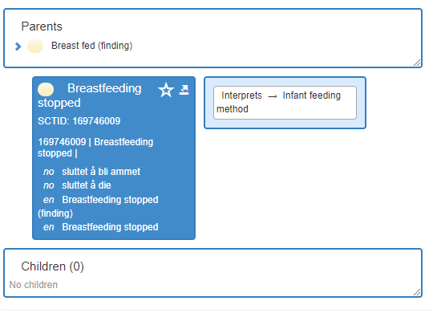
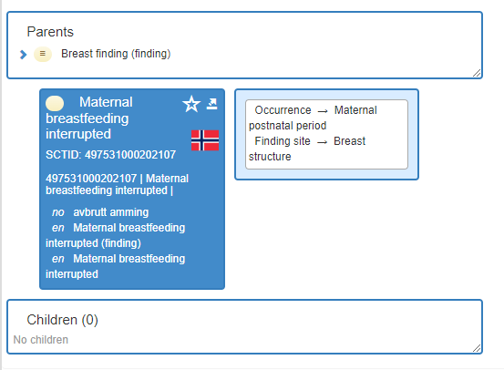
Perspectives

Slide 5
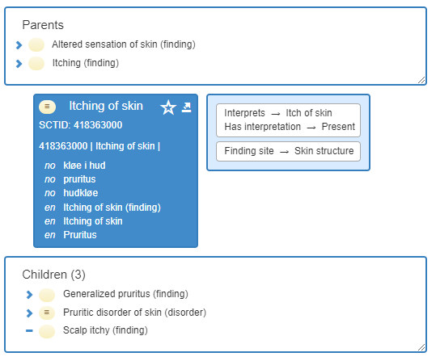
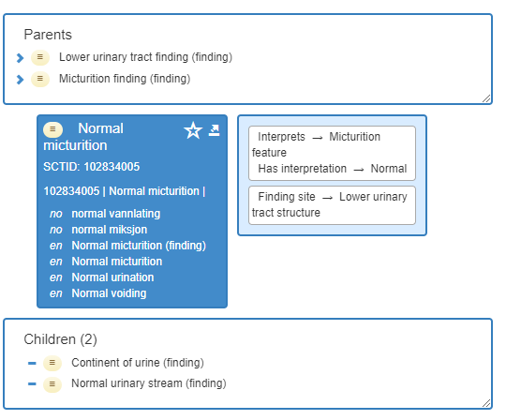
Health professional lingo

Slide 6
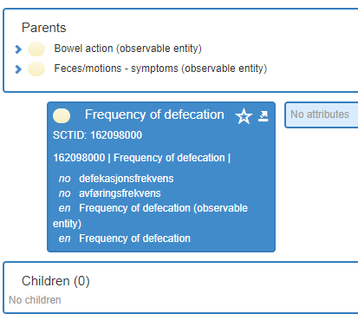
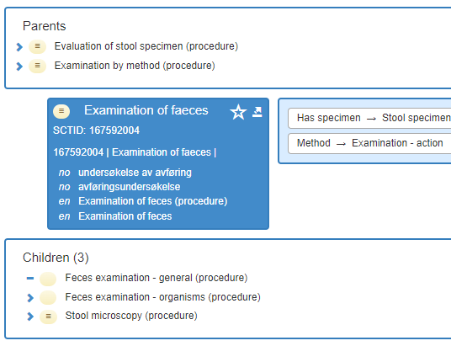
Less words in Norwegian
"Avføring" - both defecation and feces
Process and substance
Nursing group wants "avføring" on both kinds of concepts

Slide 7
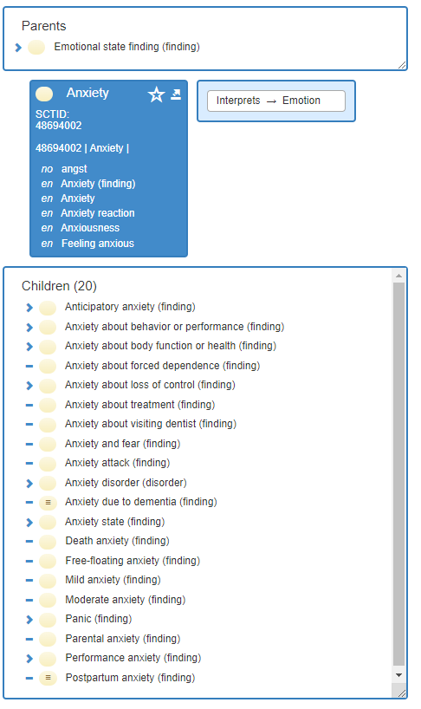
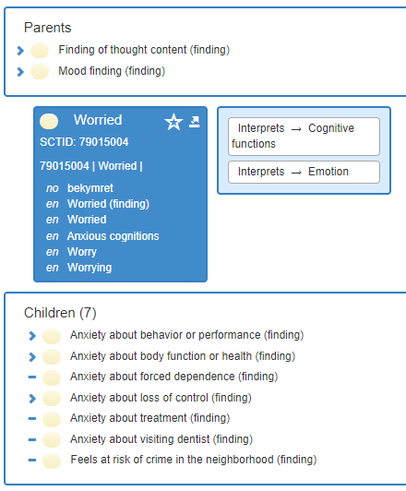
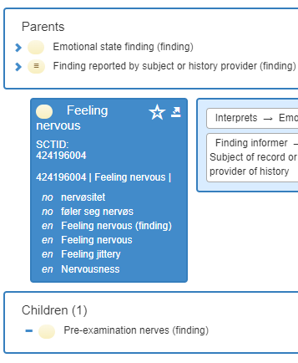
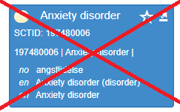
More words in Norwegian

Slide 8
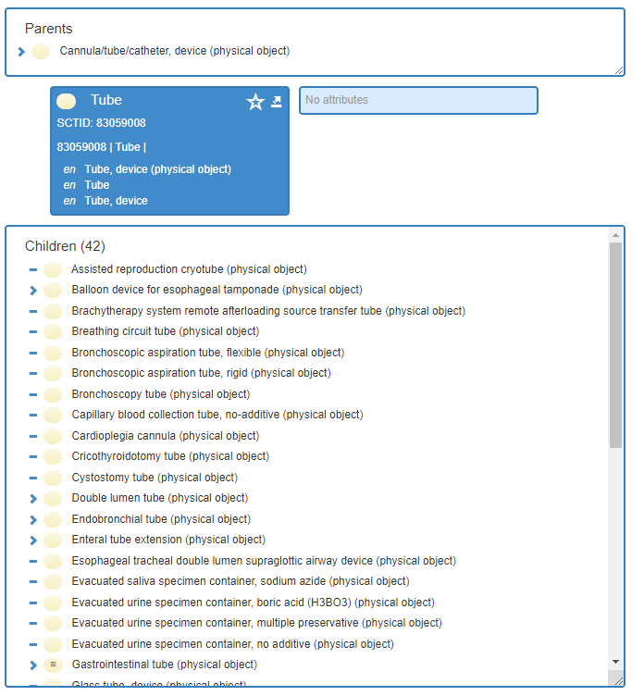
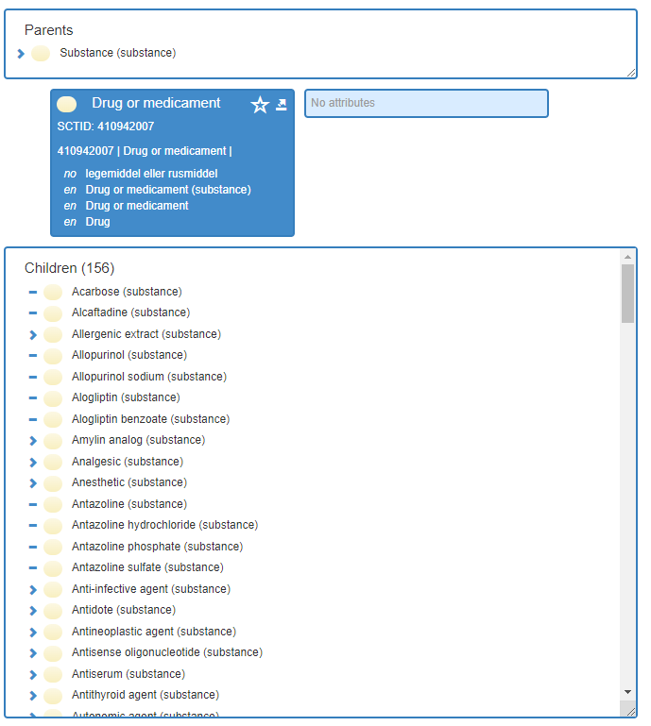
More words in Norwegian part 2 – tubes and drugs

Slide 9
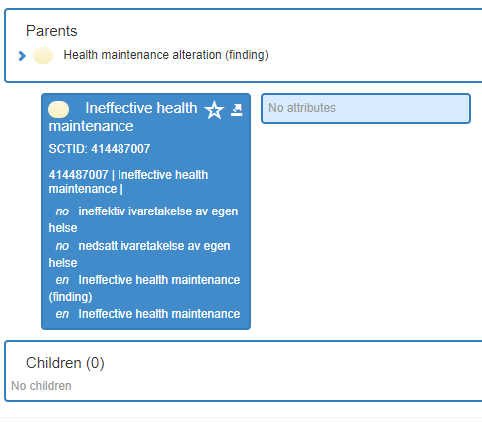
Think about the reader
Used and translated for ICD-10 map
"Bad health maintenance"
Patient and family access the nursing care plans
Quick fix with the NRC Term team

Slide 10
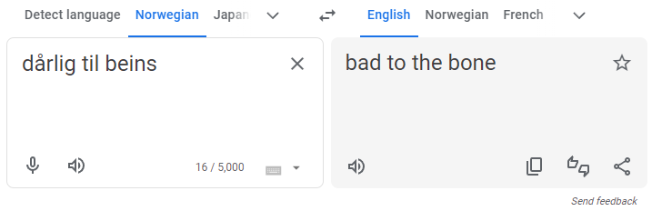
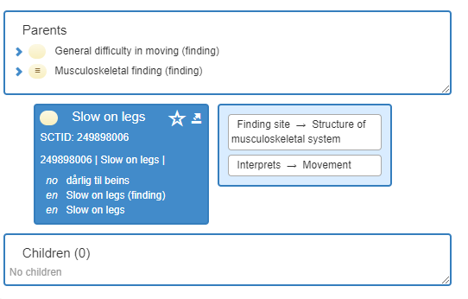
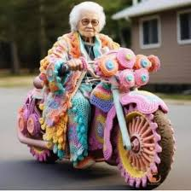
Local variations

Slide 11

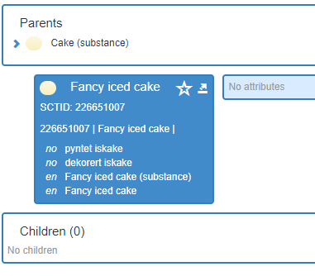
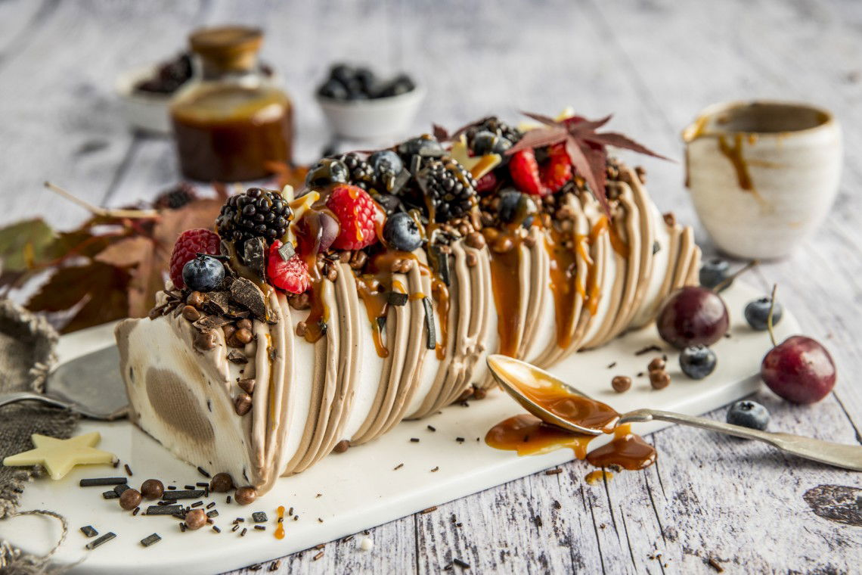
Ice cake or Iced cake?

