Slide 1
Framework of challenges in translation SNOMED CT
DRAFT

Slide 2
Framework of challenges in translation of SNOMED CT
1 Conceptual challenges
2 Ontological challenges
3 Linguistic challenges
4 Cultural challenges
Question: Is the biggest challenge lack of access to clinical specialists?

Slide 3
1 Conceptual challenges
1a Ambiguious FSN
(ambigous lexical items?)
1b FSN not in alignment with EG
1c Not equivalent synonyms
others?
Examples

Slide 4
2 Ontological challenges
2a Grouper concepts
2b Mismatch between FSN and attributes
2c Parent/child/sibling relationship
others?
Examples

Slide 5
3 Linguistic challenges
3a Consistency
3b Synonyms: Which one as PT?
3c Unknown term in target language
3d FSN-ian language
3e Inverted word order in source
3f English terms more familiar
others?
Examples

Slide 6
S?
4a
4 Cultural challenges
(=different conceptualization)
4a Source concept unknown
4b Only partial equivalency
4c Multiequivalency
4d False friends
S
T
4b
T
S
4c1
T
Examples
S
T
4c2
S

Slide 7
How are these challenges resolved? What translation strategies are adopted?

Slide 8
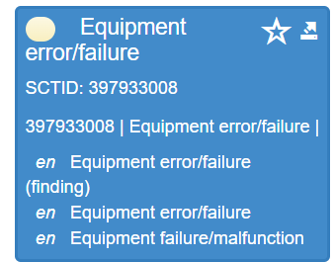
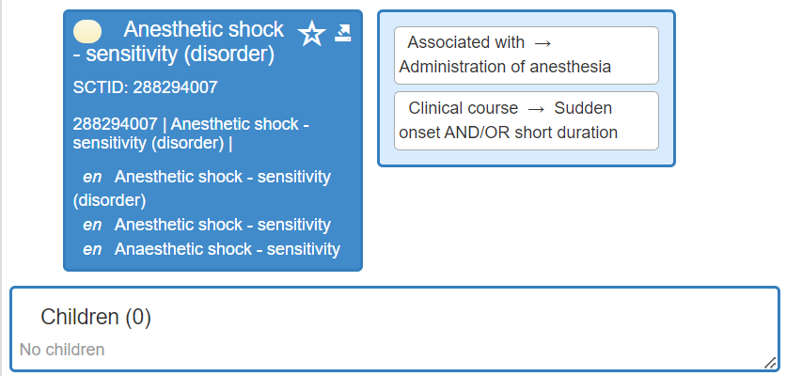
1 Conceptual challenges
1a Ambiguious FSN
1b FSN not in alignment with EG
1c Not equivalent synonyms
others?
Examples: Ambigous FSN

Slide 9
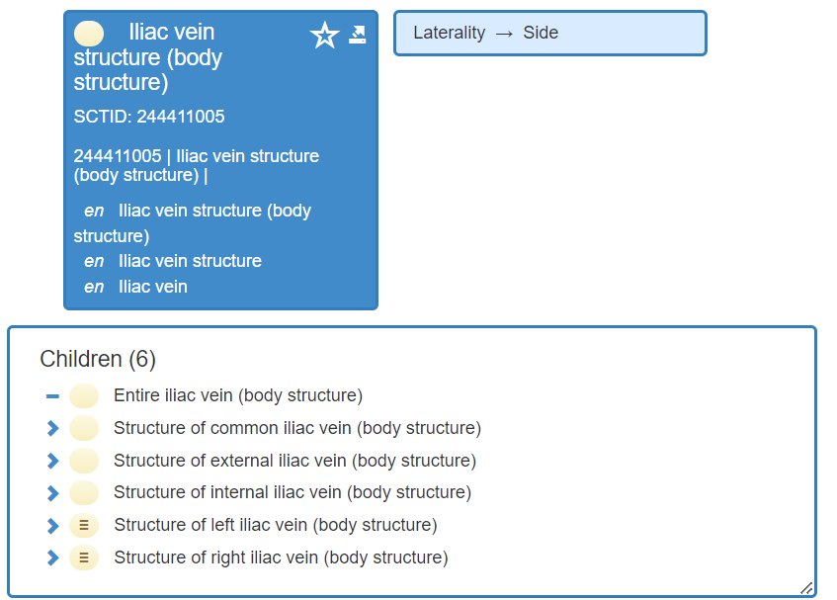
2 Ontological challenges
2a Grouper concepts
2b Mismatch between FSN and attributes
2c Parent/child/sibling relationship
others?

Slide 10
3 Linguistic challenges
3a Consistency
3b Synonyms: Which one as PT?
3c Unknown term in target language
3d FSN-ian language
3e Inverted word order in source
others?

Slide 11
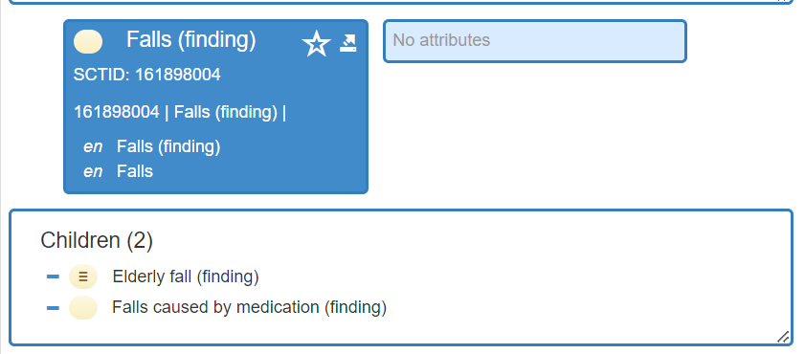
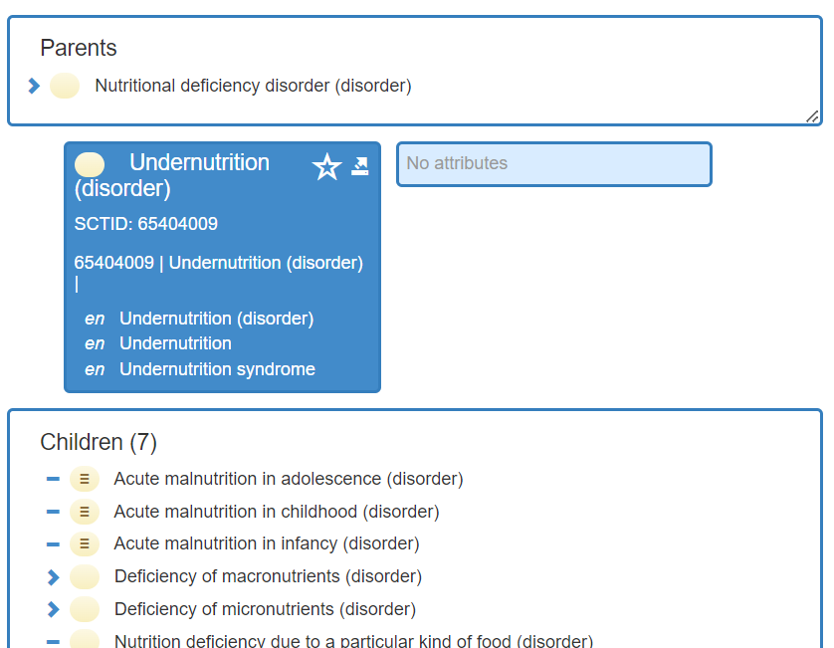
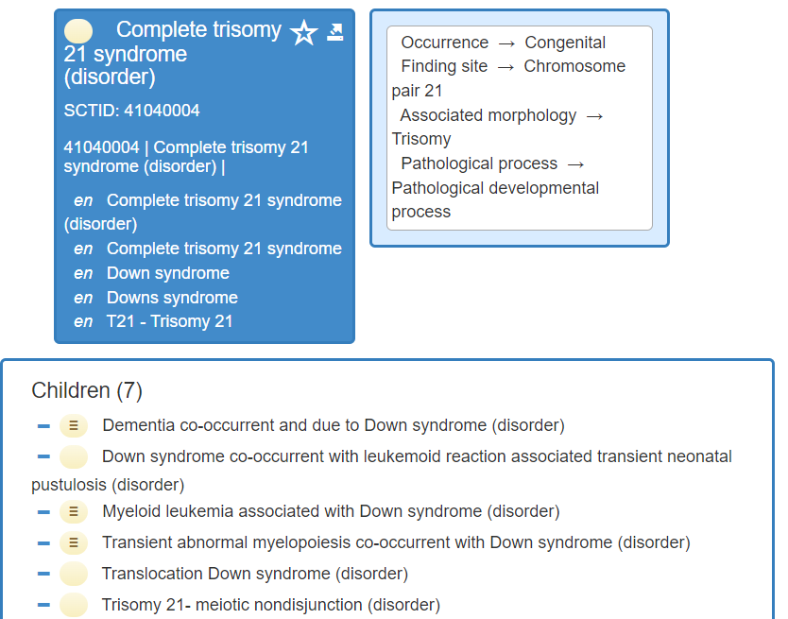
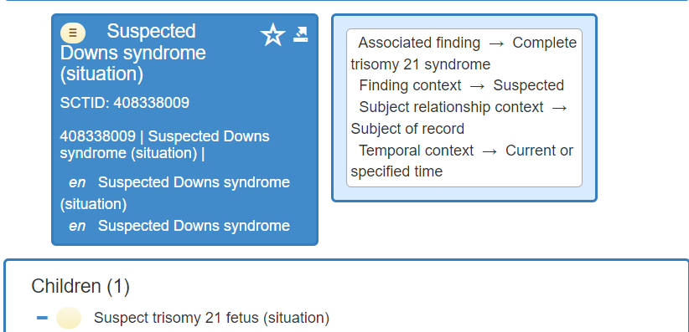
Linguistic consistency: vertical and horizontal
Example 1: vertical (parent-child)
Example 2: vertical (parent-child)
Example 3: horizontal (disorder-situation)

Slide 12
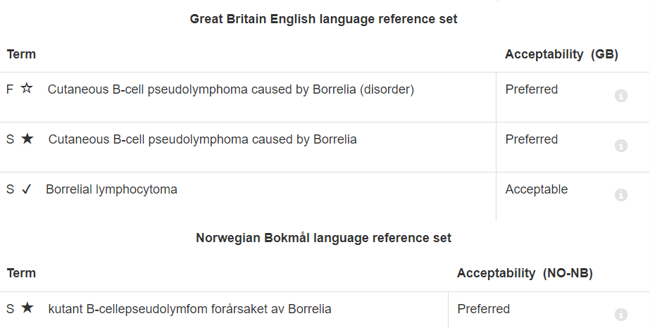
FSN-ian language
(Translated term is a direct translation of FSN, rendering an unfamiliar term in target language)

Slide 13
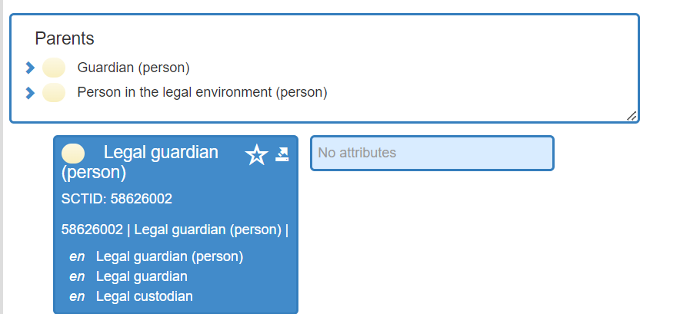
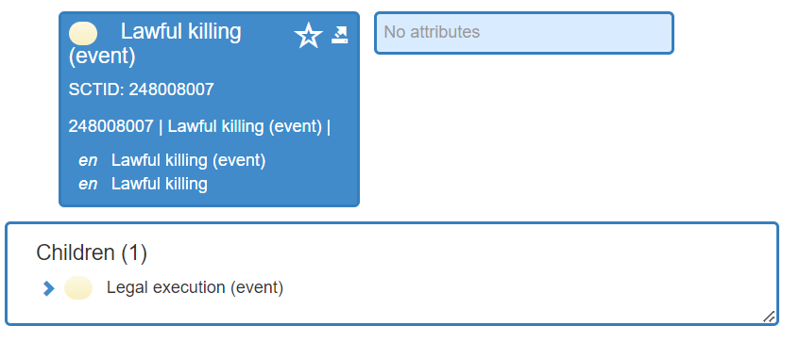
4 Cultural challenges
4a Source concept unknown
4b Only partial equivalency
failure vs insuffiscience in French

Slide 14
Other examples (rest of slides)
FSN-ian: 718373005 |Cutaneous B-cell pseudolymphoma caused by Borrelia (disorder)|
See synonyms!

Slide 15
Inverted terms:
40144003 |Morning stiffness - joint (finding)|
162213003 |Crying, excessive (finding)|

Slide 16
Adjective suffix: several possible outcomes:
Paroxysmal > paroksysmal/paroksystisk

