Slide 1
Observable entities
Daniel Karlsson

Slide 2
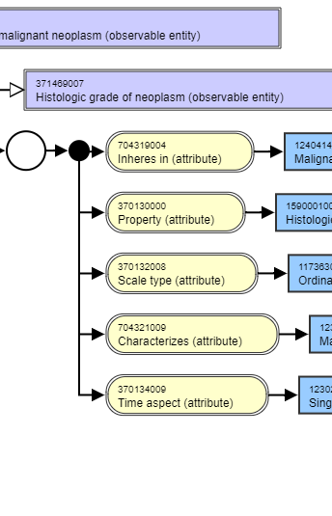
Agenda
Background
What is an Observable?
Concept model

Slide 3
Background
NHS CTV3 included ”History and observations” among Clinical findings
The first proposal for the joint Snomed-CTV3 top hierarchies had ”Measurable and observable entities”
Observable entities was a fully primitive hierarchy, no concept model
June 2008 the ”Observables and Investigation Model Project”, then a 2-year project
2009 a joint IHTSDO, LOINC and NPU pilot project
2010-2022 the project investigates use cases. Many contributors.
Jan 2017 first release with fully defined Observables

Slide 4
What is an Observabel?
Something that, when an observation is made, can have a value as result
An Observabel has two ”parts”
  What property is measured (or observed)
  How is this property measured (or observed)

Slide 5
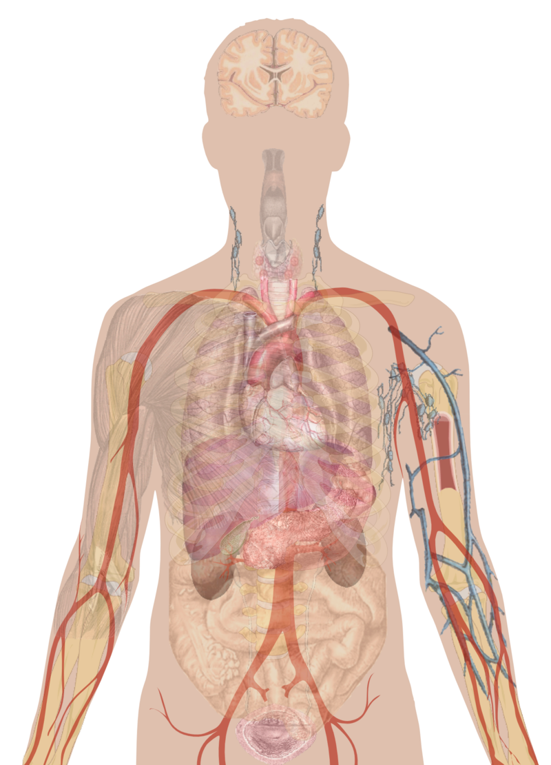
Observables model principles
WHAT
HOW

Slide 6
Observables model principles
WHAT
HOW
Core temperature, also called core body temperature, is the operating temperature of an organism, specifically in deep structures of the body such as the liver, in comparison to temperatures of peripheral tissues.

Slide 7
Observables model principles
WHAT
HOW
370130000 | Property (attribute) |
Core temperature, also called core body temperature, is the operating temperature of an organism, specifically in deep structures of the body such as the liver, in comparison to temperatures of peripheral tissues.
704319004 | Inheres in (attribute) |

Slide 8
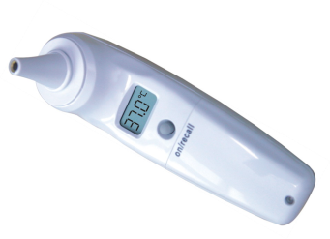
Observables model principles
WHAT
HOW
704327008 | Direct site (attribute) |
Core temperature, also called core body temperature, is the operating temperature of an organism, specifically in deep structures of the body such as the liver, in comparison to temperatures of peripheral tissues.
370132008 | Scale type (attribute) |
424226004 | Using device (attribute) |

Slide 9

Observables model principles
WHAT
HOW
Procedure information is needed for interpretation of value
Multiple ways (observation procedures) of observing the same “thing”
New ways of observation will evolve over time

Slide 10
Observables model principles
WHAT
HOW
Characterizes (attribute)
Component (attribute)
Has realization (attribute)
Inherent location (attribute)
Inheres in (attribute)
Precondition (attribute)
Process acts on (attribute)
Process agent (attribute)
Process duration (attribute)
Process extends to (attribute)
Process output (attribute)
Property (attribute)
Relative to (attribute)
Relative to part of (attribute)
Towards (attribute)
Direct site (attribute)
Procedure device (attribute)
Using device (attribute)
Scale type (attribute)
Technique (attribute)
Time aspect (attribute)
Units (attribute)

Slide 11
370130000 |Property (attribute)|
This attribute is used to specify the type of inherent quality, function, disposition or process characteristic that is being observed or measured. Its values are abstract types of quality (length, odor, concentration) or abstract types of process characteristic (rate, speed, duration), and do not include qualities that are located (length of arm, odor of urine), or given a value (elevated concentration).

Slide 12
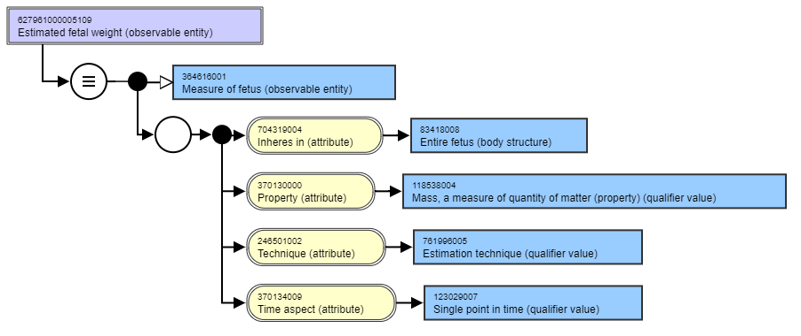
370130000 |Property (attribute)|
This attribute is used to specify the type of inherent quality, function, disposition or process characteristic that is being observed or measured. Its values are abstract types of quality (length, odor, concentration) or abstract types of process characteristic (rate, speed, duration), and do not include qualities that are located (length of arm, odor of urine), or given a value (elevated concentration).

Slide 13
704319004 |Inheres in (attribute)|, 718497002 |Inherent location (attribute)|
SNOMED CT (or specifically RF2) does not allow nested anonymous concepts (beyond role groups)
Inheres in:
This attribute specifies the independent continuant which bears the quality, and on which the dependent quality (of this observable) depends.
Inherent location
Inheres in
Property

Slide 14
704319004 |Inheres in (attribute)|, 718497002 |Inherent location (attribute)|
SNOMED CT (or specifically RF2) does not allow nested anonymous concepts (beyond role groups)
Inheres in:
This attribute specifies the independent continuant thing which bears the qualityproperty, and on which the dependent quality (of this observable) depends.
Inherent location
Inheres in
Property

Slide 15
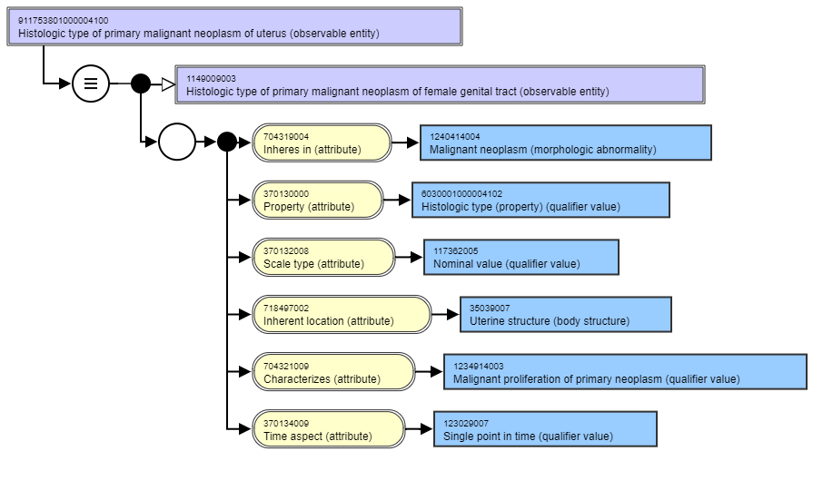
704319004 |Inheres in (attribute)|, 718497002 |Inherent location (attribute)|
SNOMED CT (or specifically RF2) does not allow nested anonymous concepts (beyond role groups)
Inheres in:
This attribute specifies the independent continuant thing which bears the qualityproperty, and on which the dependent quality (of this observable) depends.
Inherent location
Inheres in
Property

Slide 16
246093002 |Component (attribute)|
Relational properties
  Where the property is a relationship between 2 things
If one thing is a part of the other thing, Component attribute is used
  Based on Goldbook definition
Inherent location
Inheres in
Component

Slide 17
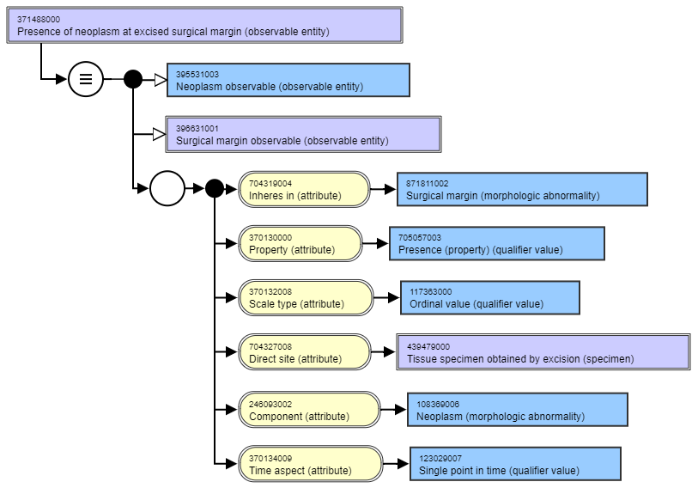
246093002 |Component (attribute)|
Relational properties
  Where the property is a relationship between 2 things
If one thing is a part of the other thing, Component attribute is used
  Based on Goldbook definition
Inherent location
Inheres in
Component

Slide 18
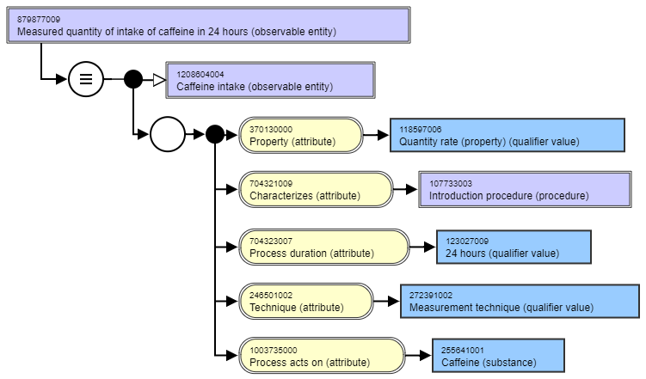
704321009 |Characterizes (attribute)|
Process Observables – change over time, rates

Slide 19
719722006 |Has realization (attribute)|, 704320005 |Towards (attribute)|
Disposition and Function Observables
Disposition
Trigger
Reaction
704320005 |Towards (attribute)|
719722006 |Has realization (attribute)|

Slide 20
Tack!
daniel.karlsson@ehalsomyndigheten.se

