Slide 1
Way of the Wizard:
Deploying Genomics in Pathology for Precision Medicine in Cancer
W. Scott Campbell PhD MBA
James R. Campbell MD
Nebraska Medicine
University of Nebraska Medical Center

Slide 2
Disclosures
We receive no financial support from any interests vending electronic health records or vocabulary services
Portions of this work have been funded by:
NIH 5U01HG009455-02 Deploying ONC national Standards in Support of Metadata for Big Data
Research Warehouse Management
PCORI CDRN-1501-26643 CDRN 04:The Greater Plains Collaborative
NIH 1U54GM115458-0, Subproject ID 5422 Great Plains Idea-Ctr-Biomedical Informatics and Cyberinfrastructure Enhancement Core

Slide 3
Third law:
“Any sufficiently advanced technology is indistinguishable from magic”
Arthur C. Clarke

Slide 4
Revolution in healthcare
Sequencing of human genome has led to flood of new observational data appearing in scientific literature and now…magically in clinical records
Majority of this clinical data is unstructured and not useful for decision support in the EHR or clinical research
Understanding of genetic and molecular basis of human disease now having impact on diagnosis and therapy
Challenge posed by wizardry of precision medicine - to have sufficiently detailed coded molecular genetic observations and diagnostic data to guide in treatment of cancer, infectious disease and pharmacogenetics

Slide 5
Limitations of ONC terminologies for Human Genomics
Research community
HUGO; Human Gene Nomenclature Committee
UniProt; Ensemble; Cosmic
NCBO: OMIM; Orphanet
Global Alliance for Genomics and Health
Clinical community
SNOMED CT 20170730:
  No concept model for subcellular anatomy or molecular structure
  No concept model for Observable entity or molecular basis of disease in Clinical findings
  Little content, all primitives
LOINC 2.61:
  3172 PCR; 1511 MOLGEN; 194 FISH; 1532 CELL MARKERS
  Concept model inadequate to fully define what is being result
  Provides only tag-level interoperability of molecular data
FHIR http://www.hl7.org/FHIR/genomics.html
  Observation genetics profile
  Diagnostic genetics report
  HLA genotyping results profile

Slide 6
Limitations of ONC terminologies for Human Genomics
Research community
HUGO; Human Gene Nomenclature Committee
UniProt; Ensemble; Cosmic
NCBO: OMIM; Orphanet; Protein Ontology
Global Alliance for Genomics and Health
Clinical community
SNOMED CT 20170730:
  No concept model for subcellular anatomy or molecular structure
  No concept model for Observable entity or molecular basis of disease in Clinical findings
  Little content, all primitives
LOINC 2.61:
  3172 PCR; 1511 MOLGEN; 194 FISH; 1532 CELL MARKERS
  Concept model inadequate to fully define what is being result
  Provides only tag-level interoperability of molecular data
FHIR http://www.hl7.org/FHIR/genomics.html
  Observation genetics profile
  Diagnostic genetics report
  HLA genotyping results profile
No meaningful semantic bridge links
genetic scientific findings with clinical
concept models

Slide 7
NM AP/MP Synoptic Data Use Cases:
Precision medicine research project planning
Cancer treatment planning
Laboratory risk and safety management
Retrieving biobank tissue for research protocols
Anatomic Pathology (AP) deals with the size, shape and microscopic
appearance of tissue
Molecular Pathology (MP) deals with the metabolic, protein and genetic
subcellular structure and behavior of tissue

Slide 8
Precision Medicine Treatment Planning
Stage IV melanoma therapy:
  BRAF V600E/K+ ➔ vemurafenib or dabrafenib and trametinib
  BRAF V600E-; KIT+ ➔ dasatinib or imatinib or nilotinib
Colon cancer therapy:
  NRAS or KRAS variant+; EGFR treatments are ineffective
  EGFR+ ➔ cetuximab or panitumumab

Slide 9
Precision Medicine Treatment Planning
Stage IV melanoma therapy:
  BRAF V600E/K+ ➔ vemurafenib or dabrafenib and trametinib
  BRAF V600E-; KIT+ ➔ dasatinib or imatinib or nilotinib
Colon cancer therapy:
  NRAS or KRAS variant+; EGFR treatments are ineffective
  EGFR+ ➔ cetuximab or panitumumab
What is needed to meet the needs of these researchers and
clinicians is a domain ontology (structured, fully defined
coding hierarchy) defining detailed MP observations which
can be employed in knowledge bases organizing the
growing body of scientific knowledge increasingly central
to clinical medicine
These data types are called “Observables” within semantics of SNOMED CT and LOINC

Slide 10
Outline
Precision medicine and Epic…Use cases for structured genomic data
BD2K Structured pathology reporting; project plan
Genomic extensions for SNOMED CT and LOINC
Architecture for transmitting pathology data to Epic
Project status: structured anatomic and genomic results in Epic and i2b2
Notes:
At Nebraska Medicine a grant is supporting the reporting of precise coded genomics data real-time from the pathology lab. That data is deployed in Epic for clinical care, enhances the decision support provided by the pathologist to the oncologist, and is re-used for research planning and execution. This presentation will examine the clinical terminology of genomics and how it is used in precision medicine.
4000 character supporting details
Beginning in 2015, Nebraska Medicine undertook a collaborative project with the College of American Pathologists, the IHTSDO and Regenstrief Institute to systematically encode the content of pathology protocols for diagnosis of cancer, addressing both anatomic and molecular pathology. Systematically analyzing the semantics within the scope of the 82 Cancer Protocol Templates of the College of American Pathologists, we revised the workflow of the clinical pathologist in order to capture structured synoptic cancer data at the time they report out their findings. The coded results are transmitted by an HL7 interface developed by Epic to store results in the EHR which may be flowcharted, graphed and used in decision support rules. Genetic sequencing of tumors and molecular observations of cancer metabolism are included in these datasets and are critical to the planning of therapy for precision medicine. Concurrent interfaces transmit the structured data to our data warehouse and to the metadata of our biobank repository. Terminology extensions to SNOMED CT and LOINC developed in this work have been published with agreement of the National Library of Medicine for testing, comment and trial use. Collaborations with other clinical sites of the Epic community have begun around support for research and clinical co-development.

Slide 11
Cancer Diagnostic Reports
Synoptic pathology reports form the definitive source for cancer diagnoses
Synoptic report format
  Data elements presented in Question/Answer style
  Structured format
  Solicits completeness and uniformity of reports
Formats today are reported in narrative
Reporting of pathologic assessment of cancer in structured synoptic form is our goal
  Canada (Cancer Care Ontario); US (College of American Pathologists); UK, Australia (Royal Colleges); Internationally (ICCR)

Slide 12
College of American Pathologists
Example
Sample from CAP Colorectal and Lung Cancer Checklists College of American Pathologists, Northfield, IL USA

Slide 13
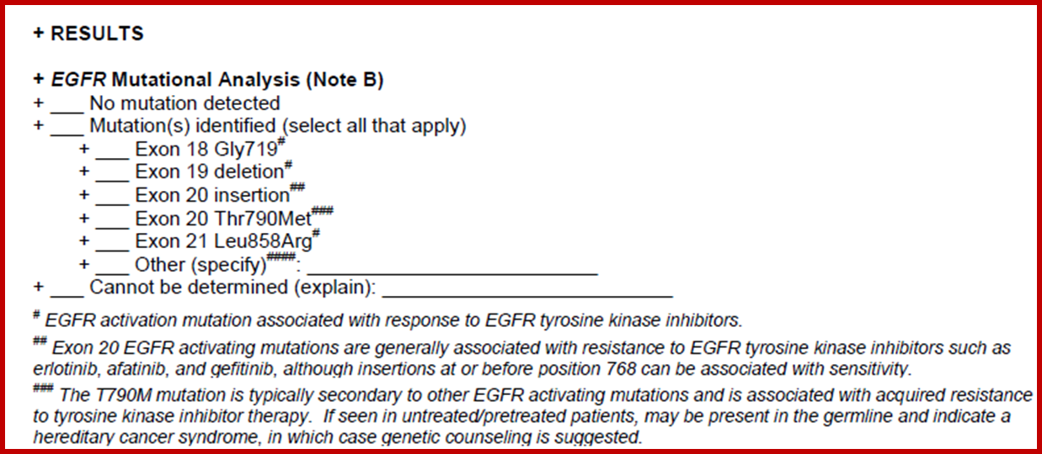
College of American Pathologists
Example
Sample from CAP Colorectal and Lung Cancer Checklists College of American Pathologists, Northfield, IL USA

Slide 14
Project Workplan
Analyze terminology in Cancer worksheet
Encode in SNOMED CT and map Observable (questions) to LOINC
Install terminology in CoPath® user interface for pathologist
Interface and integrate case data from molecular labs
HL7 Interface results to biobank for research use cases
HL7 Interface to Epic; deploy as pathology flowsheets for clinical care and structured coded findings for decision support
Develop CDA automated structured synoptic report document

Slide 15
Outline
Precision medicine and Epic…Use cases for structured genomic data
BD2K Structured pathology reporting; project plan
Genomic extensions for SNOMED CT and LOINC
Architecture for transmitting synoptic data to Epic, biobank and i2b2
Project status: structured genomic results in Epic and i2b2
Notes:
At Nebraska Medicine a grant is supporting the reporting of precise coded genomics data real-time from the pathology lab. That data is deployed in Epic for clinical care, enhances the decision support provided by the pathologist to the oncologist, and is re-used for research planning and execution. This presentation will examine the clinical terminology of genomics and how it is used in precision medicine.
4000 character supporting details
Beginning in 2015, Nebraska Medicine undertook a collaborative project with the College of American Pathologists, the IHTSDO and Regenstrief Institute to systematically encode the content of pathology protocols for diagnosis of cancer, addressing both anatomic and molecular pathology. Systematically analyzing the semantics within the scope of the 82 Cancer Protocol Templates of the College of American Pathologists, we revised the workflow of the clinical pathologist in order to capture structured synoptic cancer data at the time they report out their findings. The coded results are transmitted by an HL7 interface developed by Epic to store results in the EHR which may be flowcharted, graphed and used in decision support rules. Genetic sequencing of tumors and molecular observations of cancer metabolism are included in these datasets and are critical to the planning of therapy for precision medicine. Concurrent interfaces transmit the structured data to our data warehouse and to the metadata of our biobank repository. Terminology extensions to SNOMED CT and LOINC developed in this work have been published with agreement of the National Library of Medicine for testing, comment and trial use. Collaborations with other clinical sites of the Epic community have begun around support for research and clinical co-development.

Slide 16
MP properties and scale types
Raw somatic gene sequence data
  Variant call format
  911750381000004107 |EGFR nucleotide sequence detected in excised malignant neoplasm of lung (observable entity)|
Single somatic gene sequence variants
  HGVS annotation results
  911750391000004105|EGFR sequence variant identified in excised malignant neoplasm of lung (observable entity)|
Single somatic sequence variant identification
  Ordinal scale results
  911750421000004101|Status of EGFR c.2573T>G (L858R) sequence variant detected in excised malignant neoplasm of lung by immunohistochemistry (observable entity)|
Germline variant identification
Ordinal scale results
911754001000004109|Presence of BRCA1 germline sequence variant
detected (observable entity)|
Protein analysis by immunohistochemistry
Nominal scale results
1600001000004101|BRAF protein expression by immunoperoxidase staining of excised malignant neoplasm (observable entity)|

Slide 17
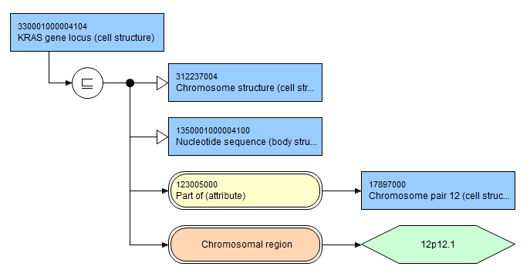
330001000004104|KRAS gene locus (cell structure)|

Slide 18
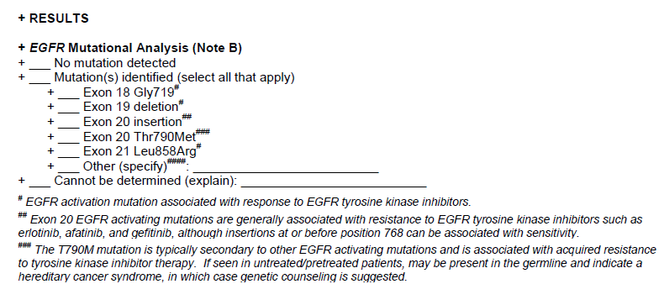
EGFR mutations in Non-Small Cell lung cancer

Slide 19
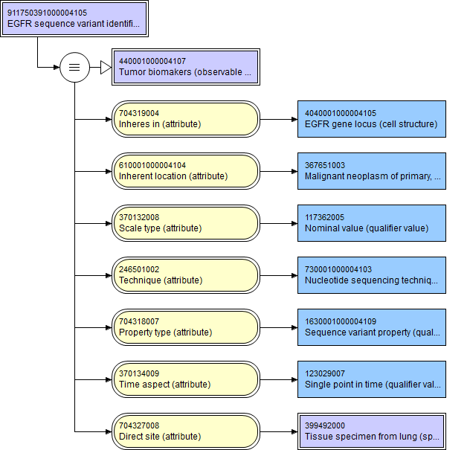
EGFR mutations in Non-Small Cell lung cancer

Slide 20
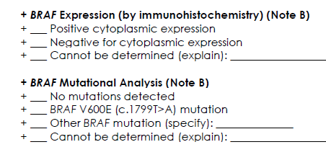
1600001000004101|BRAF protein expression by immunoperoxidase staining of excised malignant neoplasm (observable entity)|

Slide 21
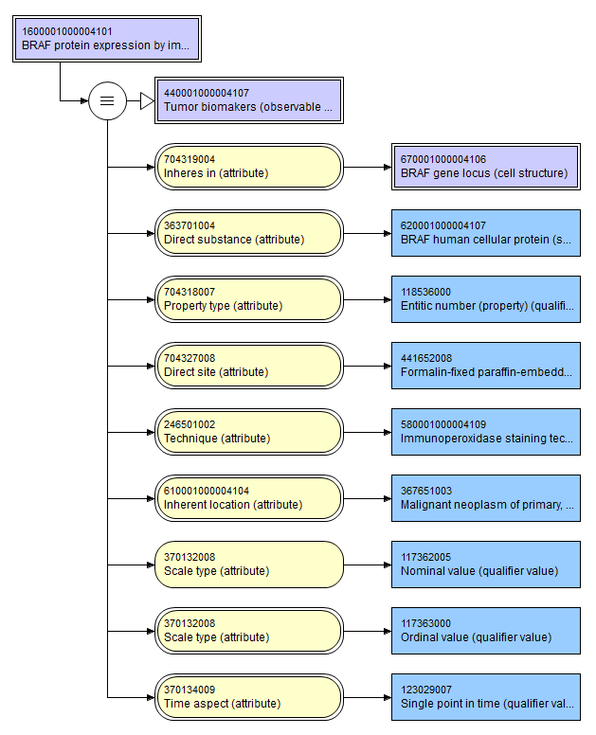
1600001000004101|BRAF protein expression by immunoperoxidase staining of excised malignant neoplasm (observable entity)|

Slide 22
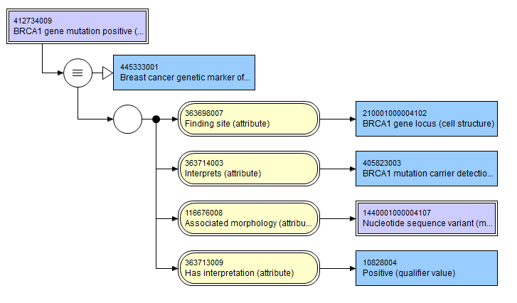
Problem list:
412734009|BRCA1 gene mutation positive(Finding)|

Slide 23
New SNOMED CT Concepts
Molecular Pathology
SNOMED CT Hierarchy | # of new MP concepts
Observable entity | 197
Clinical findings | 7
Body structure(genes) | 114
Substance(proteins) | 11
Techniques/Properties | 9
Total | 338

Slide 24
Outline
Precision medicine and Epic…Use cases for structured genomic data
BD2K Structured pathology reporting; project plan
Genomic extensions for SNOMED CT and LOINC
Architecture for transmitting synoptic data to Epic, biobank and i2b2
Project status: structured genomic results in Epic and i2b2
Notes:
At Nebraska Medicine a grant is supporting the reporting of precise coded genomics data real-time from the pathology lab. That data is deployed in Epic for clinical care, enhances the decision support provided by the pathologist to the oncologist, and is re-used for research planning and execution. This presentation will examine the clinical terminology of genomics and how it is used in precision medicine.
4000 character supporting details
Beginning in 2015, Nebraska Medicine undertook a collaborative project with the College of American Pathologists, the IHTSDO and Regenstrief Institute to systematically encode the content of pathology protocols for diagnosis of cancer, addressing both anatomic and molecular pathology. Systematically analyzing the semantics within the scope of the 82 Cancer Protocol Templates of the College of American Pathologists, we revised the workflow of the clinical pathologist in order to capture structured synoptic cancer data at the time they report out their findings. The coded results are transmitted by an HL7 interface developed by Epic to store results in the EHR which may be flowcharted, graphed and used in decision support rules. Genetic sequencing of tumors and molecular observations of cancer metabolism are included in these datasets and are critical to the planning of therapy for precision medicine. Concurrent interfaces transmit the structured data to our data warehouse and to the metadata of our biobank repository. Terminology extensions to SNOMED CT and LOINC developed in this work have been published with agreement of the National Library of Medicine for testing, comment and trial use. Collaborations with other clinical sites of the Epic community have begun around support for research and clinical co-development.

Slide 25
Structured pathology reporting: Nebraska architecture
Molecular Labs
FISH
Epic
One Chart
HL7 V2.X
HL7 V2.51
ETL
COPATH Anatomic Pathology
Immune stn
HL7 V2.3
Interface Engine
i2b2
SQL
HL7 V2.51
HL7 V2.51
ETL
Genom- Oncology
SEER
Registry
NAACCR
Ion-Torrent
Sequencer
In development
NECares
Biobank
In production

Slide 26
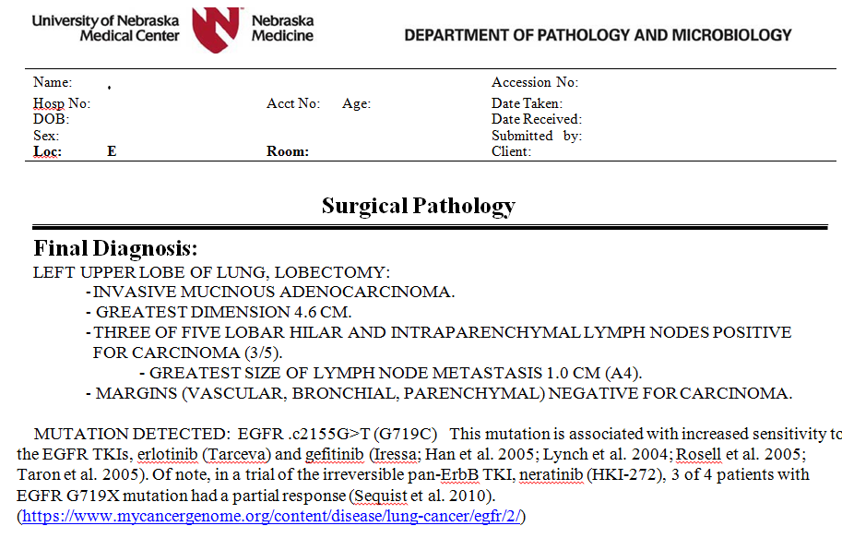
Non-small cell lung cancer with EGFR mutations likely to respond to tyrosine kinase inhibitors

Slide 27
Lung cancer gene sequence results
MSH|^~\&|GenomOncology Workbench|UNMC|20170913223645||ORU^…
R01^ORU_R01|701|P|2.5.1|1505342205103
PID|1||126456||Doe^John^J||19500101|M
OBR|1||Integration3-Lung|55232-3^Genetic analysis summary panel^LN|||201709132236
OBX|1|FT|51969-4^Genetic analysis summary report^LN||
OBR|2||Integration3-Lung|55207-5^Genetic analysis discrete result panel^…
LN|||201709132236|||||||||^Dr. Onco M.D., Ph.D.
OBX|1|CWE|911752361000004100^KRAS sequence variant identified in excised…
malignant neoplasm (observable entity)^…
SNM|1| KRAS NP_004976.2:Q61H NM_004985.3:c.183A>C|||Pathogenic |||F
OBX|2|CWE|911752361000004100^KRAS sequence variant identified in excised…
malignant neoplasm (observable entity)^…
SNM|2| KRAS NP_004976.2:Q61Y NM_004985.3:c.181_183del…
CAAinsTAC|||Likely Pathogenic|||F
OBX|3|CWE|911752161000004103^EGFR sequence variant identified in excised…
malignant neoplasm (observable entity)^…
SNM|1| EGFR NM_005228.3:c.(=)|||Normal|||F

Slide 28
Sequence Variant Frequency
461 cancer cases; 50 gene panel
Gene | Frequency | Variant identified
TP53 | 118 | TP53 c.215C>G
KDR | 61 | KDR c.1416A>T
FLT3 | 55 | FLT3 NM_004119:c.1310-3T>C
TP53 | 52 | TP53 NM_000546:c.215C>G
EGFR | 45 | EGFR c.2361G>A
PIK3CA | 30 | PIK3CA c.1173A>G
… |  | 319 discrete variants

Slide 29
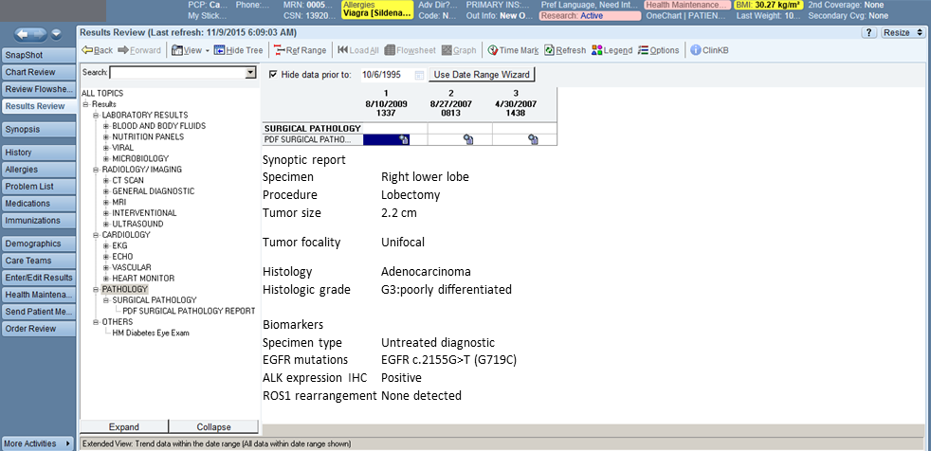
One Chart Flow sheet Presentation in Epic
Synoptic report
Specimen | Right lower lobe
Procedure | Lobectomy
Tumor size | 2.2 cm
Tumor focality | Unifocal
Histology | Adenocarcinoma
Histologic grade | G3:poorly differentiated
Biomarkers
Specimen type | Untreated diagnostic
EGFR mutations | EGFR c.2155G>T (G719C)
ALK expression IHC | Positive
ROS1 rearrangement | None detected

Slide 30
NECares: How many cases non-small cell CA of lung have EGFR sequence variants?
?Case:
2100001000004103|Histology of excised malignant neoplasm(observable entity)|: <<128632008|Non-small cell carcinoma (morphology)|
AND
911750391000004105 |EGFR sequence variant identified in excised malignant neoplasm of lung|:
  !=“.c(=) .p(=)”

Slide 31
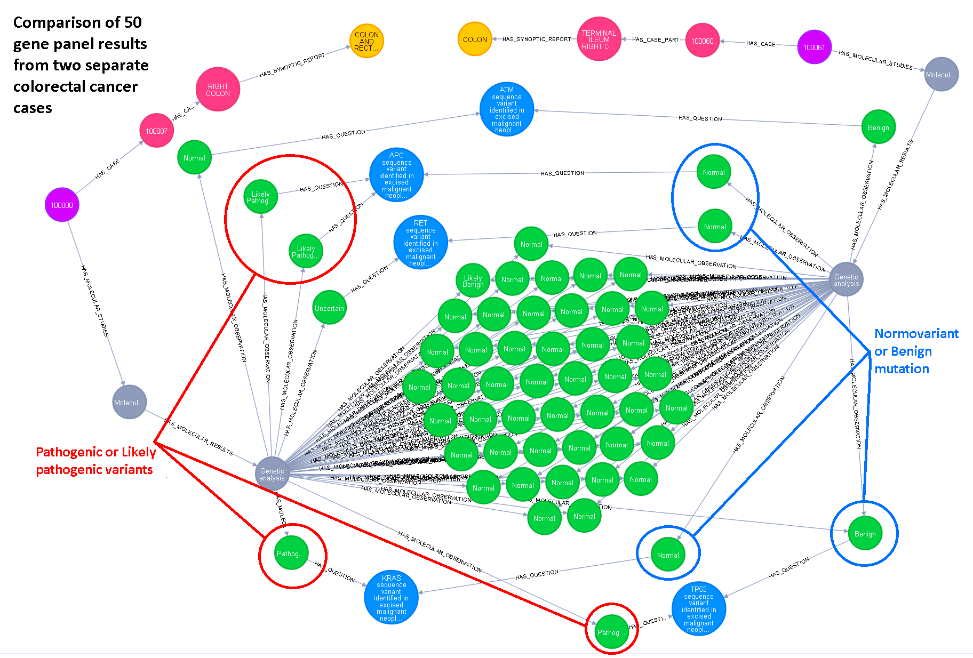
Genetic profile:
Colon cancer

Slide 32
Outline
Precision medicine and Epic…Use cases for structured genomic data
BD2K Structured pathology reporting; project plan
Genomic extensions for SNOMED CT and LOINC
Architecture for transmitting synoptic data to Epic, biobank and i2b2
Project status: structured genomic results in Epic and i2b2
Notes:
At Nebraska Medicine a grant is supporting the reporting of precise coded genomics data real-time from the pathology lab. That data is deployed in Epic for clinical care, enhances the decision support provided by the pathologist to the oncologist, and is re-used for research planning and execution. This presentation will examine the clinical terminology of genomics and how it is used in precision medicine.
4000 character supporting details
Beginning in 2015, Nebraska Medicine undertook a collaborative project with the College of American Pathologists, the IHTSDO and Regenstrief Institute to systematically encode the content of pathology protocols for diagnosis of cancer, addressing both anatomic and molecular pathology. Systematically analyzing the semantics within the scope of the 82 Cancer Protocol Templates of the College of American Pathologists, we revised the workflow of the clinical pathologist in order to capture structured synoptic cancer data at the time they report out their findings. The coded results are transmitted by an HL7 interface developed by Epic to store results in the EHR which may be flowcharted, graphed and used in decision support rules. Genetic sequencing of tumors and molecular observations of cancer metabolism are included in these datasets and are critical to the planning of therapy for precision medicine. Concurrent interfaces transmit the structured data to our data warehouse and to the metadata of our biobank repository. Terminology extensions to SNOMED CT and LOINC developed in this work have been published with agreement of the National Library of Medicine for testing, comment and trial use. Collaborations with other clinical sites of the Epic community have begun around support for research and clinical co-development.

Slide 33
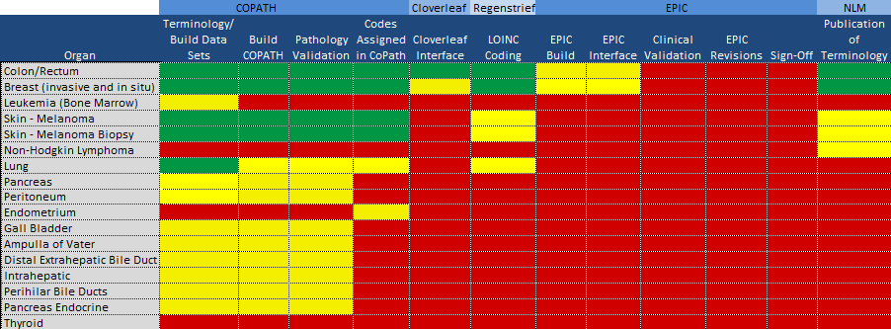
BD2K Project
Work Summary

Slide 34
Acknowledgements:
Contributing Wizards
NM: Jody Peterson, Susan Griffith, Milissa Gerkin, Anne Naberhaus, Donna Weis
UNMC: Geoffrey Talmon, Audrey Lazenby, Allison Cushman-Vokoun
Epic: Vikas Biliyar, Brad Strock, Connor Nolan, Adam Thody, Eric Kleinberg
Royal College of Pathology: Debbie Drake, Jeremy Rogers (UK Digital Health); Lazlo Iglali
College of American Pathologists: Raj Dash, Mary Kennedy, Alexis Carter
Observables Project IHTSDO:Daniel Karlsson, Ian Green, Farzaneh Ashrafi, Suzanne Santamaria, David Sperzel
NeHTA, RCPA: Michael Osborne, Meagan Judge
GO: Manuel Glynias, Nicole Kusold

Slide 35
Next Steps
Goal – complete all 82 CAP / ICCR checklists
Presenting work to IHTSDO member forum in October to confirm project status for international deployment
Current content published and shared via US NLM website for review and comment twice yearly
All new observables concepts assigned LOINC codes in collaboration with Regenstrief Institute

Slide 36
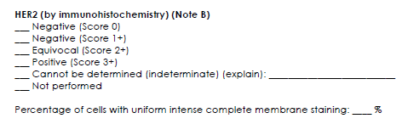
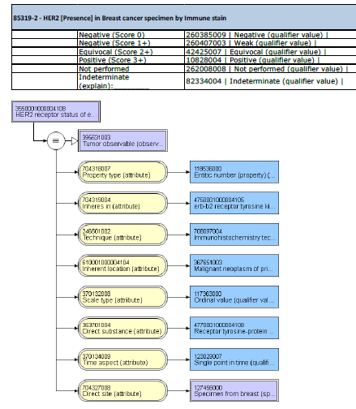
CAP Checksheets

Slide 37
Deliverables
Campbell WS, Karlsson D, Vreeman DJ, Lazenby AJ, Talmon GA, Campbell JR. A computable pathology report for precision medicine: extending an observables ontology unifying SNOMED CT and LOINC. JAMIA; 0(0), 2017, 1–8 doi: 10.1093/jamia/ocx097
https://academic.oup.com/jamia/article/doi/10.1093/jamia/ocx097/4157681/A-computable-pathology-report-for-precision?guestAccessKey=ee8ed0e2-8e9f-44bd-a467-bfbcb3e3a2c0
Annotated CAP checksheets with LOINC observables and SNOMED CT valuesets

Slide 38
Questions?
W. Scott Campbell
wcampbel@unmc.edu
James R. Campbell
campbell@unmc.edu

