Slide 1
Draft Observables Concept Model for Deployment of Anatomic/Molecular Pathology

Slide 2
Use cases for molecular pathology/genetics
Resected melanoma tests positive for BRAF V600E mutation
Patient is heterozygote for BRCA1 mutation
Resected colon cancer tests positive for MSH2 gene mutation
Finding of Human non-polyposis colon cancer type 1 genetic carrier
KRAS codon 12 sequence variant detected in excised malignant neoplasm
D2S123 mononucleotide microsatellite stability in excised malignant neoplasm

Slide 3
Query use cases for observables ontology in Molecular Pathology
Structured data:
Find all triple negative (ER, PR, Heu) breast cancer cases
Find all stage IV colorectal cancer cases that are MSH2 negative
Domain ontology:
Find all BRAF V600E + resected tumors regardless of lab technique employed (sequencing, IHC, PCR, probes)
Retrieve all patients who have mutations in a known oncogene
Identify all findings of sequence variants observed in colorectal cancer cases

Slide 4
Concept model extensions we are proposing for Molecular Pathology
Agree upon HGNC, NCBI and UNIPROT as build reference resources which will support scalable modeling of SNOMED CT extensions and automated build of content
Expand concept model for Body structures to support fully defined concept of Gene (locus)
Define templates for observables for gene sequencing, DNA probes, immunohistochemistry…
  Expand Measurement property to include molecular features
  Expand Technique to include nucleotide sequencing, epigenetic and immunohistochemical procedures in clinical use
Agree upon proper application of concept model to definition of findings based upon genomic observables (nucleotide polymorphisms) some of which require molecular lab data

Slide 5
Flattened observable model for deployment
Fully specified name (observable entity)
Observable entity
704318007|Property type|
<<Measurement property *1
≡
704319004|Inheres in|
<<Body structure, <<Substance, <<Organism, <<Specimen *1
9216841000004100 |Inherent location |
<<Body structure, <<Substance, <<Organism, <<Specimen *0-1
704320005 |Towards|
<<Body structure, <<Substance, <<Clinical finding <<Organism *0-1
704326004 |Precondition|
<<Clinical findings, <<Procedures *0-many
370134009 |Time aspect|
<<Time patterns (qualifier) *1
370132008 |Scale type|
<<Scales types(qualifier) *0-1
246514001 |Units|
<<Units(qualifier) *0-1
246501002 |Technique|
<<Technique (technique) *0-many
Specimen preparation technique
<<Preparation Technique (technique) *0-many
704327008 |Direct site|
<<Body structure,<<Specimen *0-1
Notes:
Cream attributes are defining; brown are non-defining qualifiers

Slide 6
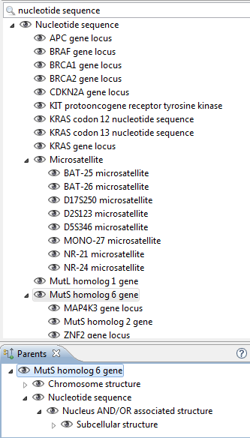
5906831100004103
|Nucleotide
Sequence|
Additions

Slide 7

Proposed Template for gene or nucleotide sequence
|Nucleotide sequence/gene locus (cell structure)|
Nucleotide sequence(cell structure)
≡
Chromosome structure(cell structure)
Part of
Chromosome pair NN(cell structure)
GrCh38 Nucleotide Sequence start
Base pair NN
GrCh38 Nucleotide Sequence end
Base pair NN
Chromosomal region
Chromosome(p|q)region
We are further deploying
GrCh37 definitions and
expect there will
be more in the future

Slide 8
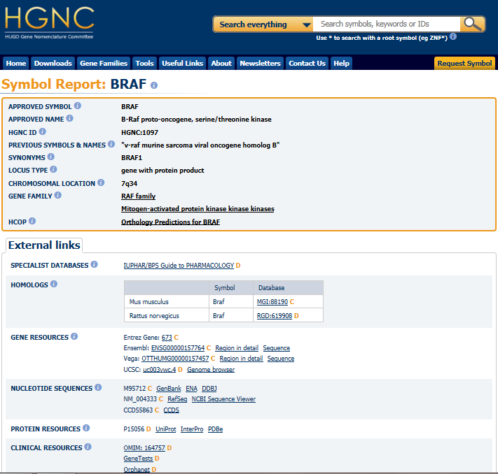

Slide 9
Agreed model
|Nucleotide sequence/gene locus (cell structure)|
Nucleotide sequence(cell structure)
<
Chromosome structure(cell structure)
Part of
Chromosome pair NN(cell structure)
Refset will be developed as part of development linking concepts to
HGNC reference data
Issues for research:
Addressing for microsatellites
Addressing for exon references; eg KRAS (exon 2) codon 12

Slide 10
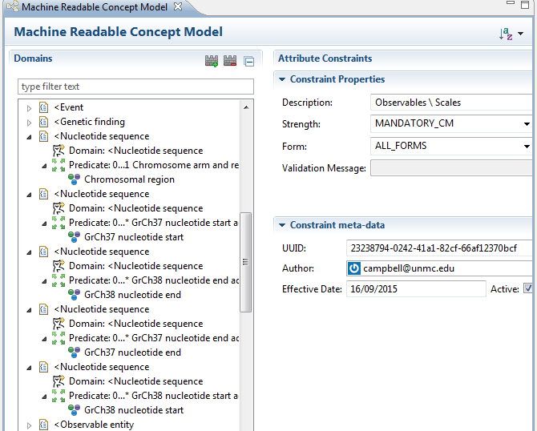
MRCM<<Nucleotide sequence

Slide 11
Exemplar
100670521000004106 |BRAF gene locus (cell structure)|
B-RAF proto-oncogene serine threonine kinase
Nucleotide sequence(cell structure)
<
Chromosome structure(cell structure)
Part of
Chromosome pair 7(cell structure)
Refset
1067052100004106 HGNC:1097 http://rest.genenames.org/fetch/symbol/BRAF

Slide 12
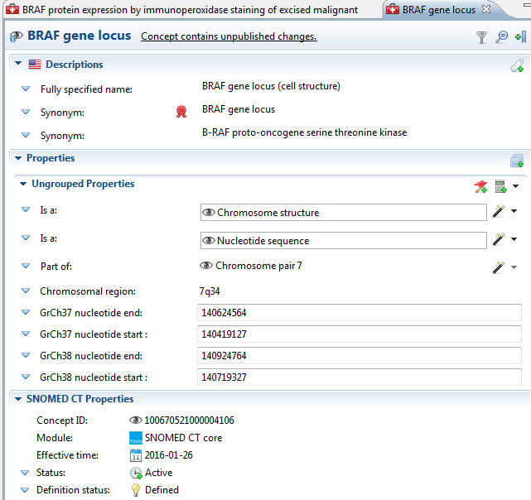
Concept model extension: Gene locus

Slide 13
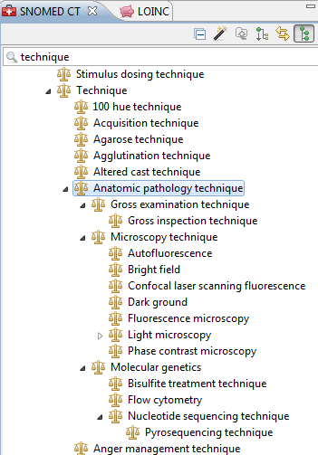
Techniques

Slide 14
Agreed flattened quality observable model template for trial use
| Gene nucleotide sequence detected (observable entity)|
Observable entity
704318007|Property type|
Sequence variant property
≡
704319004|Inheres in|
<<Nucleotide sequence
9216841000004100 |Inherent location |
<<Cell structure, <<Morphology
370134009 |Time aspect|
Single point in time
246501002 |Technique
Nucleotide sequencing technique (technique)
704327008 |Direct site||
<<Specimen
370132008 |Scale type|
Variant call format
Most sequencing data today is reported in variant call
Format with file sizes for multi-sequence tests running
Several thousand bytes
Notes:
Cream attributes are defining; brown are non-defining qualifiers

Slide 15
Agreed flattened quality observable model template for trial use
455350031000004100 |BRAF nucleotide sequence detected in excised malignant neoplasm (observable entity)|
Observable entity
704318007|Property type|
Sequence variant property
≡
704319004|Inheres in|
Malignant neoplasm
9216841000004100 |Inherent location |
BRAF gene locus
370134009 |Time aspect|
Single point in time
246501002 |Technique
Nucleotide sequencing technique (technique)
704327008 |Direct site||
Formalin-fixed paraffin embedded tissue sample
370132008 |Scale type|
Variant call format
Notes:
Cream attributes are defining; brown are non-defining qualifiers

Slide 16
Features of human nucleotide sequence by variant call format (Alexis)
Property | Example Value | Valuesets (not comprehensive, by far)
Human Genome Reference | GRCh37 | GRCh38
HUGO Gene Abbreviation | BRAF | STK11 TP53
Nucleic Acid Type Examined | DNA | RNA Mitochondrial DNA
Nucleic acid variant type | Single nucleotide variant | Insertion Deletion Translocation Copy number variant Methylation
Predicted protein variant type | Single amino acid substitution | Silent (no protein change) Insertion with frameshift and early truncation Insertion with frameshift and late truncation Deletion with frameshift and early truncation Deletion with frameshift and late truncation Fusion protein (translocation with another gene's protein) Complete non-expression of protein Splice region variant
Start coordinate | 140453135 | 140453155
Stop coordinate | 140453135 | 140453156
HGVS nucleic acid nomenclature | c.1799T>A | c.1779_1780delTGinsGA
HGVS protein nomenclature | p.Val600Glu | p.Asp594Asn
Human genetic variant from reference

Slide 17
Agreed flattened quality observable model template for trial use
BRAF V600E mutation identified in excised malignant neoplasm (finding)
Evaluation finding
Associated morphology
Nucleotide sequence variant
≡
Finding site
BRAF gene locus
Interprets
BRAF nucleotide sequence detected in malignancy
Has value
Chr7 140719927 BRAFV600E V G… |GRCh38;CM000669.2
Notes:
Cream attributes are defining; brown are non-defining qualifiers

Slide 18
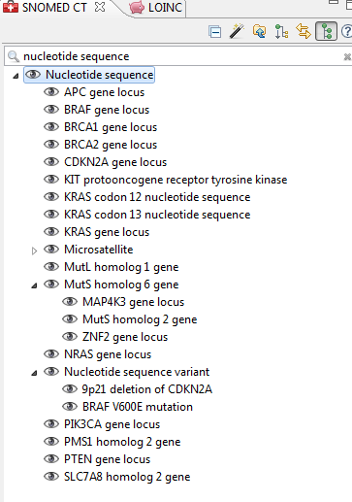
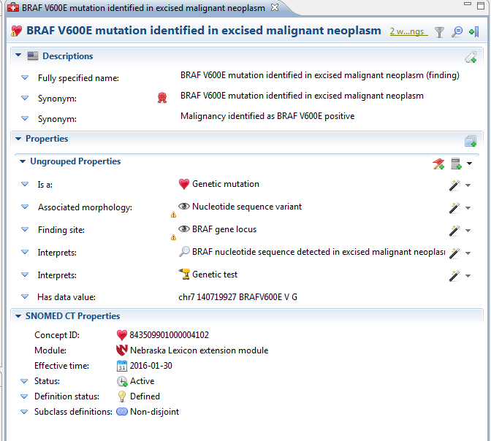
SNOW OWL exemplars

Slide 19
Agreed flattened quality observable model template for trial use
Immunohistochemical test for protein expression of gene or gene mutation (observable entity)
Tumor observable (observable entity)
704318007|Property type|
Entitic number (qualifier)
≡
704319004|Inheres in|
<<Nucleotide sequence
9216841000004100 |Inherent location |
<<Cell structure, <<Morphology
246501002 |Technique|
Immunohistochemical technique(technique)
370134009 |Time aspect|
Single point in time(qualifier)
370132008 |Scale type|
<<Scales
704327008 |Direct site|
<<Specimen
Notes:
Cream attributes are defining; brown are non-defining qualifiers

Slide 20
Agreed flattened quality observable model template for trial use
BRAF protein expression by immunoperoxidase staining of excised malignant neoplasm (observable entity)
Tumor observable (observable entity)
704318007|Property type|
Entitic number (qualifier)
≡
704319004|Inheres in|
BRAF gene locus
9216841000004100 |Inherent location |
Malignant neoplasm
246501002 |Technique|
Immunoperoxidase technique(technique)
370134009 |Time aspect|
Single point in time(qualifier)
370132008 |Scale type|
Nominal value (qualifier)
704327008 |Direct site|
Formalin fixed paraffin embedded tissue specimen
Notes:
Cream attributes are defining; brown are non-defining qualifiers

Slide 21
Exemplar
437494961000004105 |BRCA1 gene locus (cell structure)|
Breast cancer 1 BRCA1 gene locus
|Nucleotide sequence(cell structure)|
<
|Chromosome structure(cell structure)|
Part of
|Chromosome pair 17(cell structure)|
Refset:
437494961000004105 HGNC:1100 http://rest.genenames.org/fetch/symbol/BRCA1

Slide 22
Agreed flattened quality observable model template for trial use
613814021000004100 |BRCA1 nucleotide sequence detected (observable entity)|
Observable entity
704318007|Property type|
Sequence variant property
≡
704319004|Inheres in|
BRCA1 gene locus
9216841000004100 |Inherent location |
Body structure
370134009 |Time aspect|
Single point in time
246501002 |Technique
Nucleotide sequencing technique (technique)
370132008 |Scale type|
Variant call format
Notes:
Cream attributes are defining; brown are non-defining qualifiers

Slide 23
Agreed flattened quality observable model template for trial use
412734009 |BRCA1 gene mutation positive (finding)
Evaluation finding
Associated morphology
Nucleotide sequence variant
≡
Finding site
BRCA1 gene locus
Interprets
BRCA1 nucleotide sequence detected
Has value
VCF dataset for BRCA mutation
Currently defined with
405823003|BRCA1 mutation carrier test (procedure)
Notes:
Cream attributes are defining; brown are non-defining qualifiers

Slide 24
Molecular pathology build
Literature review should easily identify the genes reported with clinically significant variants
Automated build of genetic structures is feasible using HGNC reference data sets
Observables build could be templated from those gene concepts and significant clinical findings could be fully modeled

Slide 25
Action items
Coordinate with Jane Millar on IP and editorial principles with NCBI
Coordinate with Dan Vreeman on microsatellite and codon reference metadata; VCF scale type Change scale type to Sequence variant property
Ask Yong if gene may be modeled as part of a chromosome
Change scale type to defining attribute
Daniel K to identify name for “Has value”

