Slide 1
Editorial Advisory Group
IHTSDO Business Meeting
London April 2016
James T. Case
Head of Terminology

Slide 2
Agenda
Welcome & Apologies Chair
Conflicts of Interest/approval of minutes Chair
Updates on previous issues Chair
Drug product Action Item follow up TMO
Use of Products as attribute values TMO
Update on substances redesign TMO
Laterality proposal update JCA
Overview of ECE policy recommendations BGO
Content tracker review JCA
Modularization of SNOMED CT KCA
Review of "Lymphadenopathy JCA
Conference call schedule Group
Any Other Business Group
“Three-bullet” slide development Group

Slide 3
Updates on previous issues
Use of slashes in FSNs
  Currently not allowed
  Exceptions identified – hemoglobinopathies
  Decision to allow them in FSNs where standard practice (i.e. referenced authoritative source) allows.
Use of URLs in definitions
  URLs are not persistent
  Variety of other stable reference sources are available
    Document Object Identifier – DOIs
    International Standard Book Number – Published books
EAG Chair will write draft guidance

Slide 4
Drugs, Products and Substances
  Presentations by Toni Morrison – IHTSDO Senior Terminologist

Slide 5
Laterality project update

Slide 6
History of laterality
Documented as “Temporarily not allowed” since 2011
Existing pre-coordination artifact: artf223747
“Concepts with pre-coordinated laterality may be regarded as excessive pre-coordination. With rare exceptions, it should
be possible to make the recording of laterality part of the electronic health record, with record architecture elements
to record, store, transmit, retrieve and analyze.
Post-coordination is further supported with the Revision of the anatomy hierarchy, which has developed (draft) refset
indicating those anatomical codes for which lateralization is sensible. This makes pre-coordination even less necessary
in the findings/disorders and procedures.”

Slide 7
Laterality challenges
Many existing EHR systems do not have the ability to store laterality as a model element.
Many large EHR systems do not have the capability of managing post-coordinated expressions
The proposed refset of anatomical structures that can be lateralized is not readily available
There is a substantial amount of lateralized content existing in SNOMED CT, users see precedence for adding it.
A large number of “bilateral” content requests have been received that cannot be adequately modeled.

Slide 8
Prior decisions on laterality
Restriction on the addition of lateralized content to the International release will be allowed?
Options previously considered
  Option 1 – Nested role groups
  Option 2 – Pre-coordinate laterality with anatomic structure
  Option 3 – Use additional finding site with “left/right side of body”
  Option 4 – Add LATERALITY relationship to a relationship group that contains a “lateralizable” FINDING SITE value
Option 4 was initially selected for further evaluation and comment from members
  Detailed comments received that require additional consideration by the AG

Slide 9
Option 2: Lateralized anatomic structure
10930601000119107
Closed fracture of metatarsal bone of right foot
≡
64572001
Disease
116676008
Associated morphology
20946005
Fracture, closed
363698007
Finding site
New concept
Structure of metatarsal bone of right foot

Slide 10
Pros and cons: Option 2
Pros
  Considerable lateralized content currently exists (left: 559, right: 570)
  Simplifies modeling to a single un-nested role group
  Ensures that ONLY “lateralizable” anatomic structures are available for use
  Allows for retirement of multiple abstract anatomical concepts related to “bi-laterality”
  Does not require changes to the existing concept model
  Supports the independent use of Body structure concepts in an information model
    E.g. specimen collection site; site of vaccine administration
Cons
  Requires potential creation of a large number of lateralized anatomic structures (Est 17,000 source body structure concepts)

Slide 11
Option 4: Add LATERALITY relationship to relationship group
10930601000119107
Closed fracture of metatarsal bone of right foot
≡
64572001
Disease
272741003
Laterality
24028007
Right
116676008
Associated morphology
20946005
Fracture, closed
363698007
Finding site
301000
Fifth metatarsal structure

Slide 12
Pros and cons: Option 4
Pros
  Flattens the laterality model (no nesting needed)
  Close to “user-form”
  Does not require the creation of new anatomic structure concepts
  Is “consistent” with the post-coordination expression syntax
Cons
  Requires changes to the concept model
  Allows “two ways” to model lateralized concepts
  May require remodeling of large number of existing concepts
  Does not eliminate the need for lateralized body structures
  May allow creation of “Non-sense” concepts (e.g. “right liver”)
  Requires clear and detailed editorial guidance
  Requires a transform to compute equivalence between concepts

Slide 13
Laterality comments from members
(paraphrased)
Anatomical entities are lateralized in the Foundational Model of Anatomy (FMA), with which the SNOMED CT anatomy is closely aligned. Modeling laterality in SNOMED CT could be mostly outsourced as a one-time effort.
How will Option 4 prevent the creation of non-sense literalities as it will not be tied to the Body Structure hierarchy
Option 4 requires a transform to create a nested expression. What is the advantage of creating a reference structure that always requires a transform?
Given the demonstrated use case for lateralized anatomy, what is the reluctance to continue to add it as needed?
The current document does not address impact on extensions that already use lateralized anatomy in their content.

Slide 14
Laterality discussion
Should the choice of option 4 be reconsidered?

Slide 15
Update from Event-Condition-Episode Project Group
Bruce Goldberg

Slide 16
Content Tracker Review
General policy issues
James T. Case

Slide 17
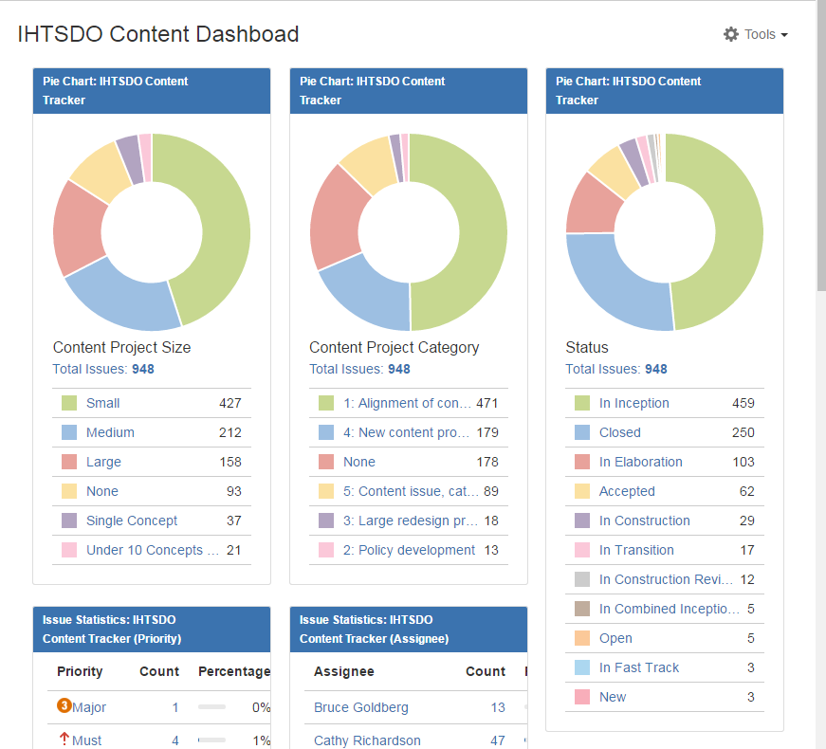
Content Tracker Dashboard
Single view of content issue statuses available on confluence
https://jira.ihtsdotools.org/secure/Dashboard.jspa

Slide 18
artf6279-definition of grouper, whitelisting of exceptions to MRCM rules in User Guide
Description – “The User Guide specifies that certain attribute values are so general that they should be applied only to "groupers". We need to define what a grouper is, and make a list of concepts that are allowed as exceptions (a "whitelist").”
Goals
  Define what a grouper is
  Define their rationale and purpose
  When should they be allowed/not allowed?
  What do we do with the existing concepts that fall under the newly established definition?
How is the MRCM affected?
Priority – how important is this issue?

Slide 19
artf221357-Extended (non-ASCII) UTF8 characters in terms
Description – “We need a policy regarding how or whether non-ASCII characters such as en-dash, em-dash, and single quote characters should appear in terms. A few are found in the Jan 2011 release”
Establish use cases
  Eponyms
  Translations
Review solutions from other organizations
  UMLS
  UKTC
Priority – how important is this issue?

Slide 20
artf6196-Moving between hierarchies without retirement: policy
Description – “Initiate project to develop more detailed and explicit guidance on moving concepts to different hierarchies without retiring them”
Historical precedence
Current guidance
  7.3.1 – “A change to the semantic type shown in parentheses at the end of the FSN may sometimes be considered a minor change if it occurs within a single top-level hierarchy (e.g. a change from a finding tag to a disorder tag, or a change from a procedure tag to a regime/therapy tag), but a move to a completely different top-level hierarchy is regarded as a significant change to the Concept's meaning and is prohibited.”
Potential large future changes
  Evaluation procedures -> Observable entity
Priority – how important is this issue?

Slide 21
artf6195-Word order variants: policy
Description – “Re-evaluate policy on word order variants”
Current policy – 7.5 – “Conventions should not attempt to address needs for variations based on word order preferences (e.g. for searching or display).”
  General naming conventions
Need to address specific requests for word order variants that originate from external members.
Other editorial guidance for section 7.5 may need review based on guidance from ECE
  E.g. “The convention should follow "natural" language when possible.”
Is natural language specific enough for an FSN?
Priority – how important is this issue?

Slide 22
Modularization of SNOMED CT
Keith Campbell

Slide 23
Lymphadenopathy issues
James T. Case

Slide 24
Current ambiguous usage of Lymphadenopathy
Clinical usage of Lymphadenopathy means either “Disorder of lymph node” or “Enlargement of lymph node”
30746006 | Lymphadenopathy (disorder)| is currently primitive with no ASSOCIATED MORPHOLOGY
  Many synonyms specifically state “enlargement”
  Many subtypes do not specify enlargement (e.g. 127117004 | Celiac lymphadenopathy (disorder) |)
If the differentiation is important, how to resolve the common clinical usage?
Is a tracker needed?

Slide 25
Conference call scheduling
Any other business
Date of next meeting
Develop “3-bullet item” slide
127117004 | Celiac lymphadenopathy (disorder) |

Slide 26
Content model changes recently requested
Domain and range revisions
  Clinical course – Add additional disease phases
    E.g. “In remission”, “latent”
  Specimen substance – physical object
    Allows for public and environmental health monitoring
Potential new attributes
  During
    E.g. “Disorder X DURING procedure Y
  Has prodcut role
    Needed to support the specific roles that are being removed as IS-A relationships from the product hierarchy

