Slide 1

Healthpoint use of SNOMED
John Williams
Chief Compliance Officer
john@healthpoint.co.nz
Samantha Burchell
Product Owner
samantha@healthpoint.co.nz

Slide 2
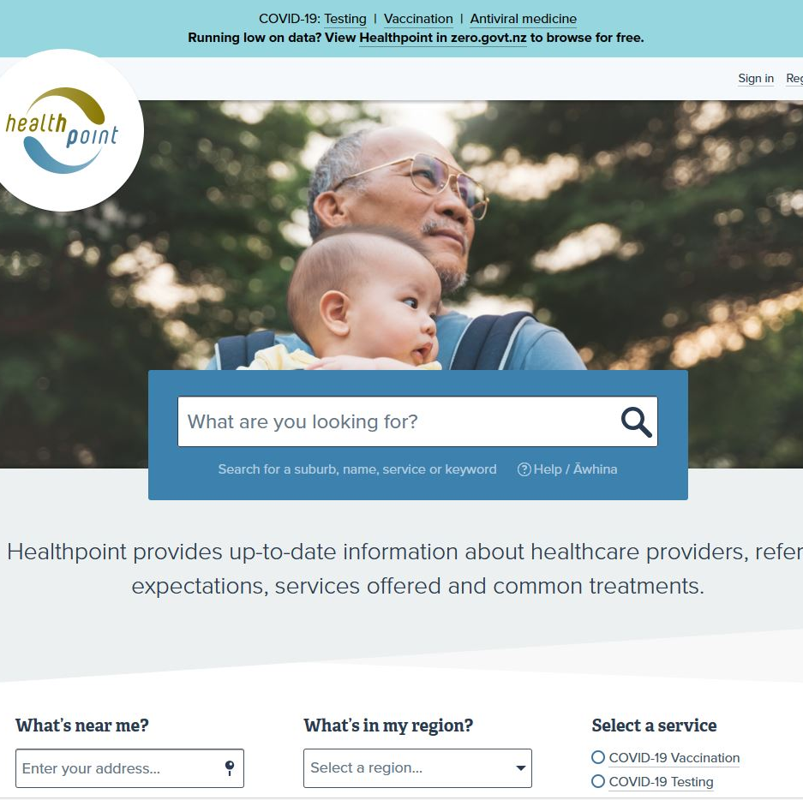
NZ Health and Social Services Directory
Detailed information about
health and social services
1 million visitors per month
8,779 active services, 6,887 locations,
8,603 Practitioners,
12,144 PractitionerRole
Partnership with helplines
Services own and edit their
own info – more than 80%
reviewed in last 4 months
100 – 400 services update per
day

Slide 3

Healthpoint API to share the Healthpoint website
Connecting people to health services
A lot of organisations need a directory, but don’t have the time or resource to maintain it
Single, central reliable source of truth. Reduce system wide duplication
Reuse in many contexts beyond Healthpoint
Use HL7® FHIR® as standard for data exchange to support uptake and interoperability
Users can query the API by a category, specialty, programme or type of service e.g. Pharmacy services, Immunisation

Slide 4
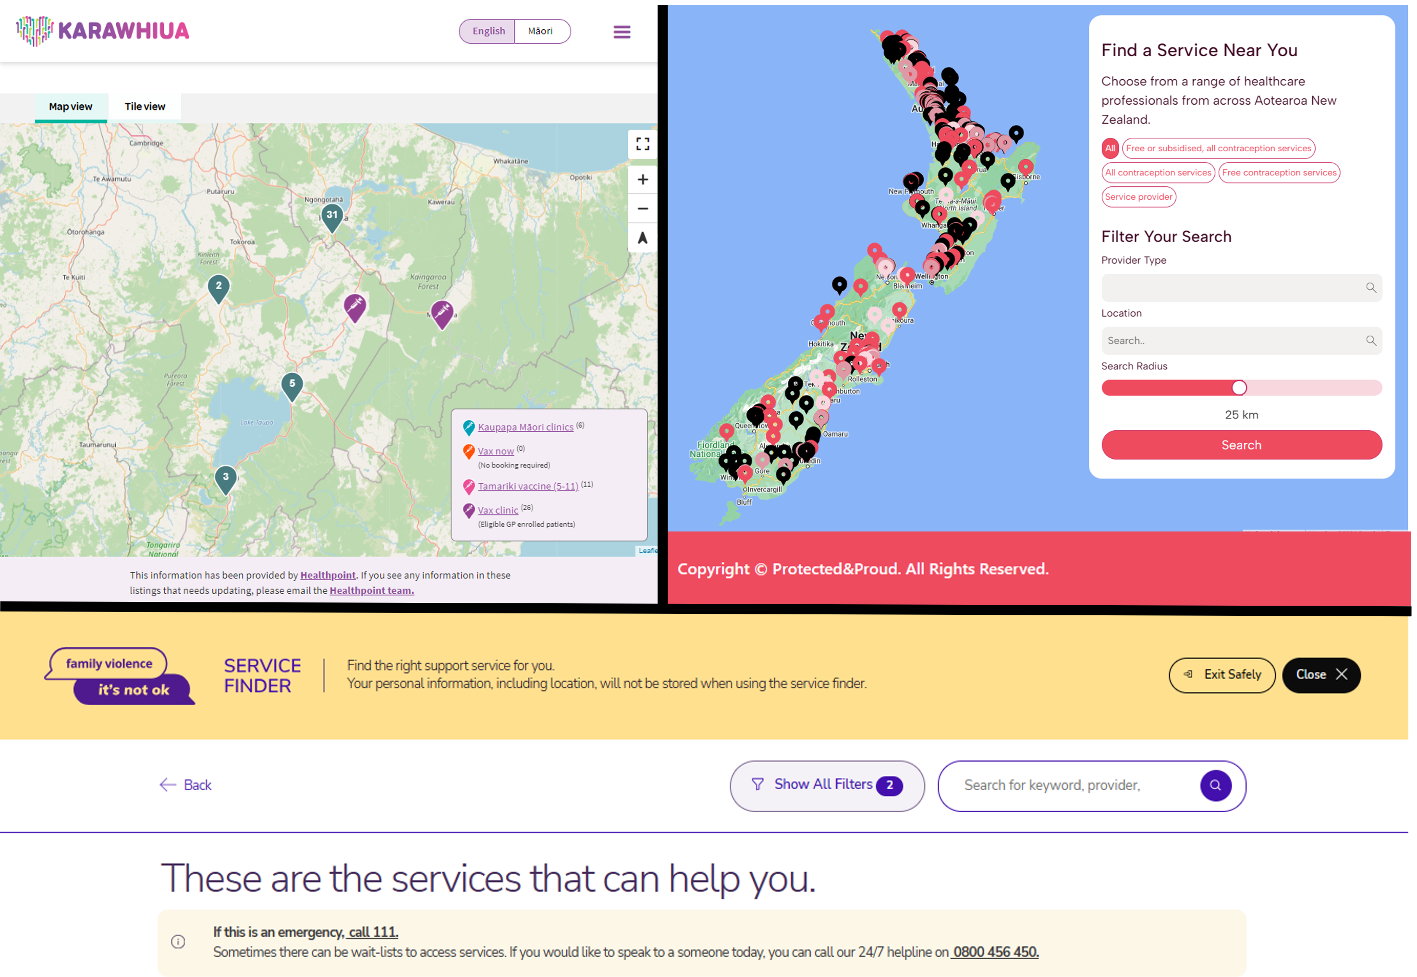
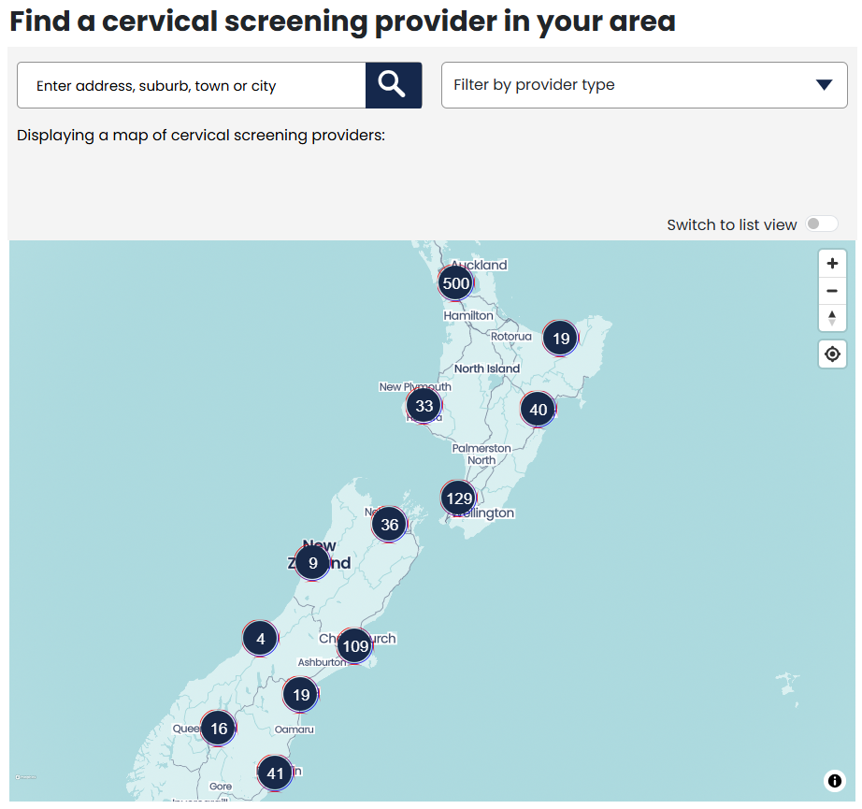
Use of the Healthpoint API
200 + registered users
Government departments, Māori health organisations, districts, PHOs, practice management software, health apps, private hospitals, health insurers, health organisations, Ambulance

Slide 5
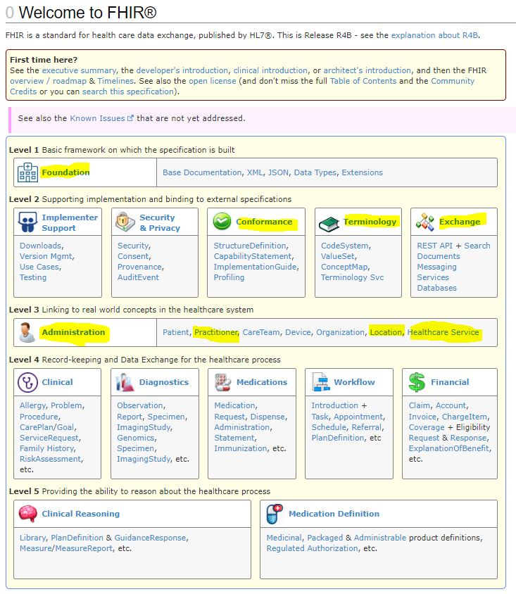
Healthpoint use of the HL7® FHIR ® Standard
Module: Predominantly L3 Administration
Resources Healthpoint data mapped to:
  Healthcare Service
  Location
  PractitionerRole
  Practitioner

Slide 6
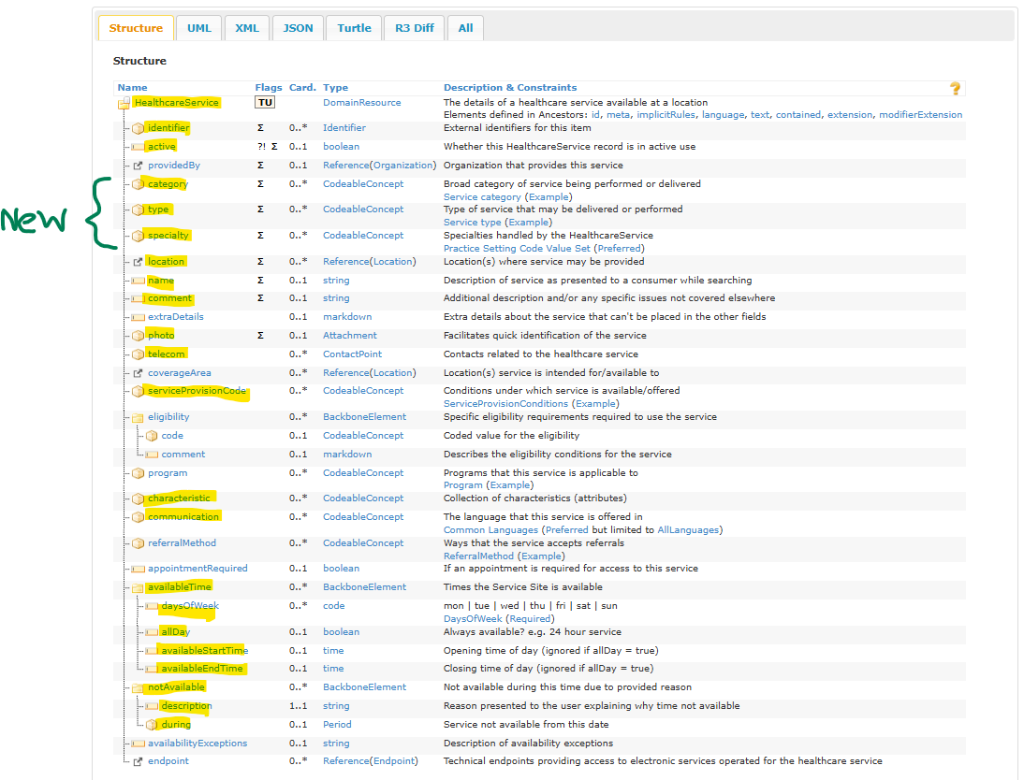
Healthpoint use of Healthcare service resource

Slide 7
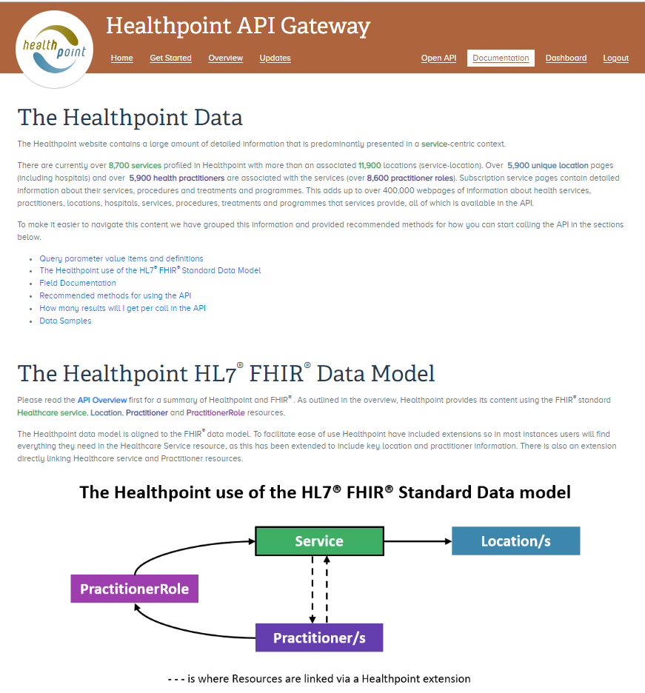
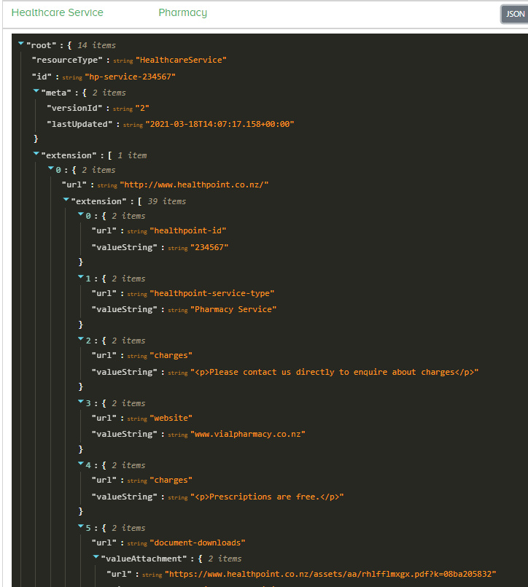
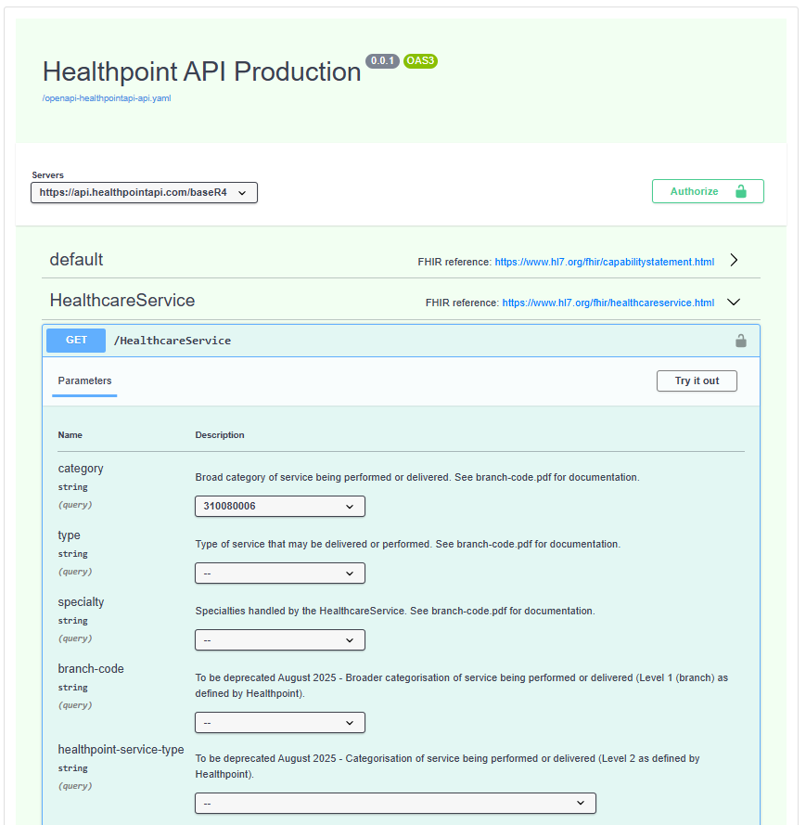
Healthpoint API
Documentation website
www.healthpointapi.com
Place where anyone, clinical, analyst or developer can understand what content they can get from the API: Open API (aka Swagger), Documentation, Samples, Common use cases

Slide 8
Why are we using SNOMED?
Connect people to health services, according to clinical need
Examples use cases for Healthpoint API: health promotion, patient journey mapping, referral to appropriate services and appointment booking
FHIR conformant
Use “category”, “type” and “specialty” and SNOMED as the clinical terminology within that
Patient friendly terms English and Te Reo Māori
Working with SNOMED National Release Centre to validate our mapping and provide a SNOMED patient friendly concept in each instance
Flexibility
We can now change our naming within the Healthpoint website without having to consult every API user and not break their implementation
Clear definitions
Reducing the chance of misinterpreting a clinical need, and ensuring greater accuracy when connecting people to the correct service
Interoperability
the machines talk faster

Slide 9
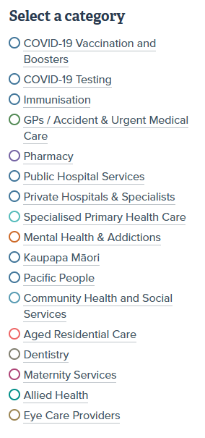

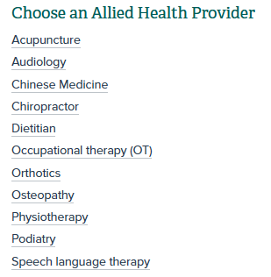
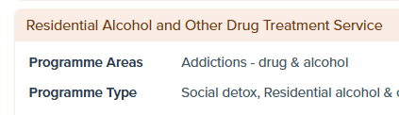
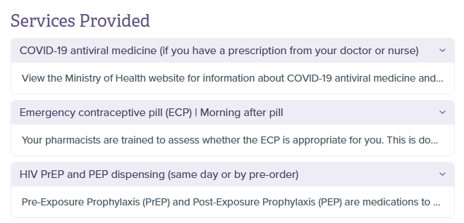
Healthpoint categorisation
Used for navigation, search and to describe what services provide
~ 1,000 terms
Templates for easy content inclusion
Categories: e.g. Allied Health
Provider types e.g. Physiotherapy
Services provided e.g. Immunisation
and subtypes: e.g. MMR
Specialties e.g. Cardiology
Programme areas e.g. Addictions – drug and alcohol and types: Social detox

Slide 10
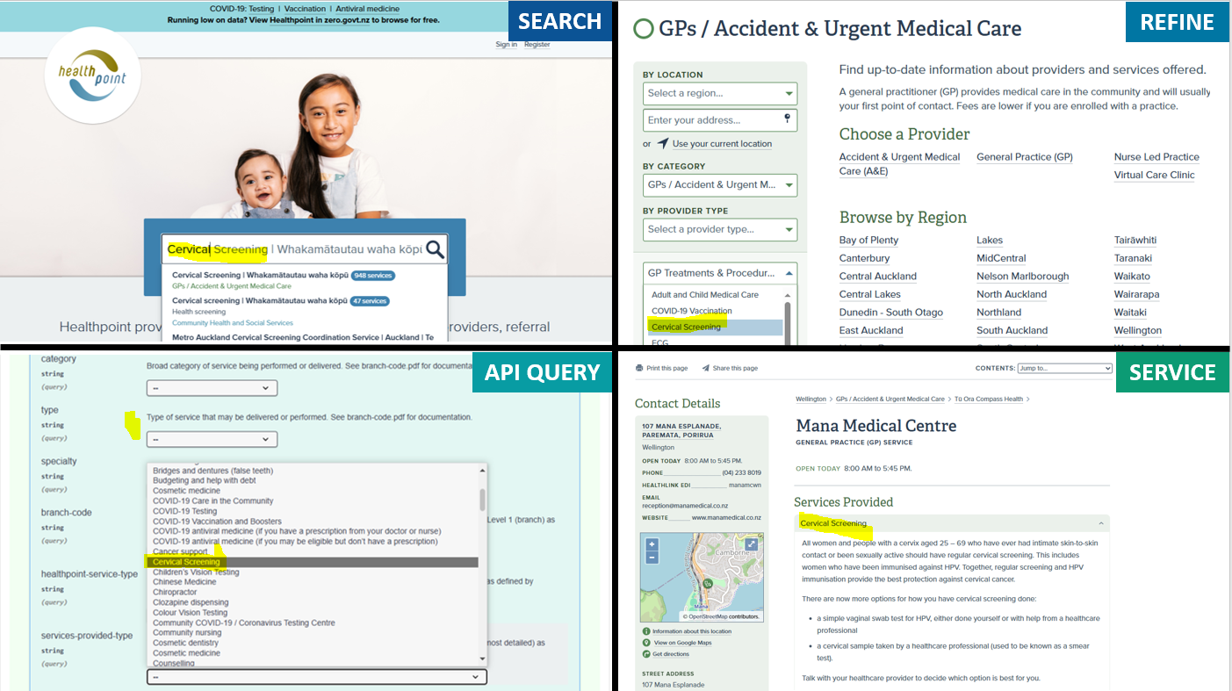

Slide 11
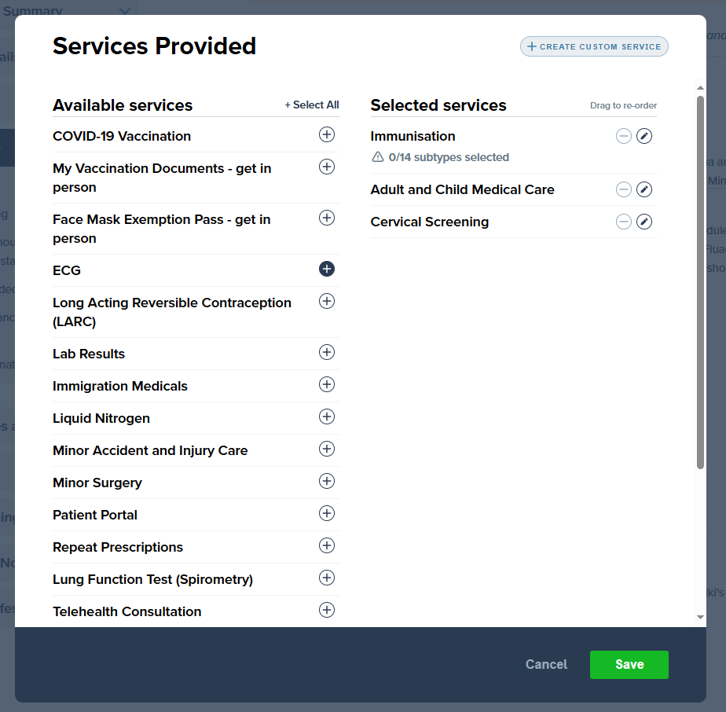
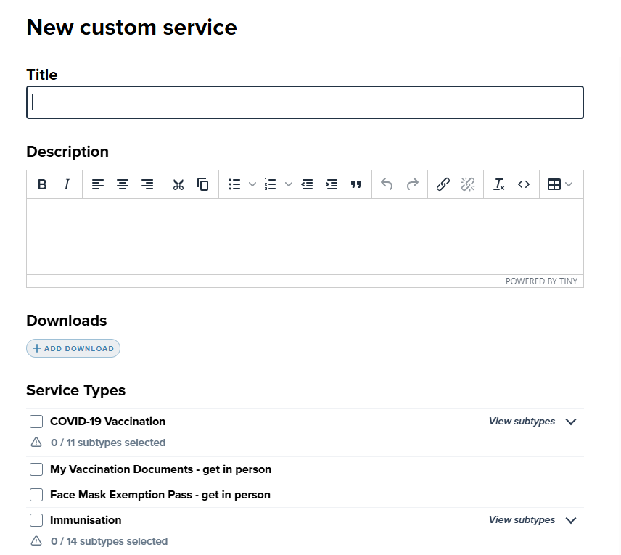
Step 1: Data remodelling and editorial upgrade
Data model changed to a Hauora one so a service can now be a mix of medical, community health and social
Editorial upgrade for easy input by editors. The most important step is content inclusion.
SNOMED is not explicitly presented in the front-end site, either editorial or published view

Slide 12
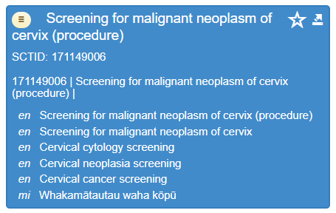
Step 2: Mapping Healthpoint concepts to SNOMED CT
Preferred
Fully specified term
Healthpoint maps to SNOMED CT, requests new concepts or synonyms as required
Healthpoint suggests patient friendly term
Mapping and patient friendly term is validated by SNOMED release centre at Health New Zealand | Te Whatu Ora
Translator from Te Taura Whiri i Te Reo Māori | Māori Language commission creates associated Māori language concepts and then peer review.
New concepts, patient friendly terms and Te Reo Māori term published in SNOMED CT, from October 2024 release
All software vendors in New Zealand can use these terms via SNOMED and terminology servers.
Synonyms
Māori language reference set
NZ common patient friendly term

Slide 13
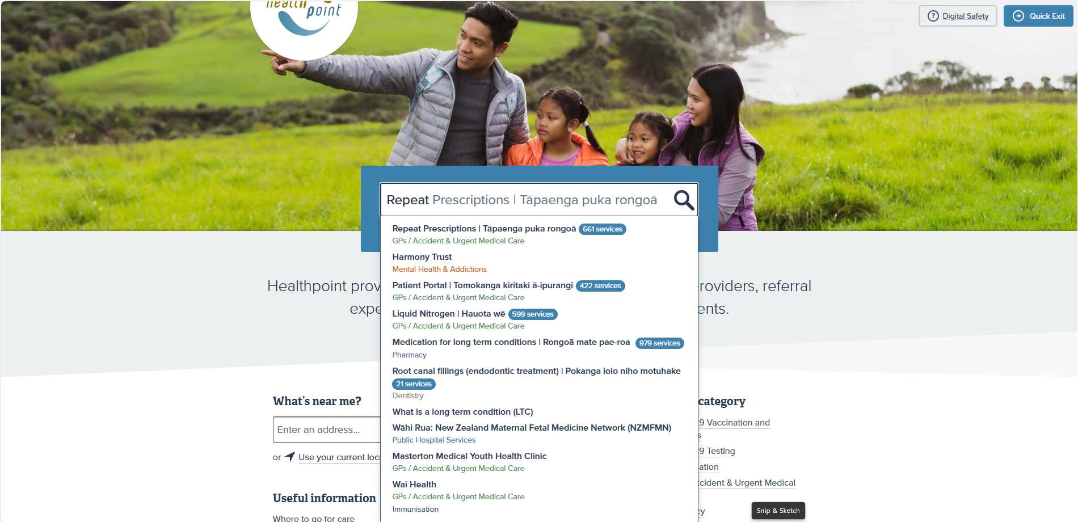
Use of SNOMED English + Te Reo Māori in the Healthpoint website

Slide 14

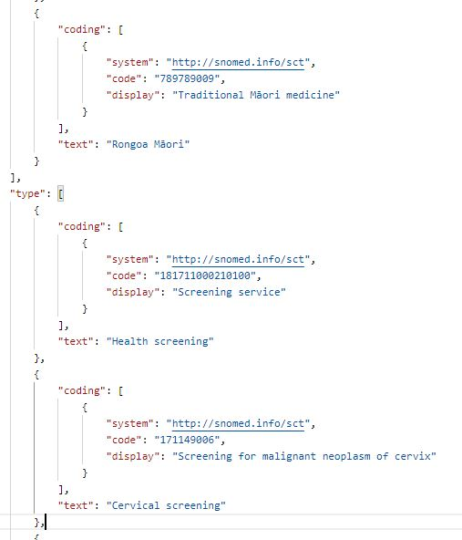
Use of SNOMED queries in the Healthpoint API
Queries:
Cervical screening (type): https://uat.healthpointapi.com/baseR4/HealthcareService? type=171149006 (987 healthcare service results)
Kaupapa Māori Cervical screening services only (category AND type): https://uat.healthpointapi.com/baseR4/HealthcareService?category=171641000210104&type=171149006 (74 service results)
Cervical screening (type) and co-ordinates (top 10 results, closest to farthest away): https://uat.healthpointapi.com/baseR4/HealthcareService? type=171149006&latitude=-36.899863&longitude=174.740481
Private specialty (category) AND Cardiology (specialty)services: https://uat.healthpointapi.com/baseR4/HealthcareService?category=382041000210102&specialty=394579002 (31 service results)

Slide 15
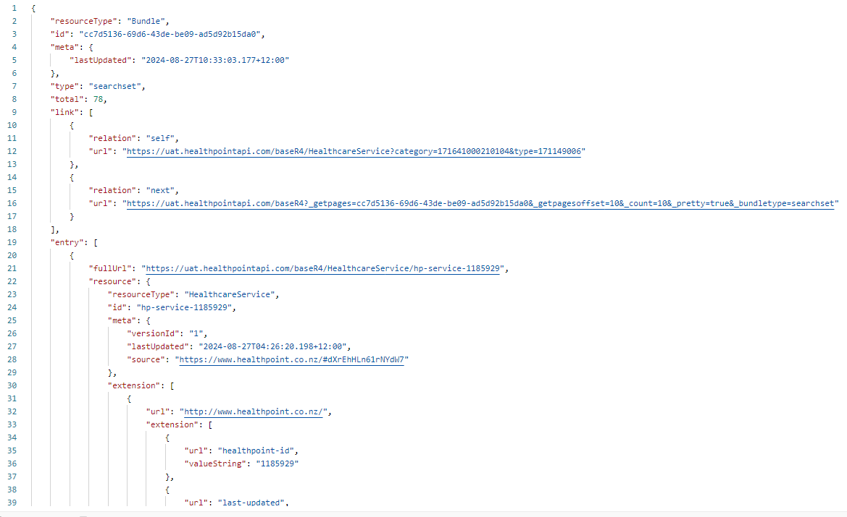
Example: Kaupapa Māori Cervical screening services only (category AND type):

Slide 16

Thank you

