Slide 1
Computable Concept Models, Pre and Post Coordination, Subsumption
Notes:
Regenstrief and the LOINC Committees are open to suggestions about how we can do things better.

Slide 2
Topics for today
A very brief history of LOINC (context, goals, assumptions)
Introduction of new things happening in LOINC
  General approach to development of computable concept models for LOINC domains
  Greater use of pre and post coordination
Regenstrief and the LOINC community are open to changes that improve LOINC and that make international interoperability better
Notes:
STAN [3:00]

Slide 3

Ultimate Goal:
Semantic Interoperability

Slide 4
Goal: We Want to Enable Semantic (or Plug-and-Play) Interoperability
“Plug and Play” < 5 days
The ultimate goal is to achieve the same level of knowledge and application sharing that is provided by the Apple App Store - the ability to download, install, and immediately begin using a new application.
Installing a new app should not require special mapping from local terms and codes to standard terms and codes. We should all be using standard codes.
That implies a single preferred digital representation for a given kind of measurement, assessment, conclusion, …
Notes:
STAN [3:00]

Slide 5
A Little Bit of LOINC History

Slide 6
Brief History of LOINC
Logical Observation Identifier Names and Codes
Organized by Clement McDonald, 1994
Supported by Regenstrief Institute and NLM
Create a universal language for observation identifiers
Creation of laboratory observations began in 1994
Creation of clinical observations began in 1996

Slide 7
Seminal Influencers
Henrik Oleson
  IUPAC Silver Book
  Concepts of system, component, kind-of-property
George De Moor, Tom Fiers
  EUCLIDES, OpenLabs
    Theoretically compelling
    Complete post coordination - 42 semantic axes
  Angelo Rossi Mori
    Archetypes

Slide 8
Focus of LOINC
Value for ‘Observation Identifier’ (Seq. #3) of OBX or the value for the “code” attribute in the FHIR Observation Resource
  Or the name of the observation in other standards, such as DICOM, and C-CDA
Individual result names first, then panels
  Panels are built based on the tests they contain
  Panels can contain other panels
Name should facilitate automated or manual matching (fully specified)
  Create local labels as needed
  Standard LOINC short names
One common identifier for tests that are ‘clinically’ the same

Slide 9
Pragmatic Approach of LOINC
Collect result names and descriptions
  IHC, VA, Regenstrief, Mayo Clinic, 3M, Vendors
Formulate a model to represent the individual pieces of information in the name
  Avoid strategies that lead to “combinatorial explosion”
Create “fully specified names”
Adjust model as needed
  Do any distinct entities have the same name?
  Do any entities that are the same have different names?
Repeat the process until no more adjustments are needed

Slide 10
The Classic Six Axis LOINC Model
<component> : <property> :
<timing> : <system> :
<scale> : <method>
2947-0 SODIUM :SCNC :PT :BLD :QN
The first 5 parts are mandatory, but method is optional.

Slide 11
LOINC makes names for things in use
We do not make all possible permutations that the six axes would allow (no blind cross products)
We try to only make names and codes for things that are real (exist in someone’s system)
We do make names that allow both atomic (post coordinated) and molecular (pre coordinated) styles
  Some people wish we would be more prescriptive
  Name everything, let others dictate usage
We do object to violations of the HL7 V2 or FHIR models
  No names that include post coordinated fields from some parts of the HL7 message (status, priority, user role)

Slide 12
Modeling Approach Changes

Slide 13
Computable Concept Models

Slide 14
Challenge – Overloading of LOINC Axes
Domain | Code | Component | Property | Timing | System | Scale | Method
Lab | 41653-7 | Glucose (substance) | MCnc (concen-tration) | Pt | BldC (specimen) | Qn | Glucometer (analytic method)
Clinical, Direct Pt Measures | 100165-0 | Range of motion (examination) | Angle (physical measure) | Pt | Knee (body part) | Qn
Document | 83615-5 | Note (kind of document) | Find | Pt | Outpatient (setting) | Doc kind? | Surgery.nurse (subject matter.role)
Notes:
Component, property, system, scale, and method all have different value sets based on the domain.

Slide 15
Why New Domain Specific Concept Models?
We have dissonance with the six axes of the classic LOINC file and the data elements required for each domain
  We want to be able to call attributes of the domain models by their real names
We want committees to decide what attributes are needed in their domain without worrying about how the attributes will be forced into the traditional six LOINC axes
We want to use the models to automate quality and consistency checks for the codes that we make
For analytics and for clinical decision support, the models enable correct query statements
  Example: Select all documents where setting = outpatient (setting, not system)
Computable models are the basis for ontologic reasoning in LOINC
  Essential for the LOINC SNOMED Extension
  LOINC parts like “knee” can be reasoned about in the context of all of the concepts in the SNOMED CT ontology. Example query: Is the knee part of the lower extremity? Answer: Yes
Goal: models and codes that meet the needs of LOINC stakeholders and that provide value for patient care, quality assurance, and analytics

Slide 16
Process and Actions
Committees describe the attributes of domain specific models based on the purpose of and use of the LOINC codes (requirements)
  The design is not constrained by the current axes
LOINC staff will create the computable models in a selected formalism
The new models will be developed and implemented in phases based on available resources
A new or enhanced LOINC database will be created by LOINC staff where the elements in the database are referenced by their proper names and relationships
Existing concepts will be imported into the new database
  Concepts that have never been used or that have no value to LOINC users will be deprecated (inactivated)
The new database will need to support existing functions
  Search LOINC – keyword queries that cross domains, filters, advanced query syntax, etc,
  Hierarchical browsing
  Must support distribution and import of LOINC codes into existing systems

Slide 17
Pre and Post Coordination

Slide 18
Foundational assumptions
There should be one LOINC code for things that have the same clinical meaning, different codes for different meanings
  The decision is easy for most things. Things that have a different component never have the same meaning. A sodium level is never used in place of a potassium level. A serum sodium never has the same clinical meaning as a urine sodium. Things that have different ”kind of properties” don’t have the same meaning.
  However, do bilirubin measurements done by different methods have the same clinical meaning? Different use cases (patient care, research, public health) may have different views of what things are the “same.”
The LOINC code alone never has all of the information that would make data instances semantically interoperable
  You also need unit of measure, interpretation, priority, reference range, device/instrument/test kit, method, reagents, provenance data, …
When possible, all available information should be sent in the message, and then let users determine what things are the “same” for their purposes
We want to use LOINC codes to represent the data in patient data stores, not just in data exchange messages
The challenge – how much meaning should be in the LOINC code versus important facts that are sent in other fields in a data exchange message?

Slide 19
One specific problem/opportunity
Personal confession: If I had it to do over again, I would not include ”method” as a definitional part of a LOINC code, I would always send it as a post coordinated field
  People don’t know whether to choose the general LOINC code or the LOINC code with the method
  Addition of new methods forces changes in analytic queries or CDS logic
  It is hard to keep up with making new LOINC codes as methods change
  We need an easy way to find ALL urine specific gravities, culture results, amphetamine screens, heart rates, blood pressures, etc.
Working assumption – the preferred representation should use post coordination for representation of method information

Slide 20
Specific Gravity Example
2695-2 | Specific gravity | Rden | Pt | Urine | Qn
5810-7 | Specific gravity | Rden | Pt | Urine | Qn | Refractometry
50562-8 | Specific gravity | Rden | Pt | Urine | Qn | Refractometry.automated
5811-5 | Specific gravity | Rden | Pt | Urine | Qn | Test strip
53326-5 | Specific gravity | Rden | Pt | Urine | Qn | Test strip.automated
{Ur Spec Gravity Method}
Ur Spec Gravity Method
Refractometry
Refractometry.automated
Test strip
Test strip.automated

Slide 21
Example instance data for Specific Gravity
Option #1
Option #2 - Preferred
  Observation
  code: 5810-7, Urine spec gravity
  by Refractometry
  value: 1.020
  Observation
  code: 2695-2, Urine spec gravity
  original/pre-coordinated: 5810-7
  method (new LOINC): Refractometry
  SCTID: 1304095001
  value: 1.020

Slide 22
Amphetamines screen/confirm codes
Amphetamine
3349-8 | Amphetamines | PrThr | Pt | Urine | Ord | {screen-conf}
19261-7 | Amphetamines | PrThr | Pt | Urine | Ord | Screen
14309-9 | Amphetamines | PrThr | Pt | Urine | Ord | Confirm>200 ng/mL
14308-1 | Amphetamines | PrThr | Pt | Urine | Ord | Screen>1000 ng/mL
Screen Confirm
Screen
Confirm
Notes:
Note that the whole proposed solution can’t be represented in the six axis parts of the model
Proposed rule: only represent the value sets that are part of the six axes as the definitional part of the LOINC code?

Slide 23
Example instance data for screen/confirm
Option #1
Option #2 - Preferred
  Observation
  code: 14309-9, Amphetamines Presence Urine Confirmation >200 ng/mL
  value: Positive
  Observation
  code: 3349-8, Amphetamines Presence Urine
  original/pre-coordinated: 14309-9
  Screen/Confirm (new): Confirm
  Threshold (new?): >200 ng/mL
  Method: 85069-3: GC-MS (new? SCT code)
  value: Positive

Slide 24
Bacteria Identified
Baccteria Identified
LOINC_NUM | Is Base | Parent | Decomp Pattern | COMPONENT | PROP | TIME | SYSTEM | SCALE | METHOD_TYP
23667-9 | Y |  |  | Bacteria identified | Prid | Pt | XXX | Nom
23667-9 new | Y |  |  | Bacteria identified | Prid | Pt | {Bacterial Culture Specimen} | Nom | {Culture Type}
43441-5 |  | 23667-9 | Method & System | Bacteria identified | Prid | Pt | BAL | Nom | Aerobic culture
600-7 |  | 23667-9 | Method & System | Bacteria identified | Prid | Pt | Bld | Nom | Culture
610-6 |  | 23667-9 | Method & System | Bacteria identified | Prid | Pt | Body fld | Nom | Aerobic culture
624-7 |  | 23667-9 | Method & System | Bacteria identified | Prid | Pt | Sputum | Nom | Respiratory culture
625-4 |  | 23667-9 | Method & System | Bacteria identified | Prid | Pt | Stool | Nom | Culture
630-4 |  | 23667-9 | Method & System | Bacteria identified | Prid | Pt | Urine | Nom | Culture
6462-6 |  | 23667-9 | Method & System | Bacteria identified | Prid | Pt | Wound | Nom | Culture
634-6 |  | 23667-9 | Method & System | Bacteria identified | Prid | Pt | XXX | Nom | Aerobic culture
Bacterial Culture Specimen (value set)
BAL
Bld
Sputum
…
Culture Type (value set)
Respiratory Culture
Aerobic culture
Culture

Slide 25
Example instance data for Bacteria Identified
Option #1
Option #2 - Preferred
  Observation
  code: 624-7, Bacteria Identified,
  Sputum, Respiratory System
  value: pseudomonas aeruginosa
  (SCTID 52499004)
  Observation
  code: 23667-9, Bacteria Identified
  original/pre-coordinated: 624-7
  System (66746-9): Sputum
  (SCTID: 119334006)
  Culture Type (new): Respiratory
  (SCTID 117056007)
  value: pseudomonas aeruginosa
  (SCTID 52499004)
Mapping

Slide 26
Neisseria gonorrhoeae DNA example
New | Neisseria gonorrhoeae DNA | PrThr | Pt | {GC Specimen} | Ord | {GC DNA method}
24111-7 | Neisseria gonorrhoeae DNA | PrThr | Pt | XXX | Ord | Probe.amp.tar
43403-5 | Neisseria gonorrhoeae DNA | PrThr | Pt | XXX | Ord | Probe.amp.sig
35735-0 | Neisseria gonorrhoeae DNA | PrThr | Pt | Cnjt | Ord | Probe.amp.tar
21414-8 | Neisseria gonorrhoeae DNA | PrThr | Pt | Cvm | Ord | Probe.amp.tar
96599-6 | Neisseria gonorrhoeae DNA | PrThr | Pt | Cvx | Ord | Probe.amp.tar
47387-6 | Neisseria gonorrhoeae DNA | PrThr | Pt | Genital | Ord | Probe.amp.tar
57180-2 | Neisseria gonorrhoeae DNA | PrThr | Pt | Nph | Ord | Probe.amp.tar
88225-8 | Neisseria gonorrhoeae DNA | PrThr | Pt | Thrt | Ord | Probe.amp.tar
21415-5 | Neisseria gonorrhoeae DNA | PrThr | Pt | Urethra | Ord | Probe.amp.tar
21416-3 | Neisseria gonorrhoeae DNA | PrThr | Pt | Urine | Ord | Probe.amp.tar
32705-6 | Neisseria gonorrhoeae DNA | PrThr | Pt | Vag | Ord | Probe.amp.tar
Notes:
Note that the whole proposed solution can’t be represented in the six axis parts of the model
Proposed rule: only represent the value sets that are part of the six axes as the definitional part of the LOINC code?

Slide 27
Example instance data for Neisseria gonorrhoeae DNA
Option #1
Option #2 - Preferred
  Observation
  code: 47387-6 Neisseria gonorrhoeae DNA [Presence] in Genital specimen by NAA with probe detection
  value: Positive
  Observation
  code: New, Neisseria gonorrhoeae DNA [Presence]
  original/pre-coordinated: 47387-6
  system (66746-9): Genital specimen
  (SCTID: 119344008)
  method: 85069-3: Probe.amp.tar
  (SCTID: 702675006)
  value: Positive

Slide 28
Overall proposed process
Determine all of the elements that are needed for unambiguous exchange of data
Determine the elements that define the primary LOINC code in the preferred model for data exchange
  The most reasonable post coordinated representation is preferred
Make LOINC codes and value sets (answer list) for the additional attributes that will be used in data exchange
If needed, make pre coordinated codes
Create a comprehensive, technology agnostic information model showing the relationships between the primary LOINC code and all of the other attributes that are needed for data sharing
As needed, make maps between pre and post coordinated isosemantic models
As needed, create use case specific, constrained subtypes (profiles/templates) of the comprehensive model
  orders from clinical system to lab system
  “orders” from lab system to instruments
  results from Instruments back to lab system
  results from lab system back to clinical system
  medical use cases: individual health record, research, public health, etc.
Make exchange syntax specific representations of the profiles/templates (HL7 V2.X, FHIR, CDA, CDISC, etc.)

Slide 29
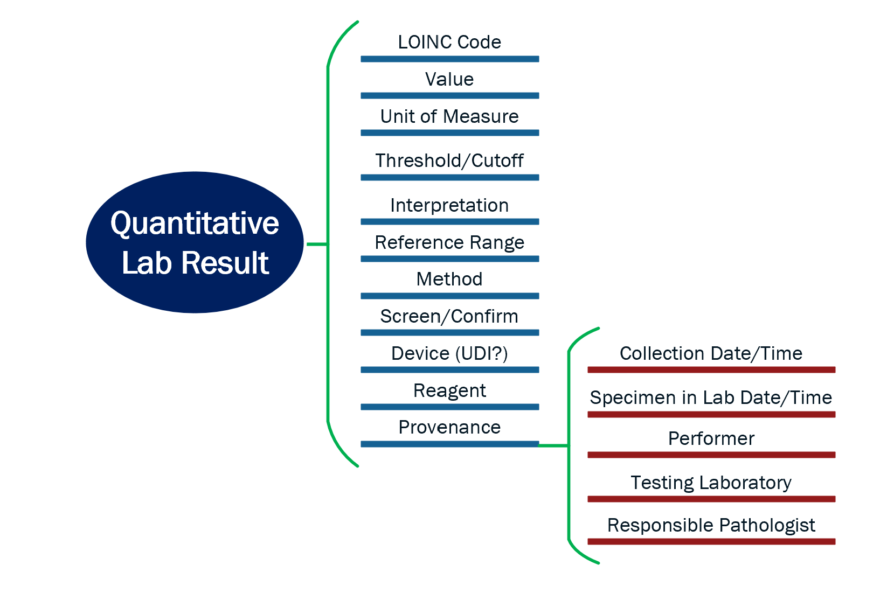
Example comprehensive model for quantitative lab
The information model :
Shows the primary LOINC code …
In the context of all other attributes that would/could be important for understanding the complete meaning of the primary data
The information model can/will be constrained to meet the requirements of specific use cases

Slide 30
Example use case specific constrained model
Amphetamines Lab Result
LOINC code: 3349-8 Amphetamines PrThr Urine
value [required] [value set presemce/absence],
threshold/cutoff [required],
interpretation [required] [value set ABC],
method [optional] [value set DEF].
screen/confirm [required] [value set screen/confirm]
device (UDI) [optional] [value set GHI]
provenance info
collection date/time
specimen in lab date/time
performer,
testing laboratory,
responsible pathologist,
…,

Slide 31
Other areas where post coordination might be useful
XXX System (microorganism antibodies, antigens, DNA, and RNA)
Specimen 1, 2, 3, 4, …; Organism 1, 2, 3, 4, …; etc.
Challenge test details
Subtypes of antibodies: IgA, IgE, IgM
”Risk of X” codes
Microbiology susceptibilities
Screen/confirm designation
Specific numeric thresholds/cutoffs
Some preconditions??? Peak/Trough, Fasting/Random, Exercising vs at Rest, clothes on/off (consider one at a time)
Other use cases yet to be discovered

Slide 32
The LOINC SNOMED Ontology

Slide 33
The LOINC Ontology: A LOINC and SNOMED CT Interoperability Solution
  Extension of SNOMED CT
    SNOMED CT: ontological framework
    LOINC: content
  Distribute LOINC content to LOINC and SNOMED CT users
    Create SNOMED CT and LOINC codes for all concepts that are shared between the terminologies
  Easy for implementers to have a unified approach to implementing both standards, giving them a choice of which codes to use for ease of implementation
  Provide a single solution that meets clinical and regulatory requirements, globally
Notes:
And, what we have been working on together is
The LOINC Ontology:
which is A LOINC and SNOMED CT Interoperability Solution
Its actually a LOINC extension of SNOMED CT where SNOMED CT provides
the ontological framework
and LOINC provides the content.
and it offers the ability to distribute LOINC content
to both LOINC and SNOMED CT users.
And that happens by creating both
SNOMED CT and LOINC codes
for all concepts that are shared between the terminologies.
The LOINC Ontology makes it easier for implementers to have a unified approach for implementing each standard
and it offers a choice to select codes based on clinical or regulatory requirements

Slide 34
More details
All LOINC content will eventually be in the extension
We will map existing SNOMED observables to LOINC codes and make new LOINC codes as needed
We will map/match LOINC parts to SNOMED concepts, and create new SNOMED concepts as needed
We will represent LOINC answer lists (value sets) and the relationship between LOINC concepts and the allowed value sets in the extension
FSNs in the LOINC Extension will be created by the rules for FSNs in the SNOMED International Edition

Slide 35

Wrap-Up

