Slide 1
Anatomy project
Yongsheng Gao
Consultant Terminologist Group meeting, 2016/03/22

Slide 2
Overview of anatomy project
Six subprojects and a follow-on
  SEP (Structure/Entire/Part) assignment
  laterality assignment
  systematic naming
  is-a and part-of modeling
  sufficient definitions
  FMA alignment
Follow-on:
G. Examination of options for eliminating “S”

Slide 3
Anatomy subproject dependencies
A
A: SEP assignment
B: laterality assignment
C: Systematic naming
D: is-a and part-of modeling
E: Sufficient definitions
F: FMA alignment
G: Options for eliminating “S”
F
D
B
C
Depends on
Facilitated by
E
G

Slide 4
Examples: SEP Assignment and systematic naming projects
Assign each concept under 91722005 | physical anatomical entity | to one of the three types
Systematic naming - Basename and SEP names
SEPID | Basename | S_name | E_name | P_name
146 | hand | Hand structure (body structure) | Entire hand (body structure) | Hand part (body structure)
225 | finger | Finger structure (body structure) | Entire finger (body structure)
2129 | Index finger | Index finger structure (body structure) | Entire index finger (body structure)

Slide 5
Project A and C: SEP Assignment and systematic naming projects
Tasks:
  for each anatomy concept, assign it to one of S, E, or P
    one E for each S, and vice versa.
  match up E’s and S’s in the hierarchy via is-a relationships
    each S must be the parent of its corresponding E
    no E may be the parent of any S
  name constraints and clues:
    anything called “entire X” must be E
    anything called “structure of X” must be S
    FSNs with no text clues as to “E” or “S” should be assigned based on their usage as values of finding-site or procedure-site or other attributes
Status:
  In SNOMED CT January 2016 release:
    Fixed 75 ambiguous anatomy concepts (no indication of S or E in FSN)
    Added 180 new anatomy concepts
    Changes concept modeling to 300 concept in procedures and findings
  Updated anatomy database, currently, SEP-table has 18,995 rows, one S, one E and one P per each row.
  To do:
    Missing E concept or ‘entire’ in description – about 7,000
    Review and decide on assignment for synonym without ‘structure’ and ‘entire’
    Apply systematic naming in SNOMED CT release

Slide 6
Project B: Laterality Assignment
Tasks:
  for each anatomy concept, determine whether it is lateral or not
    definition of lateral == lateral to the midsagittal plane (the plane dividing the entire body into left and right halves)
  constraints:
    lateral structures may not have any midline subtypes or subparts
    midline structures have lateral halves, not lateral subtypes
      left half of nose, NOT left nose.
Status:
  A complete version of laterality data included in SEP table.
  Laterality refset is being produced for each release from the SEP table.
  Laterality assignment has been reviewed and aligned with FMA
  To do: convert to central refset maintenance and regular QA

Slide 7
Project D: Is-a and part-of modeling
Tasks:
  Define each “Structure of X” as:
    Entire X OR Part-of X
  Ensure each “Entire X” is-a “Structure of X”
  Quality assure the Part-of relationships
Status:
  Completed: Definition of “Structure of X”, and E isa S, BUT
    This depends on OWL 2 EL features which are not available in our current tooling or distribution formats
      SCA tool cannot currently edit the definitions
      RF2 cannot currently represent the definitions
  To do:
    Alignment with FMA for Is-a and part-of in the phase 2 of project
    Examine options for making some of the improvements available in current distribution formats
    Examine options for editing tool support

Slide 8
Project E: Sufficient definitions
Tasks:
  Sufficiently define “E” concepts
  Quality assure the inferred relationships
Status:
  Perhaps several thousand more could be defined
  Also depends on OWL 2 EL features not available in our current tooling or distribution formats
    The SCA tool cannot currently edit the definitions
    RF2 cannot currently represent the definitions
  To do:
    Examine options for making some of the improvements available in current distribution formats
    Examine options for editing tool support

Slide 9
Project F: FMA alignment phase 1
Map SNOMED CT “E” concepts to FMA concepts
Identify erroneous, duplicate, or missing anatomy structures
Identify erroneous, archaic or unusable names & terms
Examine inconsistencies of meaning in identically named categories/groups
Identify lateralizable concepts with their FMA-named L and R versions (e.g. “bone tissue of distal phalanx of left index finger”)

Slide 10
Outcomes from Mapping review by University of Washington
82.4% of 18,767 review SNOMED CT concepts have one to one map to FMA classes.
  ‘Asserted maps’ review
    Confirmed correct maps – 8,000
    Corrected maps - 300
  ‘Asserted no map’ review
    Mapped SCT concepts to FMA classes – 7,000
    Created new FMA classes - 3,000
Unmappable SCT concepts to FMA classes – 3,000
    Redundant high level concepts
    Inappropriate terms
    Non-structural context
    Ambiguous terms
    Non-anatomical
    Non-human anatomical entities

Slide 11
Reported Issues
Count disparity: singular vs. plural concept
    Base name ‘cerebral vessel’ vs. E-name ‘Entire cerebral vessels’
Different entities represented
    Base name ‘skeletal system’ vs. E-name ‘Entire skeleton’
Missing Entire concepts or ‘entire’ in description
    Base name ‘Cervical intertransverse ligament’ vs. E-name ‘’
Synonym
    Base name ‘skull’ vs. E-name ‘Entire cranium’

Slide 12
Redesign of anatomy concept model
IS-A and Part-Of modeling
  Clear separation of is-a hierarchy and part-of relationships
  Concept definition based on ‘E’ concepts
  Logic model options
    OWL2 EL with reflexive and transitive relationship
    OWL 2 DL with disjunction
Sufficient Definitions
General Concept Inclusion/Axioms
Role chaining
Options for eliminating ‘S’
  Impact assessment

Slide 13
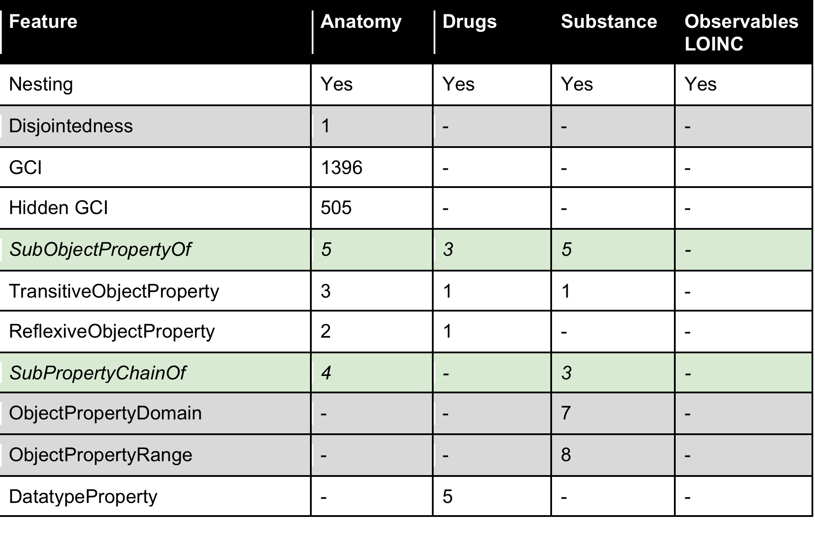
Description Logic features required by projects – (Palo Alto meeting)

Slide 14
SEP model – Structure, Entire/Entity, Part
(S)Hand
(E)Hand
(P)Hand
IS A
Part of
(S)Finger
(E)Finger
(P)Finger
(S)Index finger
(E)Index finger
(P)Index finger

Slide 15
IS-A and Part-Of differentiation
(S)Hand
(E)Hand
(P)Hand
IS A
Part of
(S)Finger
(E)Finger
(P)Finger
(S)Index finger
(E)Index finger
(P)Index finger

Slide 16
IS-A and Part-Of differentiation
(S)Hand
(E)Hand
(P)Hand
IS A
Part of
(S)Finger
(E)Finger
(P)Finger
(S)Index finger
(E)Index finger
(P)Index finger

Slide 17
IS-A and Part-Of differentiation
(S)Hand
(E)Hand
IS A
Part of
(S)Digit of hand
(E)Digit of hand
Finger SubClassOf ‘Digit of hand’
(S)Finger EquivalentTo allOrPartOf some Finger
‘Index finger’ SubClassOf Finger
‘(S)Index finger’ EquivalentTo allOrPartOf some ‘index finger’
‘Part of hand’ EquivalentTo PartOf some hand
(S)Finger
(E)Finger
(S)Index finger
(E)Index finger

Slide 18
Part of relationships
allOrPartOf - reflexive and transitive property
  part of - proper part of, transitive property
    cPartOf - constitutional part of
    rPartOf - regional part of, transitive property
    sPartOf - systemic part of
    lateralHalfOf

Slide 19
Skin of part of <region>
region of skin
regional part of
region of skin
≡
constitutional part of
<region>
region of skin
constitutional part of
regional part of
<region>
GCA (General Class Axioms), anonymous class, to ensure proper subsumption, e.g.
‘(S)Skin of hand’ subsumes of skin of regional part of the hand

Slide 20
Laterality
Laterality: side to the mid-sagittal plane
Role chain:
  Part of o laterality -> laterality
  (X part of Y), and (Y laterality R/L) implies (X laterality R/L)
  (Finger part of Hand), (Hand laterality R/L) implies (Finger laterality R/L)

Slide 21
Skin of <region>, <laterality>
skin of <side><region>
<side> should be either “left” or “right”.
<side of region> is an already lateralized structure, e.g. “left hand”
≡
region of skin
constitutional part of
<sided region>
e.g. “left hand”
≡
region of skin
constitutional part of
zone of integument
e.g. “hand”
constitutional part of
<region>
laterality
L/R

Slide 22
Lateral half of <midline entity>
‘lateral half of <midline entity>’
≡
lateral half of
<midline entity>
laterality
<side>
‘lateralHalfOf’ is a special partof relationship.
It distinguishes lateral half parts from regional parts.
A lateral half is not a regional part.
E.g. lateral half of nose = (‘lateral half of’ some nose) and (laterality some side)

Slide 23
Par of <L/R> lateral half of <midline entity>
Anonymous classs, using general class axioms.
part of
<midline entity>
≡
laterality
<side>
all or part of
lateral half of
<midline entity>
(part of ‘lower lip’) and (laterality side) =
(allorpartof (lateralHalfOf ‘lower lip’)
part of
<lateral half of midline entity>
≡
laterality
<L/R>
part of
<L/R> half of <midline entity>
(part of ‘lateral half of trunk’) and (laterality left) =
(part of ‘left half of trunk’)

Slide 24
Option to eliminate Structure concepts
(S)Hand
(E)Hand
(S)Digit of hand
IS A
Part of
(S)Finger
(E)Finger
(S)Index finger
(E)Index finger
Notes:
Benefits of having a simpler set of anatomy codes
Drawbacks of significantly more complicated disorder and procedure models

Slide 25
Option to eliminate Structure concepts
Injury of Hand
(E)Hand
IS A
PartOf
Site
Exact site
Hierarchy of attribute
Site
Exact site
Role chain:
PartOf o PartOf -> PartOf
Site o part of -> site
Injury of finger
(E)Finger
Amputation of Hand
(E)Hand
Amputation of finger
(E)Finger

Slide 26
Current activities 1
Address issues reported in phase 1
  Missing E concept or ‘entire’ in description – about 7,000
  Review and decide on assignment for synonym without ‘structure’ and ‘entire’
  Apply systematic naming in SNOMED CT release
  Create alpha release file in OWL for Jan 2016

Slide 27
Generate OWL alpha release file
Changes in July 2015 release
  Over 100 new concepts in July 2015 release have been included in this release.
  A new annotation property FMAPT has been added to present the preferred terms in FMA
  Over 13,000 FMA IDs and PTs have been updated following the feedback from the FMA alignment project. Half of them are new maps and a small number of changes are made to the existing maps.
  Two duplicated concepts have been deleted from the file.

Slide 28
Current activities 2
FMA alignment review project phase 2
  Validation of mappings
  Review IS A and Part of relationships
Initial feedback from the phase 2 review
  Mappings – majority are updated, a very small number of issues
  Constitutional Part Of, transitive
  Replace Systematic Part Of

Slide 29
Current activities 3
Routine requests management and Internal Quality improvement
Revise anatomy concept model focusing on possibility of eliminating GCI

Slide 30
Dependencies
Completion of review in relation to the FMA
Update of SEP in SNOMED CT
Concept model redesign and update
Release format
Authoring tool

