Slide 1
First Software Development AG Meeting
12th October 2015

Slide 2
Principal Scope
Propose governance model for the (an) open source community
…and then become the governance and help grow the open source community
Learn about updates on open source IHTSDO tools and upcoming roadmaps
The agenda should be driven by group, not IHTSDO.

Slide 3
Specific Responsibilities
Be the gatekeepers of published open APIs and their documentation as the governance group
Propose QA frameworks for open source community software development
Review any submissions of code or tools for inclusion into the IHTSDO open source ‘ecosystem’ (and find a better name for it!)
Provide constructive feedback on existing open source IHTSDO tools/code from a software development angle

Slide 4
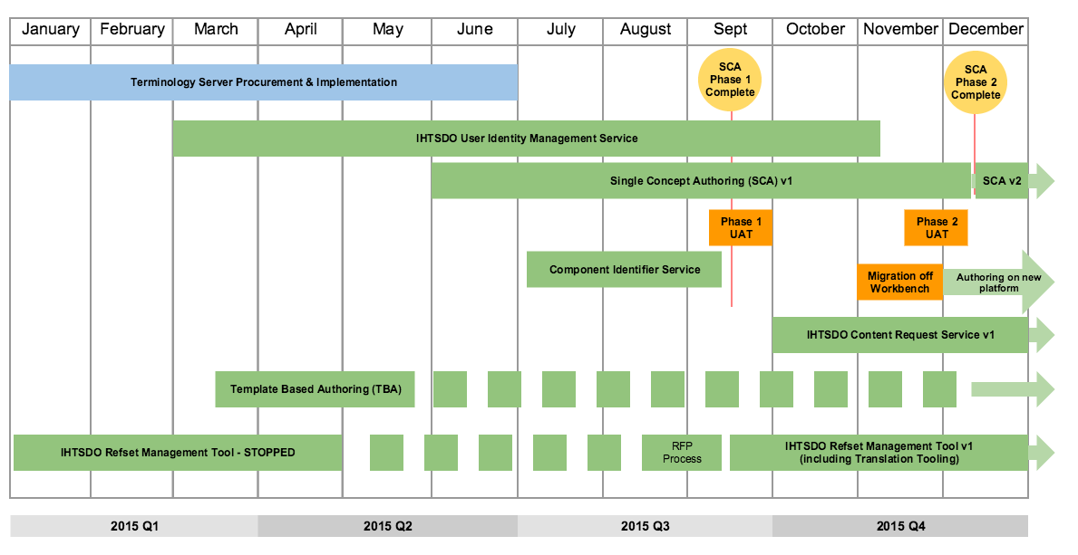
2015 SCT Tooling Roadmap

Slide 5
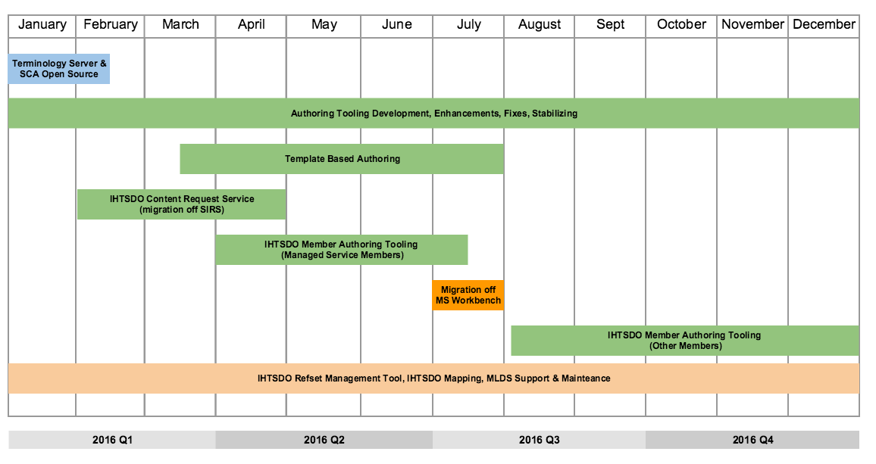
2016 SCT Tooling Roadmap

Slide 6
Delivery Strategy
Open Source Development
  All tooling development follows an open source approach.
  Once a product is live and in use, at a minimum by IHTSDO staff, all code is made available under an Apache v2 open source license.
  Anyone, including Member NRCs and the community of practice, can contribute to the open source products by either enhancing or fixing any identified issues, if appropriate.
Development policy
  In house team for SNOMED CT knowledge and technical skills for innovations and future tooling products
  Outsource to vendors where a specific project has been identified, or specific support skills are needed
  Any other development partners need to either be under contract or specific SLAs.
  Enhancements to live products are open to anyone who would like to contribute to the open source SCT tooling community
  The IHTSDO aims to develop solutions that are used by the organization and the majority of its Members, but not develop any customizations of these solutions on request.

