Slide 1


APRIL 2024
SNOMED INTERNATIONAL BUSINESS MEETINGS
Dose Form Intended Site
Nicki Ingram and Julie James
Leading healthcare terminology,
worldwide
Wednesday APRIL 17, 2024
LONDON, UNITED KINGDOM

Slide 2

A query…..
Range for “Has dose form intended site (attribute)”.
Could the target range for this attribute use route of administration concepts, rather than, as currently, a set of specific qualifier values?

Slide 3

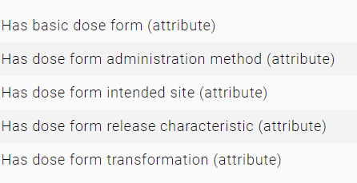
Pharmaceutical dose form concept model
Model developed 5+ years ago within the SNOMED CT model development group
In harmony with ISO IDMP standards, to facilitate national MPDs in managing their drug extensions, but specific to SNOMED CT for your use cases….hence also the mapping work
Photo by Humphrey Muleba: https://www.pexels.com/photo/photo-of-black-vehicle-at-the-road-1647120/

Slide 4
“Has dose form intended site (attribute)”
This attribute describes “a general type of site of administration that the dose form “is prepared for”” and usually that is reflected in some pharmacopoeial standards
“Oral” - must dissolve in acid pH
“Ocular” - must be initially sterile, usually preserved and buffered, no particulate matter
Photo by Humphrey Muleba: https://www.pexels.com/photo/photo-of-black-vehicle-at-the-road-1647120/

Slide 5
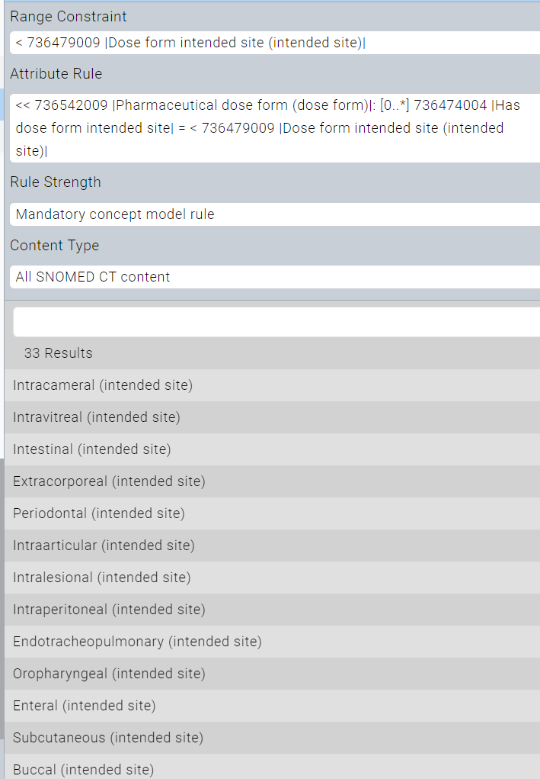
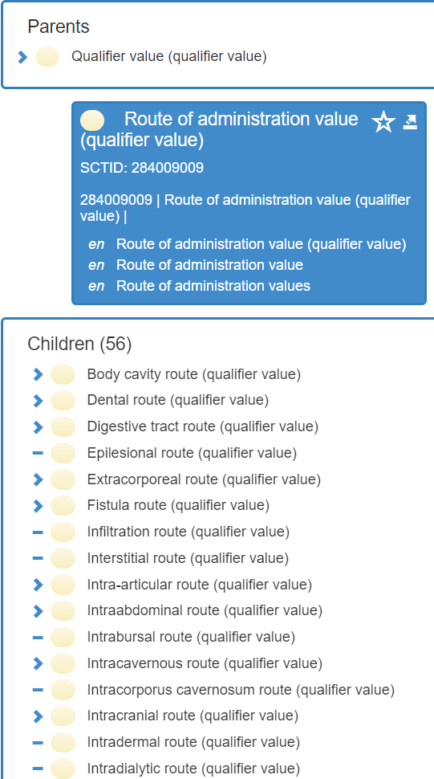
Range = < 736479009 |Dose form intended site (intended site)|
Plus additional children
Photo by Humphrey Muleba: https://www.pexels.com/photo/photo-of-black-vehicle-at-the-road-1647120/

Slide 6

Current Editorial Guidance
|Dose form intended site| should not be confused with route of administration, which is a concept used in dosage instructions for the administration of a particular medicinal product to a particular patient.
‘
Photo by Harry Shum: https://www.pexels.com/photo/the-big-ben-in-london-13433495/

Slide 7
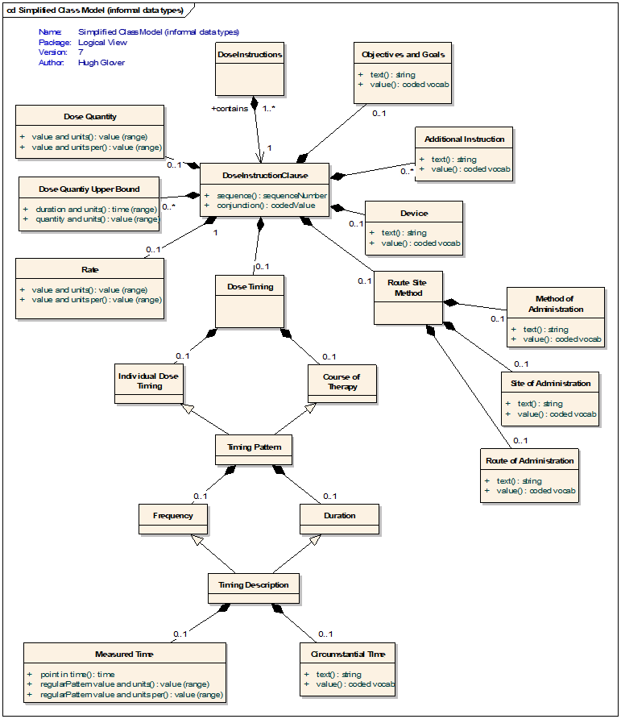
Rationale
Route of administration is clinical information
It is the prescriber’s (or administrator’s) choice for a particular patient with a particular product at a particular point in time
Whereas attributes of a dose form are always and necessarily true
Photo by Harry Shum: https://www.pexels.com/photo/the-big-ben-in-london-13433495/

Slide 8
Reasoning……
Clearly, there can be a relationship between a dose form and the route(s) of administration that a prescriber is most likely to select when using a product that has that dose form
Some decision support systems (for example) may wish to formalise that relationship, always understanding that it is not and cannot be, absolute, but will be applied using contextual and clinical knowledge
Photo by Humphrey Muleba: https://www.pexels.com/photo/photo-of-black-vehicle-at-the-road-1647120/

Slide 9

Comment
It could possibly be argued that “site of administration”, which tends to use adjectival concepts (like ocular or cutaneous) should have used (or at least be linked to) noun anatomic concepts
BUT (for example)
the traditional and clinically useful grouper concept of “parenteral” would be a little challenging
Photo by Humphrey Muleba: https://www.pexels.com/photo/photo-of-black-vehicle-at-the-road-1647120/

Slide 10
Conclusion
Status quo
There are currently no plans to make any changes to the Dose Form model
However some concept definitions have been updated to (hopefully) clarify their semantics and therefore their use

Slide 11
Information
Updated definitions
736474004 |Has dose form intended site (attribute)|
Dose form intended site describes the general anatomic location that the dose form has been formulated for administration to or at. The intended site is not intended to describe a precise site or route of administration. For example, eye drops (prepared for ocular intended site) are subject to pharmacopoeial standards for pH, and sterility.
410675002 |Route of administration (attribute)|
The route of administration is the path by which the product is taken into or makes contact with the body, and is a property of the administration action. The route of administration of a medication is determined by the prescriber in their prescription dosage instructions for a particular patient.
736479009 |Dose form intended site (intended site)|
The set of values for dose form intended site that relate to characteristics associated with a pharmaceutical dose form and do not refer to a precise anatomic location.
284009009 |Route of administration value (qualifier value)|
The set of values for route of administration. For medicinal products these values are associated with the action of administration.

Slide 12


Thank You

