Slide 1
Enhance content under 416093006 |Allergic reaction caused by drug (disorder)|
Bruce Goldberg, MD, PhD
Chair, Allergies/Hypersensitivity and Intolerance Clinical Reference Group

Slide 2
Classification of adverse drug reactions
Type A reactions
  Represent the majority of reactions, can affect any individual, and are predictable from the known pharmacologic properties of a drug.
    Examples
      Toxicity
      Side-effects
      Interactions with other drugs
Type B reactions (Hypersensitivity)
  Immune mediated
    Allergy
      Specific IgE (Type I)
      Types II-IV
    Other immunologic reactions
      Drug-induced autoimmunity
      Fixed drug eruptions
  Non-allergic reactions
    Pseudoallergy
    Intolerance
    Idiosyncrasy

Slide 3
Issue
Allergic reactions to drugs are types of adverse drug reactions (type b – hypersensitivity reactions)
SNOMED content related to adverse sensitivity and thus allergy to drugs are located in parallel hierarchies representing reactions and propensity to reactions.
The distinction between propensity (disposition) and reaction (event) is supported by the FHIR AllergyIntolerance resource
There is a huge imbalance between the amount of content under 416098002 |Allergy to drug| (finding) and 416093006 |Allergic reaction caused by drug (disorder)| with the vast majority of concepts residing under 416098002 |Allergy to drug| (finding).

Slide 4
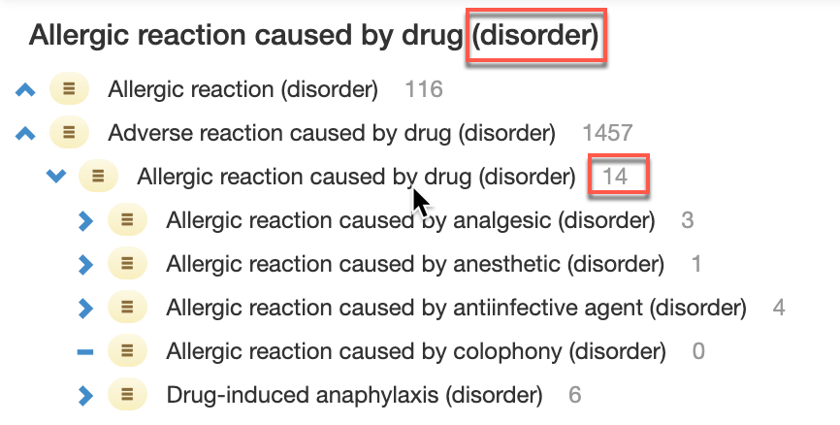
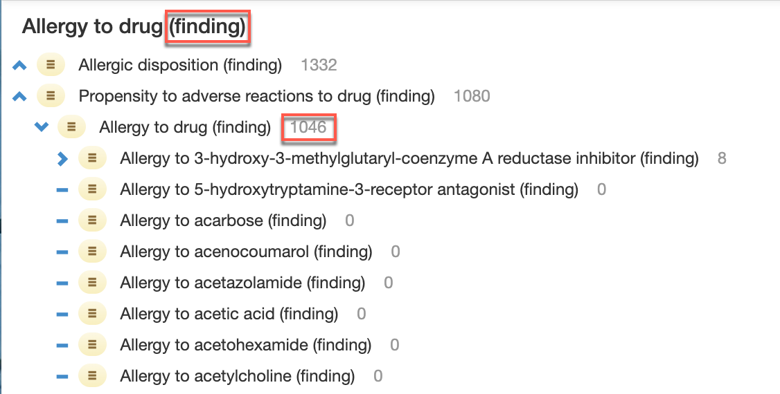
Allergy hierarchies pertaining to drugs
Propensities being findings means that the majority of drug related allergy content will not be subsumed under Allergic reaction caused by drug (disorder) and thus not be considered to be adverse drug reactions

Slide 5
PROJECT APPROACH
Review the content under 416098002 |Allergy to drug (finding) and create parallel allergic drug reactions under 416093006 |Allergic reaction caused by drug (disorder)|.
This may be amenable to automation but there is still a requirement for manual review of all newly created concepts and their classification as well as resolving issues such as consideration of dealing with previously inactivated concepts.

Slide 6
PROJECT IMPACTS
Creation of concepts of this type and number has a direct impact on the ICD mapping project.

Slide 7
PROJECT SCOPE
The scope of the project includes: Creating ~1,000 new allergic reaction caused by drug concepts
The scope of the project excludes: Addition of new content as identified by Allergy CRG

