Slide 1
Desensitization therapy
Bruce Goldberg MD, PhD

Slide 2
Desensitization
Administration of a substance causing hypersensitivity starting with a small dose and gradually increasing the dose until a state of tolerance is achieved.
Often used interchangeably with allergen desensitization, allergen hyposensitization, allergy shots, immunotherapy, allergen immunotherapy

Slide 3
Question from SNOMED CT
Question:
SNOMED is involved in a mapping project with MedDRA, and MedDRA has a procedure, ‘Immune tolerance induction’. We think this isn’t quite the same as SNOMED’s 182678001 |Allergen immunotherapy (regime/therapy)|. Immune tolerance induction [ITI] has been used in Hemophilia A, so it’s not just for allergies but autoimmune disorders and post-transplants.
1. Is ITI the same as 243196004 |Immunoglobulin desensitization therapy (regime/therapy)|?
2. If so, should then 243196004 |Immunoglobulin desensitization therapy (regime/therapy)| be a sibling of 182678001 |Allergen immunotherapy (regime/therapy)| instead a subtype?
3. Should the above concepts have any relationship to 127785005 |Administration of substance to produce immunity, either active or passive (procedure)|? Currently, they do not.
Answer:
Immune tolerance induction (aka induced tolerance) refers to the development of an unresponsive state of the immune system to specific antigens in order to prevent an inappropriate, harmful response. One type of Immune tolerance can be induced by desensitization protocols where an antigen or allergen is administered in increasing doses. Examples are allergen immunotherapy and the immune tolerance induction of hemophilia which uses increasing doses of factor VIII to decrease inhibitory antibodies.
‘Immune tolerance induction’ is not the same as SNOMED’s 182678001 |Allergen immunotherapy (regime/therapy) although 182678001 |Allergen immunotherapy (regime/therapy) could be considered a kind of Immune tolerance induction’.
243196004 |Immunoglobulin desensitization therapy (regime/therapy)|. There are few references to what this actually means but I am thinking that it refers to the administration of (high dose) immunoglobulin for inflammatory and autoimmune diseases in which the immunoglobulin has an immunomodulatory effect and so can be considered to be a subtype of Immune tolerance induction (See attached article). This is not related to 182678001 |Allergen immunotherapy (regime/therapy)|but may be a sibling under a new parent of Immune tolerance induction
127785005 |Administration of substance to produce immunity, either active or passive (procedure) is not related to Immune tolerance induction as the former is focused on inducing a protective immune response while the latter suppresses a damaging immune response.

Slide 4
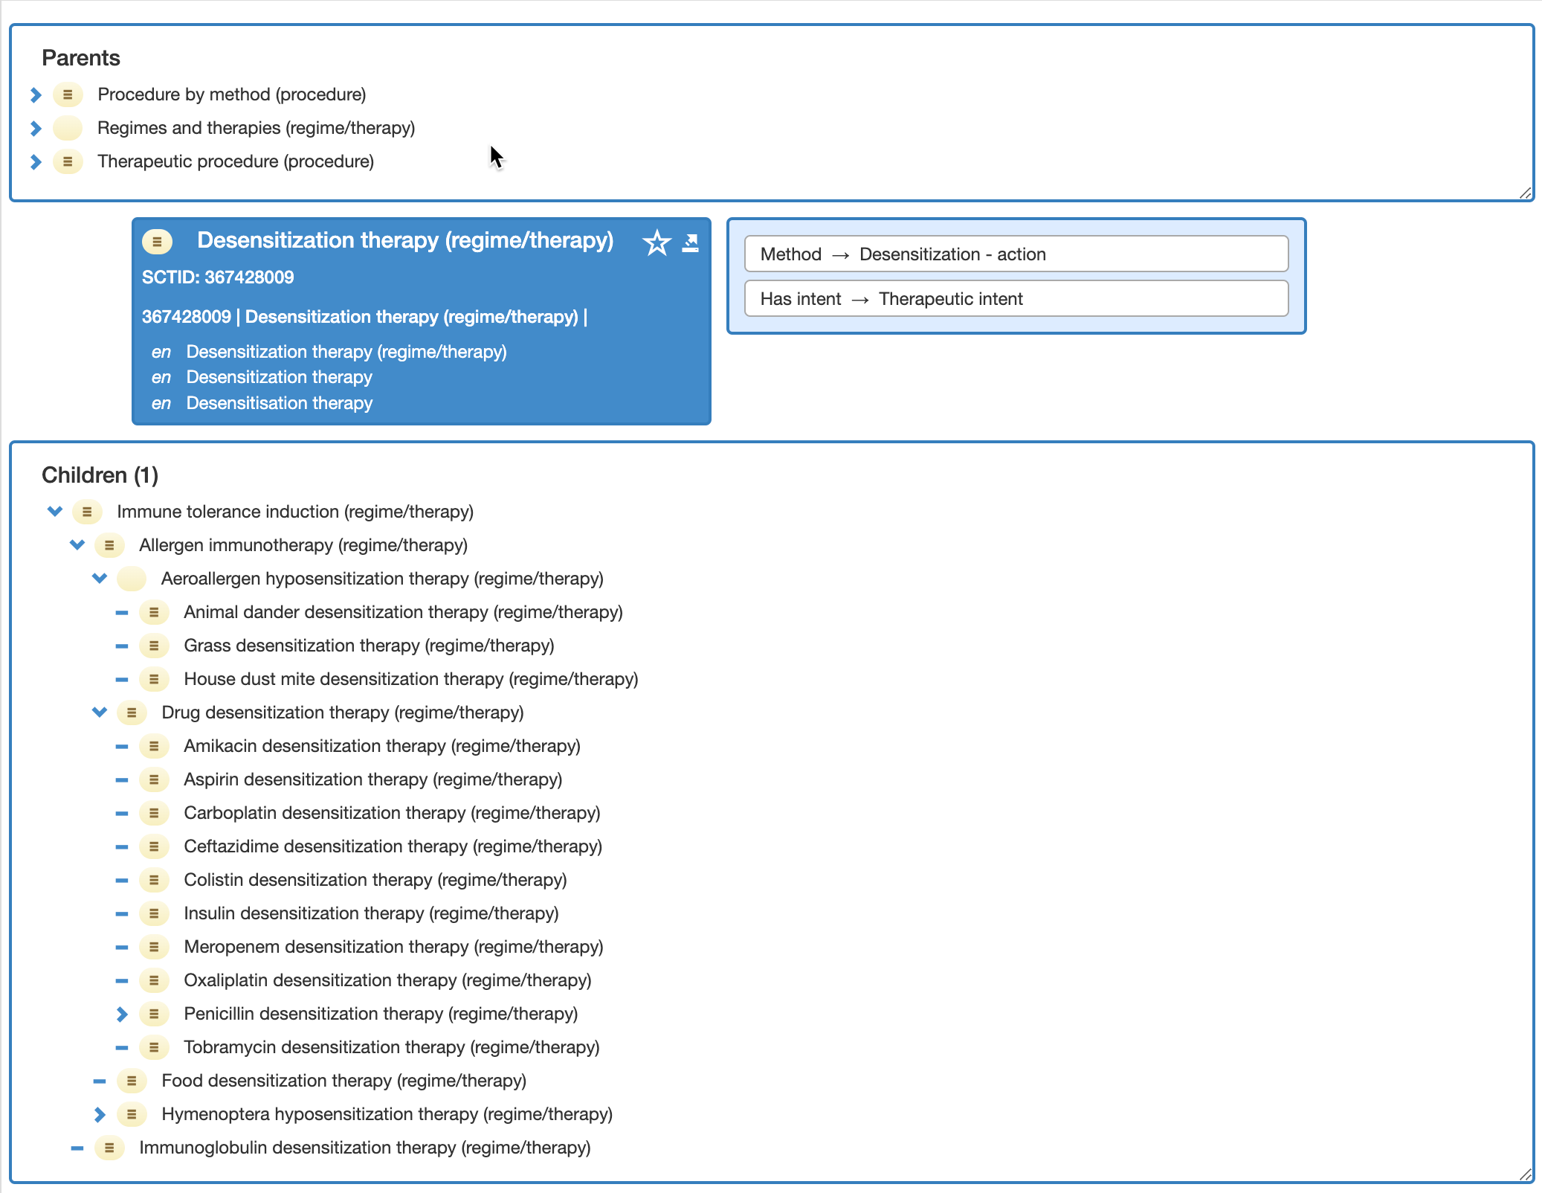
367428009 |Desensitization therapy (regime/therapy)|

Slide 5
Allergen immunotherapy
Administration of an allergen extract in increasing doses by various routes in order to suppress symptoms on exposure to that allergen. Used for type I allergy (immediate hypersensitivity, IgE mediated).
Induction (build up phase)phase may take months up to a year.
Maintenance phase may last several years after which may be discontinued. Tolerance may persist after discontinuation or may wane.
Used for:
  Aeroallergens (pollens, dust mites, animals, molds)
    Routes – subcutaneous, sublingual
  Hymenoptera venom
    Route – subcutaneous
  Food (peanut)
    Route - oral

Slide 6
Mechanisms of allergen immunotherapy
The mechanisms of action of allergen-specific immunotherapy include the very early desensitization effects, modulation of T-and B-cell responses and related antibody isotypes, and migration of eosinophils, basophils, and mast cells to tissues, as well as release of their mediators.
Regulatory T (Treg) cells have been identified as key regulators of immunologic processes in peripheral tolerance to allergens.Skewing of allergen-specific effector T cells to a regulatory phenotype appears as a key event in the development of healthy immune response to allergens and successful outcome in patients undergoing allergen-specific immunotherapy.
Naturally occurring FOX3–positive CD4⁺CD25⁺ Treg cells and inducible T_{R}1 cells contribute to the control of allergen-specific immune responses in several major ways
  Suppression of dendritic cells that support the generation of effector T cells
  Suppression of effector T_{H}1, T_{H}2, and T_{H}17 cells
  Suppression of allergen-specific IgE and induction of IgG4
  Suppression of mast cells, basophils, and eosinophils
  Suppression of effector T-cell migration to tissues.

Slide 7
Drug desensitization
Differs from allergen immunotherapy
  Administered acutely over a period of hours when a drug suspected of producing a hypersensitivity reaction is being considered.
  Not only for IgE-mediated allergy but also for delayed allergic reactions and non-allergic hypersensitivity (pseudoallergy) – e.g., aspirin desensitization.
  Tolerance is maintained only when taking drug (may be true for IgE-mediated food allergy as well).

Slide 8
Proposed changes to 367428009 |Desensitization therapy (regime/therapy)| hierarchy
367428009 |Desensitization therapy (regime/therapy)|
  1284973003 |Immune tolerance induction (regime/therapy)|
    243198003 |Aeroallergen hyposensitization therapy (regime/therapy)|
      243201008 |Animal dander desensitization therapy (regime/therapy)|
      243200009 |Grass desensitization therapy (regime/therapy)|
        Subcutaneous grass hyposensitization therapy (regime/therapy)|
        Sublingual grass hyposensitization therapy (regime/therapy
      243199006 |House dust mite desensitization therapy (regime/therapy)|
        Subcutaneous house dust mite hyposensitization therapy (regime/therapy)|
        Sublingual house dust mite hyposensitization therapy (regime/therapy)
      Food desensitization therapy (regime/therapy)|
        Peanut desensitization therapy (regime/therapy)|
    243196004 |Immunoglobulin desensitization therapy (regime/therapy)|
  243192002 |Drug desensitization therapy (regime/therapy)|

Slide 9
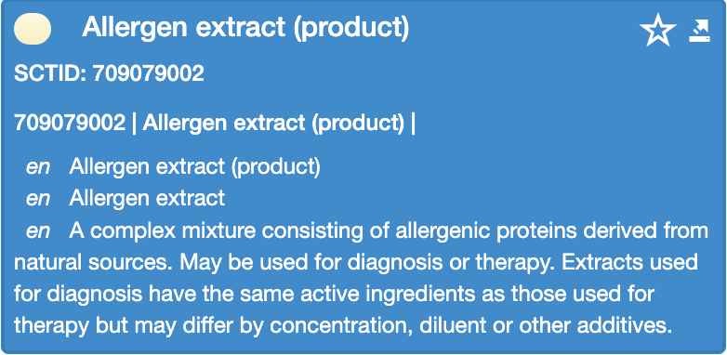
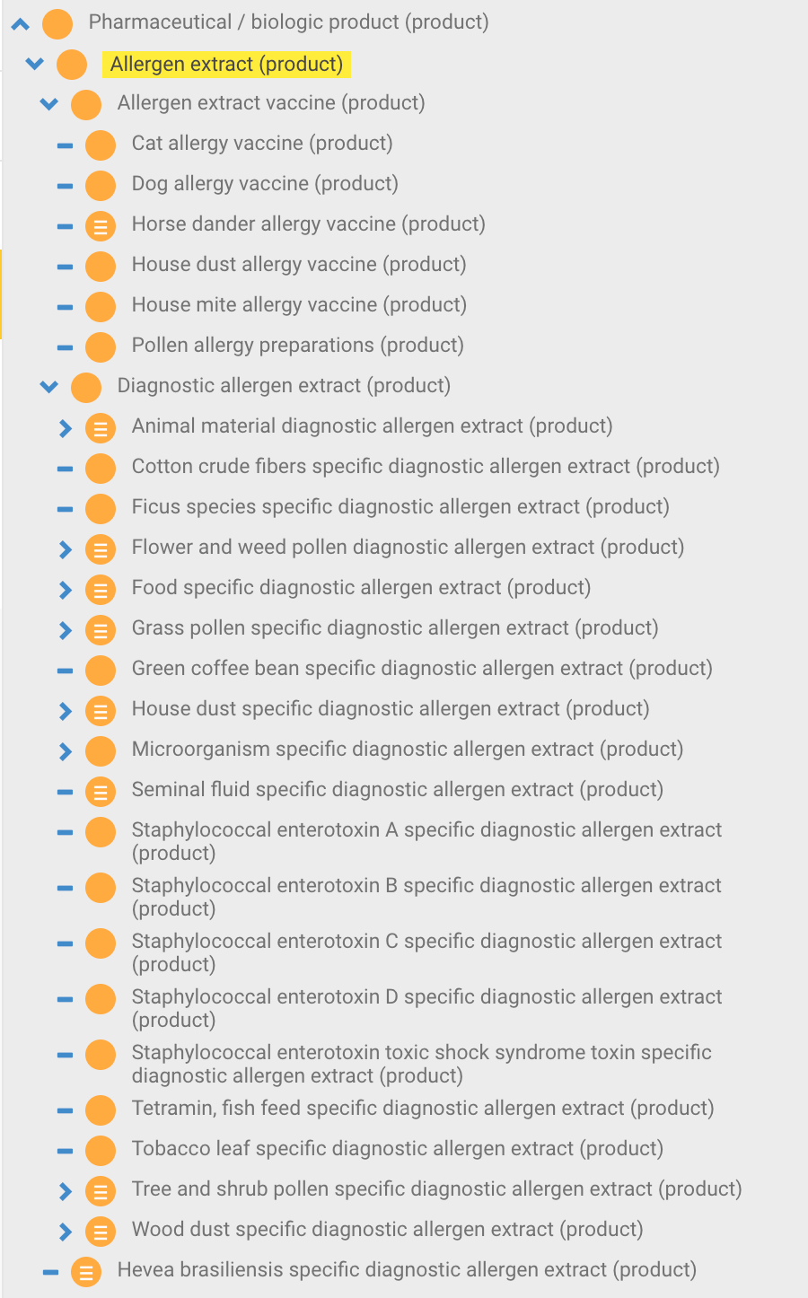
Allergen extracts
Hierarchy distinguishes between diagnostic and therapeutic extracts but not by administration route for the latter. In U.S. at least commercial products only exist for peanut (Palforzia®), dust mite (Odactra®), Ragweed (Ragwitek®) and grass pollens* (Oralair®)
*Perennial Ryegrass (Lolium perenne)
Kentucky bluegrass (Poa pratensis)
Timothy grass (Phleum pratense)
Orchard grass (Dactylis glomerata)
Sweet Vernal grass (Anthoxanthum odoratum)

Slide 10
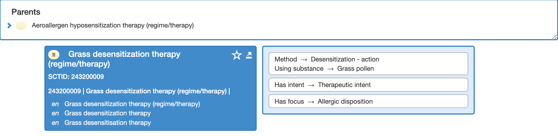
Allergen desensitization therapy model
Specifies substance not product

