Slide 1
Allergy to cetuximab and the alpha-gal syndrome

Slide 2
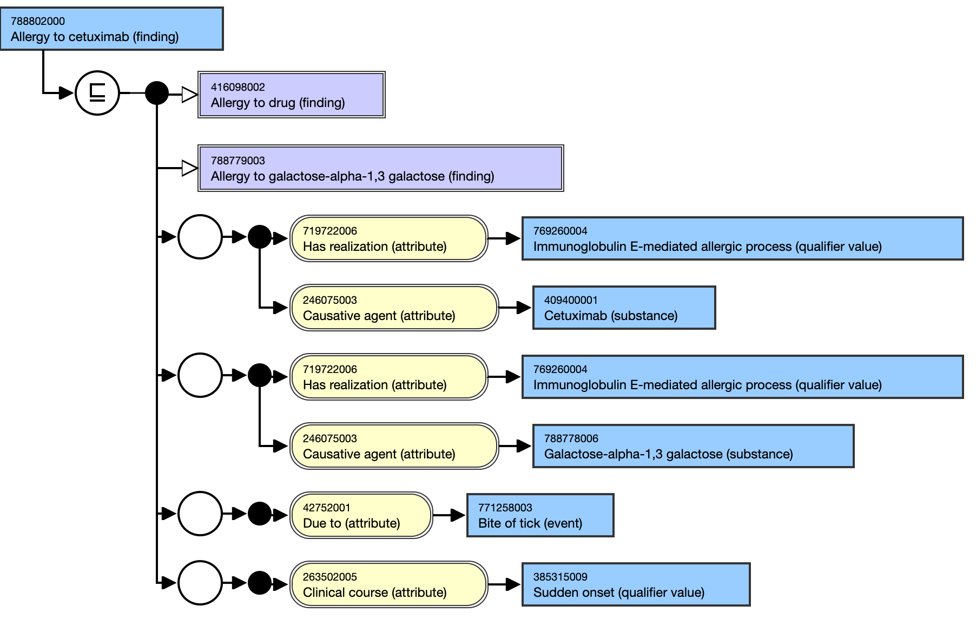
788802000 |Allergy to cetuximab (finding)| - current model
Model based on presumption that allergy to cetuximab is always related to alpha-gal syndrome

Slide 3
Is allergy to cetuximab is always related to alpha-gal syndrome ?
Although all reports in the literature mention galactose alpha 1-3 galactose sensitization as the principal cause of cetuximab allergy, cetuximab is a chimeric human-mouse monoclonal antibody and theoretically an immune response to the murine component can occur.
Human anti-mouse antibodies are usually of the IgG class

Slide 4
Revised model
Retire 788802000 |Allergy to cetuximab (finding)|
Retire 788781001 |Delayed allergy to red meat (finding)|
Create 1306673002 |Allergy to cetuximab due to alpha-gal syndrome (finding)|
Create 1306709006 |Alpha-gal syndrome (disorder)|

Slide 5
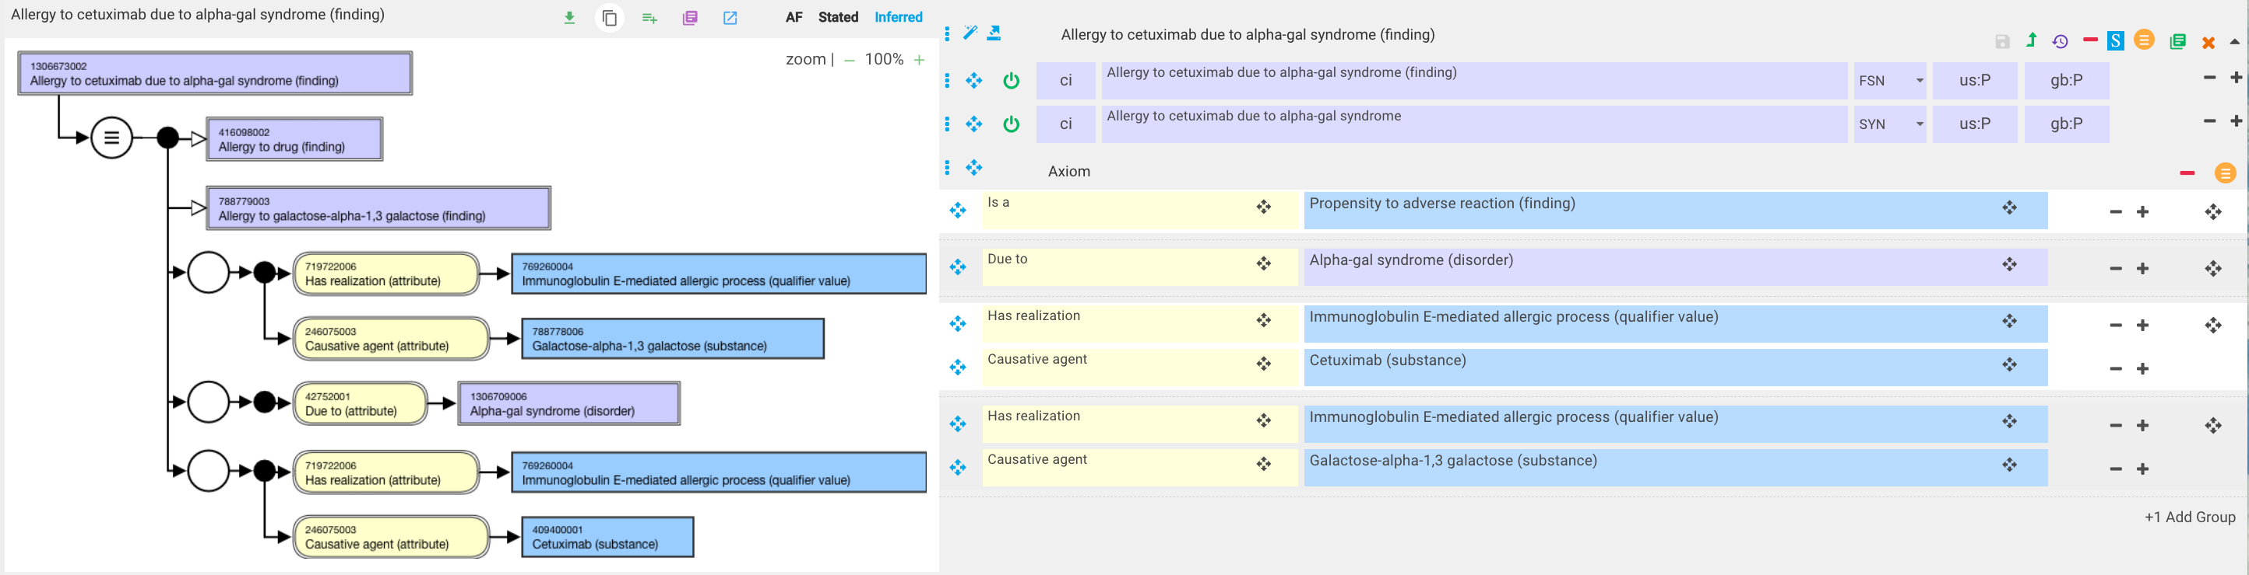
|Allergy to cetuximab due to alpha-gal syndrome (finding)|

Slide 6
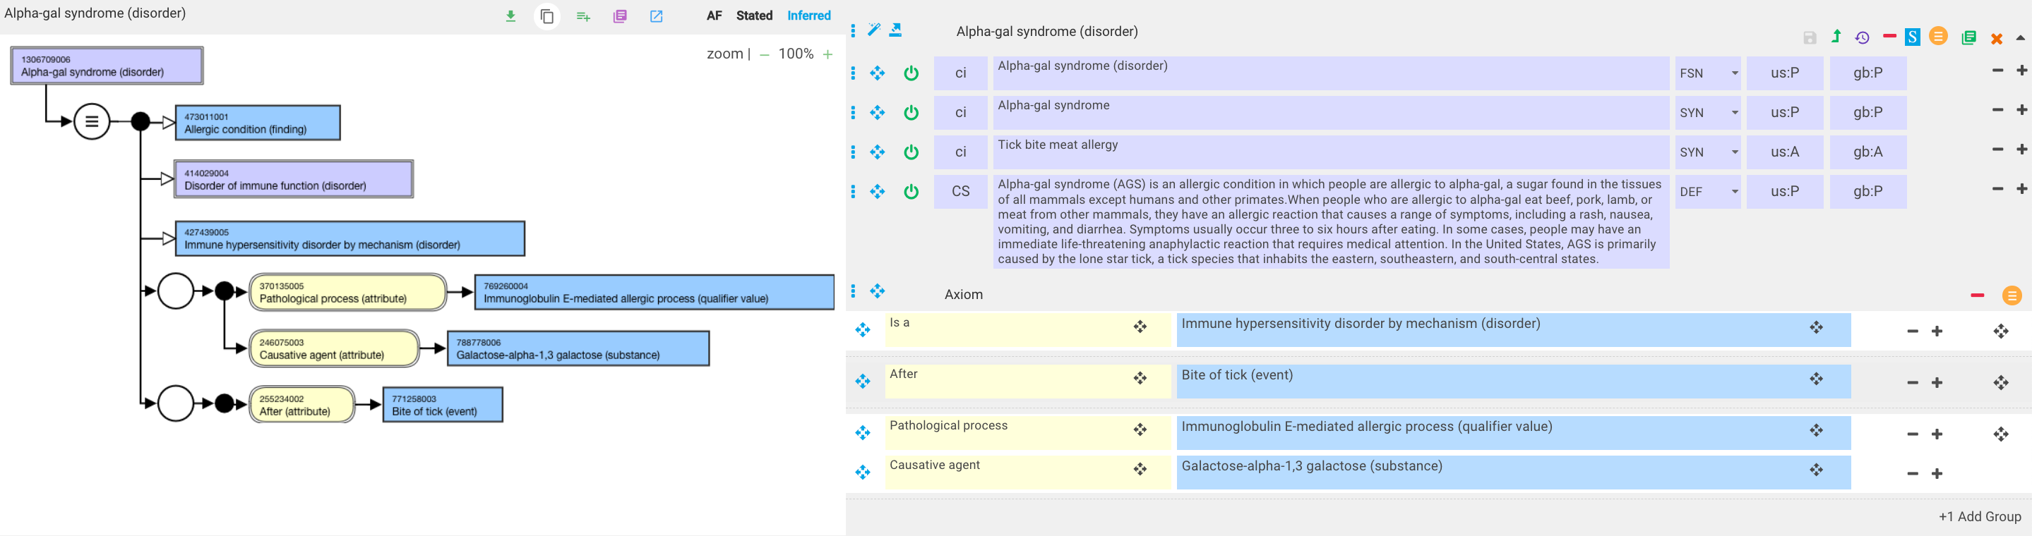
|Alpha-gal syndrome (disorder)|

