Slide 1
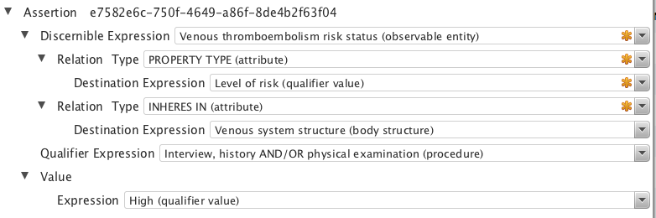
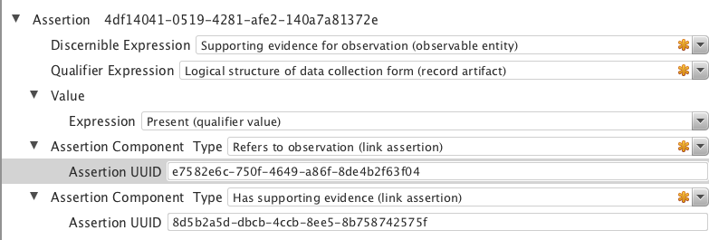
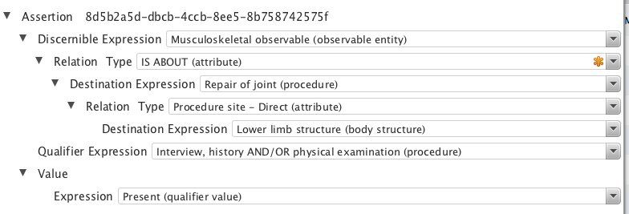
Using three LEGOs to represent “supporting evidence”
Refers to observation
Has supporting evidence

Slide 2
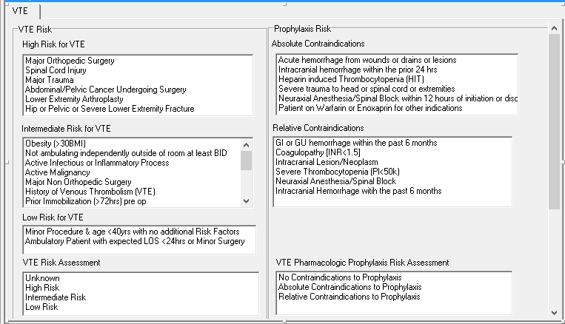
PNCS VTE form “logic”

Slide 3
Suggested concepts for the
“connector” LEGO
Discernible
  Supporting evidence for observation (observable entity)*
    IS-A Clinical history/examination observable (observable entity)
Qualifier
  Logical structure of data collection form (record artifact)*
    IS-A Record composition (record artifact)
Assertion Component relationship types
  Refers to observation (link assertion)*
    IS-A Link assertion (link assertion)
  Has supporting evidence (link assertion)*
    IS-A Link assertion (link assertion)
* indicates a new concept

Slide 4
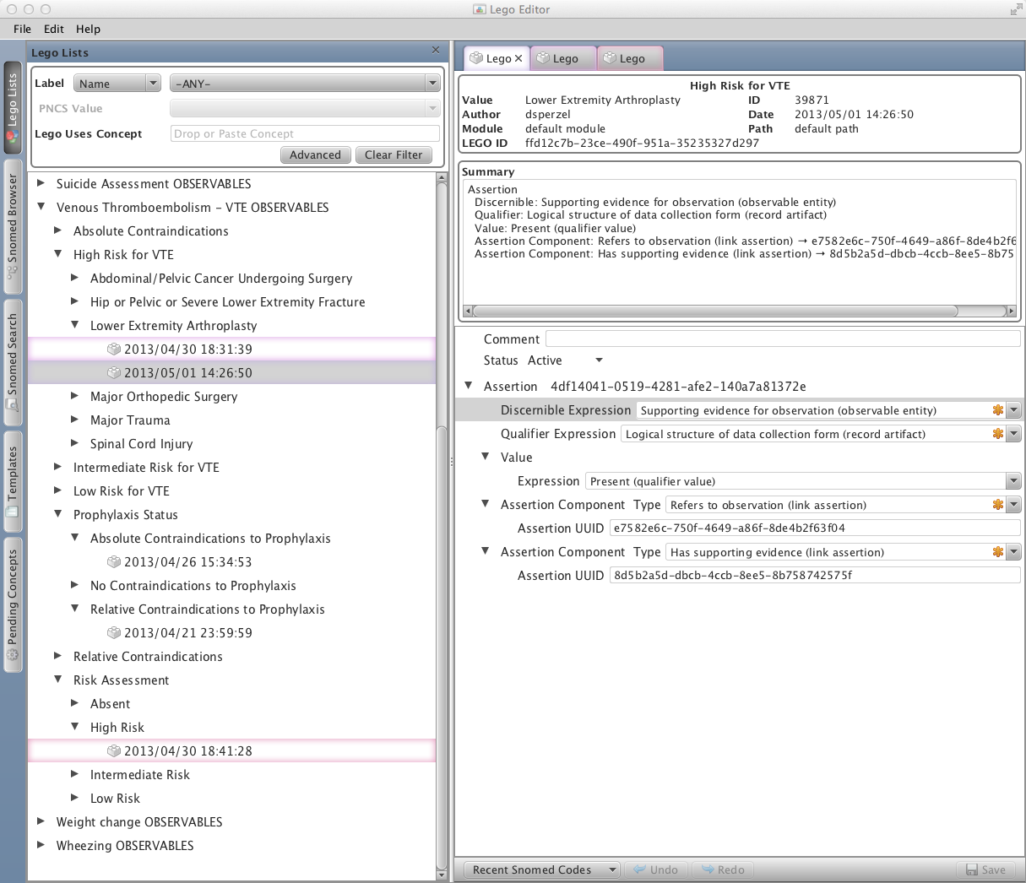
Assertion component “pointers”

