Slide 1
LOINC terms with impression (IMP) Property
How to model Impression LOINC codes

Slide 2
Background
LOINC codes with property IMP (as of July 2014 release): 877 (Active, Trial, Discouraged)
  Lab: 666
    Fetal cell screen [interpretation] in Blood
  Clinical: 164
    Fetal Study observation general US
  Attachments: 36
    Radiology Study recommendation (narrative)
  Surveys: 11
    Neonatal pressure ulcer risk evaluation [NSRAS]
Order/Observation
  843: Observation only
  15: both order and observation (all lab)
  19: blank (Clinical or survey)
Notes:
The overall organization of LOINC is divided first into four categories, “lab”, “clinical”, “attachments” and “surveys”. (This split is recorded in CLASSTYPE field of the LOINC Table.) The laboratory portion is further divided into the usual categories of chemistry, hematology, serology, microbiology (which includes parasitology and virology), and toxicology. We have separated antibiotic susceptibilities into their own category. The clinical portion of LOINC contains entries for vital signs, hemodynamics, intake/output, EKG, obstetric ultrasound, cardiac echo, urologic imaging, gastroendoscopic procedures, pulmonary ventilator management, and other clinical observations.

Slide 3
Background
Scale
  Nom: 527
  Nar: 265
  Ord: 74
  Set: 9
  Doc: 2
Component name:
  Comment: 112 (including 80 service comments -- with nominal scale?)
  Interpretation: 52
  Analysis: 24
  Review: 17
  Note: 8
  Report/narrative: 8
  Assessment: 6
  Recommendation: 2
  Pattern: 112
Notes:
Set: Used for clinical attachments

Slide 4
Problem Statement
How do we deal with impression property types in general?
What is the impression? Is it an observable about another observable (or a series of observables)? Is it a finding or a procedure? Or a hybrid?
If/how we can use the observables model: an observable whose property type is an impression?

Slide 5
Definition from LOINC manual: IMP
Impression is a diagnostic statement, always an interpretation or abstraction of some other observation (a series of test results, an image, or a total patient), and almost always generated by a professional.

Slide 6
Definition from LOINC manual - Find
Finding is an atomic clinical observation, not a summary statement as an impression. Physical, historical, review of systems and other such observations have a property of Finding. These may have a scale of Nom for coded findings, Nar for findings reported in narrative text or Ord for ordinal findings.

Slide 7
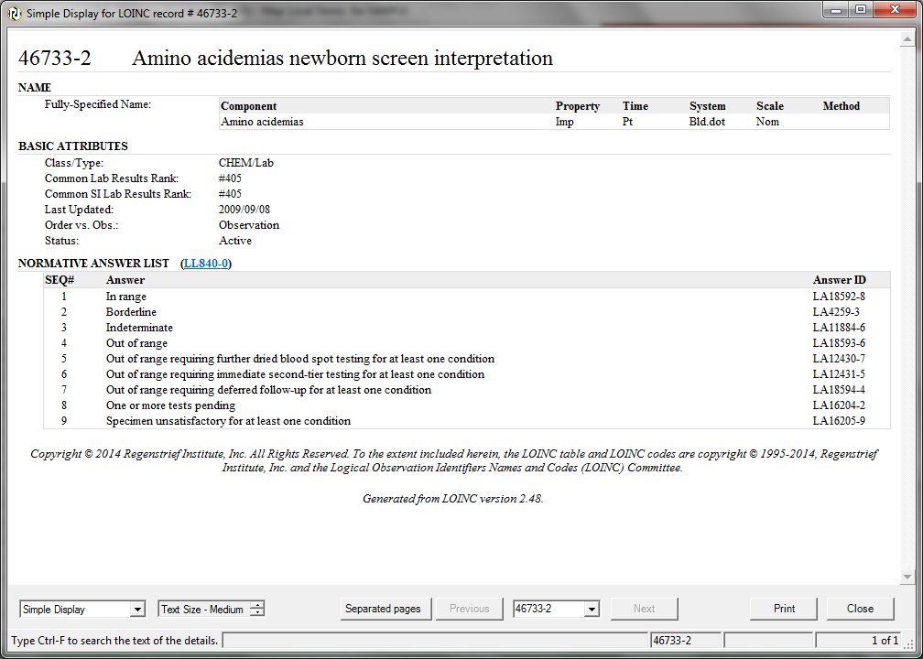
Answer list in Relma
Notes:
Some of the answers seem to contradict the definition of IMP from RII (e.g. “One or more tests pending”)

Slide 8
Answer list for LOINC impression codes
41 LOINC code
Scale
  36 - Nom
  2 – Nar (why not Nom?)
  3 - Ord
Class type:
  39 - lab
  1 - clinical: CCHD newborn screening interpretation
  1 - Survey: Neonatal pressure ulcer risk evaluation [NSRAS]

Slide 9
SNOMED CT Editorial guidelines - Converting LOINC or NPU codes into observable entities
6.3.4.1 Rules for converting LOINC names into observable entities
  12. Impression/interpretation is a valid value of PROPERTY-TYPE, but the rest of the model does not fit and therefore these terms require an expanded model (i.e. they must remain incompletely modeled at present).
  Update Editorial Guideline
Notes:
Out of date.

Slide 10
SNOMED CT Editorial guidelines - Guidance for content submitted using LOINC or IFCC-IUPAC names
LOINC name: Amino acids:Imp:Pt:Urine:Nar
Long common name: Amino acids [interpretation] in Urine Narrative
  (a) Pattern: Pattern of analyte X in system Y (observable)
  (a) FSN: Pattern of amino acids in urine (observable)
  (b) Pattern: Interpretation of pattern of analyte X in specimen Y (procedure)
  (b) FSN: Interpretation of pattern of amino acids in urine (procedure)

Slide 11
Observable Redesign model
https://csfe.aceworkspace.net/sf/go/doc6640?nav=1
  Slides 8-9

