Slide 1
Translation User Group
French feedback on semi-automatic translation
12/12/2023 | Maël LE GALL

Slide 2


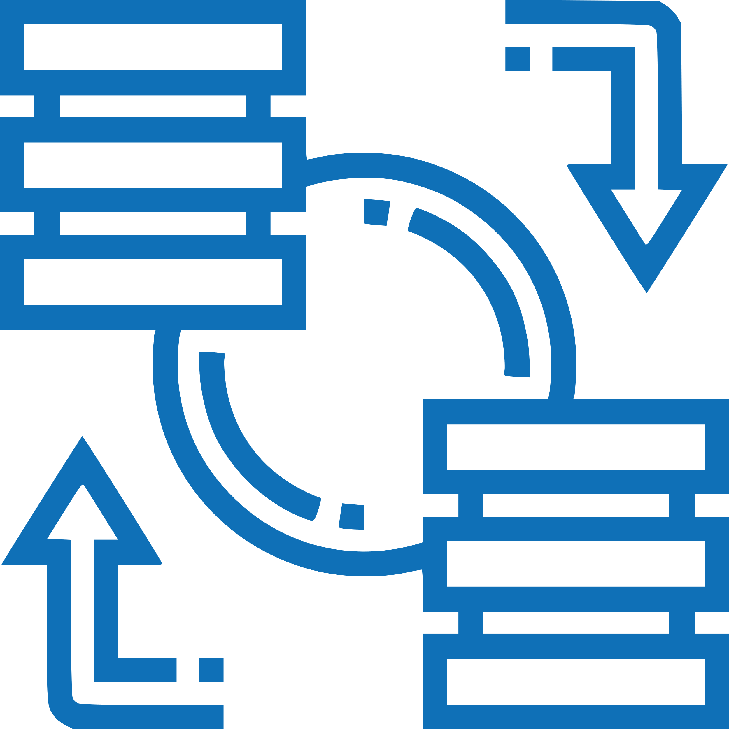

Translation – A need and a requirement
Translation as a need
Ensure the deployment of SNOMED CT
Facilitate the understanding and skill development of stakeholders
Support the secondary use of data (NLP, NER, Data analytics…)
Translation as a requirement
Since 1994 all public entities or body exercising a public service mission must respect the Toubon Law on translation :
Every document concerning a good or a service must be in French or translated in French

Slide 3








CGTS – Health Terminologies Management Centre
Interoperability
CGTS
NRC
Define norms and standards to structure data
Publish reference Terminologies
Support the development of semantic interoperability
22
7
2
WHO Collaborative Centre
LOINC

Slide 4


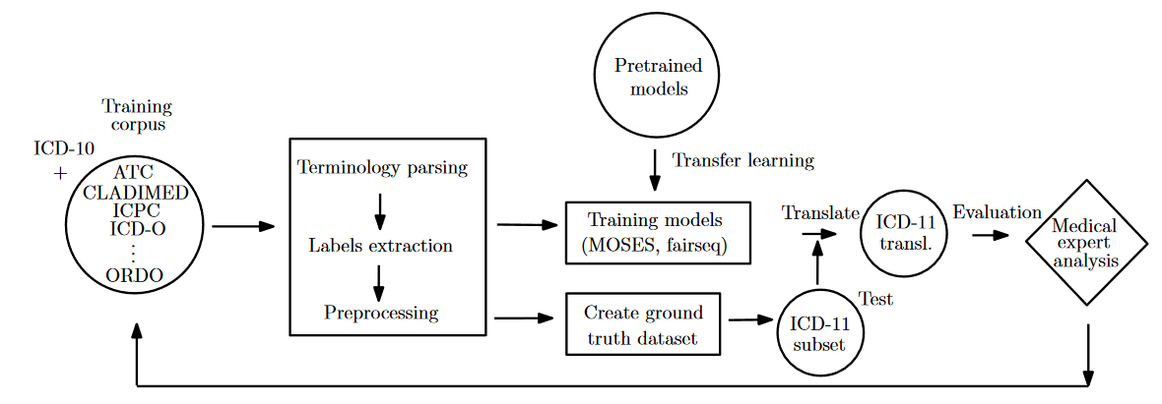
Translation pipeline
Fr
A translation by description
rather than by concept
ICD-11 translation pipeline
10.18653/v1/2020.louhi-1.7
Based on translated Terminologies
En
This pipeline was fine-tuned for SNOMED CT translation (Terminology-based descriptions & homemade rules)

Slide 5







French Translation Collaboration Group
Goal
Members of the group
Create a common French translation that every country can use in its national edition.
French-speaking NRCs
Reduces the translation effort for every country
Creates common translation rules
Enhances confidence in the validity of French translation
Stakeholders (Private companies & hospitals)
Challenges faced
1
Rules were made for manual translation
2
French spelling rectifications of 1990 were only recommended
Not always implementable in an automatic translation process
Presence of both spelling in corpora
New spellings still not officially recognized as the main spelling by the French Academy
Difficulty to validate the behaviour of some implemented rules

Slide 6





Body structure challenges
Change of nomenclature for some body structures
Presence of both nomenclature
No French programmatically accessible source to identify the old and previous nomenclature
SEP model translations led to unnatural translations and difficulty to manage gender & number agreement
“Entire X of Y” ➔ 16 variations
Synonyms management
Different synonyms in English can have the same meaning in French and vice-versa
Acronyms management
Same acronym but different meaning
Different acronyms but same meaning
English acronyms without equivalence in French
Should we generate all possible synonyms?
Balance between reducing cross validation time & increasing relevant synonyms amount for users

Slide 7




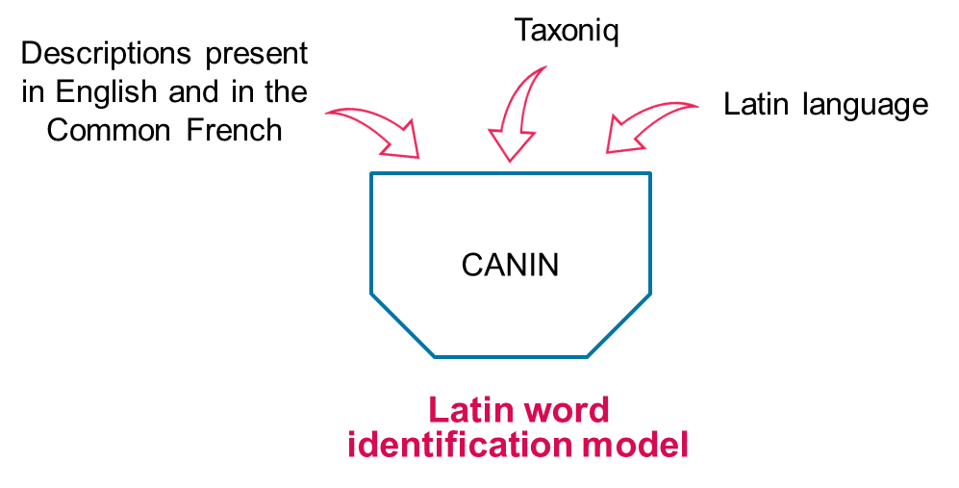
Organism challenges
Organism hierarchy specificities
Architecture quality (in progress thanks to Microbiology group)
The descriptions “are” the concept
Non-FSN descriptions represent heterotypical and homotypical synonyms, historical names, …
Taxonomic Latin
Quality of translation is dependent on hierarchy quality
Domain specificity
Taxonomic Latin
Improvement of translation pipeline, by using :
Identification of taxonomic Latin word in a term that do not need to be translated.
MeSH mapping
Taxoniq Python library
Wikipedia
Google’s knowledge graphs

Slide 8
Key messages
Automatic translation is a great tool, but results require human validation
Each hierarchy has its specificities and requires adjustment
Quality and clarity of concept is essential to ensure quality of translation

Slide 9
Examples
Difficulty to implement
  SS1 – First letter always in lower case except proper nouns, symbols, codes, acronyms, taxa
  SS2 – Use singular except for concept with implicit plural
Difficulty to validate implementation
  SS6 – Add gender agreement variations for noun between parenthesis, e.g. clinicien(ne)

