Slide 1


SNOMED-LOINC attributes mapping & hierarchy
SNOMED / Odysseus Medical Ontologies Team
November 27 2023

Slide 2
Problem outline
In OMOP vocabularies, SNOMED and LOINC are the main foundation for Standard concepts for Measurements
Due to differences in granularity, vocabularies could not be mapped to each other
Analytical use case include selecting all patients with certain measurements
SNOMED Measurements
(lower granularity)
Is a
LOINC Lab tests
(higher granularity)
Notes:
Both standards
Mapping depends on granularity
Use case: hierarchy between diff vocabs in one domain to pick up
Mapping is impossible because of different attribute sets

Slide 3
SNOMED and LOINC attributes accordance
SNOMED | LOINC
Component | Component
Process output
Property type | Property
Time aspect | Timing
Process duration
Direct site | System
Inheres in
Scale type | Scale
Technique | Method
* only matching attributes between LOINC and SNOMED, related to measurements in both vocabularies, are shown
Notes:
Concepts consist of attributes in both vocabs, and here you can see matching attributes are represented

Slide 4
Mapping Input
Take temporary relationships between LOINC Attributes and respective SNOMED attributes given by the table ‘scccrefset_mapcorrorfull_int’ - comes from LOINC sources
(6,242 relationships)
Take temporary relationships between LOINC Measurements and respective SNOMED attributes given by the table of ‘scccrefset_expressionassociation_int’ - comes from LOINC sources
(132,110 relationships)
Create temporary relationships between LOINC Components and SNOMED Components based on name similarity
(3,650 relationships)
Notes:
Describe that we started with what could be found, so it is the result of your work and collaboration
Source 1: attributes
Source 2
Source 3 we are developing on our side and it is similar to what you’ve done in source 1

Slide 5
Mapping steps
1. Defining the axes of LOINC Measurements and their SNOMED Attributes:
links given by the source, only relationships 'Has component', 'Has dir proc site', 'Inheres in', 'Has scale type' (48,921 relationships).
links derived from the source mappings of LOINC Attributes to SNOMED Attributes (8,138 relationships).
links derived from hardcoded mappings between most commonly used LOINC Systems (Blood, serum, urine, CSF, plasma and stool) and Scales ('Quantitative'/ 'Qualitative') and respective SNOMED Attributes (88,363 relationships).
links derived from new LOINC Components to SNOMED Components mappings (2,467 relationships).
2. Remove LOINC Measurements with inapplicable properties in the SNOMED architecture context:
exclude ratio/interpretation/identifier/z-score/susceptibility-related concepts

Slide 6
Building the hierarchy
Use only fully-defined SNOMED concepts and their attributes.
Create ‘LOINC Measurement’ => ‘Is a’ => ‘SNOMED Measurement’ relationships using:
Common attribute combinations:
I. Component + Specimen + Scale (172 cases)
II. Component + Specimen (3,959 cases)
III. Component + Scale (890 cases)
IV. Component only (11,321 cases)
String matching (LOINC Component||' measurement' = SNOMED Measurement) (1,833 cases)
Notes:
This is how we build the actual hierarchy
Snomed is higher because of our analytical use case

Slide 7
Example (1)
SNOMED Attributes derived from LOINC source tables
Has component = Bilirubin
Has scale type = Ordinal value
Inheres in = Gastrointestinal tract material
Has dir proc site = Stool specimen
Has time aspect = Single point in time
Has property = Presence
Useful relationships

Slide 8
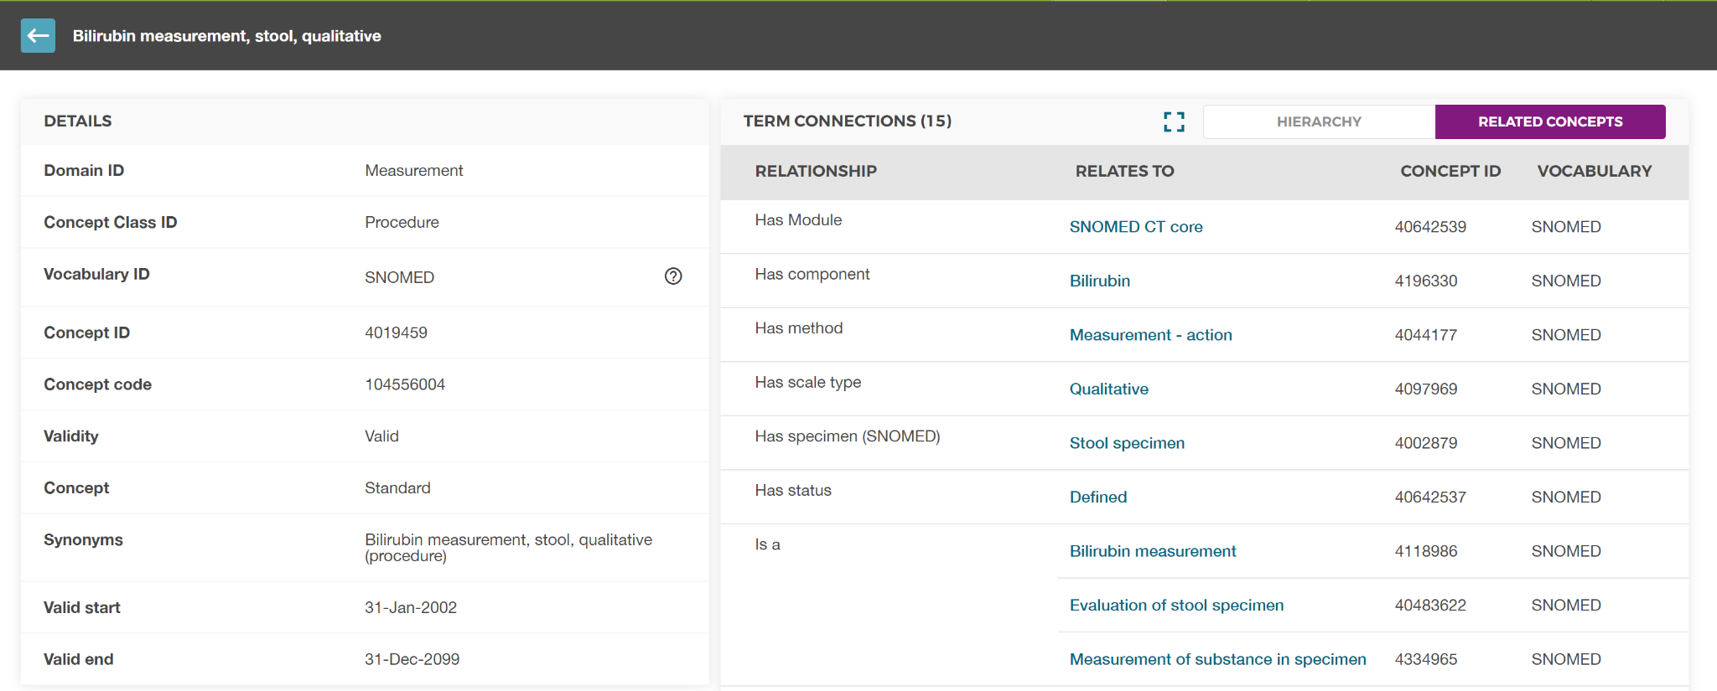
Example (1)

Slide 9
Example (1)
Hierarchical relationship is formed:
104556004, Bilirubin measurement, stool, qualitative
Is a
1976-0, Bilirubin.total [Presence] in Stool

Slide 10
Building the hierarchy
Use only fully-defined SNOMED concepts and their attributes.
Create ‘LOINC Measurement’ => ‘Is a’ => ‘SNOMED Measurement’ relationships using:
Common attribute combinations:
I. Component + Specimen + Scale (172 cases)
II. Component + Specimen (3,959 cases)
III. Component + Scale (890 cases)
IV. Component only (11,321 cases)
String matching (LOINC Component||' measurement' = SNOMED Measurement) (1,833 cases)
Notes:
This is how we build the actual hierarchy
Snomed is higher because of our analytical use case

Slide 11
Other examples of 3-attribute relationships
Quantitative measurement of creatinine in peritoneal fluid specimen
Albumin measurement, urine, quantitative
Is a
Is a
Is a
Is a
Creatinine [Mass/volume] in Peritoneal fluid
Creatinine [Moles/volume] in Peritoneal fluid
Albumin/Protein.total [Pure mass fraction] in Urine by Electrophoresis
Albumin [Mass/time] in 24 hour Urine
Albumin [Mass/volume] in Urine by Electrophoresis

Slide 12
Building the hierarchy
Use only fully-defined SNOMED concepts and their attributes.
Create ‘LOINC Measurement’ => ‘Is a’ => ‘SNOMED Measurement’ relationships using:
Common attribute combinations:
I. Component + Specimen + Scale (172 cases)
II. Component + Specimen (3,959 cases)
III. Component + Scale (890 cases)
IV. Component only (11,321 cases)
String matching (LOINC Component||' measurement' = SNOMED Measurement) (1,833 cases)
Notes:
This is how we build the actual hierarchy
Snomed is higher because of our analytical use case

Slide 13
Examples of 2-attribute relationships
Glucose measurement, quantitative
Glucose measurement, blood
Qualitative measurement of opiate agonist
Urine opiate measurement
Is a
Is a
Is a
Is a
Is a
Is a
Glucose [Moles/volume] in Mixed venous blood
Glucose [Moles/volume] in Capillary blood by Glucometer
Opiates [Presence] in Vitreous fluid
Opiates [Presence] in Urine

Slide 14
Building the hierarchy
Use only fully-defined SNOMED concepts and their attributes.
Create ‘LOINC Measurement’ => ‘Is a’ => ‘SNOMED Measurement’ relationships using:
Common attribute combinations:
I. Component + Specimen + Scale (172 cases)
II. Component + Specimen (3,959 cases)
III. Component + Scale (890 cases)
IV. Component only (11,321 cases)
String matching (LOINC Component||' measurement' = SNOMED Measurement) (1,833 cases)
Notes:
This is how we build the actual hierarchy
Snomed is higher because of our analytical use case

Slide 15
Examples of 1-attribute (Component) relationships
Testosterone measurement
Troponin T measurement
Is a
Is a
Is a
Is a
Testosterone [Mass/volume] in Body fluid
Testosterone [Moles/volume] in Semen
Troponin T. cardiac [Mass/volume] in 2 hour 5th generation Serum or Plasma
Troponin T.cardiac delta [Mass concentration difference] in 6 hour Serum or Plasma

Slide 16
Building the hierarchy
Use only fully-defined SNOMED concepts and their attributes.
Create ‘LOINC Measurement’ => ‘Is a’ => ‘SNOMED Measurement’ relationships using:
Common attribute combinations:
I. Component + Specimen + Scale (172 cases)
II. Component + Specimen (3,959 cases)
III. Component + Scale (890 cases)
IV. Component only (11,321 cases)
String matching (LOINC Component||' measurement' = SNOMED Measurement) (1,833 cases)
Notes:
This is how we build the actual hierarchy
Snomed is higher because of our analytical use case

Slide 17
Examples of relationships by name similarity
Specimen volume measurement
Is a
Is a
Is a
Volume of Amniotic fluid
Volume of Cerebrospinal fluid
Volume of Sputum

Slide 18
Data flow chart
Formation of SNOMED attributive pool just for fully-defined SNOMED Measurements
* Talapova P. et al., The hierarchical crosswalk between LOINC and SNOMED CT Laboratory Procedures, 2020
STEP 1
Creation of a normalized set of equivalent SNOMED attributes for LOINC Laboratory tests
STEP 2
STEP 3
Multi-axial SQL-based search of commonly available attribute combinations for both LOINC and SNOMED
Tier 1: Component + Specimen + Scale
SNOMED: Quantitative measurement of 11-deoxycortisol in urine specimen
LOINC: 11-Deoxycortisol [Mass/volume] in Urine
Tier 2: Component + Specimen
SNOMED: Cerebrospinal fluid Tau protein measurement
LOINC: Tau protein [Mass/volume] in Cerebral spinal fluid
Tier 3: Component + Scale
SNOMED: Quantitative measurement of cannabinoids
LOINC: Cannabinoids [Mass/mass] in Hair
Tier 4: Component
SNOMED: Rheumatoid factor measurement
LOINC: Rheumatoid factor [Titer] in Serum
STEP 4
String match for non-attributive counterparts
SNOMED: Specimen volume measurement
LOINC: Volume of Amniotic fluid

Slide 19
Limitations
We process only LOINC Lab tests
High granularity of LOINC concepts
Relationships to SNOMED concepts with similar sets of attributes as LOINC concepts, but different meaning (by name patterns).
Buprenorphine measurement
Already exists in SNOMED
Is a
Should be built, even though only one attribute is matching
Urine buprenorphine level
Is a
Is a
Buprenorphine [Presence] in Urine
Should not be built, even though two attributes are matched

Slide 20
Dropping temporary links
Currently, only hierarchical ‘Is a’ and a small number of non-hierarchical ‘Maps to’ relationships between LOINC and SNOMED are supported.
That means that we do not include the following relationships in our OMOP Vocabulary releases:
relationships between LOINC Attributes and respective SNOMED attributes (‘LOINC-SNOMED eq’)
relationships between LOINC Measurements and respective SNOMED attributes ('Has time aspect', 'Has component', 'Has dir proc site', 'Inheres in', 'Has property', 'Has scale type', 'Has technique', 'Has precondition')

Slide 21
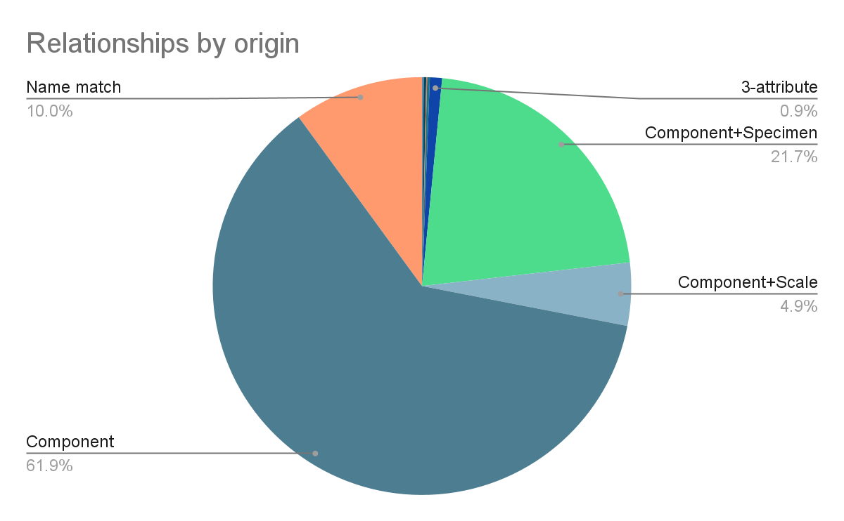
Statistics
18,175 hierarchical relationships between LOINC Measurements and SNOMED Measurements are formed.

Slide 22
Room for improvement
Cover more Lab tests. Currently, 16,873 (29,4%) of LOINC Lab tests have links to SNOMED Measurements
Do not stop at Lab tests!
Improve string matching algorithms
Get use of LLMs/GPTs
Create links between LOINC and SNOMED manually, when semantics of the concepts makes them difficult to be processed automatically

Slide 23
Conclusion
LOINC and SNOMED are both Standard vocabularies for Measurements in OMOP ecosystem with different level of granularity, what limits the horizontal mapping use case
We developed a multiaxial SQL-based algorithm that creates a hierarchy between LOINC and SNOMED
We built 18,175 hierarchical relationships based on attributes similarity and mappings, and text matching
There is a possibility to improve and collaborate

