Slide 1
Agenda
Introductions – Name and organization (5 min)
Problem statement (5 min)
What challenges / needs have NRCs identified? (30 min)
Potential changes to concept models (15 min)
  Assessment scales – staging and scales (5 min)
  Assessment scores – observable entities (5 min)
  Assessment procedure – procedure (5 min)
Discussion: Next steps for a formal project proposal (5 min)

Slide 2
Problem Statement
Assessment-related content in SNOMEDCT is currently not fit for purpose
  Assessment scales
  Assessment procedures
  Assessment scores

Slide 3
Specifically
No way to link scale and procedure
No way to link score and procedure
Able to link score and assessment – but rarely modeled
No way to unambiguously represent assessment scales in a machine-readable way
  The thing an assessment is designed to measure is the KEY semantic feature of assessment-related concepts and is missing
  Assessment instruments are difficult to unambiguously represent (lots of versions, editions, overlapping names) and has not yet been solved in

Slide 4
SNOMED Assessment Content
Assessment scores 849
Assessment procedures 666
Staging and scales 1,648
Assessment scales 1,458
International Edition Daily Build 11/21/2024
Notes:
< 782487009 | Assessment score (observable entity) |
MBPSO score = << 363870007 | Mental state, behavior / psychosocial function observable (observable entity) | {{ D term = "score"}}
Direct child of MBPSO (versus more specific parent) = <! 363870007 | Mental state, behavior / psychosocial function observable (observable entity) | {{ D term = "score"}}
< 254291000 | Staging and scales (staging scale) |
< 273249006 | Assessment scales (assessment scale) |

Slide 5
What is your experience?
Use cases you need to support
Challenges using the current model
Ideas for improvements
Let’s set aside IP issues for now

Slide 6
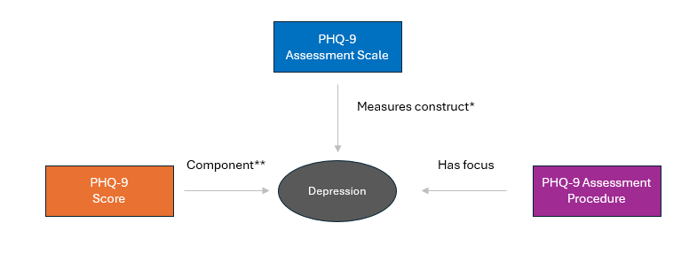
ESSENTIAL DEFINING ATTRIBUTE!
Example: Depression assessment
Notes:
Before I walk through the 3 slides showing a attributes that might help solve some of the problems with each.
If we could only make one set of changes to these 3 semantic types, this is it
The construct measured is the most essential semantic feature of an assessment.
This is the single most important defining attribute for each of these concept classes

Slide 7
Assessment Scale
Attribute Cardinality | Attribute | Value
1..* | 116680003 |Is a (attribute)| | << 273249006 |Assessment scales (assessment scale)|
0..1 | Measures construct | << 404684003 |Clinical finding (finding)|
0..1 | Has intent | << Assessment Intent (qualifier value) < Screening (qualifier value) < Diagnosis (qualifier value) < Change over time (qualifier)
0..1 | Has sampling period | <7389001 | Time frame (qualifier value) |
0..1 | Has respondent | <125676002 | Person (person) |
0..1 | Is validated for period of life | << 282032007 |Periods of life (qualifier value)|
0..1 | Is validated for setting | < 276339004 | Environment (environment) |
0..1 | Is validated for health status | << 404684003 |Clinical finding (finding)|
Notes:
Highligthed in ye

Slide 8
Assessment Score
Attribute Cardinality | Attribute | Value
1..* | 116680003 |Is a (attribute)| | << 782487009 | Assessment score (observable entity) | Needs to be a child of concept representing the more general observable (e.g., mood, functioning, behavior)
0..1 | Component [v. Construct] | Requires further analysis – how do we get concept to subsume correctly under the more general OE?
 | 246501002 |Technique (attribute)| | << 254291000 |Staging and scales (staging scale)| OR << 272394005 |Technique (qualifier value)|
1..1 | | Using assessment instrument (attribute) | | << 254291000 |Staging and scales (staging scale)| Is there any value in a discrete defining attribute for assessment instruments or is | Technique | acceptable?

Slide 9
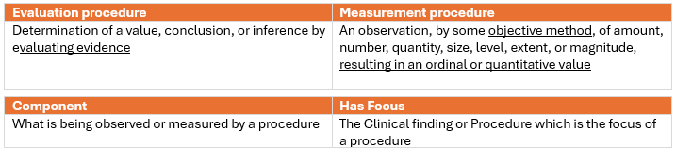
Assessment Procedure
Attribute Cardinality | Attribute | Value
1..* | 116680003 |Is a (attribute)| | << |Assessment using assessment scale (procedure)|
1..1 | 260686004 |Method (attribute)| | 129265001 |Evaluation - action (qualifier value)| 129266000 | Measurement - action (qualifier value) |
1..1 | 370129005 |Measurement method (attribute)| | << 273249006 |Assessment scales (assessment scale)|
1..* | 363702006 |Has focus (attribute)| | << 404684003 |Clinical finding (finding)|
 | 363703001 |Has intent (attribute)| | << 363675004 |Intents (nature of procedure values) (qualifier value)| Requires further analysis (the intent is a defining attribute of the scale not the procedure)

Slide 10
PRN

Slide 11
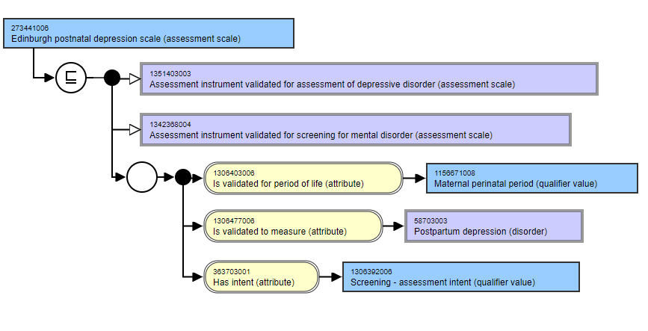

Slide 12
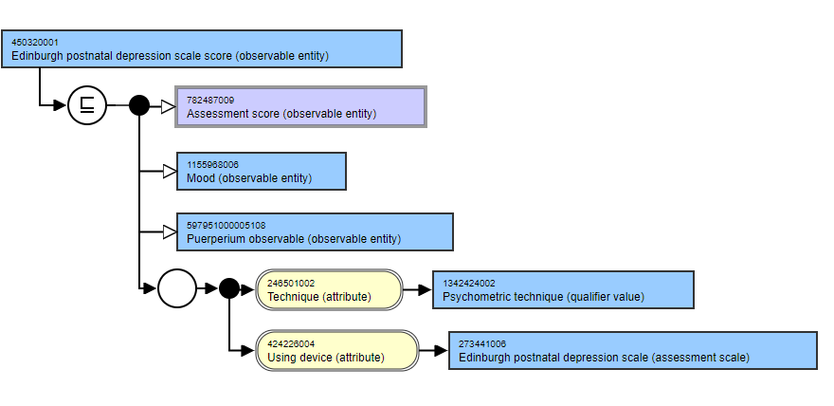

Slide 13
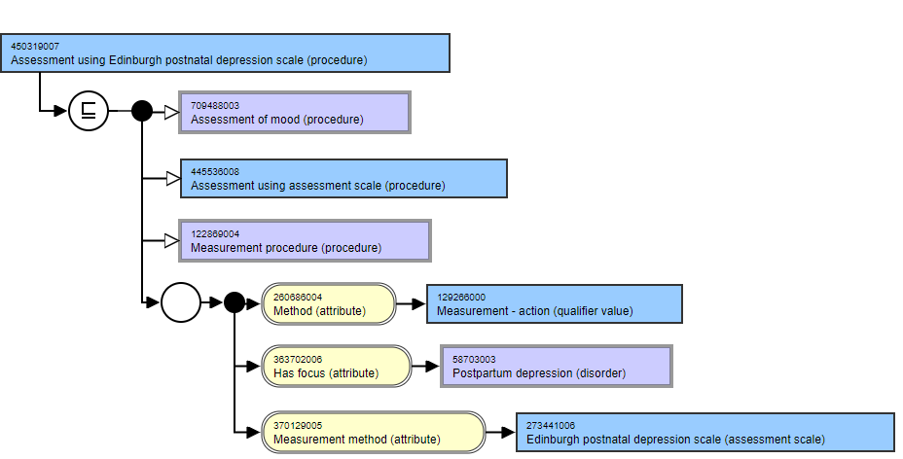

Slide 14
Quality: Internal Consistency
Assessment, No Score
Assessment , No Procedure
Score, No Procedure
Score, No Assessment
Procedure, No Assessment

Slide 15
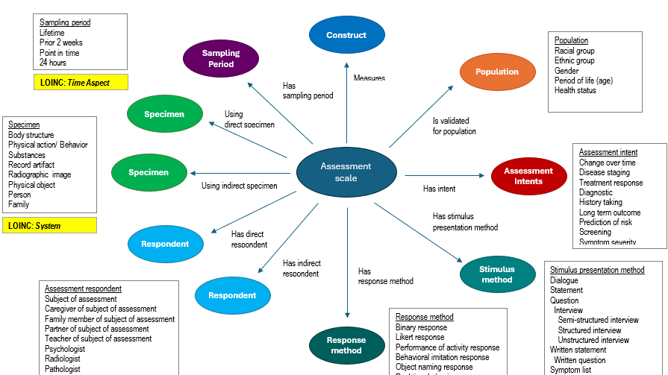

Slide 16
