Slide 1
Pens, clicks and dialsV2
A discussion on the challenges of strength representation for injectable (diabetic) products
SNOMED CT DCAP
October 2023
Or “How Google Images is the drug content author’s friend”

Slide 2

SNOMED CT “Core” drugs model and population
The line between “everything” and “something” is hard to draw
The aim is to decide what is
  Good enough for the use cases
  Manageable and maintainable by SNOMED staff
It is always going to be a “living balance”

Slide 3

Clarity is good
Understanding what is expected and why
Understanding scope boundaries and the reasons for them
Exploring and documenting options together

Slide 4
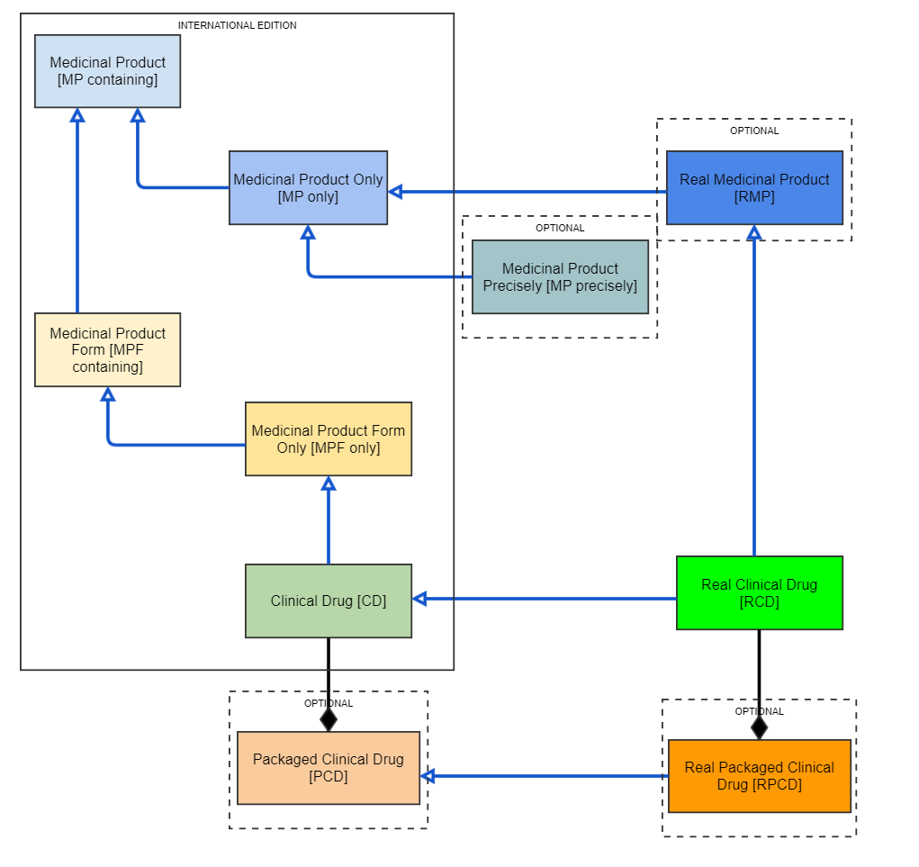
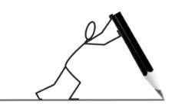
The “CD question”
Some members really value CDs
  Some members want more detailed CDs
Some members feel MPF only is “good enough” to meet the use cases
Clearly, any “drawing the line” will not please everyone !
☺
☹

Slide 5

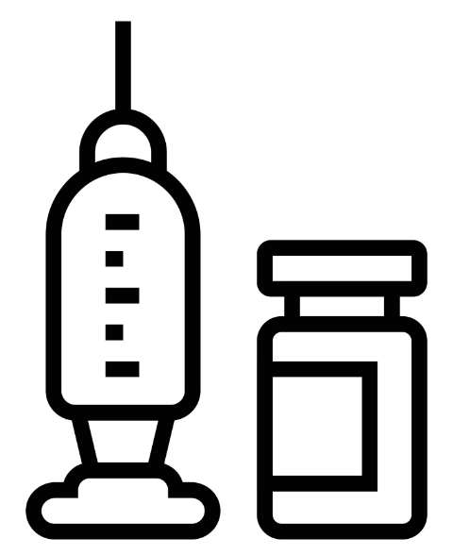
For liquid products, the international content uses concentration strength
Exotocillin 100mg/mL oral suspension
  Not Exotocillin 500mg/5mL oral suspension
Exotocillin 10mg/mL solution for injection
  Not Exotocillin 25mg/2.5mL solution for injection
BUT, in extensions, there is the option for
Exotocillin 10mg/mL solution for injection 2.5mL vial

Slide 6
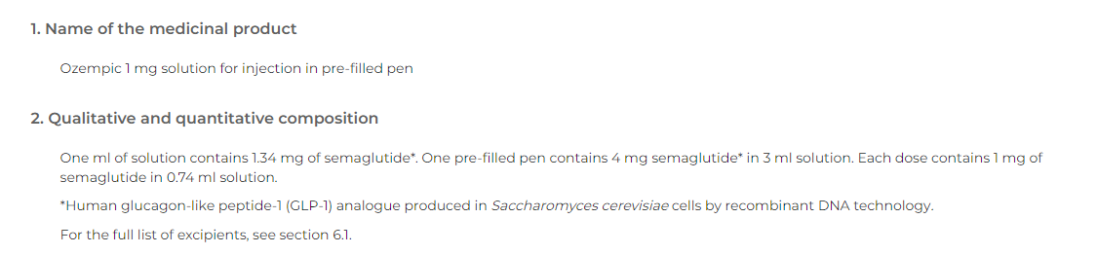
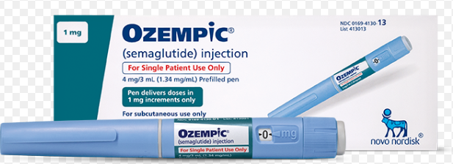
A “pre-filled pen”
  Is this?
Product containing precisely semaglutide 1 milligram/1 actuation conventional release solution for injection (clinical drug)
  The pattern here is treating the pen presentation as a “metered dose device”
  Or is it…..?
Product containing precisely semaglutide 1.34 milligram/1 millilitre conventional release solution for injection (clinical drug)
  The pattern here is treating the pen presentation as a unit of presentation, where the SNOMED CT international edition rule is to normalise to a concentration strength

Slide 7
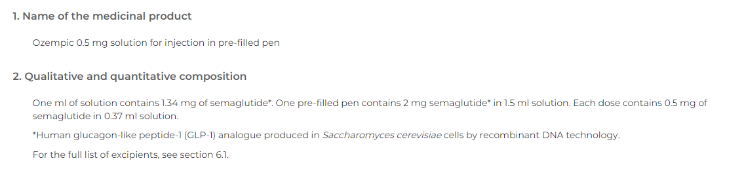
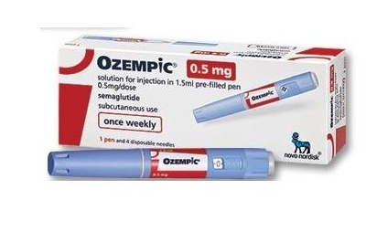
But then….
  Is this a different CD?
Product containing precisely semaglutide 500 microgram/1 actuation conventional release solution for injection (clinical drug)
  The pattern here is treating the pen presentation as a “metered dose device”
  Or is it the same CD as before…..?
Product containing precisely semaglutide 1.34 milligram/1 millilitre conventional release solution for injection (clinical drug)
  The pattern here is treating the pen presentation as a unit of presentation, where the SNOMED CT international edition rule is to normalise to a concentration strength

Slide 8
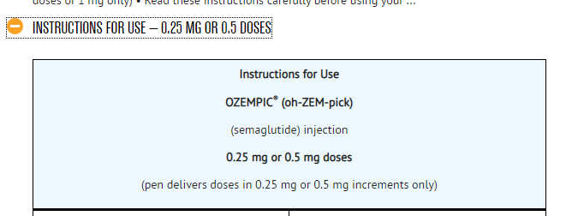
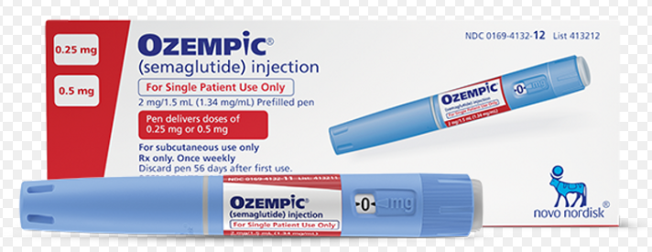
And just to make things more complex:
For some presentations, the patient or carer can alter the dial – and thereby alter the “meter” to deliver a different dose quantity per “actuation” (click)

Slide 9

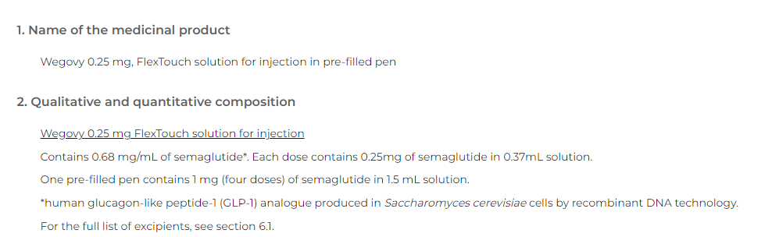
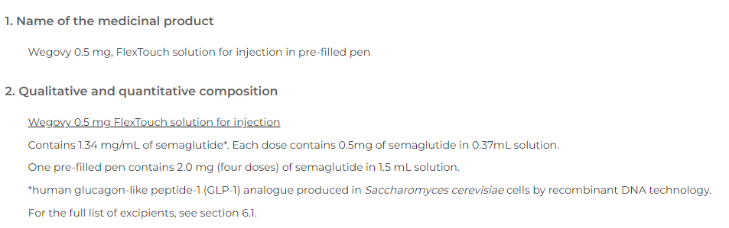
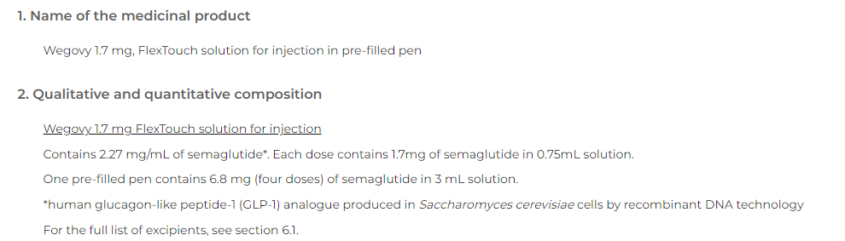
Then along came Wegovy…..
0.68mg/mL – not in S-CT
But is 250microgram per actuation
1.34mg/mL
500 microgram per actuation
2.27mg/mL – not in S-CT

Slide 10
(Reminder of) International use cases
To provide a consistent and usable set of international medications concepts for member nations to use as a foundation for national medicinal product terminology
For those member nations with an existing terminology, the improved model underpinning the concepts will facilitate both direct use or mapping
For those member nations without an existing terminology, the concepts provide a consistent starting set of concepts and a model to develop from, reducing resource (especially set up costs) and risk in development
To provide compatibility with the IDMP model, where possible, for identification of medicinal products.
To facilitate international interoperability of medication concepts for (for example) patient summaries and cross-border care; this is supported most efficiently when the medication concepts themselves are from national extensions built upon or mapped to the international core
To facilitate development of international medication decision support, such as allergy checking and duplicate therapy checking, thereby reducing costs of maintenance and implementation
To support the use of a classifier on both international and national medicinal product concepts, to facilitate maintenance of the hierarchy
To support analysis of medication information in healthcare data for various research purposes
To provide medication concepts to support sufficiently defining concepts in other hierarchies within SNOMED CT

Slide 11

Discussion
Not an “interface terminology”
Therefore something that has to be “mapped to”
The national must reflect what exists at the national level so that clinicians can safely recognise the products involved
Probably, the concentration strength is likely to be the most useful for that mapping (EM, IS, SB, DM, SA, OD, IO)
Stuart – suggestion/possibility of exploring use of GCIs for alternative representations such as “actuations”
Flexible model to fit to local needs – take what you need
Prescribing is not a use case for the international BUT newer members are wanting to be able to use international content in that context (more as an interface terminology)
Stability of identifiers is important, so mapping may be desirable
Some countries require “CDs” that are less granular for prescribing

Slide 12
Discussion
Less granular substances
e.g. Amlodipine
But does not work safely for perindopril, promethazine, metformin….
All the elemental substances (Calcium, Iron)
Also the property chains – and the BoSS
Prescription level – dose forms may be too granular for some countries and cultures of practice
GR: do not need intermediate concepts in the International release
AL: countries can find it difficult to align their local data to the international release

Slide 13
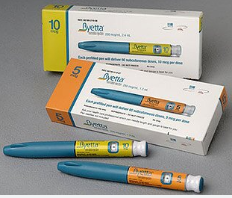
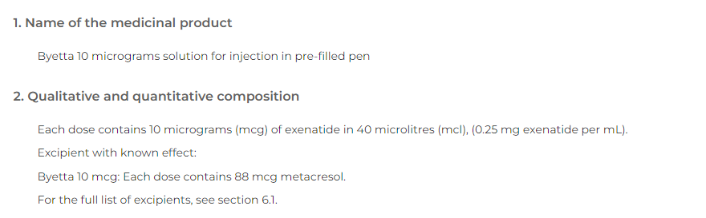
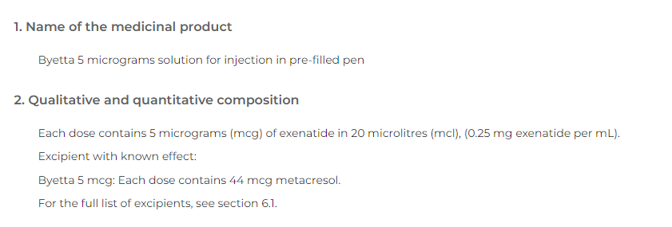
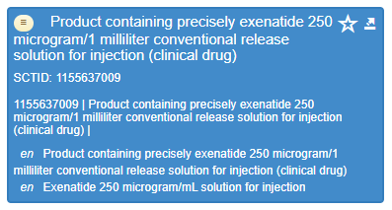
What about other products?

Slide 14
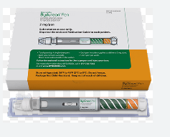
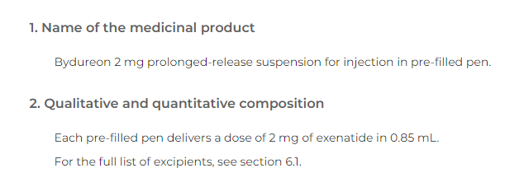
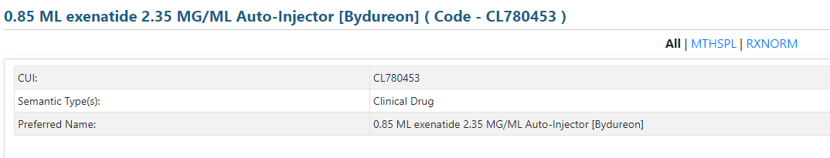
BUT…..
The authorised literature does not give a concentration strength so we have to calculate it…..
2mg in 0.85mL = 2/0.85mg per mL
2.35(3)mg/mL – not very clinically intuitive ;(

Slide 15
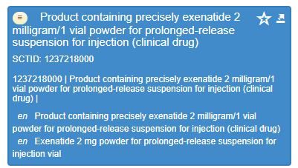
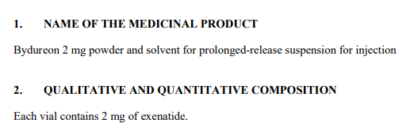
And….
The currently available international CD is not the same dose form:
….which is based on an “old” version of Bydureon that is now discontinued in several countries….
So we do need a new concept to represent the medication that patients are using now

Slide 16
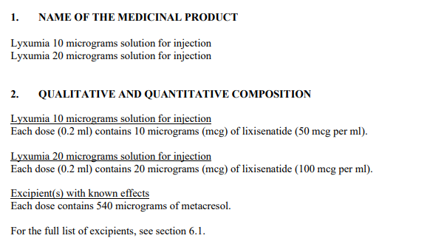
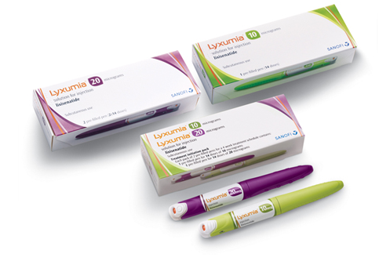
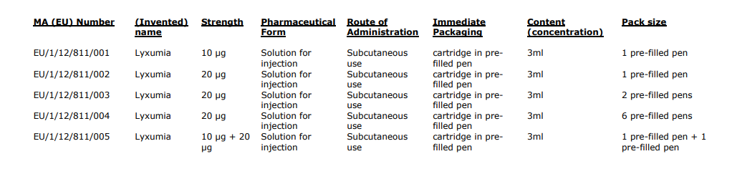
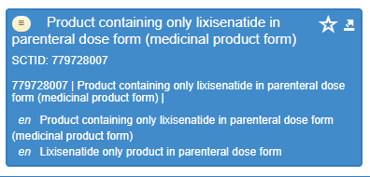
This medicine gives a concentration strength

