Slide 1







London, UK
Drug Content Analysis Project (DCAP) Project pilot overview
April 5^{th,} 2023
snomedexpo.org | linkedin.com/company/ihtsdo | twitter.com/snomedct | youtube.com/@snomedct

Slide 2
Background
Project group established at the business meetings in Lisbon 2022
Scope, goals: identify clinical drug concepts that exist in extension models of participating NRCs that are eligible for promotion with appropriate reference to authoritative source material, to the international edition.

Slide 3
Project pilot approach
Basis for analysis: drug content in Norwegian extension filtered by chosen category of drugs
  Additional suggestions are welcome! Please add your national drug concepts and associated documentation if relevant
Filtering candidates for content relevant for international edition
Review of suggested concepts and attachment of accepted references by the participants in a shared document
Migrating accepted concepts to international edition

Slide 4
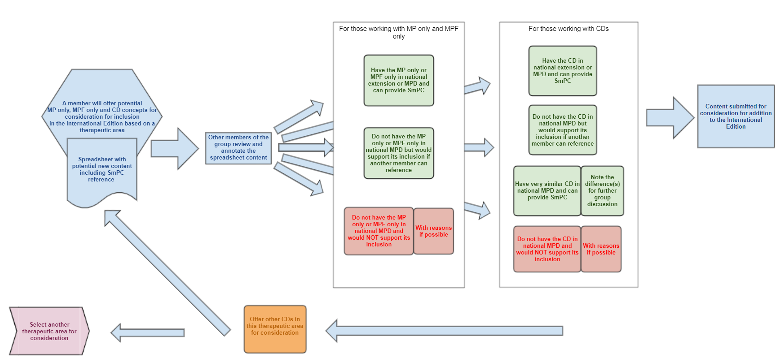
Work process – review of candidates

Slide 5
Data sets for analysis
Query-based accumulation of Norwegian national CDs/MPFos/Mpos based on the chosen group of medicines/characteristics
  We can play with this approach – ECL opens the possibility for a great range of definitions for a subset
Topics thus far
  Anti-infectives – review completed. Thank you to all participants for your contribution!
  Non-insulin medicinal products for treatment of diabetes mellitus – review to commence shortly
  …? What areas would you like us to prioritize next?

Slide 6
Input from the members
The group addressed the difference in usefulness for the various national implementations
  Originally focused on CD level concepts – the scope has been extended to offer review at MPFo/MPo level if desired
Format for review file has been slightly edited as we went along
Please contact us if you have suggestions, improvement requests or any other bright ideas!

Slide 7
London, UK
Drug Content Analysis Project (DCAP) Test batch of 20 concepts imported from Norway: report on author’s findings
April 5^{th,} 2023
snomedexpo.org | linkedin.com/company/ihtsdo | twitter.com/snomedct | youtube.com/@snomedct

Slide 8
From 23 March DCAP meeting - recap on decisions
1. We can import the Norwegian extension anti-infective clinical drugs to the SCT International edition in a batch (split into separate tasks in the Authoring Platform that can be traced on a logging spreadsheet).
2. The concepts that do not meet Editorial Guidance will be excluded before the list is sent to the technical team for batching. Changes to the defining characteristics will not be made to concepts already published in a national extension to match or fit in with international Editorial Guidance, but instead proposal agreed that if a new concept is required a request will be submitted from DCAP through the CRS system for a concept that does align with guidance.
Rationale:
DCAP has validated that the medicinal product should be represented in the International content, it’s just that the representation of it from the donor country is not quite in line with the International patterns.
Changing a national extension concept alters the meaning of the concept which brings a discrepancy between the meaning of the concept in the original system (in this case Norway) and the International – which is unacceptable.
6 concepts out of the initial test 20 were found to have breached international Editorial Guidance…

Slide 9
International Editorial Guidance Variance 1
In the test batch of 20 the following breaches to international Editorial Guidance were found:
1078301000202109 Ceftolozane (as ceftolozane sulfate) 1 g and tazobactam (as tazobactam sodium) 500 mg powder for concentrate for solution for infusion vial (clinical drug)
‘x for y for z’ dose forms will remain out of scope per current Editorial Guidance.
Example, Powder for concentrate for conventional release solution for infusion (dose form) will not be modeled. Instead, based on pharmacist expert input that ‘dissolve’ is the important transform to capture, then 764843001 |Powder for conventional release solution for infusion (dose form)| will be used in the international edition as the dose form.

Slide 10
International Editorial Guidance Variance 2
1080021000202107 Product containing precisely cilastatin (as cilastatin sodium) 500 mg and imipenem (as imipenem monohydrate) 500 mg and relebactam (as relebactam monohydrate) 250 mg/1 vial powder for conventional release solution for infusion (clinical drug)
In the International edition of SNOMED CT Clinical Drugs will not use hydrated substances in their definition or naming when the hydrated substance is the Precise Active Ingredient only (unless the basis of strength substance is also the hydrate).

Slide 11
International Editorial Guidance Variance 3
Clinical drugs using the dose form 'infusion or injection' (for example, 1234926008 |Conventional release solution for infusion or injection (dose form)|) are reserved for use in national extensions. Instead, the International edition adds 3 clinical drug concepts defined with a grouper dose form for 'infusion and/or injection' plus 2 subtypes with one for infusion and one for injection.
1208958005 |Conventional release solution for infusion and/or injection (dose form)|
385229008 |Conventional release solution for infusion (dose form
385219001 |Conventional release solution for injection (dose form)|

Slide 12
International Editorial Guidance Variance 4
1079941000202104 |Product containing precisely bictegravir (as bictegravir sodium) 50 milligram and emtricitabine 200 milligram and tenofovir alafenamide (as tenofovir alafenamide fumarate) 25 milligram/1 each conventional release oral tablet (clinical drug)|
Imported with above CD was the Norwegian extension concept 147791000202106 |Product containing only bictegravir and emtricitabine and tenofovir alafenamide (medicinal product)|
Editorial Guidance for international Medicinal Product containing only and Medicinal Product Form containing only:
"For content in the International Release, this attribute value should represent the base ingredient, not a modification, unless explicitly identified as an exception.”
Proposal – Include the tenofovir alafenamide modification in the MPs/MPFs

Slide 13
Substances missing from International edition
Substances missing from the SCT International edition but present in the national extension and required for modeling the newly imported clinical drug.
Authoring perspective – current process is to submit any new substances required (will be very small numbers) through the CRS system first so that they exist in the terminology prior to adding a new clinical drug. Out of 140 Norwegian anti-infectives only one substance was not present in the International edition.
Proposal – DCAP to identify and add missing substances to CRS as a first step prior to importing the clinical drugs.
Possible but not picked up in small sample of 14 = Substance variance with International edition.
US variant terming for substances and other GB/US wording variation (e.g., nebulizer/nebuliser)
Proposal – following discussion with Peter Williams he can identify these on import based on the substance concept, and automatically create the US substance variant or GB wording in the task.

Slide 14
Importing MP-only and MPF-only by batch automation
Test batch issue: At the same time as importing the CDs the initial scope to technical was to automatically bring in the Norwegian MP-only (Medicinal Product containing only) and MPF-only (Medicinal Product Form containing only) if required (i.e., missing from the International edition).
1106491000202106 |Product containing precisely cabotegravir 30 milligram/1 each conventional release oral tablet (clinical drug)|
High level MP-only 1105771000202105 |Product containing only pyridine (medicinal product)| was imported by batch automation from the Norwegian extension. This has classified to have 192 descendants.Also imported was 1002701000202101 |Product containing only pyridine in oral dose form (medicinal product form)| = 119 descendants after classification.
In addition to import of 1213681000202103 |Product containing only cabotegravir in oral dose form (medicinal product form)|
Proposal – following discussion with Peter the batch import script for MP-only and MPF-only can be limited to immediate levels above the CD (no need for DCAP to identify and list any MP-only and MPF-only that require to be imported from the national extension).

Slide 15
Complexity in MP and MPF supertype model
Norway do not have the existential supertypes MP-containing, and MPF-containing (open world) because there is no use case for them, and clinical care works on the universal restriction.
Proposal - use automation to create these concepts. Upload a new test batch to check this process works.
Example: especially complex for concepts with multiple ingredients.
Batch imported from the Norwegian extension:
1078711000202105 |Product containing precisely aciclovir 50 milligram/1 gram and hydrocortisone 10 milligram/1 gram conventional release cutaneous cream (clinical drug)|
1076441000202100 |Product containing only aciclovir and hydrocortisone in cutaneous dose form (medicinal product form)|
1075681000202103 |Product containing only aciclovir and hydrocortisone (medicinal product)|
In the SCT International edition there is no: Product containing aciclovir and hydrocortisone in cutaneous dose form (medicinal product form) and similar– these will all need to be created.
I have found that checking which supertypes are missing is not so easy…. Plus a time resource heavy step.

Slide 16
Process and findings from test batch importation
Similar clinical drugs (requiring the same MPs and MPFs ) were in separate tasks in the test batch, making checking difficult including determining if new MP/MPFs are present or require to be added.
Proposal – technically identify all similar and group in same task at time of batch automation process
Small numbers per task please and preferably just 3 new clinical drug concepts per task given that for each CD possibly the corresponding MP-containing, MP-only, MPF-containing, MPF-only may be imported too or else need to be created. Flexibility over numbers to allow for all supertypes to be present in same task.
Tracking the new clinical drugs? Usual process is that every new CD added comes though the CRS system but this does not import all the attributes (necessary for maintaining the defining relationships). Discussion required (Monica to discuss with Rory)

Slide 17

Discussion
Thoughts on process outlined..

Slide 18
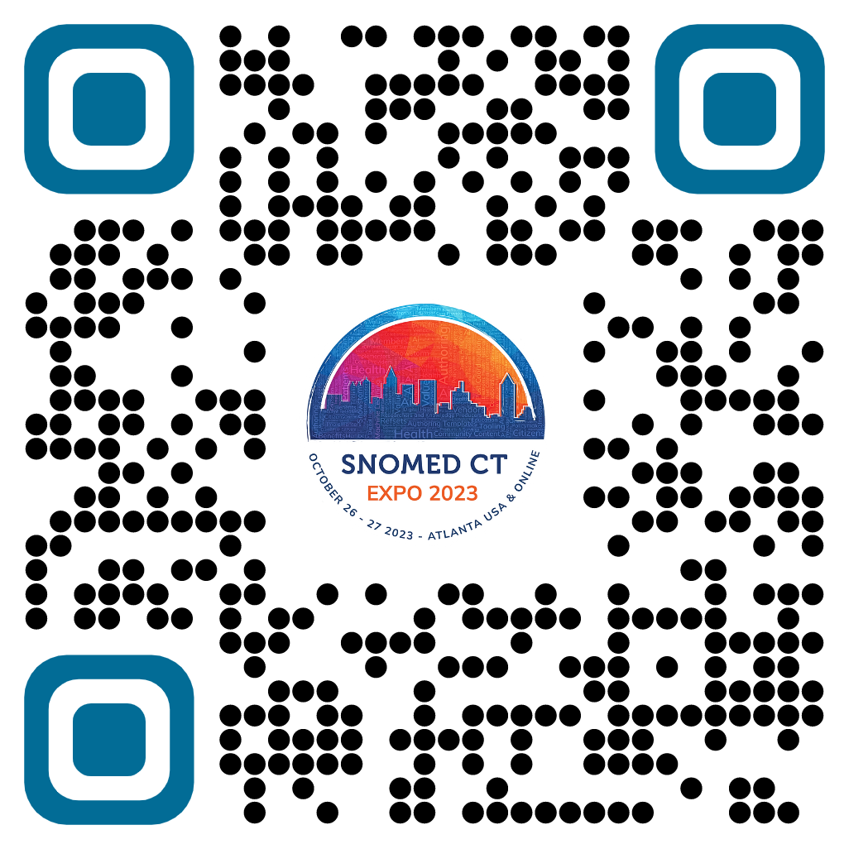
Quality Data, Informed Healthcare
Call for Abstracts
Submit your abstract online at snomedexpo.org before April 17, 2023
linkedin.com/company/xqihtsdo | twitter.com/snomedct | youtube.com/@snomedct

Slide 19


Thank You

